Slide 1
Distributed Systems
(Refresher)

Slide 2
Distributed Systems Basics
1. API call flow over the network
When you call an API over the network, a well-defined sequence of steps happens across your application, the network, and the server.
a. API call is created (Client side)
Your application prepares a request.
Example (HTTP REST API):
Method: GET / POST / PUT / DELETE
URL: https://api.example.com/users/42
Headers: Authorization, Content-Type, etc.
Body (optional): JSON, XML, form data
➡️ At this point, it’s just data in memory.
b. DNS resolution (Name → IP)
If you used a domain name:
api.example.com → 93.184.216.34
OS checks DNS cache
If not found → queries DNS servers(1st OS checks the local host file in .NET )
Result is cached for future calls
⏱️ Usually a few milliseconds
c. TCP connection is established
The client opens a TCP connection to the server IP and port (usually 443 for HTTPS).
3-way handshake:
SYN →
SYN-ACK ←

Slide 3
Distributed Systems Basics
1. API call flow over the network
c. TCP connection is established
ACK →
➡️ A reliable, ordered communication channel is now ready.
(With HTTP/2 or HTTP/3, this may be reused or optimized.)
d. TLS handshake (for HTTPS)
If it’s HTTPS:
Server sends its SSL certificate
Client verifies it (CA, expiry, domain match)
Encryption keys are negotiated
🔐 All further data is encrypted
e. HTTP request is sent
Your API request is sent over the established connection.
Example:
GET /users/42 HTTP/1.1
Host: api.example.com
Authorization: Bearer token
➡️ The request is broken into network packets and transmitted.
f. Network routing & delivery
Packets travel through:
Routers
Switches
ISPs

Slide 4
Distributed Systems Basics
1. API call flow over the network
f. Network routing & delivery
Load balancers (cloud / data center)
➡️ They eventually reach the API server.
g. Request received by the server
On the server side:
Web server (Nginx, Apache, Envoy) accepts the request
Request is forwarded to the application server
Middleware runs:
Authentication
Authorization
Logging
Rate limiting
Validation
h. Business logic execution
The API handler:
Parses request
Runs application logic
Queries databases / caches
Calls other internal services (possibly more APIs)
Example:
UserController → UserService → Database
⏱️ This is often the most time-consuming step.

Slide 5
Distributed Systems Basics
1. API call flow over the network
i. Response is generated
Server creates a response:
Status code (200, 404, 500, etc.)
Headers
Body (JSON, etc.)
Example:
{
"id": 42,
"name": "Alice"
}
j. Response sent back over the network
Response is split into packets
Encrypted (HTTPS)
Routed back to the client
TCP guarantees correct order & delivery
k. Client receives and processes response
On the client:
TCP reassembles packets
TLS decrypts data
HTTP client parses response

Slide 6
Distributed Systems Basics
1. API call flow over the network
k. Client receives and processes response
Your code reads:
Status
Headers
Body
Example:
response.json()
l. Connection handling
Depending on configuration:
Connection is kept alive (HTTP keep-alive)
Or closed
Reusable connections improve performance.
Key failure points 🚨
An API call can fail at many stages:
DNS failure
Network timeout
TLS handshake error
Authentication failure
Server crash
Database latency
That’s why retries, timeouts, and circuit breakers exist.

Slide 7
Distributed Systems Basics
1. API call flow over the network
End-to-end timeline (simplified)
Client code
→ DNS lookup
→ TCP handshake
→ TLS handshake
→ HTTP request sent
→ Server processing
→ HTTP response
→ Client parsing
One-line summary
Calling an API over the network means your request is serialized, routed, securely transmitted, processed by a remote service, and returned as a structured response—with multiple protocol layers ensuring reliability and security.
📌 Latency contributors: DNS + TCP + TLS + RTT + server processing

Slide 8
Distributed Systems Basics
1. API call flow over the network
API Call Mapped to OSI Layers (Layer-by-Layer)
Think of an API call as data flowing top → bottom on the client, across the network, then bottom → top on the server.
🟣 Layer 7 – Application
Protocols: HTTP, HTTPS, REST, gRPC, GraphQL
What happens
Your code creates an HTTP request
Headers, body, method are defined
JSON serialization happens
Example
GET /users/42 HTTP/1.1
Authorization: Bearer token
Failures
4xx / 5xx errors
Invalid request format
🔵 Layer 6 – Presentation
Responsibilities
Encryption / Decryption (TLS)
Compression (gzip, brotli)
Encoding (UTF-8, JSON)

Slide 9
Distributed Systems Basics
1. API call flow over the network
🟡 Layer 4 – Transport
Protocols: TCP / UDP (QUIC for HTTP/3)
What happens
TCP 3-way handshake
Packet ordering & retransmission
Flow & congestion control
Failures
Connection timeout
Packet loss
Congestion collapse
🟠 Layer 3 – Network
Protocols: IP, ICMP
What happens
Routing across routers
IP addressing
TTL handling
Failures
Network unreachable
Routing loops

Slide 10
Distributed Systems Basics
1. API call flow over the network
🔴 Layer 2 – Data Link
Protocols: Ethernet, Wi-Fi
What happens
Frame delivery on local network
MAC addressing
ARP resolution
Failures
Packet collisions
NIC issues
⚫ Layer 1 – Physical
Medium
Fiber, copper, radio waves
What happens
Bits transmitted as signals
Failures
Cable unplugged 😄
Signal attenuation

Slide 11
Distributed Systems Basics
1. API call flow over the network
🧠 One-liner
HTTP lives at Layer 7, TLS spans Layers 5–6, TCP is Layer 4, IP is Layer 3.
**Where optimizations apply (Layer-wise)**
Layer Optimization
L7 Caching, pagination
L6 Compression
L5 Session reuse
L4 Connection pooling
L3 Geo-routing
L2 Faster NIC
L1 Better network
🧪 Real-world example
Why first API call is slow, next ones are fast?
DNS cached
TCP connection reused
TLS session resumed
🎯 Summary
API latency is dominated by network RTT and server processing, not code execution.
Optimizing connections, reducing round trips, and caching gives the biggest wins.

Slide 12
Distributed Systems Basics
2.TCP vs UDP
Feature TCP UDP
Connection Connection-oriente Connectionless
Reliability Guaranteed delivery Best-effort
Ordering Ordered Not guaranteed
Retransmission Yes No
Flow control Yes No
(inbuilt
Backpressure)
Speed Slower Faster
TCP (Transmission Control Protocol)
Reliable
Ordered
Used when accuracy matters
Examples
HTTP/HTTPS
FTP
Email
Database connections

Slide 13
Distributed Systems Basics
2.TCP vs UDP
UDP (User Datagram Protocol)
Fast
No delivery guarantee
Used when speed matters more than accuracy
Examples
Video streaming
Online gaming
VoIP
DNS
📌 One-liner:
TCP trades speed for reliability; UDP trades reliability for speed.
3.Round-Trip Time (RTT)
RTT = Time taken for a packet to go from client → server → client
Example:
Client sends request at t0
Server responds at t1
RTT = t1 - t0
Why RTT matters
TCP handshake takes 1 RTT
TLS handshake takes 1–2 RTTs
Each API call latency depends heavily on RTT

Slide 14
Distributed Systems Basics
3. Round-Trip Time (RTT)
📌 Lower RTT = faster APIs
📌 High RTT = noticeable slowness even if server is fast
Where RTT is used
TCP: RTT is crucial for
Setting retransmission timeouts
Congestion control
Networking diagnostics:
ping command measures RTT
Performance analysis:
High RTT → slow network response
Factors affecting RTT
Physical distance between sender and receiver
Network congestion
Routing paths
Processing delay at routers and servers
Transmission medium (fiber, Wi-Fi, mobile networks)
Quick example using ping
ping google.com
Output:
time=24 ms
👉 That 24 ms is the RTT.

Slide 15
Distributed Systems Basics
4.Timeout
A timeout is the maximum time a client waits for a response before giving up.
Types of timeouts
Connection timeout – server unreachable
Read timeout – server slow to respond
Write timeout – unable to send data
Session timeout - Inactivity limit
Execution timeout - Max allowed runtime
Why timeouts exist
Prevent infinite waiting
Improve fault tolerance
Enable retries and fallbacks
📌 Example
Timeout = 5s
Server responds in 6s → request fails
📌 Tip:
A timeout does NOT mean server failed — it means the client stopped waiting.

Slide 16
Distributed Systems Basics
Head-of-Line (HoL) Blocking
Head-of-Line blocking happens when one slow request blocks all following requests.
Where HoL Blocking happens
a. Networking (most common example)
TCP-level HoL Blocking
TCP guarantees in-order delivery
If packet #1 is lost, packet #2 and #3 cannot be delivered to the application until #1 is retransmitted
➡️ Even if packet #2 arrived successfully, it must wait
✔️ Happens in HTTP/1.1 and HTTP/2 over TCP
b. HTTP Protocols
🔹 HTTP/1.1
Uses one request at a time per connection
If one request is slow, all subsequent requests wait
➡️ Severe HoL blocking
🔹 HTTP/2
Introduced multiplexing (multiple streams in one connection)
BUT still runs over TCP
If one TCP packet is lost:
All streams pause, not just the affected one
➡️ HoL blocking still exists at the transport layer
🔹 HTTP/3 (Solution!)
Runs over QUIC (UDP-based)
Each stream is independent

Slide 17
Distributed Systems Basics
Head-of-Line (HoL) Blocking
b. HTTP Protocols
Packet loss in one stream does not block others
✅ No Head-of-Line blocking
Operating Systems / Queues
A single-threaded queue
One slow task at the front blocks all others
How HoL Blocking is solved 🛠️
Approach How it helps
Multiplexing Allows parallel requests
Multiple connections Avoids single queue
HTTP/3 / QUIC Removes TCP-level HoL
Asynchronous / multi-threaded design Prevents queue blocking
Prioritization Important tasks go first
📌 One-liner:
HoL blocking occurs when ordered delivery causes fast requests to wait behind slow ones.
Removing order and running things in isolation(parallel) makes systems come out of HoL issue.

Slide 18
Distributed Systems Basics
NAT (Network Address Translation)
NAT allows multiple private devices to share a single public IP address(with different ports).
Why NAT exists
IPv4 address shortage
Security (hides internal network)
Cost efficiency: Fewer public IPs are required.
Easy internal network changes
How NAT works (simple example)
Your laptop has a private IP: 192.168.1.10
Your router has a public IP: 203.0.113.5
When your laptop accesses a website:
The packet leaves your laptop with source IP 192.168.1.10
The router replaces it with 203.0.113.5
The router stores this mapping in a NAT table
When the response comes back, the router translates it back to 192.168.1.10Types of NAT
1. Static NAT
One private IP ↔ one public IP
Fixed mapping
Used for servers
📌 Example:
192.168.1.100 ↔ 203.0.113.10

Slide 19
Distributed Systems Basics
NAT (Network Address Translation)
2. Dynamic NAT
Private IPs mapped to a pool of public IPs
Mapping changes dynamically
3. PAT / NAPT (Port Address Translation)
(Most common – used in home networks)
Multiple private IPs share one public IP
Differentiated using port numbers
📌 Example:
192.168.1.10:5001 → 203.0.113.5:30001
192.168.1.11:5002 → 203.0.113.5:30002
4. SNAT & DNAT
SNAT (Source NAT)
Changes source IP (outgoing traffic)
DNAT (Destination NAT)
Changes destination IP (incoming traffic)
Used in port forwarding
📌 Side effects
Harder for peer-to-peer communication
Needs NAT traversal (STUN, TURN)

Slide 20
Distributed Systems Basics
NAT (Network Address Translation)
Disadvantages of NAT
❌ Breaks end-to-end connectivity
❌ Causes issues with some protocols (VoIP, IPsec)
❌ Adds processing overhead
One-line summary
NAT allows multiple private devices to access the Internet using one public IP by translating IP addresses and ports.
🎯 Quick Summary
API call → DNS → TCP → TLS → HTTP → Response
TCP vs UDP → reliability vs speed
RTT → fundamental unit of latency
Timeout → client-side failure control
HoL blocking → ordered delivery bottleneck
NAT → multiple devices share one public IP

Slide 21
Distributed Systems Basics
What is a Distributed System?
A distributed system is a system where multiple machines coordinate to achieve a common goal while communicating through messages.
Key characteristics
Multiple nodes
Computers are physically separate
Each has its own CPU, memory, and storage
Network communication
Nodes communicate via messages (HTTP, RPC, gRPC, sockets, etc.)
No shared memory
Concurrency
Many operations happen at the same time
No global clock
Each machine has its own time → synchronization is hard
Partial failures
One node may fail while others continue working
Example (real-world analogy)
Think of Google Drive:
Files are stored across many servers
If one server fails, your file is still available
To you, it feels like a single system

Slide 22
Distributed Systems Basics
What is a Distributed System?
**Common examples
System Why it’s distributed
Internet Millions of computers communicating
Cloud services (AWS, Azure) Data and services spread across data centers
Microservices architecture Each service runs independently
Distributed databases (Cassandra, MongoDB) Data stored across multiple machines
Hadoop / Spark Data processing across cluster
One-liner
A distributed system is a set of independent computers that communicate and coordinate through a network to appear as a single system.
Why Do We Need Distributed Systems?
We need distributed systems because many real-world computing problems cannot be efficiently solved by a single machine. Distributed systems allow multiple independent computers (nodes) to work together as one system to achieve scale, reliability, and performance.
Below are the core reasons -
A. Scalability (Handle Growth)
A single machine has limited CPU, memory, and storage.
Distributed systems allow:
Horizontal scaling → add more machines instead of upgrading one
Support for millions of users and huge data volumes

Slide 23
Distributed Systems Basics
Why Do We Need Distributed Systems?
Below are the core reasons -
Example:
Google Search
Facebook
Netflix
👉 Without distributed systems, these would crash under load.
B. High Availability (Always On)
Hardware and software fail.
Distributed systems:
Replicate data and services across multiple nodes
Continue working even if some machines fail
Example:
If one server goes down, another serves the request
Banking, e-commerce, cloud services
👉 Single-machine systems have a single point of failure.
C. Fault Tolerance (Failure Is Normal)
Failures are expected, not exceptional.
Distributed systems:
Detect failures automatically
Recover using replicas and consensus protocols

Slide 24
Distributed Systems Basics
Why Do We Need Distributed Systems?
C. Fault Tolerance (Failure Is Normal)
Distributed systems:
Example:
Distributed databases (Cassandra, MongoDB)
Cloud storage (Google Drive, AWS S3)
👉 The system survives node crashes without data loss.
D. Better Performance (Parallelism)
Work can be done in parallel.
Distributed systems improve:
Throughput → more requests per second
Latency → serve users from nearby locations
Example:
MapReduce processing terabytes of data
CDNs serving content closer to users
E. Geographic Distribution
Users are spread across the globe.
Distributed systems:
Place servers closer to users
Reduce network delay
Example:
YouTube videos load faster from nearby data centers
Online games reduce lag

Slide 25
Distributed Systems Basics
Why Do We Need Distributed Systems?
F. Cost Efficiency
Scaling a single powerful machine is:
Expensive
Limited
Distributed systems:
Use commodity hardware
Scale incrementally as demand grows
👉 Adding 10 small machines is often cheaper than buying 1 supercomputer.
G. Data Volume & Big Data
Modern applications generate massive data.
Distributed systems:
Store data across multiple machines
Process large datasets efficiently
Example:
Hadoop
Spark
Distributed file systems (HDFS)
H. Resource Sharing
Different machines contribute different strengths.
Distributed systems allow:
Shared storage
Shared computation

Slide 26
Distributed Systems Basics
Why Do We Need Distributed Systems?
Shared services
👉 Efficient utilization of resources across the network.
What If We Don’t Use Distributed Systems?
Problem Single Machine
Scalability ❌ Limited
Fault tolerance ❌ No
Availability ❌ Low
Big data handling ❌ Impossible
Global access ❌ Slow
Summary
We need distributed systems because:
Scalability – Single machines have limits
High availability – System remains available even if one node fails
Fault tolerance – Failures are isolate
Performance – Workload is distributed
Geographical distribution – Users closer to servers → lower latency
Cost efficiency – Commodity hardware instead of one powerful machine
Big Data - Can Handle large volumes, variety, velocity etc of data
Resource Sharing - Can share storage, compute, network and services

Slide 27
Distributed Systems Basics
Advantages and Disadvantages of Distributed Systems
✅ Advantages
Scalability (easy to add more machines)
High availability
Fault tolerance
Better performance for large workloads
Resource sharing
❌ Disadvantages
Complexity (design, debugging, maintenance)
Network latency and failures
Data consistency challenges
Security issues
Harder testing and monitoring
Latency vs Throughput
🕒 Latency
Time taken to process a single request
Measured in milliseconds (ms)
Example:
API response time = 100 ms
🚀 Throughput
Number of requests processed per unit time
Measured in requests/second (RPS)

Slide 28
Distributed Systems Basics
Latency vs Throughput
🚀 Throughput
Example:
10,000 requests per seconds
📌 You can have:
Low latency, low throughput
High throughput, high latency
Horizontal vs Vertical Scaling
Vertical Scaling (Scale Up)
Add more power to one machine
Increase CPU, RAM, Disk
Simple but limited
Example:
Upgrade server from 8GB RAM to 64GB RAM
Horizontal Scaling (Scale Out)
Add more machines
Add servers/nodes
More complex but highly scalable
Example:
Add 10 more backend servers
📌 Distributed systems mainly use horizontal scaling.

Slide 29
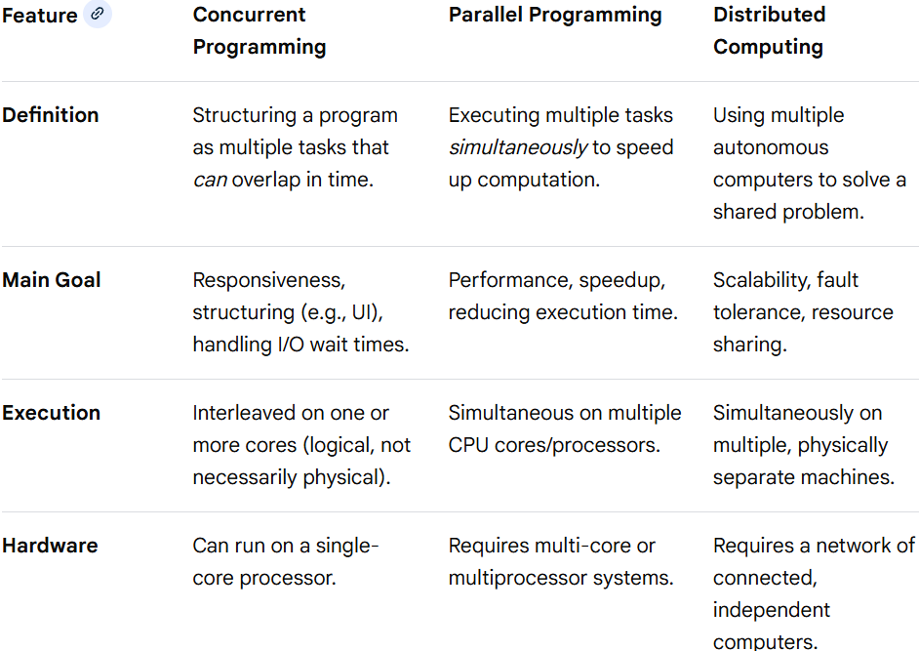
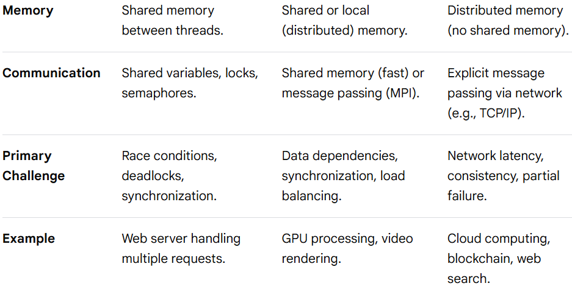
Distributed Systems Basics
Concurrent vs Parallel vs Distributed Programming/Computing

Slide 30
Distributed Systems Basics
Concurrent vs Parallel vs Distributed Programming/Computing
Summary of Differences
Concurrent vs. Parallel: A concurrent system manages multiple tasks simultaneously (interleaved), while a parallel system runs them simultaneously (truly at once). Concurrency is a structure (dealing with many things), while parallelism is an execution (doing many things).
Parallel vs. Distributed: Parallel computing usually occurs on a single computer with shared memory, while distributed computing involves independent machines, each with its own local memory, communicating over a network.
Key Overlap: Distributed systems use concurrent programming to manage multiple connections/tasks, and parallel programming is used within nodes of a distributed system to boost performance.

Slide 31
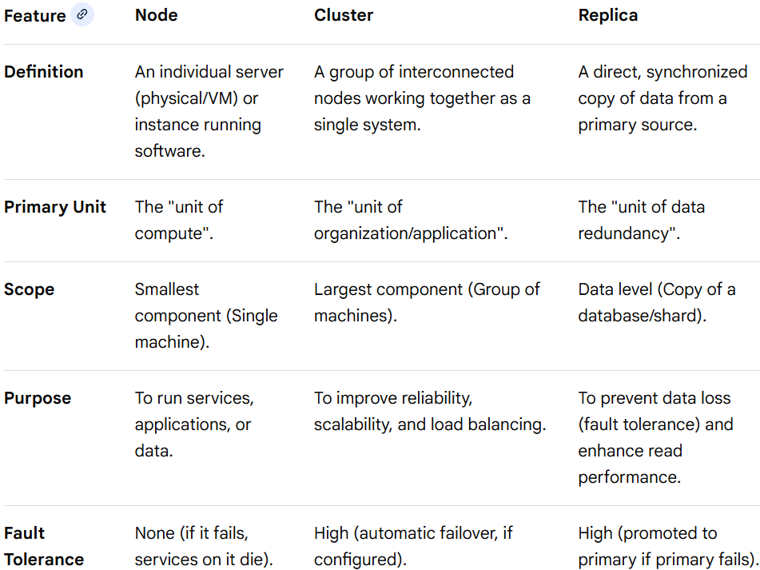
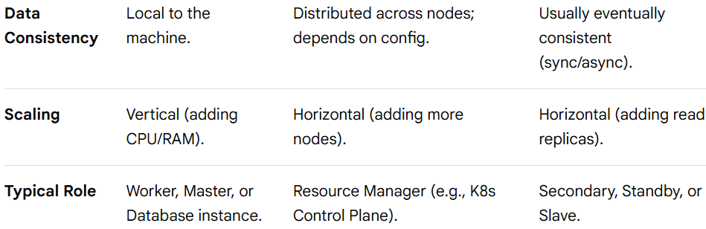
Distributed Systems Basics
Node vs Cluster vs Replica
N.B.- Replica is not a node and rather a copy of code/data of some node into another node

Slide 32
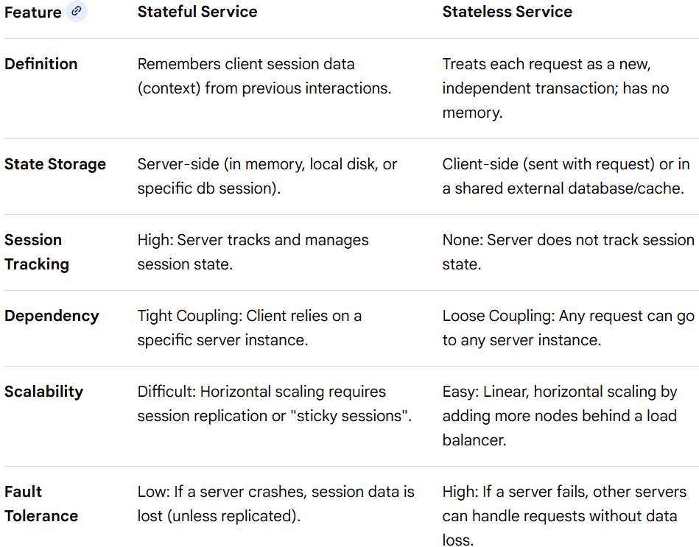
Distributed Systems Basics
Stateful vs Stateless Service
Stateful and stateless services represent fundamentally different approaches to handling user data, session continuity, and server-side memory. Stateful services maintain context across requests, whereas stateless services treat every request as an independent, isolated interaction.

Slide 33
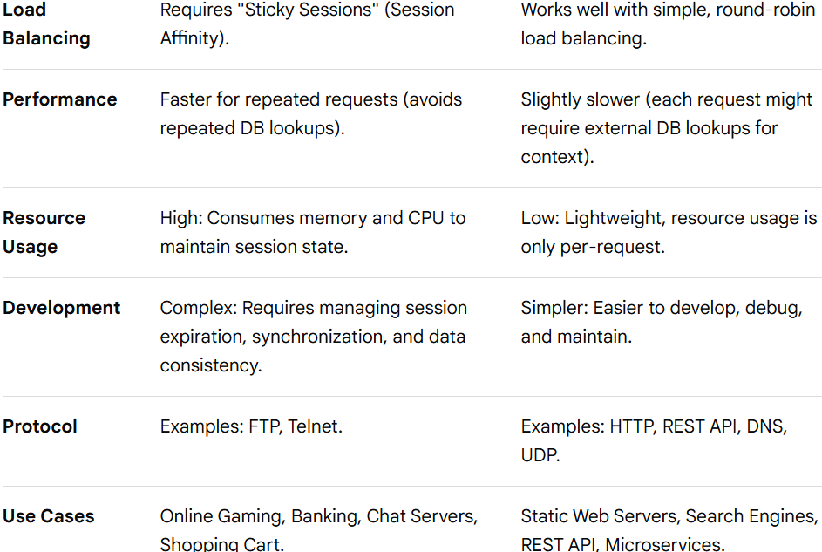

Distributed Systems Basics
Stateful vs Stateless Service

Slide 34
Distributed Systems Basics
Stateful vs Stateless Service
Summary of Key Differences
Stateful = Context-aware. It knows who you are and what you did last. If the server fails, you lose that memory.
Stateless = "Dory" (forgetful). It treats every request as if it’s the first time it has ever seen you. It relies on the client to send all context (e.g., in a JSON Web Token) with every call.
When to Use Which?
Use Stateful When:
Real-time interaction is necessary: Multiplayer gaming, collaborative editing, or chat servers require live shared state.
Multi-step transactions are required: Complex, multi-step workflows like online banking or specialized banking applications.
Performance relies on local caching: When you need to avoid fetching user profile/permissions from a central database for every single click.
Use Stateless When:
High scalability is needed: Cloud-native applications, microservices, or public-facing REST APIs.
System resilience is crucial: You need the system to stay online even if multiple servers crash.
Simplified Deployment: You want to easily add or remove servers on the fly without worrying about user session migration.
Modern Approach: Most modern systems use a hybrid approach where the application server is stateless (for scaling) and the state is offloaded to a specialized, high-performance database (like Redis) that is stateful.

Slide 35
Distributed Systems Basics
Shared Nothing Architecture
In shared-nothing architecture:
Each node has its own memory, disk, and CPU
Nodes do not share state
Communication is via the network
Benefits
High scalability
No single point of failure
Fault isolation
Examples
Cassandra
MongoDB
Kafka
Hadoop

Slide 36
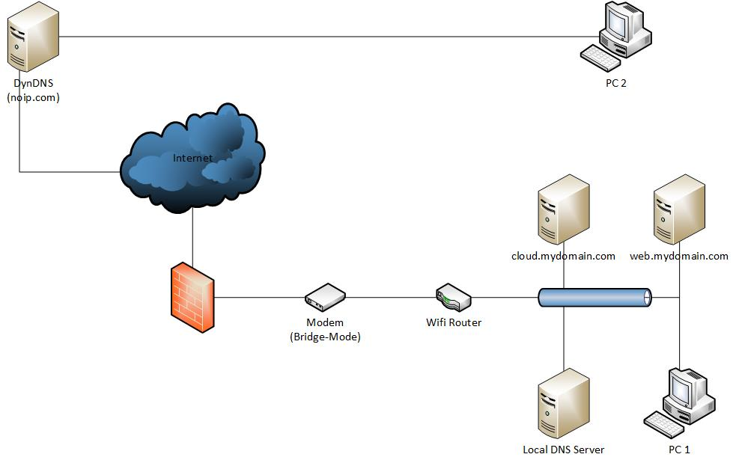
Distributed Systems Basics
DNS –

Slide 37
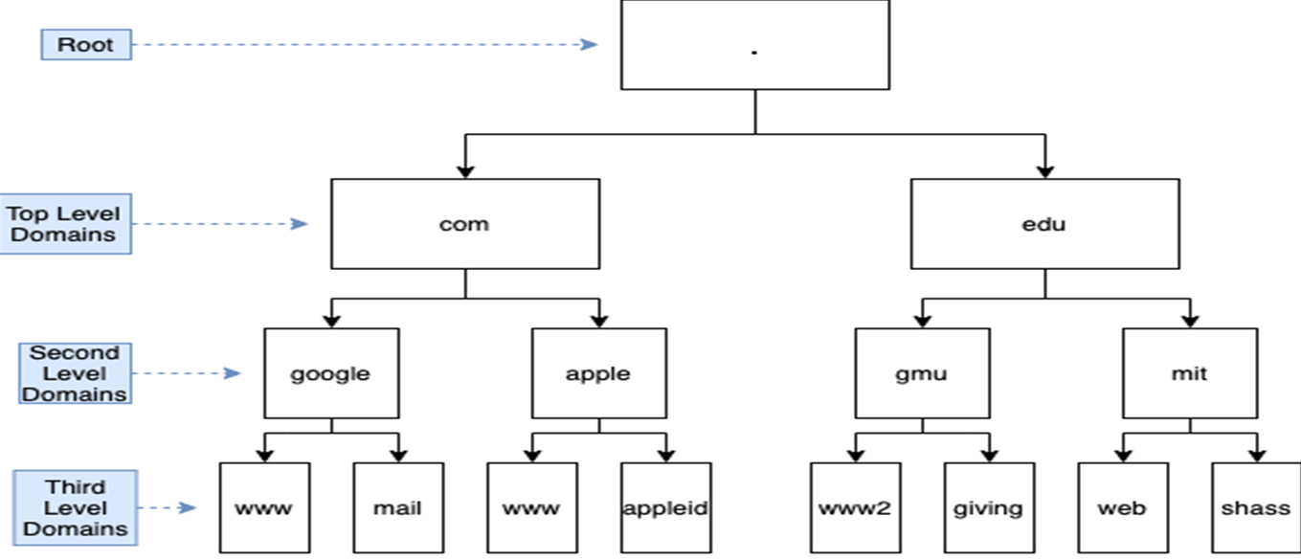
Distributed Systems Basics
DNS –
Hierarchy -

Slide 38
Distributed Systems Basics
DNS -
For Further Exploration –
Local DNS – i.e. via Host File(c# - How do i change the hosts file in a windows program? - Stack Overflow)
Hierarchical DNS(using physical servers) –
Introduction to Domain Name System (DNS)
How the Domain Name System Works
DNS Resolution – How the internet find its way | LinkedIn

Slide 39
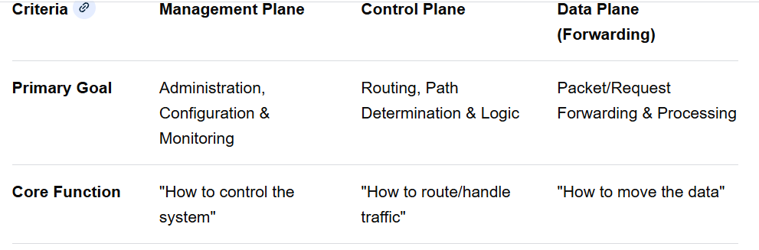
Distributed Systems Basics
Management vs Control vs Data Plane
Conceptual Overview
Modern distributed systems and networks are divided into three functional planes to achieve separation of concerns, scalability, and security.
Data Plane (The Muscle): The "workhorse" that processes and forwards actual user data/traffic (e.g., HTTP requests, packets).
Control Plane (The Brain): The decision-maker that tells the data plane how to handle traffic (e.g., routing tables, load balancing rules).
Management Plane (The Administrator): The interface for humans/automated systems to configure, monitor, and manage the system (e.g., GUIs, APIs, CLI)
Comparison

Slide 40
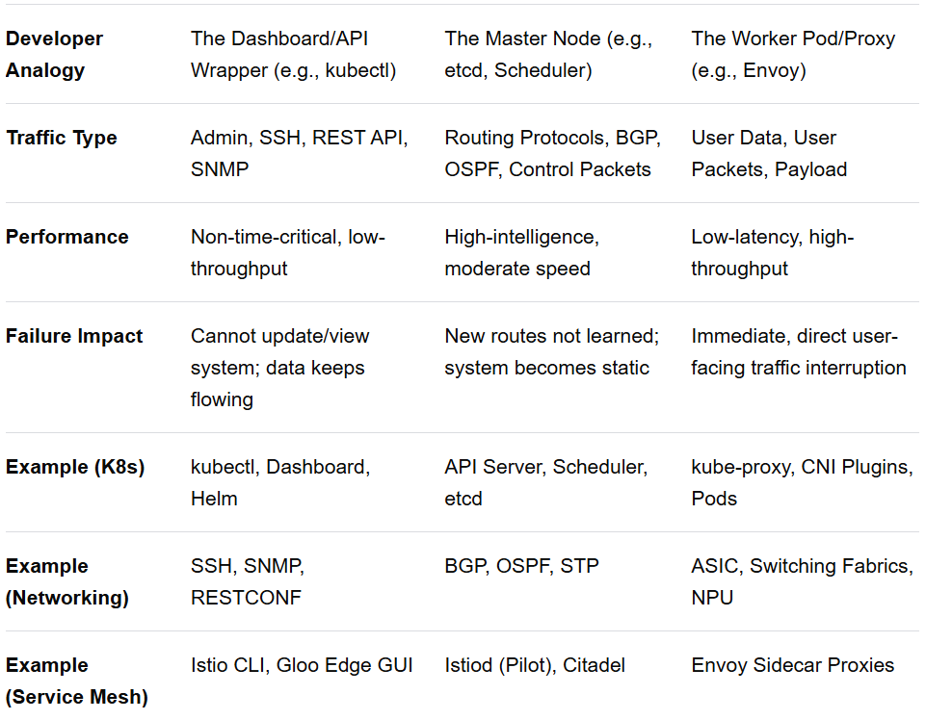
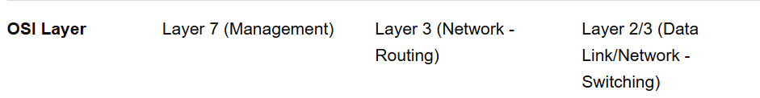
Distributed Systems Basics
Management vs Control vs Data Plane

Slide 41
Distributed Systems Basics
Management vs Control vs Data Plane
Breakdown
1. Management Plane
Purpose: To provide a human-readable or machine-API-based interface to manage the configuration and monitor the health of the system.
Application Development View: This is where you call POST /v1/configuration to set up a load balancer policy. If this plane goes down, you cannot change configurations, but the existing application keeps working.
Key Responsibilities: User authentication, logging, configuration management, monitoring (SNMP, telemetry), provisioning.
2. Control Plane
Purpose: To make intelligent, automated decisions about how traffic should be handled and to propagate those decisions to the Data Plane.
Application Development View: In a service mesh, the control plane (e.g., Istiod) monitors which service pods are available and tells the data plane proxies (Envoy) which IP addresses to send traffic to.
Key Responsibilities: Routing table updates, path determination, security policy enforcement (ACLs), network topology maintenance.
3. Data Plane
Purpose: To execute the forwarding decisions made by the control plane. This is where user data packets are inspected, processed, and forwarded.
Application Development View: This is where your actual microservice requests flow. If this is slow, your user application is slow. It is designed for maximum speed and minimal latency, often using specialized hardware (ASICs) or optimized software (Envoy, VPP).
Key Responsibilities: Packet switching, encapsulating/de-encapsulating, applying ACLs, NAT, QoS

Slide 42
Distributed Systems Basics
Management vs Control vs Data Plane
Separation Advantages
Scalability: You can scale the data plane to handle millions of requests without scaling the control plane, which only needs to handle configuration updates.
Resilience: If the control plane fails, the data plane keeps forwarding traffic based on the last known good configuration.
Security: You can secure the management/control plane interfaces tightly (e.g., restricted access) while allowing the data plane to run in a high-performance, open-data mode.
Flexibility: You can update or replace the Control Plane software without downtime in the Data Plane.

Slide 43
Timing and Ordering
Timing and ordering in distributed systems define the sequence of events across independent nodes, as physical clocks cannot be perfectly synchronized. They are critical to establish causal relationships, ensure data consistency, and resolve conflicts. Without them, systems suffer from data corruption, inconsistent state, and broken transaction serialization.
Why Timing and Ordering Are Needed
Causal Ordering: Ensures if event A causes event B, A is processed before
Consistency: Maintains the same state across nodes, critical for distributed databases.
Conflict Resolution: Acts as a tie-breaker, such as deciding which transaction occurred first in concurrent updates.
Fault Tolerance: Helps distinguish between actual node failure and high network latency.
🌍 The Core Problem: Time is Broken in Distributed Systems
In a single process:
Event A happens
Event B happens
Order = obvious.
In distributed systems:
Machine A Machine B
---------- ----------
Event A1 Event B1
Event A2 Event B2

Slide 44
Timing and Ordering
🌍 The Core Problem: Time is Broken in Distributed Systems
In distributed systems:
Problems:
Clocks drift
Messages delayed
Events occur concurrently
Network reordering happens
So, we need ways to answer:
Did event X happen before event Y?
Are X and Y concurrent?
Can we produce one consistent global order?
Clock Skew - In a distributed system, every computer (node) has its own physical clock (quartz crystal oscillator) that tells the time. Even if you set all clocks to 12:00:00 simultaneously, they will eventually drift apart because of:
Manufacturing Imperfections: No two crystals oscillate at exactly the same frequency.Environmental Factors: Temperature fluctuations affect speed.
Clock Skew: The difference in time between two clocks at any given point in time.
Clock Drift: The difference in the rate (frequency) at which two clocks progress.
Intuitive Analogy: Imagine two friends, Alice and Bob, both wearing wristwatches. Alice’s watch runs 1 second fast every day, and Bob’s runs 1 second slow. After 10 days, their watches are 20 seconds apart. This 20-second gap is the skew.

Slide 45
Timing and Ordering
Clock Skew
Why Clock Skew Matters
Incorrect Event Ordering: If Node A writes data at 10:00:05 and Node B writes to the same record at 10:00:02 (but B’s clock is fast), the system might incorrectly assume B happened after A.
Data Inconsistencies: Transactions or updates might be applied in the wrong order, causing data corruption.
Security Failures: Authentication protocols like Kerberos rely on timestamps; if clocks differ by more than a few minutes, login requests fail.
Positive vs. Negative Skew
Positive Skew: Receiver receives the clock signal later than the sender (Clock B lags behind A).
Negative Skew: Receiver receives the clock signal earlier than the sender (Clock B is ahead of A).
What Happens Without Proper Ordering
Data Divergence: Replicas end up with different values for the same data.
Lost Updates/Race Conditions: Concurrent requests to the same resource are processed in a conflicting manner.
Inconsistent Views: Users see events happening in different orders on different nodes.
Strategies and Techniques for Implementation
Physical Clock Synchronization: Uses protocols like NTP (Network Time Protocol) to align node clocks, though these still have drift.
Lamport Timestamps: A logical clock approach ensuring that if event A-> B (causality), then C(A)<C(B).

Slide 46
Timing and Ordering
Strategies and Techniques for Implementation
Vector Clocks: Extends logical clocks to detect concurrent events and precisely track causal history, used in systems like DynamoDB.
Total Ordering/Sequencers: Uses a centralized sequencer or consensus algorithms (e.g., Paxos, Raft) to enforce a single, global order of events.
Key Concept: Because physical time is unreliable across distributed machines, logical clocks (Lamport/Vector) are often preferred over physical time for ordering.
🧭 Lamport Clock (Logical Clock)
💡 Intuition
Lamport clock answers:
👉 "Can I tell which event happened before another?"
It does NOT detect concurrency precisely — only causality.
🔥 Core Idea
Each process keeps a counter.
Time is just monotonically increasing numbers.
📜 Rules
Rule 1: Internal event
clock = clock + 1
Rule 2: Sending message
clock = clock + 1
Send message with timestamp = clock

Slide 47
Timing and Ordering
🧭 Lamport Clock (Logical Clock)
Rule 3: Receiving message
clock = max(local_clock, received_timestamp) + 1
🧠 Why max?
Because receiving a message implies:
send_event → receive_event
So, receiver must be logically after sender.
📦 Lamport Clock Example
Two nodes: A and B
A: clock=0
B: clock=0
Step 1: A internal event
A: 1
Step 2: A sends message to B
A: 2
Message timestamp = 2
Step 3: B receives message
B: max(0,2)+1 = 3
Step 4: B internal event
B: 4

Slide 48
Timing and Ordering
🧭 Lamport Clock (Logical Clock)
📊 What Lamport Guarantees
If:
Event A → Event B (causal)
Then:
timestamp(A) < timestamp(B)
❌ Limitation
If:
timestamp(A) < timestamp(B)
That does NOT mean causality.
They might be concurrent.
⚙️ Implementation Sketch
class LamportClock
{
private int clock = 0;
public int Tick()
{
return ++clock;
}

Slide 49
Timing and Ordering
🧭 Lamport Clock (Logical Clock)
⚙️ Implementation Sketch
class LamportClock
{
//code in earlier slide
public int SendEvent()
{
return ++clock;
}
public int ReceiveEvent(int receivedTime)
{
clock = Math.Max(clock, receivedTime) + 1;
return clock;
}
}
🧭 Vector Clock
Lamport cannot detect concurrency.
Vector clock fixes that.
💡 Intuition
Instead of a single number:
👉 Track what each node knows about every other node

Slide 50
Timing and Ordering
🧭 Vector Clock
📦 Vector Clock Example
Nodes A, B, C.
Start
A: [0,0,0]
B: [0,0,0]
C: [0,0,0]
A performs event
A: [1,0,0]
A sends message to B
B merges:
B: [1,0,0]
Then increment B index:
B: [1,1,0]
C performs event independently
C: [0,0,1]
🔥 Concurrency Detection
Event X < Event Y if:
∀i : X[i] <= Y[i]
AND
∃j : X[j] < Y[j]
Otherwise → concurrent.

Slide 51
Timing and Ordering
🧭 Vector Clock
🔥 Concurrency Detection
Example
A event = [2,0,0]
C event = [0,0,2]
Neither dominates → concurrent.
⚙️ Implementation Sketch
class VectorClock
{
private int[] clock;
private int id;
public VectorClock(int nodeCount, int nodeId)
{
clock = new int[nodeCount];
id = nodeId;
}
public int[] Tick()
{
clock[id]++;
return clock;
}

Slide 52
Timing and Ordering
🧭 Vector Clock
⚙️ Implementation Sketch
class VectorClock
{
// Code in earlier slide
public int[] Send()
{
clock[id]++;
return (int[])clock.Clone();
}
public void Receive(int[] received)
{
for(int i=0;i<clock.Length;i++)
clock[i] = Math.Max(clock[i], received[i]);
clock[id]++;
}
}
❌ Vector Clock Problems
Storage grows O(N)
Message overhead grows O(N)
Dynamic membership is hard

Slide 53
Timing and Ordering
🧭 Total Ordering / Sequencer Based Ordering
Lamport & vector clocks give partial ordering.
Sometimes systems require:
👉 Everyone must process events in exact same order
Example:
Replicated logs
Databases
Event sourcing
Messaging brokers
💡 Sequencer Model
One node becomes:
GLOBAL ORDER AUTHORITY
Architecture
Producer → Sequencer → All replicas
📜 Implementation Steps
Step 1: Client sends message to sequencer
Message M
Step 2: Sequencer assigns global sequence
Sequence number++
Attach seq to message
Step 3: Broadcast message
All nodes apply messages in increasing order.

Slide 54
Timing and Ordering
🧭 Total Ordering / Sequencer Based Ordering
📦 Example
Messages from clients:
M1 arrives
M2 arrives
M3 arrives
Sequencer assigns:
M2 → seq 1
M1 → seq 2
M3 → seq 3
All nodes replay exactly same order.
⚙️ Implementation Sketch
class Sequencer
{
private long seq = 0;
public SequencedMessage Assign(Message m)
{
return new SequencedMessage
{
Sequence = Interlocked.Increment(ref seq),
Payload = m }; }
}

Slide 55
Timing and Ordering
🧭 Total Ordering / Sequencer Based Ordering
🔥 Replica Side
SortedDictionary<long, Message> buffer;
long nextExpected = 1;
Process only when:
buffer contains nextExpected
❌ Problems
Single point of failure
Bottleneck
High latency
👉 Paxos / Raft are essentially distributed sequencers.
🧭 Google TrueTime (Spanner's Secret Sauce) – A Sophisticated Physical Clock
Now we move from logical clocks → physical time with uncertainty modeling.
TrueTime is wildly different and extremely sophisticated.
💡 Problem Google Solved
They wanted:
👉 Globally consistent transactions across data centers
Using real time ordering.
⚠️ Why Physical Clocks Fail
Machines have:
Clock drift

Slide 56
Timing and Ordering
🧭NTP(Network Time Protocol)
NTP is the standard protocol for synchronizing physical clocks over variable-latency networks (like the internet).
The NTP Hierarchy (Stratum)
NTP uses a hierarchy of time sources called stratum.
Stratum 0: High-precision time sources like atomic clocks, GPS, or radio clocks.
Stratum 1: Computers directly attached to Stratum 0 devices (Primary servers).
Stratum 2, 3...: Servers that synchronize with higher-stratum servers.Maximum Levels: 15.
A stratum 16 indicates the device is unsynchronized.
How NTP Works (The Exchange)
NTP clients exchange packets with servers to calculate two main things: offset (time difference) and round-trip delay. Client sends request (T_{1}).Server receives (T_{2}), replies (T_{3}).Client receives reply (T_{4}).
Calculation:
Delay (delta): (T_{4}-T_{1})-(T_{3}-T_{2})
Offset (theta): frac{(T_{2}-T_{1})+(T_{3}-T_{4})}
Limitations of NTP Accuracy: On the internet, accuracy is usually within tens of milliseconds, which is too slow for high-performance databases.
Non-Monotonicity: NTP can make time "jump" backward or forward suddenly to correct large drifts, breaking the assumption that time only moves forward.

Slide 57
Timing and Ordering
🧭 Google TrueTime – A Sophisticated Physical Clock
⚠️ Why Physical Clocks Fail
NTP inaccuracies
Network latency
So physical time is unreliable.
💥 TrueTime Idea
Instead of returning one timestamp:
It returns time interval
[earliest, latest]
API
TT.now() → [earliest, latest]
📜 Guarantee
Actual real time is somewhere inside interval.
🧠 How TrueTime Works Internally
Google uses:
GPS clocks
Atomic clocks
Specialized hardware
Continuous synchronization

Slide 58
Timing and Ordering
🧭 Google TrueTime – A Sophisticated Physical Clock
📦 Example
TT.now() = [10:00:00.000 , 10:00:00.007]
Meaning:
Actual time ∈ interval
Uncertainty = 7ms
🔥 Spanner Transaction Ordering
To ensure global serializability:
Spanner uses:
👉 Commit wait
Commit Algorithm
Step 1: Transaction gets timestamp T
Step 2: Wait until
TT.after(T)
Meaning:
TT.now().earliest > T
Step 3: Commit becomes visible
This guarantees:
If T1 committed before T2 started
→ T1 timestamp < T2 timestamp

Slide 59
Timing and Ordering
🧭 Google TrueTime – A Sophisticated Physical Clock
📦 Example
Transaction A:
Assigned timestamp = 100
TrueTime:
TT.now = [95,105]
System waits until:
TT.now().earliest > 100
Then commit.
🔥 Why This Is Revolutionary
It gives:
External consistency
Globally serializable transactions
Real-time ordering across datacenters
⚙️ Simplified TrueTime Implementation Model
struct TimeInterval
{
public DateTime Earliest;
public DateTime Latest;
}

Slide 60
Timing and Ordering
🧭 Google TrueTime – A Sophisticated Physical Clock
🔥 Why This Is Revolutionary
⚙️ Simplified TrueTime Implementation Model
class TrueTime
{
public TimeInterval Now()
{
var physical = ReadHardwareClock();
var epsilon = EstimateUncertainty();
return new TimeInterval
{
Earliest = physical - epsilon,
Latest = physical + epsilon
};
}
}
🔥 Commit Wait
void Commit(long ts)
{
while(TrueTime.Now().Earliest <= ts)
Thread.Sleep(1);
}

Slide 61
Timing and Ordering
🧭 Google TrueTime – A Sophisticated Physical Clock
🧠 Comparing All Techniques
Technique Tracks Causality Detects Concurrency Gives Total Order Uses Physical Time
Lamport ✅ ❌ ❌ ❌
Vector ✅ ✅ ❌ ❌
Sequencer ❌ ❌ ✅ ❌
TrueTime ✅ ✅ ✅ ✅
🧠 When Each Is Used
Lamport
Distributed logs
Causal ordering
Vector Clock
Conflict detection
CRDT systems
Dynamo / Cassandra versions
Sequencer
Kafka partitions
Raft leaders
Totally ordered multicast
TrueTime
Spanner
Globally consistent databases

Slide 62
Timing and Ordering
🌌Insight
These mechanisms represent three different philosophies of time:
Logical Time
(Lamport, Vector)
👉 Time derived from causality
Authority Time
(Sequencer)
👉 Time derived from leadership
Physical Time with Uncertainty
(TrueTime)
👉 Time derived from physics + error bounds
🌌 Another Insight
You cannot have simultaneously:
Perfect ordering
Low latency
High scalability
No central authority
Each technique sacrifices something.

Slide 63
Timing and Ordering
Hybrid Logical Clocks
Hybrid Logical Clocks (HLC) combine the best of physical clocks (real-time, human-readable) and logical clocks (causality-preserving). They are widely used in modern distributed databases like CockroachDB and YugabyteDB.
Components of HLC
An HLC timestamp is a 64-bit value represented as a tuple: $\langle$Physical Component, Logical Counter(rangle).
Physical Component (l): Tracks physical time (max of local physical time or latest seen time), usually with microsecond precision.
Logical Counter (c): A counter that increments to track causal dependencies when the physical component stays the same (e.g., during rapid events or when local time is slower than another node).
HLC Properties
Monotonicity: HLC is guaranteed to increase, even if the underlying NTP clock jumps backward.
Causality Tracking: If event A happens-before event B (\(A\rightarrow B\)), then \(HLC(A)<HLC(B)\).Closeness to Physical Time: Unlike pure logical clocks (Lamport clocks), HLCs stay close to NTP time, making them useful for debugging.
HLC Algorithm (Intuitive Breakdown) - Each node maintains its HLC (l_{local},c_{local}).
1. On a Local Event: Update l_{local} to (max (l_{local},PhysicalTime)).If (l_{local}) increases, (c_{local}) resets to 0.If (l_{local}) stays same, (c_{local}) increments.
2. On Sending a Message: Send current HLC \(\langle l,c\rangle \). Increment local counter before sending.
3. On Receiving a Message (langle l_{msg},c_{msg}\rangle ): Update (l_{local}): (max (l_{local},l_{msg},PhysicalTime)).

Slide 64
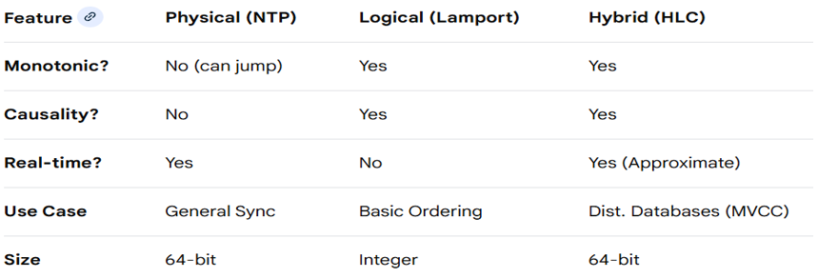
Timing and Ordering
Hybrid Logical Clocks
Update (c_{local}):If (l_{local}) is updated to a new max (greater than both previous (l_{local}) and (l_{msg})), (c_{local}) resets to 0.
If (l_{local}) equals (l_{msg}) and (l_{local}) equals previous local (l), (c_{local}) becomes (max (c_{local},c_{msg})+1).
Otherwise, (c_{local}) is updated based on which timestamp was greater, ensuring (HLC_{new}>HLC_{old}) and (HLC_{new}>HLC_{msg}).
Comparing Clocks

Slide 65
Timing and Ordering
In Practice
In a modern distributed database:
1) NTP runs in the background to keep the node's physical clock roughly aligned with the real world (within milliseconds).
2) When a transaction occurs, the system uses an HLC.
3) If a node's NTP clock is slightly behind, the HLC uses the logical counter to ensure that the event is still ordered after events it causally depends on.
4) If a node's NTP clock is ahead, the HLC uses the physical component to ensure the timestamp is still close to real-time.
This ensures consistency (causal ordering) and correctness (monotonically increasing time) without requiring prohibitively expensive hardware like GPS/atomic clocks on every server (as needed by Google's TrueTime).
For Further Exploration
Distributed Systems: Physical, Logical, and Vector Clocks
Distributed Systems Clocks | LinkedIn
Distributed Systems & Networking: Time, Order, and Coordination
All Things Clock, Time and Order in Distributed Systems
Lamport's logical clock
Vector Clocks in Distributed Systems
Total Ordering Architectures – Documentation
Google’s True Time
Notes on Google's "TrueTime“
Why Your Computer Can’t Tell Time (And How Atomic Clocks Are Quietly Saving the World)
Syncing Clocks with Satellites: How NTP Actually Works - YouTube
Hybrid Logical Clocks
Hybrid Logical Clocks

Slide 66
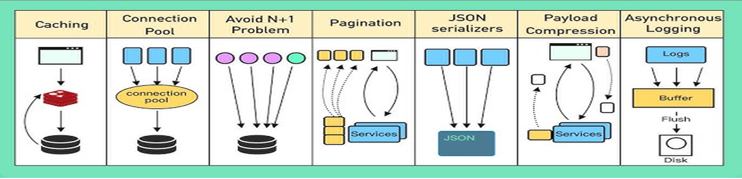
Performance
Logs & Profiling Tools –
1) Logs - Always 1st check logs to find the root cause of the performance issue. Also, to increase the overall performance of the application, may-be you can opt for asynchronous logging.
2) Profiling Tools – If via step 1 above, not able to find the root cause, run some profiling tools (e.g. ANTS Profiler[$$$]) & find where is the issue & what’s the cause of the issue. SQL Server has inbuilt profiler. Similar profilers(or profiling add-ons) are available in other DBs(including NoSQL DBs).
API Performance Improvement Techniques in General

Slide 67
Performance
Response Time Improvement
Time required to get the response from server since the request has been sent from the client.
Ways to improve Response Time
1) SQL Tuning
Always return specific columns in Select rather than using *
Try to get all relevant results in single shot using proper where clause(if needed use paging)
Check that proper indexes are applied in where clause and join clause columns.
Other Sql Tuning Techniques – SQL Performance Tuning – GeeksforGeeks
2) Data Access Layer Tuning
a) ORMs(Dapper & EF) Tuning
Dapper being a micro-orm & uses mainly raw sql, nothing much is there to tune within Dapper itself & most of the Sql Tuning techniques should do the trick.
b) For EF Tuning, refer
15+ Steps to improve EF Core Performance
c) For ADO.NET, refer
.net - C# - What are Some High Performance Best Practices/Tips for ADO.NET - Stack Overflow

Slide 68
Performance
Response Time Improvement
Ways to improve Response Time
3) Caching
Small one time write & multiple read based application data can be cached in-memory but validate that it doesn’t throw OOM Exception.
Large Application data, Session data & rarely-changing data can be cached using some Distributed Cache (Refer - Redis OSS vs. Memcached - Difference Between Caches - AWS for further exploration)
Caching Types –Types of Cache - GeeksforGeeks
Caching Strategies – Top caching strategies - by Alex Xu - ByteByteGo Newsletter
Caching Eviction Strategies – Cache replacement policies – Wikipedia
Cache Stampede - The Coordinated Omission Problem in the Benchmark Tools
Cache Versioning/Busting - The ultimate guide to cache-busting for React production applications | by Max Shahdoost | Medium & Strategies for Cache-Busting CSS | CSS-Tricks
For Further Exploration-
Optimizing Distributed Cache for Read-Heavy vs. Write-Heavy Workloads with Docker
HybridCache in ASP.NET Core - New Caching Library
4) Web UI Tuning –
Bundling & Minification
Compression
Pre-Fetching
CDN
Http/Web Caching
Cache Control & Expires
Etag/Last Modified - Which one to use : Expire Header, Last Modified Header or ETags - Stack Overflow

Slide 69
Performance
Response Time Improvement
For Further Exploration -
Frontend Optimization - 9 Tips to Improve Web Performance – KeyCDN
Data Fetching Patterns in Single-Page Applications
API Pagination | Feed | LinkedIn
Others saying slow but it’s fast for me| LinkedIn
ASP.NET-Core-1.0-High-Performance: ASP.NET Core 1.0 High Performance
Best practices for improving performance using Azure Service Busz

Slide 70
Performance
Resource Utilization & ways to improve it –
Ckecking if some resource(RAM, HardDisk, CPU or Network) is getting overutilized w.r.t. some metric beyond the threshold limit.
RAM Optimization -
1) Garbage Collection Optimization – Refer Garbage Collection slide(s) of Programming For HTLL Systems deck(mainly for memory leaks issues)
2) Use Chunking & Streaming Techniques if needed(e.g. you face OOM[Out of Memory] Exception)
Let’s say you are given below requirements –
Server “A” needing a 1TB file to be processed but having only 1GB RAM
Another server “B” is there with > 1TB HardDisk size
How do you split the 1TB file in Server A into 1K 1GB files & put them in server B using server A as the
processing server?
Hint - c# - How to load large files with StreamReader in chunks? - Stack Overflow
CPU Optimization -
May get StackOverFlow Exception(sometime some irrelevant exception also shows up) if the CPU gets utilized too much. Mainly happens(in continuously running schedulers) due to tight loop issue wherein the CPU continuously runs the loop & at some point reaches 100% utilization. To fix the issue, introduce a Thread.Sleep(1) within the loop at the end, to make the CPU relax for sometime. And ofcourse Multi-Core Parallelism can be used to make computations fasters. Also, Concurrent Programming/Multi-Threading techniques can be used to boost CPU Performance.

Slide 71
Performance
Resource Utilization & ways to improve it –
Network & HardDisk (& DB) IO Optimization-
Use async/await(refer Async/Await slides of Programming Paradigms training)
Use Bulk Operations/Batch Processing wherever possible
If possible, use Parallel Async IO
Other Network & HardDisk(& DB) Optimization –
Other Network & HardDisk performance issues(e.g. fragmentation etc) needs to be checked separately. Most of these other issues are concerns of Infra, DBA etc. teams though.
For Further Exploration –
What is http multipart request? - Stack Overflow
c# - How do I download a large file (via HTTP) in .NET? - Stack Overflow

Slide 72
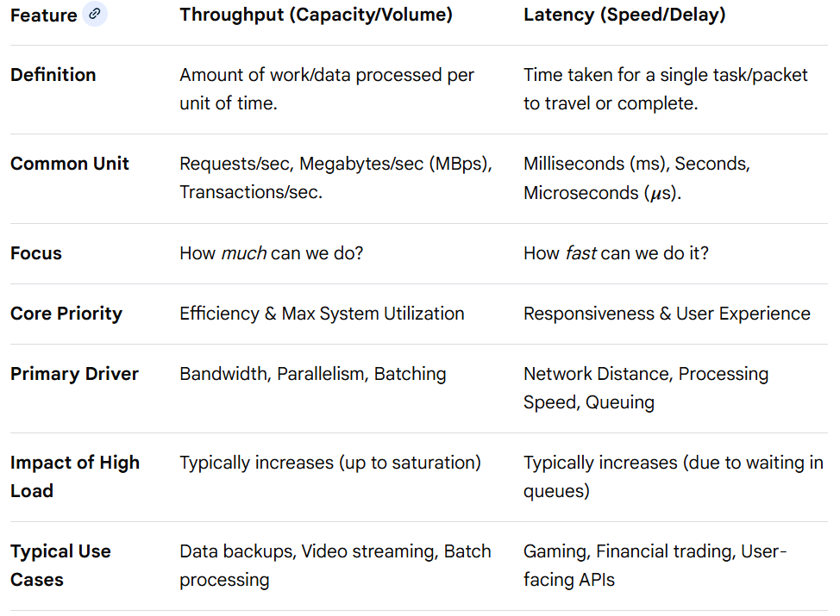
Performance
Throughput & Latency

Slide 73
Performance
Throughput & Latency
Trade-offs in System Design
The relationship between these two metrics is rarely linear and is often governed by Queuing Theory (Little's Law: (L= . W).
Batching Improves Throughput, Increases Latency: To increase throughput, systems often wait to collect multiple requests before processing them together. This maximizes efficiency but forces early requests to wait for later ones, increasing latency.
Parallelism Improves Throughput, May Affect Latency: Adding more nodes or threads allows more tasks to be processed simultaneously (higher throughput), but the coordination, synchronization, and communication between these nodes can introduce latency.
Queueing Adds Latency to Gain Throughput: High-throughput systems (like message brokers) use queues to buffer data. While this ensures that no data is lost during spikes, it adds waiting time (queuing latency) for the requests.
Caching Lowers Latency, May Improve Throughput: Serving data from a cache (e.g., Redis) gives immediate responses (low latency) and reduces the load on backend databases, allowing them to handle higher volume (higher throughput).
Consistency vs. Performance: Strong consistency (e.g., ACID database transactions) often requires locking mechanisms, which lowers throughput. Eventual consistency allows higher throughput by allowing parallel, uncoordinated writes, but might not be suitable for all applications.

Slide 74
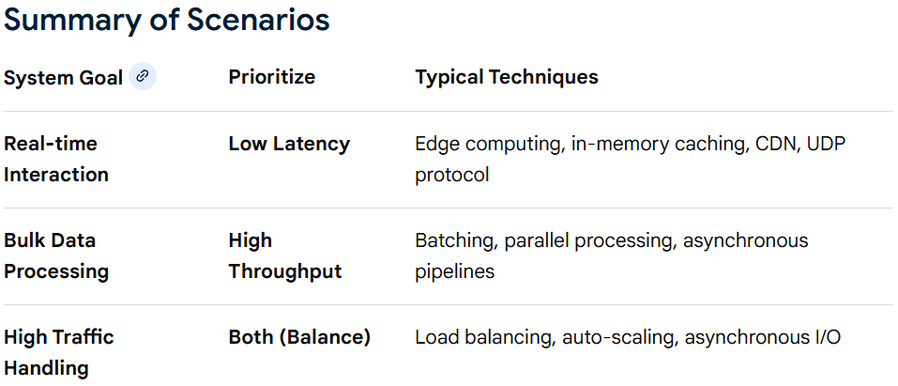
Performance
Throughput & Latency

Slide 75
Performance
Little’s Law
Little’s Law — The Universal Performance Equation
Statement
𝐿 =𝜆𝑊
Where:
L = average number of items in system
λ = arrival rate (items/sec)
W = average time in system
🔑 Why it’s powerful
Makes no assumptions about arrival/service distributions
Applies to networks, TCP, CPUs, disks, routers
1.1 Intuition (Burn it into memory)
What’s inside = How fast things come in × How long they stay
Little’s Law Applications
2.1 Bandwidth–Delay Product (BDP)
Let:
L = in-flight packets
λ = throughput
W = RTT
In-flight data=Bandwidth×RTT
➡ BDP is Little’s Law

Slide 76
Performance
Little’s Law Applications
2.2 TCP Congestion Window
𝑐𝑤𝑛𝑑=𝜆×𝑅𝑇𝑇
If cwnd < BDP ⇒ underutilized
If cwnd > BDP ⇒ queues build ⇒ delay/loss
2.3 Router Queue Length → RTT Inflation
𝑅𝑇𝑇𝑞𝑢𝑒𝑢𝑒=𝐿𝑞𝜆
➡ Growing queue ⇒ growing RTT
➡ TCP delay-based congestion detection
2.4 Buffer Sizing
From Little’s Law:
𝐵≈𝑅𝑇𝑇×𝐶
Where:
B = buffer size
C = link capacity
2.5 Throughput from Observables
If you can measure:
Average queue length
Average delay
𝜆=𝐿𝑊
Used in passive network monitoring.

Slide 77
Performance
Little's Law for Latency
Latency = Queue Length / Throughput
Insight - Concurrency increases average throughput but increases tail latency (p95/p99) unless resources are isolated and back-pressure is applied in each isolation(if not each then most isolations).
RTT vs Latency
Latency: one-way delay (Sender → Receiver)
RTT: two-way delay (Sender → Receiver → Sender)
📌 Roughly:
RTT ≈ 2 × latency (but not always exactly)
Measuring API Latency (p95, p99) 📊
A. Why averages are useless
Example:
90 requests → 50 ms
10 requests → 1000 ms
Average = 145 ms ❌ (misleading)
p95 = ~1000 ms ✅
p99 = ~1000 ms 🚨

Slide 78
Performance
Measuring API Latency (p95, p99) 📊
B. Percentiles explained
Metric Meaning
p50 Median
p90 90% faster than this
p95 User pain threshold
p99 Worst-case experience
p99.9 System health
C. How to calculate p95 / p99
Collect latency samples
Sort ascending
p95 = value at 0.95 × N
Example:
1000 requests
p95 → 950th value
p99 → 990th value
D. Tools used in practice
Tool Purpose
Prometheus Metrics
Grafana Visualization
OpenTelemetry Tracing
Jaeger / Zipkin Distributed tracing
Locust / JMeter Load testing

Slide 79
Performance
Measuring API Latency (p95, p99) 📊
E. Golden Signals (Google SRE)
Latency (p95/p99)
Traffic
Errors
Saturation
🔑 Key takeaway
**p95 tells you how most users feel; p99 tells you how your system behaves under stress.Stateless systems provide predictable p99 latency and scale reliably under concurrency.**
For Further Exploration
Little's law: calculate response time vs. number of CPUs
The Tail at Scale

Slide 80
Performance
Some Important Statistics
Current & Target loads –
Avg transactions/day
Typical hours transactions
Peak hours transactions
Avg Response time
90 percentile response time
Inbound & Outbound Batch Jobs
Volume
Duration
Transactions/sec
For Further Exploration
Benchmarking Message Queue Latency – Brave New Geek

Slide 81
Performance
Co-ordinated Omission
Coordinated omission is a performance measurement error occurring in load testing where the testing tool pauses during system slowdowns, failing to record high-latency data points. This causes the system to appear faster than it is, because the tool only records "service time" (processing) rather than the total "response time" (wait + processing).
Key Details About Coordinated Omission
How it Happens: When the System Under Test (SUT) slows down, the load generator waits for the slow response, missing the scheduled timing for subsequent requests.
Impact on Data: It hides latency spikes and creates optimistic, misleading, or incorrect performance reports.
Example Scenario: A server hangs for 500ms, causing the load generator to skip 500 requests during that time. The tool reports only the single long, 500ms request rather than 500 individual failed requests.
Mitigation Techniques: To fix this, testers should use tools that record the intended schedule regardless of the response (e.g., Hyperfoil or Goose), use tools that support asynchronous, open-model traffic generation, or use HdrHistogram for accurate recording.
Coordinated omission was popularized by Gil Tene, who highlighted the distinction between measuring service time versus true user-experienced response time.
For Further Exploration
The Coordinated Omission Problem in the Benchmark Tools | by siddontang | Medium

Slide 82
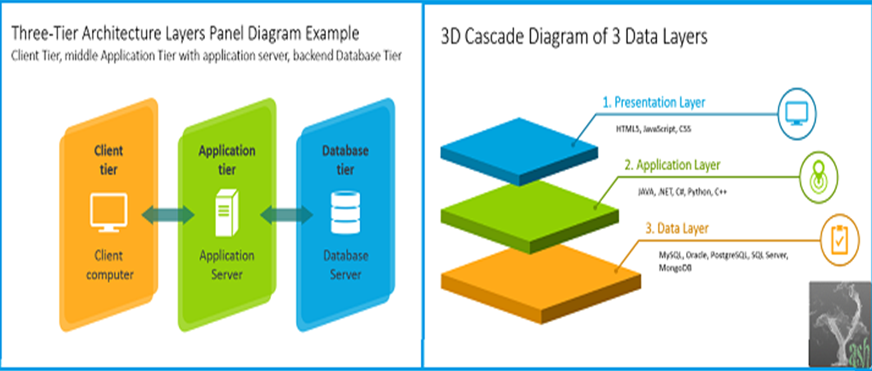
Scalability
Layer vs Tier –

Slide 83
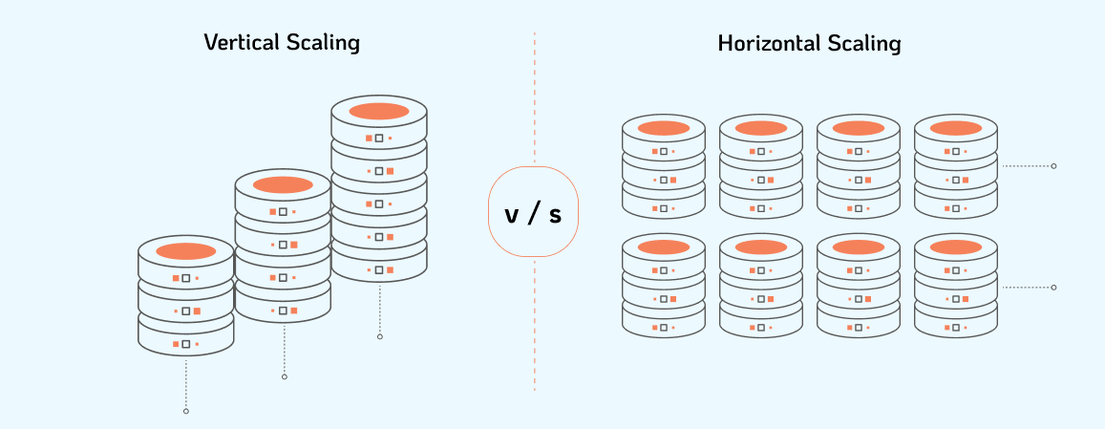
Scalability
Vertical vs Horizontal Scaling –

Slide 84
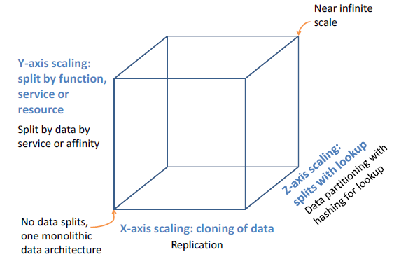
Scalability
Scale Cube –

Slide 85
Scalability
Layer vs Tier –
What's the difference between a cake tier and a layer of cake? – My Baker
Horizontal vs Vertical Scaling –
Horizontal vs. Vertical Scaling: HPA, VPA & Beyond | nOps
Scale Cube –
The Scale Cube

Slide 86
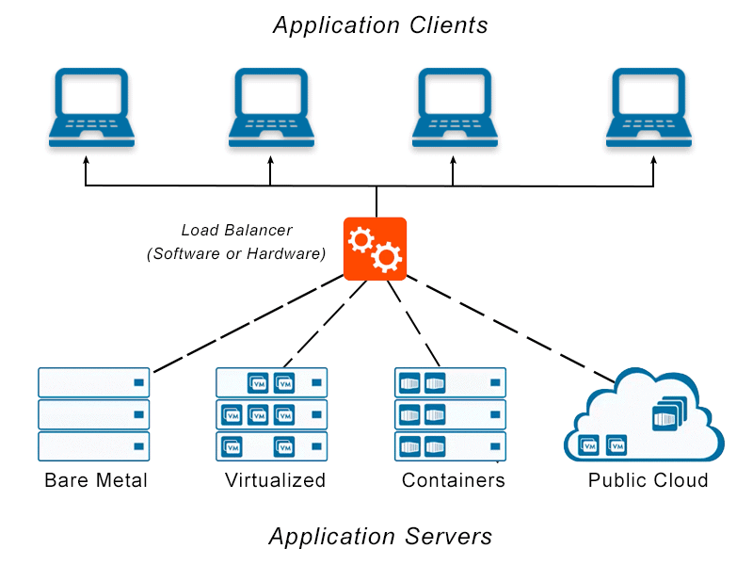
Scalability
Load Balancer–

Slide 87
Scalability
Load Balancer (Types)–
LB Type | Layer(s) | Feature(s) | Use Case(s)
GLB(Global Load Balancer) | Layer 3 | Multi-Region: Allows for global load balancing across multiple Cloud Regions. DNS-Based: GLB primarily relies on DNS for routing decisions. Failover and Latency-Based Routing: GLB solutions often use these techniques for resilience and performance optimization. | — GLB is used to distribute traffic across multiple Cloud Regions or data centers to achieve global redundancy and disaster recovery. — It involves configuring DNS-based solutions with failover policies and latency-based routing to direct traffic to the nearest healthy endpoint.
ALB(Application Load Balancer) | Layer 7 | SSL Termination: ALB can terminate SSL/TLS connections from clients, offloading SSL processing from backend servers. Health Checks: Supports health checks at the application layer. Sticky Sessions: Provides support for sticky sessions. WebSockets: Supports WebSocket traffic. HTTP/2: Supports HTTP/2, providing better performance for modern web applications. | — Best suited for routing HTTP and HTTPS traffic. — Ideal for load balancing multiple applications or microservices on a single port, as it supports content-based routing and can route requests to different target groups based on URL paths or hostnames. — Provides advanced features like host-based routing, path-based routing, and support for container-based applications.

Slide 88
Scalability
Load Balancer (Types) contd …–
LB Type | Layer(s) | Feature(s) | Use Case(s)
NLB(Network Load Balancer) | Layer 4 | High Throughput: NLB is designed for high throughput and low-latency use cases. TLS Termination: NLB supports TLS termination, but it’s not as feature-rich as ALB in handling HTTPS traffic. Health Checks: Supports health checks at the transport layer. | — Ideal for handling TCP/UDP traffic, including custom protocols, non-HTTP protocols, and high-performance workloads. — Commonly used for load balancing databases, gaming applications, and other services that rely on raw transport layer connections. — Works well for scenarios where source IP preservation is important.

Slide 89
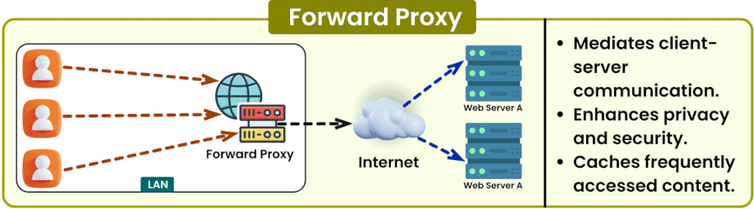
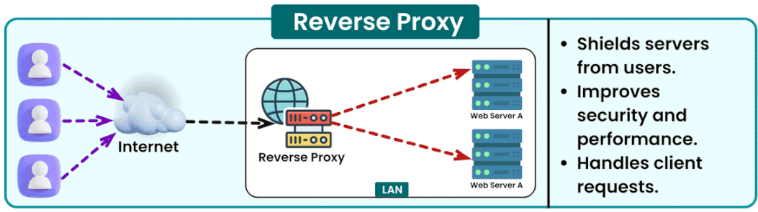
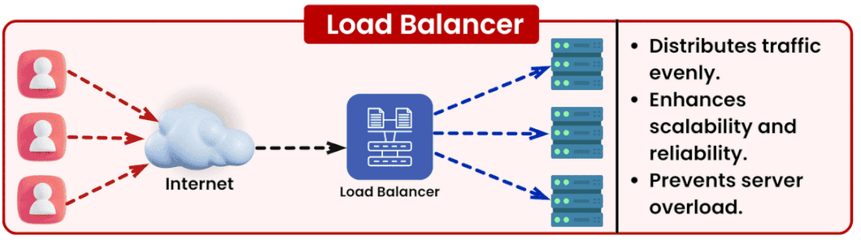
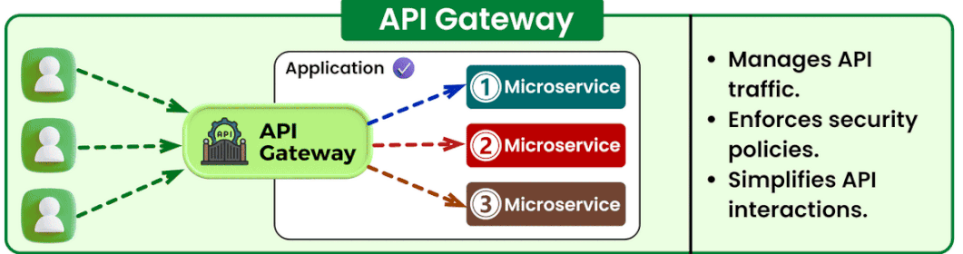
Scalability
Forward Proxy vs Reverse Proxy (vs Load Balancer vs API Gateway)–

Slide 90
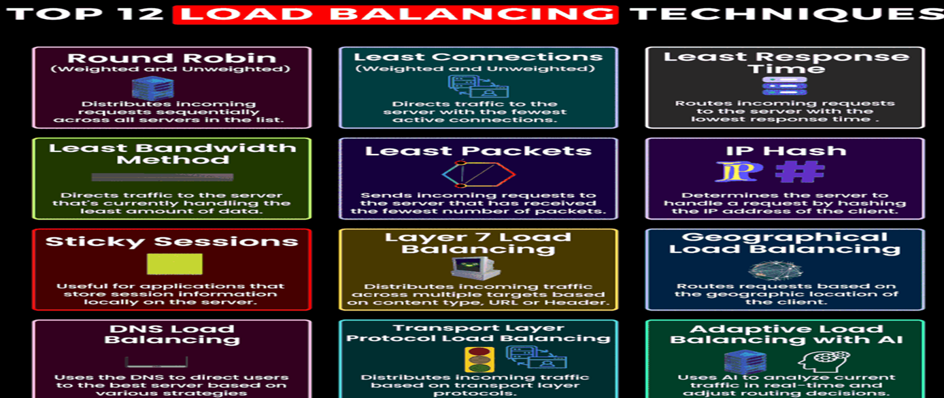
Scalability
Load Balancing Techniques –
For Further Exploration –
Top 12 Load Balancing Techniques to keep on your Radar | LinkedIn

Slide 91
Scalability
For Further Exploration –
Load Balancers –
Introduction to Load Balancers
Load Balancer Types –
Load Balancer Choices | SystemsArchitect.io
Load Balancer Sticky Session(/Session Affinity) –
What is Session Stickiness | Pros and Cons of Using Session Cookies | Imperva
Forward Proxy & Reverse Proxy –
Forward and Reverse Proxy in System Design
A Deep Dive into YARP and Ocelot: Your Gateway to API Gateways (e.g. can be used to build a Payment Gateway[PCI-DSS Compliant PCI Proxy])
Service-Fabric-Yarp
Zuul

Slide 92
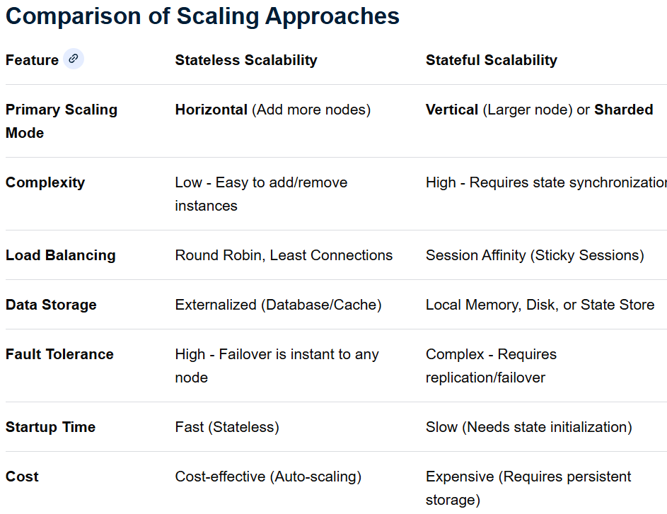
Scalability

Slide 93
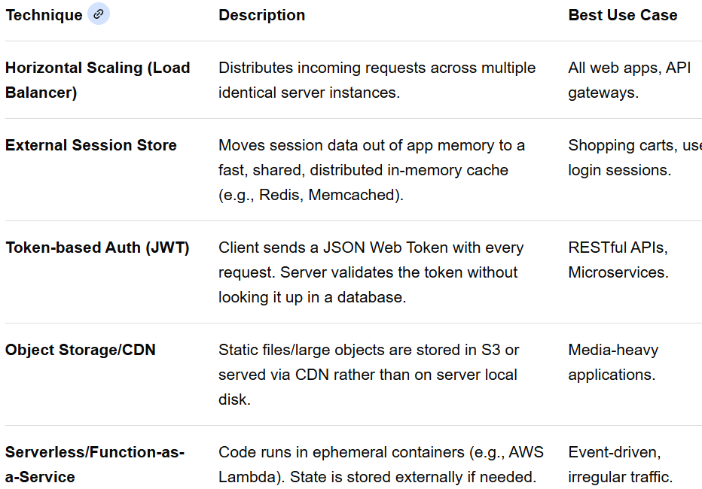
Scalability
Scaling Techniques

Slide 94
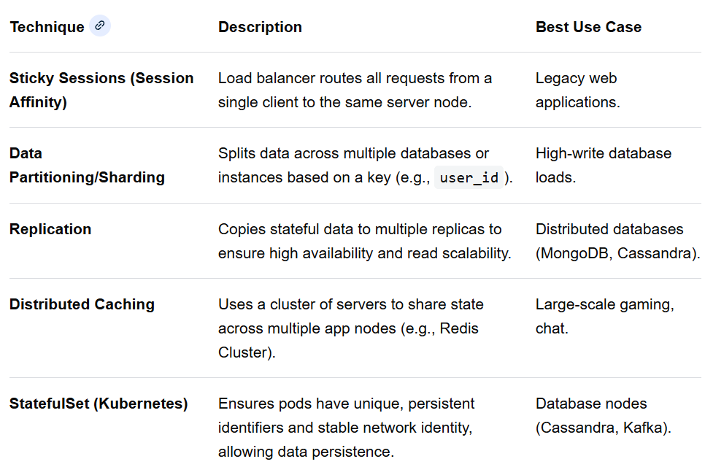
Scalability
Scaling Techniques

Slide 95
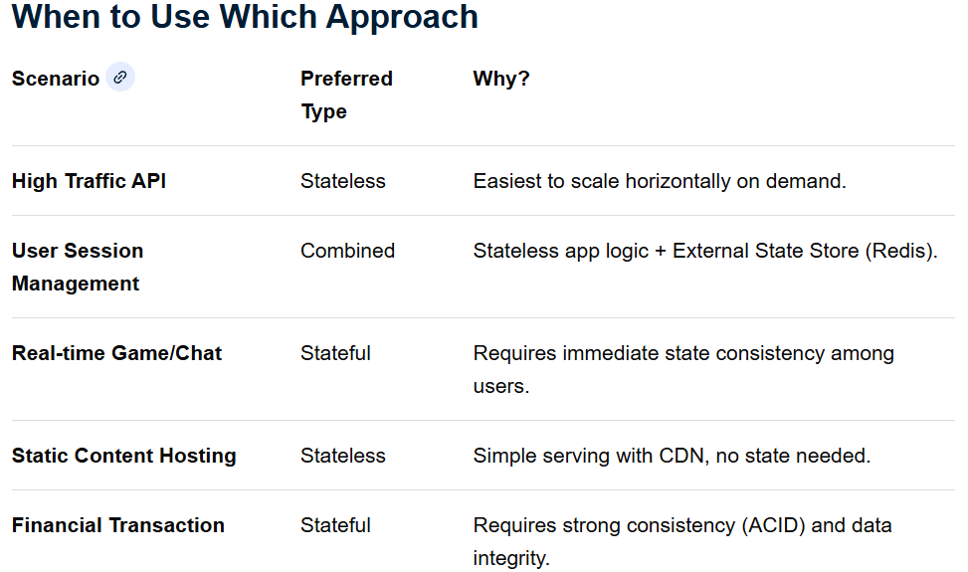
Scalability

Slide 96
Scalability
Summary Checklist for Scalability w.r.t When to use What
Eliminate Local State: Remove all session.setAttribute and local file writes.
Externalize Session: Use Redis for storing user state.
Implement JWT: For stateless authentication.
Use Sharding: If using databases, plan for partitioning early.
Use Load Balancer: Implement Round Robin or Least Connections for routing.

Slide 97
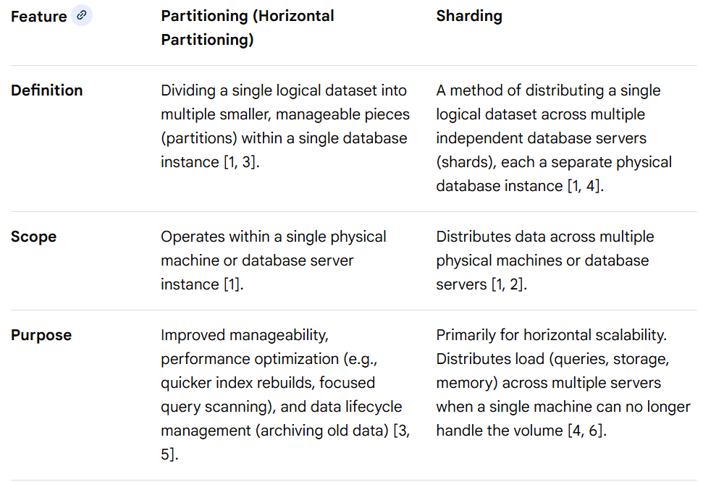
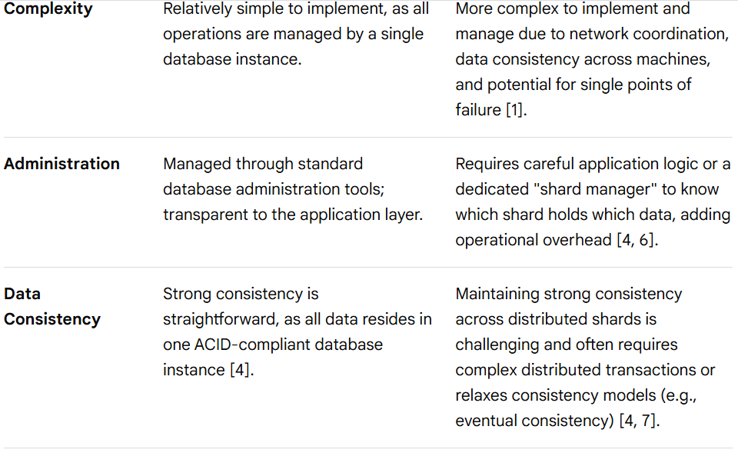
Scalability
Sharding vs Partitioning(needed for Distributed Stateful components[DBs/MQs/Caches etc]) –

Slide 98
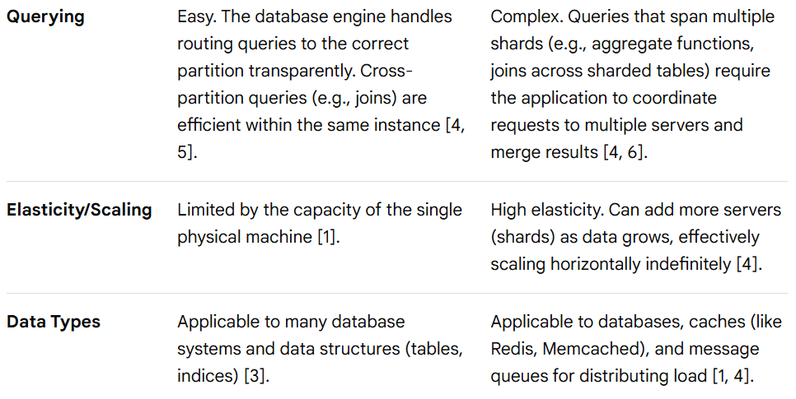
Scalability
Sharding vs Partitioning(needed for Distributed Stateful components[DBs/MQs/Caches etc]) –

Slide 99
Scalability
Considerations for Stateful Components w.r.t Partitioning and Sharding
When choosing between partitioning and sharding for stateful components (like databases or caches), several factors need careful consideration:
1. Choice of Shard/Partitioning Key
The "key" determines how data is distributed. A good key ensures an even distribution of data and query load.
Common strategies include:
Range-based: Data sorted by key values (e.g., all users with IDs 1-1000 on one server). Can lead to "hot spots" if data growth isn't uniform.
Hash-based: Uses a hash function on the key to randomly distribute data. Excellent for load balancing but makes range queries inefficient.
Directory-based: A lookup service (a "shard manager") maps keys to their physical location. Offers flexibility but adds a potential single point of failure.
2. Operational Complexity and Management
Sharding fundamentally introduces the complexities of distributed systems.
Rebalancing: As data grows or servers are added/removed, data often needs to be moved between shards (rebalanced) to maintain an even load. This is a complex operational task in sharded systems.
Failure Modes: Sharding introduces new failure modes. If one partition fails in a non-sharded system, the whole system might be down. In a sharded system, only a fraction might be unavailable, but managing partial outages and data replication becomes crucial.

Slide 100
Scalability
Considerations for Stateful Components w.r.t Partitioning and Sharding
3. Application Architecture Changes
Partitioning is largely transparent to the application code, but sharding almost always requires the application to be aware of the data distribution logic or integrate with a middleware that handles it. The application must know where to read from and write to.
In summary, use partitioning for optimizing performance and manageability within existing hardware limits, and use sharding when you have exhausted the capacity of a single machine and require horizontal scalability to handle massive data volumes or traffic.

Slide 101
Scalability
Data Locality
Data locality in stateful partitioning/sharding refers to the design principle of placing data on the same physical node or in the same geographic region where it is processed,, reducing network latency and improving performance. It is crucial for high-performance, large-scale systems where fetching data from a remote source is too slow.
Core Concepts of Data Locality in Sharding
Locality Principle: By partitioning data into smaller, independent shards based on a specific shard key (e.g., user ID, region), you can ensure all relevant data for a request resides on a single machine.
Geographic Proximity (Geo-Sharding): Data is placed close to the users who access it, reducing round-trip time for applications with global users.
Memory-First Access: When data is local, it can be cached or processed directly from memory, avoiding slow disk I/O.
Benefits of Data Locality
Significantly Lower Latency: Requests do not require multiple network hops to retrieve data.
Reduced Network Congestion: Since data doesn't move across the network to the application, bandwidth usage is lowered.
Improved Throughput: Parallel processing of shards allows for higher volume processing.
Simplified Consistency: Transactions operating on data within a single shard (local) are easier to manage than cross-shard transactions.
Common Implementation Strategies
Geo-based Sharding: Segregating data by geographical location (e.g., European customers on eur_customers shard).

Slide 102
Scalability
Data Locality
Common Implementation Strategies
Hash-Based Sharding: Distributing data uniformly using a hash function to prevent hotspots, while still ensuring the hash-mapped machine contains all necessary data for that user.
Range-Based Sharding: Dividing data by specific, ordered ranges (e.g., date ranges) to keep temporal data together.
Directory-Based Sharding: Using a separate service to map keys to specific shards, allowing for dynamic rebalancing.
Challenges and Considerations
Cross-Shard Operations: If a query needs data from multiple shards, performance drops because of the network overhead to combine the data.
Data Hotspots: Improper shard key selection can lead to one shard handling too much traffic, reducing the benefits of distributed locality.
Rebalancing: As data grows, moving data across nodes while maintaining locality is complex.
Reference Data: Frequently accessed, non-partitioned data may need to be replicated on every node to maintain full locality.

Slide 103
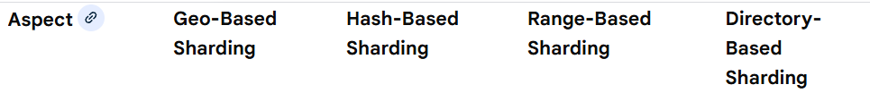
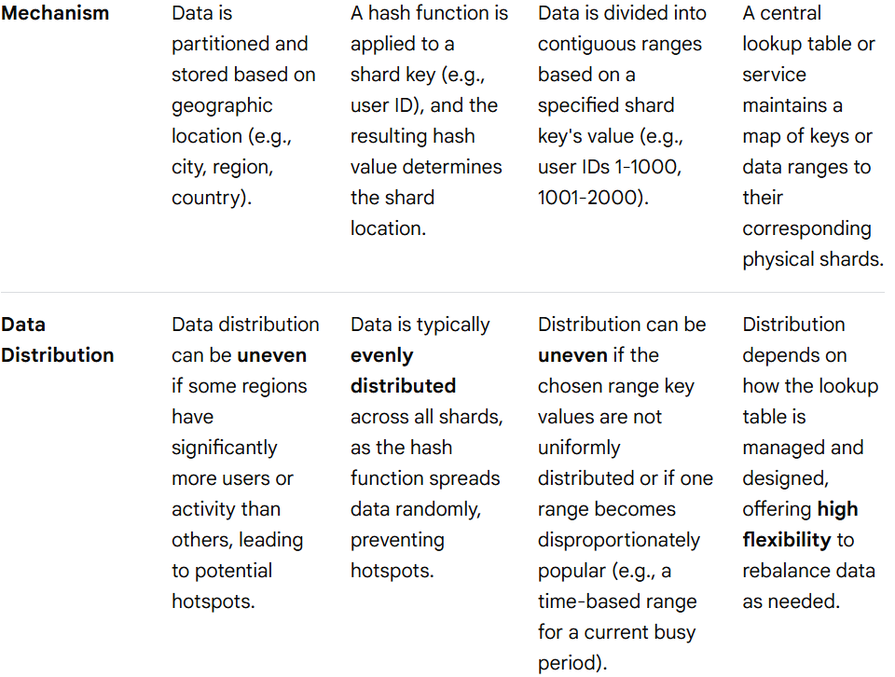
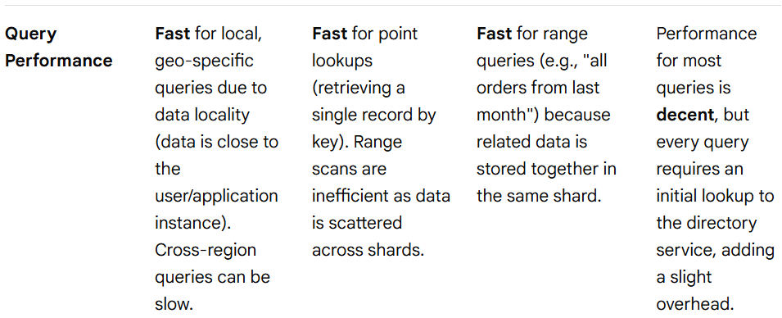
Scalability
Shard/Partitioning Key Strategies comparison

Slide 104
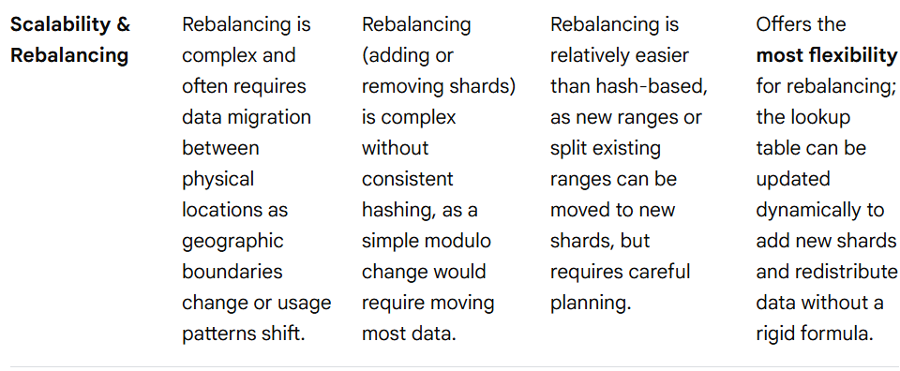
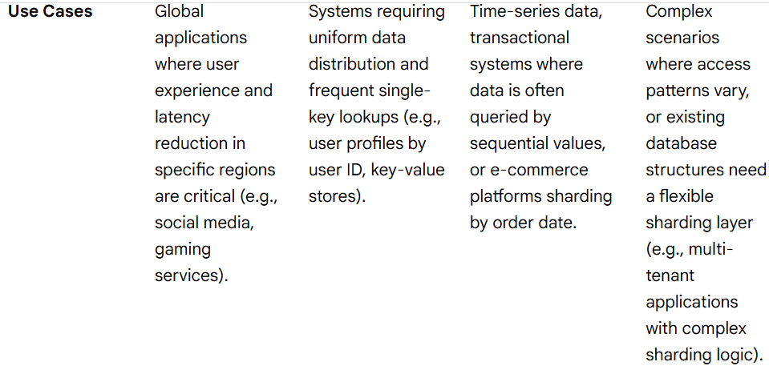
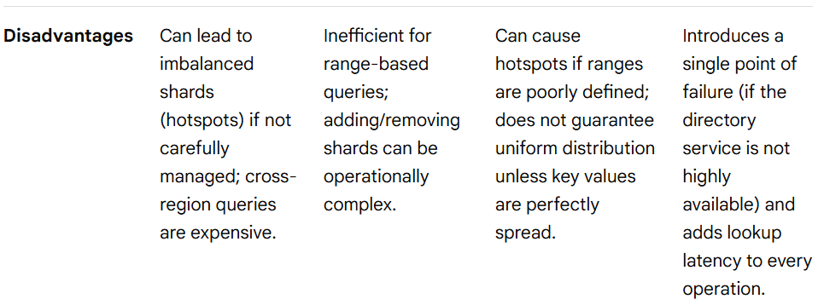
Scalability
Shard/Partitioning Key Strategies comparison

Slide 105
Scalability
Shard/Partitioning Key Strategies Considerations
When sharding stateful components (like a database or a stateful service in Kubernetes), choosing the right strategy is critical as the wrong key can negatively impact performance.
Shard Key Selection: The choice of the shard key is paramount. A bad shard key can lead to data skew and performance bottlenecks, regardless of the method used.
Application Logic: Sharding adds complexity to the application or introduces a middleware layer to route queries correctly. This overhead must be managed.
Data Consistency: Performing joins and transactions across shards is significantly more challenging and requires careful design to maintain data consistency.
Flexibility: Directory-based sharding provides the most flexibility for rebalancing and managing hotspots but introduces a dependency on the directory service. Hash-based sharding offers inherent balance, while range-based sharding optimizes specific query patterns.
N.B, - Apart from Partitioning and Sharding, Retention Based Archival/Removal of data also can indirectly be helpful in scaling stateful components.

Slide 106
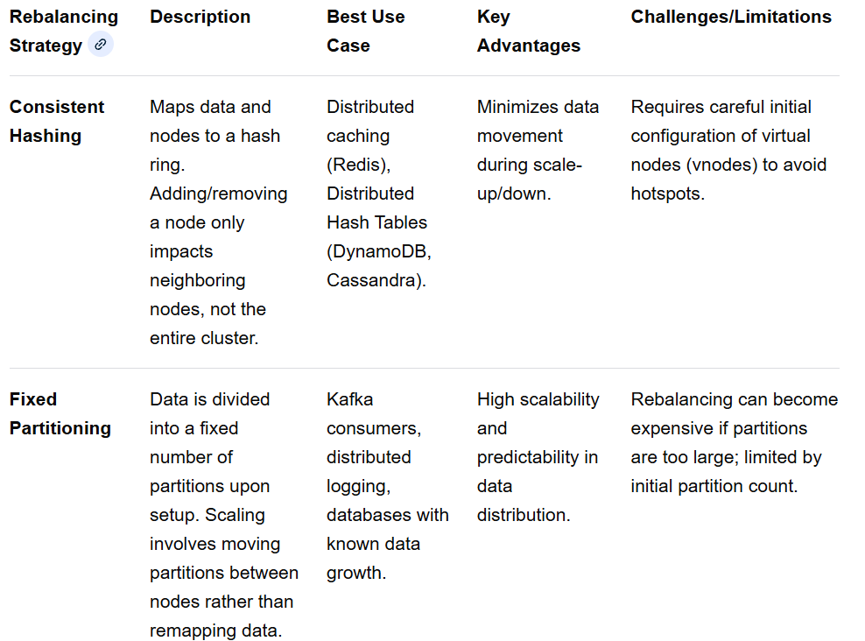
Scalability
Rebalancing
Rebalancing is the process of redistributing data or tasks across nodes in a distributed system to ensure no single node becomes a bottleneck (hotspot) when scaling stateful components. It is essential for ensuring high availability, performance, and scalability in distributed databases, streaming platforms (e.g., Kafka), and stateful applications (e.g., Kubernetes StatefulSets).
Rebalancing Strategies

Slide 107
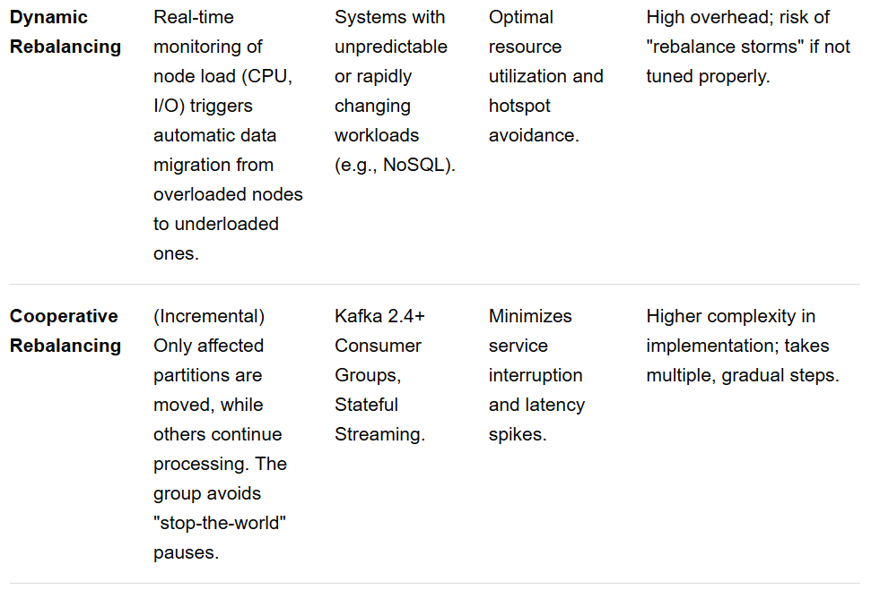
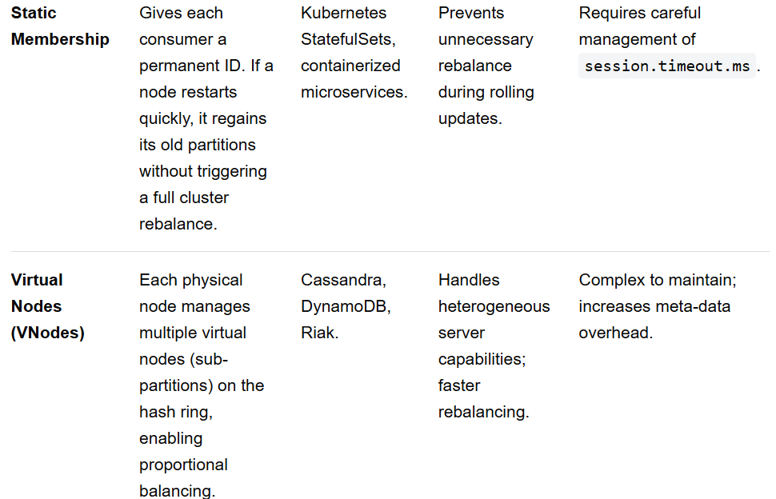
Scalability
Rebalancing Strategies

Slide 108
Scalability
Specific System Rebalancing Techniques
1. Apache Kafka Rebalancing (Streaming/Consumer Groups)
Kafka rebalances to maintain consumer group stability when members join/leave or partition counts change.
Eager Rebalancing (Old): All consumers stop, release all partitions, and wait for new assignments ("stop-the-world").
Cooperative/StickyAssignor (Modern): Partitions are only moved if necessary. The CooperativeStickyAssignor allows consumers to keep processing un-migrated partitions.
Static Membership: Using group.instance.id allows a pod to crash and rejoin, resuming its old partitions without forcing a rebalance of the entire group.
2. Apache Cassandra Rebalancing (Distributed Database)
Cassandra uses a peer-to-peer approach where each node is responsible for a range of data, typically defined by tokens.
VNode (Virtual Node) Rebalancing: When a new node joins, it takes over a small amount of data from many existing nodes to avoid overwhelming one node.
nodetool move: Used to change a node's token range to rebalance the ring.
nodetool drain: Used to gracefully shut down a node, pushing its data to replicas before removing it.
3. Kubernetes StatefulSets (Stateful Apps)
Ordered Scaling: Kubernetes maintains ordinal indices (0, 1, 2) for pods. Scaling up adds pods one by one, enabling state initialization.
Persistent Volume Claims (PVCs): When a pod is rescheduled, it retains its persistent storage, allowing the stateful component to resume immediately without re-synchronizing entire data sets.

Slide 109
Scalability
Key Requirements for Effective Rebalancing
Minimum Data Movement: The algorithm should move the smallest amount of data necessary to restore balance, minimizing network and I/O load.
Availability During Rebalancing: The system must continue to accept reads/writes during data migration.
Graceful Shutdowns: Ensuring consumers close connections properly (e.g., consumer.close()) to avoid premature rebalance triggers.
Monitoring Key Metrics: Track rebalance frequency, time-to-steady-state, and lag to anticipate issues.
Throughput(a concept related to Scalability) – Number of requests(/transactions) served by a (Web/App/DB) server.
Ways to Improve Throughput –
1) Load Balancers & Horizontal Scaling
2) Asynchronous Processing (mainly to increase write throughput)
3) Use Partitioning to increase Write Throughput while use Replication to increase Read Throughput

Slide 110
Scalability
Schema Changes During Rebalancing
Schema changes during data rebalancing involve modifying the structure of databases or distributed systems while data is being redistributed across nodes, partitions, or shards. In modern, distributed systems, this is often handled online (without downtime) to avoid blocking read/write operations, though it can result in temporary performance impacts.
Common Schema Changes During Rebalancing
Column Modifications: Adding or removing columns from existing tables.
Projection/Index Changes: Adding or removing projections or indexes to optimize queries on the new, rebalanced structure.
Partition Manipulation: Splitting, merging, or moving partitions between nodes.
Data Type Adjustments: Changing column types, which may require data re-encoding, as seen in complex migration scenarios.
How Schema Changes Work During Rebalancing
Online/Non-blocking Changes: Databases like CockroachDB use online schema changes, allowing table structures to be updated without stopping the application.
"Expand and Contract" Model: A common approach where the schema is first expanded (new columns added), application code is updated to support both old/new, data is migrated, and finally, the old schema is removed (contracted).
Background Jobs: Many systems, such as Vertica and CockroachDB, execute schema changes as background jobs that can be paused or resumed.
Atomic Updates: Using distributed timestamps or Raft consensus algorithms ensures that all nodes agree on the new schema version, preventing inconsistencies.

Slide 111
Scalability
Schema Changes During Rebalancing
Challenges and Risks
Resource Consumption: Schema changes (like adding an index) during rebalancing can consume high CPU, memory, and I/O, potentially leading to latency spikes if run during peak hours.
Replication Lag: In distributed systems, changes must propagate to all replicas, which can cause temporary inconsistencies.
Table Locking: Some operations, such as adding columns or modifying constraints, might briefly lock tables.
Partial Failures: If a node fails during a schema update, the system must be capable of detecting this and retrying the operation.
Best Practices
Maintain Backward Compatibility: Ensure applications can function with both the old and new schema versions during the transition.
Use Staging Environments: Test changes in an environment that mimics production traffic and data volume.
Avoid Concurrent Changes: It is recommended not to perform multiple schema changes at the same time in production.
Monitor Performance: Track metrics before, during, and after to quickly spot degradation.

Slide 112
Scalability
Scaling Approach in General
Scaling stateful components (databases, cache, session managers) involves managing data consistency while increasing capacity. The progression typically moves from simplifying early growth, to distributing load for high availability, and finally combining approaches for optimal performance and cost. Follow the below order in general to scale a system -
Phase 1: Vertical Scaling (Scale Up)
Objective: Increase capacity with minimal architectural changes.
Monitor Bottlenecks: Use observability tools (Prometheus/Grafana) to identify CPU, memory, or I/O bottlenecks.
Upgrade Hardware: Increase CPU, RAM, or storage size on the existing machine.
Optimize Database Config: Adjust configuration parameters (e.g., buffer pools, cache sizes) to leverage new resources.
Implement Temporary Solutions: Use sticky sessions on the load balancer to keep user state on the server, avoiding complex data synchronization.
Phase 2: Horizontal Scaling (Scale Out)
Objective: Distribute load across multiple nodes, breaking the single-node limitation.
Externalize State: Move session data out of the application memory into a distributed store like Redis, Memcached, or a SQL/NoSQL database.
Implement Database Replication: Setup primary-replica (master-slave) architectures to handle read-heavy workloads.
Implement Database Sharding: Partition data across multiple database instances to distribute write loads (e.g., splitting by user ID).

Slide 113
Scalability
Scaling Approach in General
Phase 2: Horizontal Scaling (Scale Out)
Use StatefulSets (Kubernetes): Use StatefulSets to manage pods, ensuring each has a stable identity, persistent storage (PVC), and network ID.
Set Up Load Balancing: Use a load balancer to distribute traffic across the new instances.
Phase 3: Hybrid/Diagonal Scaling (Combination)
Objective: Balance performance and cost by using vertical scaling for primary nodes and horizontal for read-replicas.
Combine VPA and HPA: Use Kubernetes Vertical Pod Autoscaler (VPA) to optimize the size of individual pods, and Horizontal Pod Autoscaler (HPA) to scale the number of pods.
Use Tiered Storage: Keep hot, critical data on high-performance vertical instances (e.g., NVMe SSDs) and cold data on cheaper, distributed storage.
Database Proxy/Middleware: Implement a middleware (e.g., ProxySQL, Vitess) to route queries intelligently between a large vertical primary and multiple horizontal replicas.
Event Sourcing/CQRS: Implement Command Query Responsibility Segregation (CQRS), where the write-model is scaled vertically for consistency, and read-models are scaled horizontally for speed.
Key Considerations and Best Practices
Consistency vs. Availability: Stateful systems must address the CAP theorem. Use synchronous replication for strict consistency (banking) and asynchronous for speed (social media).
Data Synchronization: When scaling horizontally, use automated tools for data partitioning and synchronization to prevent data loss.
Testing: Perform load testing to simulate traffic spikes and measure latency before fully committing to a hybrid approach.
Automation: Use operators to automate the scaling of stateful applications based on resource usage.

Slide 114
Scalability
Distributed Indexing
Distributed indexes speed up data retrieval in partitioned databases by splitting the index across multiple nodes, allowing parallel searches rather than scanning the entire system. They work by either partitioning index data by key (global) or anchoring them to specific nodes (local), ensuring efficient queries, high availability through replication, and reduced network latency.
Key concepts in how distributed indexes work:
Partitioned Indexing (Sharding): Since data is too large for one machine, the index is split (e.g., using hash or range partitioning) and distributed across nodes.
Global Secondary Index: The index spans all nodes, allowing quick searches without knowing the exact data location, often used in systems like Apache Cassandra.
Local Secondary Index: The index is tied to a specific node, which is faster for writes and avoids cross-node network lookups, as seen in DynamoDB.
Query Process (Scatter-Gather): A query is sent to multiple nodes (scatter), and the results are combined (gather) to provide the final answer, which is crucial for scalability.
Replication for High Availability: To prevent downtime, multiple copies (replicas) of index partitions are maintained across different nodes.
Commonly used with data structures like B-trees, these distributed structures ensure that even as data grows, search performance remains high.
For Further Exploration
How indexes work in Distributed Databases, their trade-offs, and challenges

Slide 115
Scalability
For Further Exploration –
8 Must Strategies for System Scaling | Feed | LinkedIn
7 Must Strategies for DB Scaling | LinkedIn
Art of Scalability
The Art of Capacity Planning, 2nd Edition [Book]
Scalability Rules: 50 Principles for Scaling Web Sites eBook
Web Operations: Keeping the Data On Time
Scaling Pods and Nodes in K8s | Build Intelligent Apps On Azure
Scale applications in Azure Kubernetes Services (AKS) - Azure Kubernetes Service
Performance and scaling best practices for small to medium workloads in AKS
Azure Service Bus - Automatically update messaging units - Azure Service Bus
Microsoft Azure Service Bus quotas and limits - Azure Service Bus (an Azure SB topic/queue/subscription doesn’t allow more than 5K concurrent requests and so topics/queues/subscriptions might have to be [auto]scaled if > 5K concurrent requests needed to be supported or some sort of chunking/batching needs to be there from the publisher end[Sending Large Batches to Azure Service Bus | Mikhail Shilkov – seems even a batch request is considered as a single request but need to test this]).Sometimes Batching can solve timeout issues as well.
Kubernetes Event-driven Autoscaling (KEDA) - Azure Kubernetes Service
KEDA_Related_Query_Answered_By_ChatGPT · GitHub
Autoscaling Survey(Auto-Elastic Scalability Techniques(Reactive Techniques are Rule Based & State of the Art Proactive Techniques are ML based) )
Sharding vs Partitioning: Understanding Database Distribution Methods | DataCamp

Slide 116
Network Partition
A network partition is a failure scenario in distributed systems where connected nodes split into isolated "islands" due to network, hardware, or software failures. Although nodes remain operational, they cannot communicate with others outside their segment, leading to issues like split-brain syndrome (independent, conflicting operations) or data inconsistency.
Key Aspects of Network Partition:
Cause: Often triggered by broken links, congested networks, or malfunctioning switches.
Behavior: Nodes on one side cannot communicate with nodes on another, but might still serve requests within their own group, often resulting in inconsistent data.
CAP Theorem: Under the CAP theorem (Consistency, Availability, Partition Tolerance), systems must choose between consistency and availability during a partition.
Detection: Typically identified via heartbeat messages; if a node stops receiving messages within a timeout, it is declared isolated.
Examples and Impact:
Split-Brain: Two separate parts of a database cluster both accept writes for the same data, leading to conflicting records.
System Impact: Services might become unavailable, or data may become outdated on one side of the partition.
Management Strategies:
Quorum-based approaches: Ensuring only a majority partition can perform writes.
Reconciliation: Reconciling data after connectivity is restored.
N.B. - In Distributed Systems, since we use separate nodes, so practically network partition is unavoidable.

Slide 117
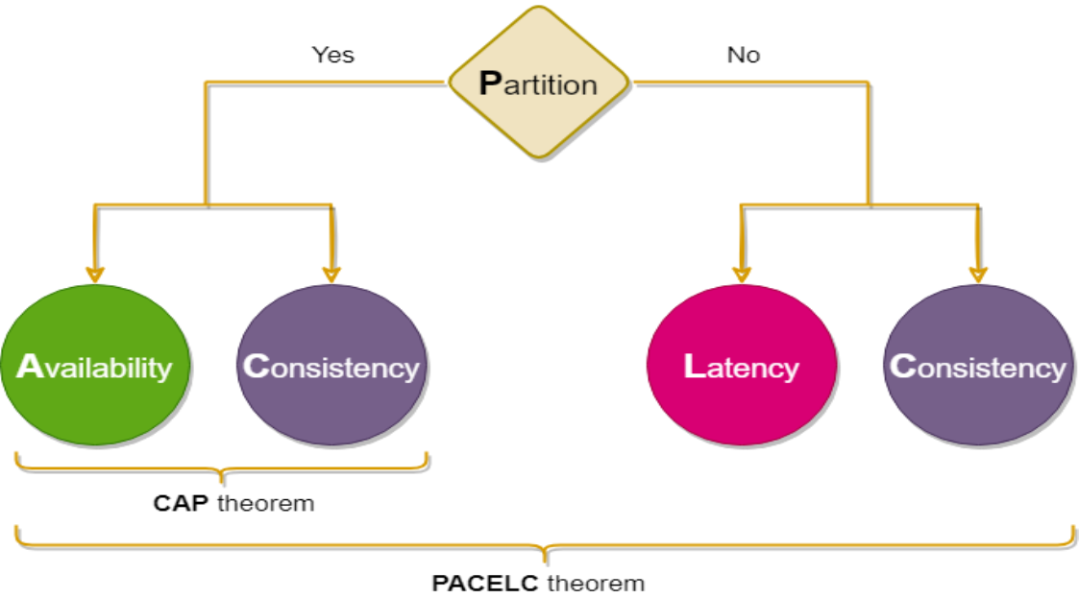
CAP & PACELC Theorems

Slide 118
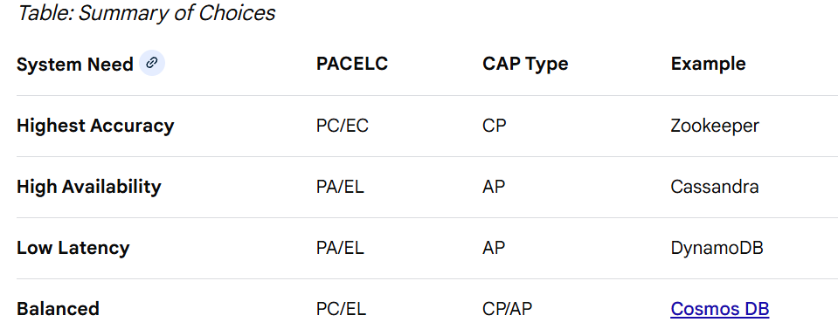
CAP & PACELC Theorems
CAP theorem states distributed systems must choose between Consistency (C) and Availability (A) during a network Partition (P), while PACELC extends this to show that even without partitions (E), systems must trade off Latency (L) for Consistency (C). Systems are generally either CP (Strong consistency) or AP (Eventual consistency) since Network Partition is unavoidable in Distributed Systems.
CAP & PACELC Explained
CAP Theorem (P, A, C): If a network partition occurs (P), you must choose between Consistency (all nodes see the same data) or Availability (all nodes return data).
CP (Consistency + Partition Tolerance): Prioritizes data integrity; rejects requests if nodes cannot sync (e.g., MongoDB, Redis).
AP (Availability + Partition Tolerance): Prioritizes uptime; returns the best available data, allowing temporary inconsistency (e.g., Cassandra, DynamoDB).
PACELC Theorem (P-A-C-E-L-C): If P, choose A or C. Else (E), when the system is running normally, you must choose between Latency (L) and Consistency (C).
PC/EL: During failure, prioritize consistency; else, optimize for low latency (e.g., PNUTS).
PA/EL: During failure, prioritize availability; else, optimize for low latency (e.g., DynamoDB).
Best Practice – For Complex Systems, make the Reads available and writes consistent in general but there can be sometimes exception(s) to this rule

Slide 119
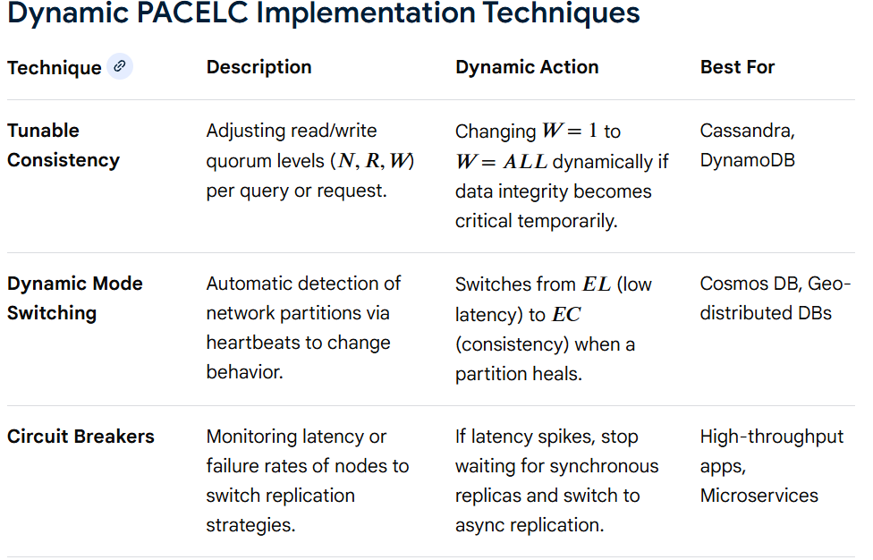
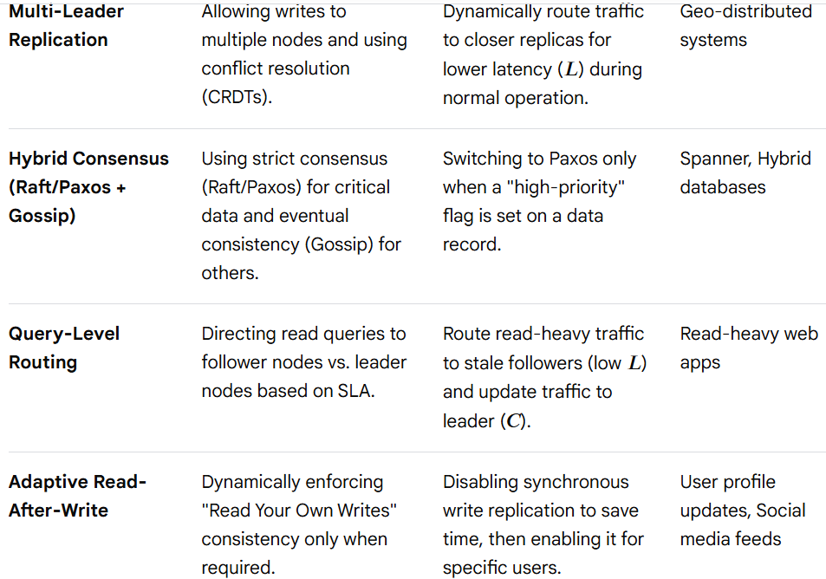
Dynamic PACELC Configuration
The PACELC theorem extends the CAP theorem by defining trade-offs during network partitions (P) between Availability (A) and Consistency (C), and Else (E) when running normally, between Latency (L) and Consistency (C). Dynamic PACELC configuration refers to the ability of a distributed system to adapt these trade-offs at runtime based on network conditions, workload, or business requirements.

Slide 120
Dynamic PACELC Configuration
Breakdown of Dynamic Techniques
Quorum Tuning (Cassandra/DynamoDB): In a PA/EL system, you can dynamically choose to require that all replicas acknowledge a write (making it (PC/EC) temporarily) to ensure strict consistency for financial transactions, then revert to (ANY) or (ONE) for high availability.
Heartbeat-Based Switching (Cosmos DB): Systems can monitor network health. If the network is healthy, they operate in an (EL) mode (low latency). If a partition is detected, they dynamically switch to (PC) mode (aborting writes that would cause inconsistency).
Conflict-Free Replicated Data Types (CRDTs): Used to achieve (PA/EL).The system remains highly available and accepts all writes, using CRDTs to automatically merge data in the background without needing coordination.
Summary of PACELC Configurations
PA/EL: Availability > Consistency (P) & Latency > Consistency (E)
PA/EC: Availability > Consistency (P) & Consistency > Latency (E)
PC/EL: Consistency > Availability (P) & Latency > Consistency (E)
PC/EC: Consistency > Availability (P) & Consistency > Latency (E)
Key Considerations for Implementation Detection Latency:
How quickly the system detects a network partition (P) determines how effectively it can switch to a (PC) mode.
State Transfer Cost: Switching between (EC) and (EL) modes may require heavy data synchronization.
Application Logic: The application must be able to handle temporary inconsistency if the system switches to a lower consistency mode to improve latency.

Slide 121
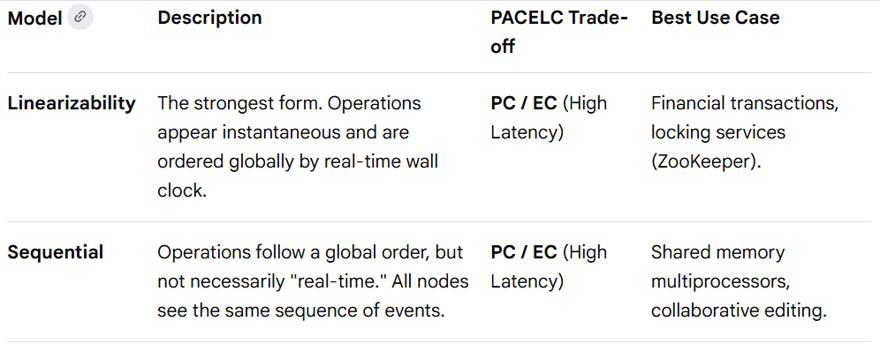
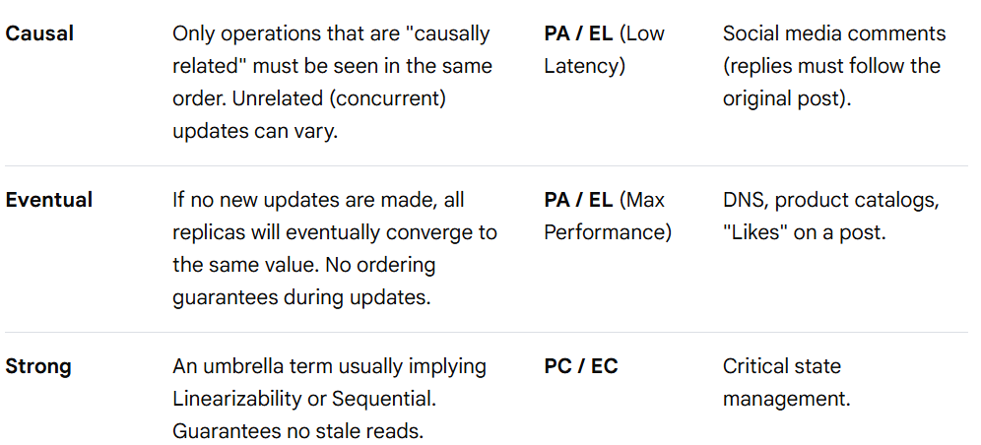
Consistency Models
Consistency models define the guarantees a distributed system offers regarding data visibility and order across multiple nodes. Data-centric models provide system-wide guarantees across all clients, while client-centric models offer guarantees only for a single client's session, which is crucial for systems that prioritize availability and low latency with many replicas.
Data-Centric Consistency Models
These models focus on the internal state of the database and how updates flow between nodes. They provide guarantees about the global order of operations

Slide 122
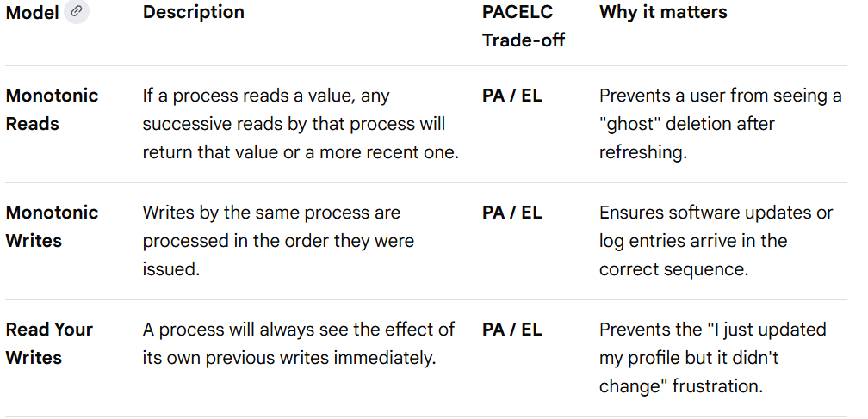
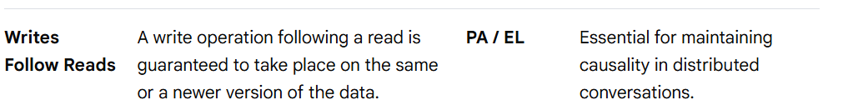
Consistency Models
Client-Centric Consistency Models
These focus on the perceived consistency from the perspective of a single client/session, even if the underlying data-centric model is weak (like Eventual Consistency)

Slide 123
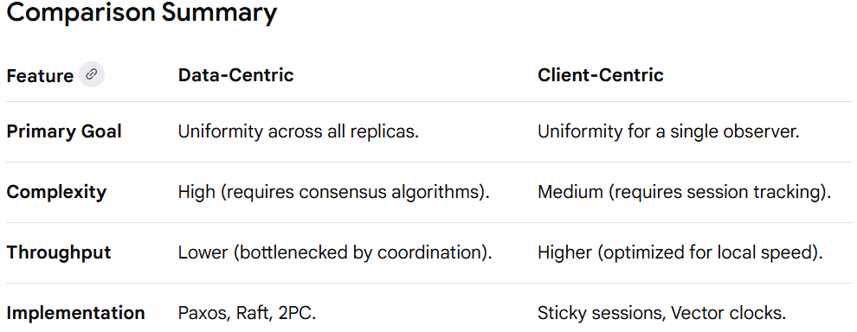
Consistency Models
How to Choose a Consistency Model
Choose Strong/Strict Consistency (CP) if: Data accuracy is paramount, such as financial transactions (banking, stock trading) or the cost of an "out of order" operation is high (e.g., double-spending money) or you are managing distributed locks or leader election or your users are sensitive to "stale" data and are willing to wait an extra 50–100ms for a response etc
Choose Eventual/Weak Consistency (AP) if: Availability and performance are prioritized over immediate accuracy, such as social media feeds, likes, or analytics or high availability is non-negotiable (e.g., an e-commerce checkout button) or low latency is a competitive advantage (e.g., a fast-scrolling social feed) or
you can resolve conflicts later (e.g., using CRDTs or "Last Write Wins") etc.
Choose Tunable Consistency (PACELC) if: You need a flexible system that can be tuned based on the specific query or operation (e.g., Cassandra or Cosmos DB allows tuning on a per-query basis)
Choose Causal/Session Consistency if: You need a balance between performance and user experience (e.g., content management systems).
Key Insight: You can often "fake" a high-consistency experience on an eventual-consistency backend by using Read Your Writes. By pinning a user's session to a specific node or using local caching, the user feels the system is "Strong," even if the rest of the world sees "Eventual."

Slide 124
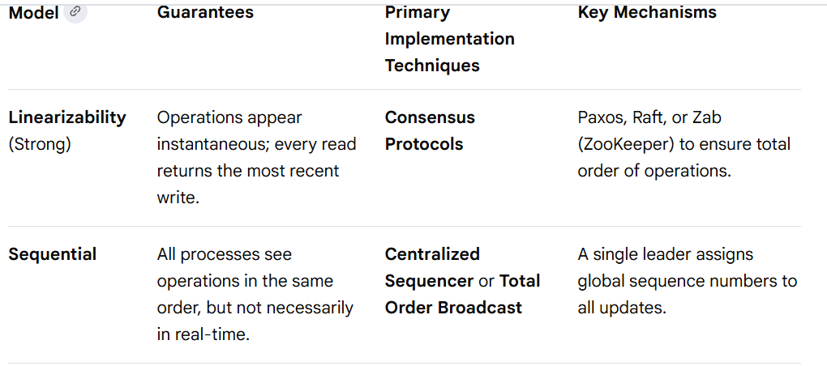

Consistency Models
Implementation Techniques
Data Centric Models

Slide 125


Consistency Models
Implementation Techniques
Client Centric Models
Comparison Summary
Data-centric models are generally harder to implement and scale because they require global coordination (e.g., Paxos or Raft).
Client-centric models are often implemented using Sessions to manage read/write sets, reducing overhead by only enforcing consistency for a single user's history.

Slide 126
Replication
Replication in distributed systems is the process of storing copies of the same data across multiple, independent nodes (computers or servers). It is essential for enhancing system availability (ensuring access even during node failures), increasing performance (reducing latency and boosting read throughput), and providing fault tolerance.
Why We Need Replication:
High Availability: If one server crashes, the system remains operational by directing traffic to another replica, avoiding downtime.
Low Latency: Data can be placed geographically closer to users, reducing the time required to retrieve information.
Improved Scalability & Read Performance: Heavy read loads can be distributed across multiple replicas, increasing overall read throughput.
Durability: Maintaining multiple copies prevents data loss, as data is not relying on a single, faulty hardware node.
Disaster Recovery: Keeping replicas in different, physically separated locations protects against complete data center failures.
Common replication strategies include single-leader, multi-leader, and leaderless (peer-to-peer) replication.

Slide 127

Replication(As Scaling Strategy)

Slide 128

Replication(As Scaling Strategy)
Web Stateful Replication –

Slide 129

Replication(As Scaling Strategy)
Web/Service Stateless Replication –

Slide 130

Replication(As Scaling Strategy)
DB Replication –

Slide 131

Replication(As Scaling Strategy)
DB Replication contd … –

Slide 132

Replication
Replication Strategies
Architectural Replication Strategies

Slide 133

Replication
Replication Strategies
Synchronization Replication Strategies

Slide 134

Replication
Replication Strategies
Data Transfer & Update Strategies

Slide 135

Replication
Replication Strategies
Advanced & Operational Strategies

Slide 136
Replication
Replication Strategies
Summary of Key Trade-offs (CAP Theorem Framework)
For Strong Consistency: Use Single-Leader + Synchronous Replication.
For High Availability: Use Leaderless + Asynchronous Replication (with Quorums).
For Multi-Region Writes: Use Multi-Leader Replication.
For Low Latency Reads: Use Full Replication with Many Followers.
Leaderless Replication – A bit more in Depth
In distributed systems (particularly Dynamo-style leaderless architectures like Cassandra or DynamoDB), ensuring all replicas of data are consistent requires multiple mechanisms working together.
Quorum-based replication handles the consistency during the read/write request.
Read Repair fixes inconsistencies during a read operation.
Anti-Entropy (via Merkle trees) fixes inconsistencies in the background.
Gossip Protocol spreads membership, state, and schema info across the network to enable the other processes.

Slide 137



Replication
Leaderless Replication – A bit more in Depth

Slide 138
Replication
Leaderless Replication – A bit more in Depth
Breakdown
1. Read Repair
How it works: When a client reads a key, the coordinator node reads from (R) replicas. If the versions differ (using timestamp or vector clocks), the coordinator writes the newest version back to the stale nodes.
Pros: Immediate consistency for frequently read data.
Cons: If data is never read, it is never repaired.
2. Anti-Entropy (using Merkle Trees)
How it works: Because comparing full datasets is expensive, nodes compute Merkle trees—a hash-based tree structure. Replicas exchange top-level hashes. If they match, data is synchronized. If not, they descend the tree to find exactly which row differs.
Pros: Ensures all data, including rarely accessed data, eventually converges.
Cons: High I/O and network usage; usually run during low-traffic times.
3. Gossip Protocol
How it works: Nodes periodically choose a random peer and exchange state information (e.g., "Node A is alive," "Table X schema is version 5"). Within a few cycles, all nodes know the state of the entire cluster.
Usage: Used for node discovery, failure detection, and schema distribution, not usually for the data itself, but for metadata about the data.
4. Quorum-Based Replication (N, R, W)
N: Number of replicas (replication factor).
W: Minimum nodes that must acknowledge a write to succeed.
R: Minimum nodes that must respond to a read to succeed.

Slide 139
Replication
Leaderless Replication – A bit more in Depth
Breakdown
4. Quorum-Based Replication (N, R, W)
Consistency Model:If (W+R>N), you achieve strong consistency (similar to a majority quorum).If (W+R<=N), you get eventual consistency.
Sloppy Quorum: In a partition, nodes might write to different nodes than they usually would ("hinted handoff"), then sync when the network heals.
Summary of Differences
Read Repair vs. Anti-Entropy: Read Repair is reactive (on read), Anti-Entropy is proactive (background).
Gossip vs. Others: Gossip is for membership/state; the others are for data consistency.
Quorum vs. Others: Quorum defines immediate consistency rules; the others define eventual consistency mechanisms.

Slide 140
Replication
Conflict Resolution
Conflict resolution in distributed systems is the process of reconciling inconsistent data versions across multiple nodes when they accept conflicting updates simultaneously, often due to network partitions or asynchronous replication. It ensures data integrity and consistency by determining the final, valid state using methods like Last-Write-Wins (LWW), version vectors, or CRDTs.
Why We Need Conflict Resolution
Data Consistency: Distributed systems (e.g., databases) often store replicas on different nodes to improve performance and availability. Conflict resolution ensures that all nodes eventually converge to the same data state.
Concurrent Updates: In distributed systems, users can update the same data item on different nodes at the same time. Without resolution, these conflicting updates lead to data divergence.
Network Partitions: If a network failure separates nodes, they may both update the same record. When the connection restores, the system must decide which update takes precedence.
Preventing Data Loss: Without proper resolution (e.g., using naive strategies), some updates might be incorrectly overwritten and lost

Slide 141


Replication
Conflict Resolution Techniques

Slide 142

Replication
Conflict Resolution Techniques

Slide 143
Replication
Classification of Techniques
Based on Timing:
On-Write (Proactive): Conflicts are detected and resolved immediately at the time of writing (e.g., Quorum, Conditional Writes).
On-Read (Reactive): Conflicts are accepted silently and detected/resolved only when data is read (e.g., LWW with Vector Clocks).
Based on Approach:
Automatic (Deterministic): System automatically resolves conflicts without human intervention (e.g., CRDTs, LWW).
Manual: Human intervention is required.
Key Considerations for Choosing a Technique
Consistency vs. Availability: If high availability is needed (AP in CAP theorem), use CRDTs or LWW. If strong consistency is needed (CP), use Quorum/Consensus.
Data Structure Type: Simple types (e.g., counters) work well with CRDTs, while complex, non-commutative data requires custom logic or Version Vectors.
Clock Accuracy: LWW depends heavily on synchronized clocks; if clocks drift, data loss can occur. Vector Clocks are safer in distributed systems.

Slide 144

Replication
Distributed Database Schema Evolution
Distributed databases handle schema evolution through a combination of backward/forward compatibility, a lack of rigid schema enforcement (in the case of NoSQL), and coordinated updates using mechanisms like schema registries, versioning, and online migration tools.
Techniques

Slide 145


Replication
Distributed Database Schema Evolution
Techniques

Slide 146

Replication
Distributed Database Schema Evolution
Techniques
Best Practices
Plan non-breaking changes first: Prioritize changes that are backward compatible, such as adding nullable columns, before implementing breaking changes.
Version control everything: Treat your schema changes like code changes, using version control and clear documentation.
Automate and test: Use automated tools to apply migrations and rigorously test all changes in a staging environment that mirrors production.
Have a rollback plan: Always have a clear, tested contingency plan to revert changes in case of issues.

Slide 147
Replication
Distributed Database Schema Evolution
Expand/Contract Pattern
The expand/contract pattern is a phased approach to database schema changes that ensures zero-downtime rolling migrations by maintaining backward compatibility at each step. It involves a temporary "dual read-write" state where both the old and new schema elements coexist and are used in parallel, allowing the system to remain online during the transition.
The Expand/Contract Process with Dual Read-Write Logic
The process is broken down into several independent, reversible steps, allowing for a safe, incremental rollout.
Phase 1: Expand
Design and Deploy New Schema Elements: Introduce the new schema elements (e.g., new columns, tables, or indexes) alongside the original ones. The new elements should not have constraints (like NOT NULL) that would break the existing application code.
Modify Application Code for Dual Writes: Update the application code to write to both the old and the new data structures simultaneously. The application still reads data exclusively from the original structure, ensuring that the external behavior remains unchanged and all existing data remains the source of truth.
Backfill Existing Data: Run a background migration script to copy and transform existing data from the old schema to the new schema. This process should be designed to handle potential race conditions if the application is also writing to the same records, possibly using conditional logic or triggers.
Phase 2: Transition (Dual Read-Write State)
Modify Application Code for Dual Reads and New Writes:
The application continues to write to both structures.
The application's read operations are switched to read from the new schema.

Slide 148
Replication
Distributed Database Schema Evolution
Expand/Contract Pattern
The Expand/Contract Process with Dual Read-Write Logic
Phase 2: Transition (Dual Read-Write State)
Modify Application Code for Dual Reads and New Writes:
During this period, both old and new application versions can run in parallel (using feature flags for controlled rollouts can help manage this). The new version reads from the new schema while the old version reads from the old.
Test and Validate: The system runs in a production environment with the new schema as the source of truth for reads. This is an opportunity to test the new structure's functionality and performance with live traffic.
Phase 3: Contract
Discontinue Writes to the Original Structure: Once the new schema is validated and considered stable, update the application code to stop writing to the old data structure. All data access (reads and writes) now exclusively uses the new schema.
Remove the Original Structure: After confirming that no part of the system is using the old schema elements (typically after a "confidence window" to ensure no rollbacks are needed), the original tables, columns, or other elements can be safely removed from the database.
Key Benefits
Zero Downtime: The application remains available and functional throughout the entire process.
Backward Compatibility: Each step maintains compatibility with the previous application version, allowing for independent deployment of schema and code changes.

Slide 149
Replication
Distributed Database Schema Evolution
Expand/Contract Pattern
Key Benefits
Easy Rollback: Most steps allow for a safe and easy rollback; if an issue arises, you can revert the code to an earlier version that uses the existing (still-present) schema.
Incremental Risk Mitigation: Breaking a large, risky change into smaller, manageable steps reduces the overall risk of a migration failure.
For Further Exploration
Chain replication : how to build an effective KV-storage (part 1/2)
System Design Concepts: Dynamo
Conflict Resolution Strategies for Distributed Systems: When Two Truths Collide
A Look at CRDT
Conflict-free replicated data type - Wikipedia
Distributed Data • Akka core
Operational-Transformation/ot.js(How Text Editors handle Conflict Resolution)

Slide 150


Distributed Transaction

Slide 151


Distributed Transaction
Distributed transaction management requires balancing consistency, availability, and performance. 2PC/3PC provide strict ACID compliance with higher blocking risk, whereas Saga and TCC prioritize eventual consistency and high availability. The Transactional Outbox pattern ensures reliable event publishing, serving as a foundational component for Saga in microservices, ensuring local database updates and messaging are atomic.

Slide 152


Distributed Transaction
Pattern Deep Dive
2PC (Two-Phase Commit): A "voting" protocol. A central coordinator asks all participants if they can commit. If all say yes, it sends a commit signal.
Main Flaw: If the coordinator fails during the process, participants stay blocked, holding locks indefinitely.
3PC (Three-Phase Commit): Adds a "Pre-Commit" phase. This creates a timeout mechanism. If a participant doesn't hear back, it can safely assume a state based on its current phase, reducing the blocking problem of 2PC.
Saga Pattern: Splits one large transaction into a sequence of small local ACID transactions. If step 3 fails, it executes "compensating" transactions for steps 1 and 2 (e.g., if "Charge Card" succeeds but "Book Flight" fails, Saga triggers "Refund Card").

Slide 153
Distributed Transaction
Pattern Breakdown
TCC (Try-Confirm-Cancel): A business-level version of 2PC. The "Try" phase doesn't just lock rows; it reserves resources (e.g., deducting inventory into a "pending" bucket). This prevents blocking other users while ensuring the final "Confirm" will succeed. It "reserves" resources (Try) and then confirms or cancels them, ensuring eventual
consistency without long-term locks.
Transactional Outbox: Solves the "dual write" problem where you update a database and send a message. You save the message in an "Outbox" table in the same DB transaction as your data update. A separate process then polls
this table and pushes messages to your broker (e.g., Kafka).
Selection Guide
Use 2PC/3PC for scenarios needing immediate, strict consistency across traditional relational databases.
Use Saga for complex, long-running, asynchronous microservice transactions.
Use TCC for high-contention scenarios requiring reservation logic (e.g., booking engines).
Use Transactional Outbox in any system needing to guarantee message delivery alongwith a database update.

Slide 154


Distributed Transaction
Synchronous Transaction using 2PC(/3PC) -

Slide 155

Distributed Transaction
Synchronous Transaction using TCC(Try-Confirm-Cancel)
For Further Exploration
Try-Confirm/Cancel Transaction Protocol

Slide 156

Distributed Transaction
Asynchronous Transactions Using Saga Pattern – Handling Cancelation or Failures using Compensating Transactions -

Slide 157

Distributed Transaction
Asynchronous Transaction Using Transactional Outbox Pattern
Solves dual write problem e.g. order business entity and orderCreated event to be saved in Data Table and Outbox table respectively in an atomic transaction below & then Outbox Processor[a background service] polls Outbox Table and sends the event to downstream systems via Service Bus Topic & then marks the record from outbox table so that events remain in outbox table for further replay if required

Slide 158
Distributed Transaction
For Further Exploration -
An Example of Synchronous Transaction using single DB 2PC Approach(i.e. in a Non-Distributed way using MS-DTC that needs to be enabled for this, in windows based machines) –
DDD-Based-Enterprise-Application-Framework/Infrastructure/UnitOfWork/UnitOfWork.cs at master · sandipray63in/DDD-Based-Enterprise-Application-Framework · GitHub (check the commit and commitAsync methods).
N.B. - Always wrap Synchronous Transactions using UnitOfWork Pattern.
ACID vs BASE –
What are the differences and similarities between ACID and BASE properties of database transactions?
ACID vs BASE: Database transactions – System Design
2PC/3PC Transactions –
Dealing Distributed Transactions with 2PC, 3PC, Local Transaction Table with MQs
Flat & Nested Distributed Transactions – GeeksforGeeks
Asynchronous Transactions using Outbox and Saga Pattern –
Outbox(& Inbox) Pattern – Pattern: Transactional outbox
Saga Pattern - Pattern: Saga
Microservices Data Consistency - transaction-manager-for-microservices.pdf

Slide 159

Availability, Reliability & Fault Tolerance
Availability, Reliability, and Fault Tolerance are core pillars of system design, often confused but serving distinct purposes.
Reliability focuses on the frequency of failures (consistency).
Availability focuses on the percentage of time a system is functional (uptime).
Fault Tolerance focuses on maintaining operations despite failures (continuity).
Comparison

Slide 160

Availability, Reliability & Fault Tolerance
Comparison
Breakdown
1. Reliability (Consistency)
Reliability is concerned with how consistently a system performs its required function without failure over a specified period. A highly reliable system is trustworthy.
Metric: Mean Time Between Failures (MTBF). A higher MTBF means the system fails less often.
Focus: Prevention of failures through high-quality design, testing, and durable components.
Example: A medical device that must work perfectly for 24 hours without crashing.

Slide 161
Availability, Reliability & Fault Tolerance
Breakdown
2. Availability (Uptime)
Availability measures the percentage of time a system is operational, accessible, and ready to serve requests. It factors in both reliability and how quickly a system can be repaired (maintainability).
Metric: Uptime % (99.9% = "three nines", 99.999% = "five nines").
Focus: Minimizing downtime, even if it requires a short interruption for failover.
Example: An e-commerce website that might experience a few seconds of downtime while load balancers switch to a backup server.
3. Fault Tolerance (Continuity)
Fault Tolerance is the ability of a system to continue operating properly in the presence of one or more component failures. It provides zero downtime because the system masks the failure.
Metric: Zero downtime / Continuous operation.
Focus: Eliminating single points of failure by running redundant components in parallel.
Example: A banking transaction system or airplane control system that must never stop, even if a server fails instantly.
Key Relationships
Reliability affects Availability: Highly reliable systems naturally have higher availability because they fail less often.
Fault Tolerance creates Availability: Fault-tolerant systems are inherently highly available, but not all highly available systems are fault-tolerant.
Trade-off: Fault tolerance is generally much more expensive and complex to implement than simple high availability.

Slide 162
Availability, Reliability & Fault Tolerance
For Further Exploration
High Availability vs Fault Tolerance: A Comparative Guide
Availability vs Durability vs Reliability vs Resilience

Slide 163
Availability – A Bit more in Detail
Total System Availability – How to measure?
System Reliability and Availability
Calculating Total System Availability
How to Calculate System Availability: Definition and Measurement
Health Checks – /health(/error) endpoints using httpHead(/httpGet) verbs. AP/BackgroundServices Health checks can be strong indicator of API/BackgroundServices Availability since Availability can be calculated as ratio of successful health checks to the total number of health checks performed over a specific period. Although MTTD + MTTR + MTTF can give a much better picture about Availability but its not a trivial task to calculate MTTD, MTTR & MTTF from health checks.(check next 2 slides)
Liveness vs Readiness –
Liveness: Used to check if the app is available and alive.
Readiness: Used to check if the application is ready to be used and serve the traffic.
Normally the readiness check is only performed when an application has just been started, to make sure the load balancer or orchestrator can start directing the traffic. After the Application becomes ready, only then liveness check is performed. Typically, while a Liveness probe would return Healthy or UnHealthy, the Readiness probe could return Degraded if the application is not ready to process requests yet.
For Further Exploration –
Health checks with ASP.NET Core and Kubernetes - David Guida
High availability for multitier AKS applications - Azure Architecture Center | Microsoft Learn
Performing a health check in .NET Core Worker Service - Stack Overflow

Slide 164
Availability – A Bit more in Detail
Calculating MTTD, MTTR & MTTF from Health checks -
It is possible to calculate MTTD, MTTR, and MTTF using data from health checks. These metrics are all derived from tracking the time between events related to system failures and their resolution. Health checks can provide the necessary data points for these calculations.
Explanation:
MTTD (Mean Time to Detect):
Health checks can be configured to monitor system health and trigger alerts when issues arise. By logging the time of the issue detection (from the health check alert) and the time of the actual incident occurrence (if it can be determined), you can calculate the time it took to detect the issue (MTTD).
MTTR (Mean Time to Repair/Resolution):
Health checks can also be part of the resolution process. They can be used to verify when a system or service has been restored to a healthy state after an issue is resolved. By measuring the time from detection to resolution (including any repair or remediation actions) based on health check data, you can calculate MTTR.
MTTF (Mean Time to Failure):
This metric is typically used for non-repairable systems, but health checks can be used to track the time until a system or component reaches a point where it needs to be replaced. By monitoring the system's health and logging the time of failures, you can determine the average time to failure for that component.

Slide 165
Availability – A Bit more in Detail
Calculating MTTD, MTTR & MTTF from Health checks
How Health Checks Enable the Calculations:
Automated Detection:
Health checks automate the detection of issues, providing a timestamp for when the problem was recognized.
Automated Verification:
Health checks can also automatically verify if a problem has been resolved, providing a timestamp for the resolution.
Data Logging:
By logging all health check data, including timestamps of incidents and resolutions, you have the necessary data points for calculating MTTD, MTTR, and MTTF.
In essence, health checks serve as a reliable source of data for tracking the key metrics of incident management and system reliability.
Redundancy
Redundancy is introduced in a system to avoid Single Point of Failure.
Redundancy Types –
Active Redundancy
All nodes do the processing
Ideal for Highest Availability

Slide 166
Availability – A Bit more in Detail
Redundancy
Redundancy Types –
Passive Redundancy
Only Active nodes do the processing
Ideal for quick Recovery
Cold Redundancy
Spare Nodes are brought up only on failover
Not for High Availability. Good for things like BackUp etc.
Stateless Components Redundancy(SlCR) –
- APIs/Services are in general stateless components
- Similar to Stateless Replication
- But need to have servers for availability requirements on top of scalability requirements.
- Kind of Active - Active always
Stateful Components Redundancy(SfCR) –
- DBs, Cache, MQs, Static Content Servers are stateful components.
- Again, similar to Stateful Replication
- In case of DBs, the redundant server is more of a Backup rather than a replica & Master Slave Architecture is mainly used(mainly async).
- For other stateful components, mainly Master-Master Architecture is used(mainly in async mode)

Slide 167

Availability – A Bit more in Detail
DR(Disaster Recovery) –
Difference between Business Continuity & DR is that Business Continuity is continuing the business on some parts of the system failure but DR is more of accommodating to situations after total system failure.
DR should be done not only for data but also for code & Infra.
Code – DR can be done using Distributed Version Control Systems.
Infra – Quick Recovery can be done using IaC.
RTO & RPO –
RTO(Recovery Time Objective) – How much time does it take to recover from a failure? DR techniques for code & infra(alongwith Data) improves this.
RPO(Recovery Point Objective) – How much & how frequently data/code/infra should be backed up so that on failure we can atleast use the Backup?

Slide 168


Availability – A Bit more in Detail
DR(Disaster Recovery) –
For Further Exploration –
Disaster recovery options in the cloud
Enterprise-scale disaster recovery
The ultimate guide to achieving RPO/RTO

Slide 169
Availability – A Bit more in Detail
Availability Tiers
“Availability tiers” typically describe levels of system uptime, resilience, and fault tolerance offered by infrastructure, cloud providers, or distributed systems. They are usually expressed in terms of SLA (Service Level Agreement) percentages and architectural guarantees.
🔹 Tier 0 – Best Effort (No SLA)
No formal uptime guarantee
Single server / single availability zone
Manual backups (if any)
Downtime expected during failures or maintenance
Typical use cases:
Dev/test environments
Internal tools
Prototypes
🔹 Tier 1 – Basic Availability (99% – 99.5%)
Single-region deployment
Basic monitoring
Manual recovery
Some backup mechanism
Downtime per year:
99% → ~3.65 days
99.5% → ~1.83 days

Slide 170
Availability – A Bit more in Detail
Availability Tiers
🔹 Tier 1 – Basic Availability (99% – 99.5%)
Use cases:
Small business websites
Non-critical SaaS features
🔹 Tier 2 – High Availability (99.9% – 99.95%)
Multi-instance deployment
Load balancer
Auto-restart on failure
Data replication
Possibly multi-AZ within one region
Downtime per year:
99.9% → ~8.76 hours
99.95% → ~4.38 hours
Use cases:
Production SaaS apps
E-commerce platforms
APIs with moderate SLAs
🔹 Tier 3 – Mission Critical (99.99%)
Multi-AZ architecture
Automatic failover
Database replication (sync/async)

Slide 171
Availability – A Bit more in Detail
Availability Tiers
🔹 Tier 3 – Mission Critical (99.99%)
Health checks & autoscaling
Disaster recovery plan
Downtime per year:
~52.6 minutes
Use cases:
Financial systems
Healthcare platforms
Large-scale SaaS
🔹 Tier 4 – Ultra High / Fault Tolerant (99.999% – Five 9s)
Multi-region active-active
Zero single point of failure
Automated failover
Continuous replication
Chaos testing
Blue/green or canary deployments
Downtime per year:
~5.26 minutes
Use cases:
Global payment systems
Stock exchanges
Critical infrastructure

Slide 172
Availability – A Bit more in Detail
Availability Tiers
📊 Availability Percentage Comparison
SLA Downtime/Year Downtime/Month
99% 3.65 days 7.2 hours
99.9% 8.76 hours 43.8 min
99.99% 52.6 min 4.38 min
99.999% 5.26 min 26 sec
🔹 Cloud Provider Availability Examples
☁️ Multi-AZ Example – Amazon Web Services
Availability Zone (AZ): Isolated data center within a region
Multi-AZ = protection from data center failure
Multi-Region = protection from regional disaster
☁️ High Availability on Microsoft Azure
Region pairs for disaster recovery
Zone-redundant services
Geo-redundant storage
☁️ Global HA on Google Cloud Platform
Global load balancing
Multi-regional managed databases
Cross-region replication

Slide 173
Availability – A Bit more in Detail
Availability Tiers
🔹 Technical Dimensions Behind Availability Tiers
Availability tiers are determined by:
1️⃣ Redundancy Level
Single node
Multi-node
Multi-AZ
Multi-region
2️⃣ Data Strategy
No replication
Asynchronous replication
Synchronous replication
Distributed consensus (Raft/Paxos)
3️⃣ Recovery Metrics
RTO (Recovery Time Objective)
RPO (Recovery Point Objective)
4️⃣ Deployment Model
Active-passive
Active-active
Blue/green
Canary

Slide 174
Availability – A Bit more in Detail
Availability Tiers
🔹 Cost vs Availability Tradeoff
Availability increases non-linearly in cost:
99% → cheap
99.9% → moderate
99.99% → expensive
99.999% → extremely expensive
Each extra “9” dramatically increases:
Infrastructure cost
Operational complexity
Engineering overhead
🔹 Enterprise Data Center Tiering (Different Meaning)
Do not confuse with Uptime Institute Data Center Tiers:
TierDescriptionTier IBasic capacityTier IIRedundant componentsTier IIIConcurrent maintainabilityTier IVFault tolerant
This refers to physical data center infrastructure, not application SLA.
🔹 Summary
Availability tiers generally progress like:
Single Server → Redundant Nodes → Multi-AZ → Multi-Region → Active-Active Global
Each tier adds:
More redundancy
Lower RTO/RPO
Higher cost
More operational complexity

Slide 175
Availability – A Bit more in Detail
Availability Tiers
Implementation Roadmap
1. Low Availability Tier (Tier I & II)
Target: Low cost, non-critical services (e.g., internal staging, basic website).
Implementation: Single server instance, minimal or no redundant backups.
Detailed Steps:
Infrastructure: Single virtual machine, single load balancer.
Data: Basic data backups (snapshot daily).
Network: Single Internet Service Provider (ISP).
Maintenance: Requires scheduled downtime.
2. Medium Availability Tier (Tier III)
Target: Production applications, customer-facing portals, medium e-commerce.
Implementation: Redundant components (N+1) ensuring concurrent maintainability (repairs without taking it offline).
Detailed Steps:
Infrastructure: Multiple web/app servers behind a load balancer (Active-Passive or Active-Active).
Data: Clustered databases (e.g., Master-Slave) with synchronous replication.
Network: Multiple, diverse paths for power and network connectivity.
Maintenance: Components can be removed or repaired without interrupting operations.
3. High Availability Tier (Tier IV)
Target: Mission-critical, financial, large-scale SaaS, healthcare.
Implementation: Fault-tolerant infrastructure (2N or 2N+1) with automatic failover.

Slide 176

Availability – A Bit more in Detail
Availability Tiers
Implementation Roadmap
3. High Availability Tier (Tier IV)
Target: Mission-critical, financial, large-scale SaaS, healthcare.
Implementation: Fault-tolerant infrastructure (2N or 2N+1) with automatic failover.
Detailed Steps:
Infrastructure: Geographically dispersed redundant systems.
Data: Real-time data mirroring across multiple Availability Zones or Regions.
Network: Two fully active, independent distribution paths.
Failover: Automated, instantaneous failover (no human intervention)

Slide 177
Availability – A Bit more in Detail
Availability Tiers
Key Considerations for Implementation
Cost vs. Reward: Higher tiers cost significantly more. Ensure the cost of downtime exceeds the cost of higher-tier infrastructure.
RTO/RPO: Define Recovery Time Objective (how fast to restore) and Recovery Point Objective (how much data loss is acceptable).
Testing: Regularly conduct Chaos Engineering (e.g., chaos monkey) to test failover capabilities.
Automation: Automate backups, failover procedures, and infrastructure deployment using Infrastructure as Code (IaC).

Slide 178
Availability – A Bit more in Detail
Correlation(Correlated Redundancy)
If I have 2 machines at the same place & there has been some power failure then both the machines will go down since the failure of both is due to the same reason(i.e. the failure reason is correlated).So we should plan for correlated redundancy situations as well and that’s one of the main reasons why most of the Cloud Providers divide their cloud into Regions, Zones, Data Centers & other levels of granularity.
Network Availability & Scalability -
Network availability is a measure of how well a network can respond to performance and connectivity demands, while network scalability is a network's ability to handle increased amounts of change:
Network availability
Also known as network uptime, this is a measure of how well a network can respond to performance and connectivity demands. A common goal for organizations is to achieve five nines (99.999%) of availability.
Network scalability
A scalable network can efficiently manage increased amounts of users, devices, or data, while maintaining stable and reliable performance.
Here are some strategies for ensuring network availability and reliability:
Design redundancy into the network architecture
Monitor performance
Implement security
Update and patch
Test and backup
Train and document
Load balancing can also improve a network's availability, scalability, security, and performance by directing and controlling internet traffic between application servers and their clients
For Further Exploration-
What Is Network Scalability? How to Optimize for Growth | Nile
What is Network Availability? - IT Glossary | SolarWinds
What Is Network Availability? | F5

Slide 179

Fault Tolerance And Resiliency
Fault Tolerance and Resiliency are both critical, complementary concepts in software architecture and systems engineering that ensure system stability, but they operate on different principles.
Fault Tolerance is a proactive approach, designed to prevent a system from failing even if components break, ensuring zero downtime.
Resiliency is a reactive/adaptive approach, focusing on a system's ability to recover from unexpected failures, adapt to, and bounce back to a normal state.
Comparison

Slide 180

Fault Tolerance And Resiliency
Comparison

Slide 181
Fault Tolerance And Resiliency
Breakdown
Fault Tolerance (The "No Downtime" Approach)
Fault tolerance is about building a system that can withstand a failure (e.g., a server crash) and continue providing service without any downtime. This is often achieved through redundancy—having standby components ready to take over immediately, or running active-active components.
Key Techniques: Mirroring, Lockstep processors, RAID storage, Load Balancers.
Best for: Mission-critical systems (e.g., flight control systems, banking, healthcare) where downtime means total failure.
Resiliency (The "Bounce Back" Approach)
Resiliency focuses on the ability of a system to "bounce back" after a disruption. It acknowledges that failures will happen and designs the system to handle them gracefully. It is about how a system handles unexpected scenarios, adapting to them to remain functional at some level.
Key Techniques: Circuit breakers (stop trying a failed service), Retries, Graceful Degradation (disabling non-essential features), Auto-scaling.
Best for: Distributed systems, cloud applications, microservices, where service degradation is preferable to a total crash.
Key Differences
Scope: Fault tolerance is generally aimed at component failures (e.g., a disk failing). Resiliency is a broader term, often applied to the entire system or service level, encompassing how the system reacts to network failures, high load, or downstream service outages.

Slide 182
Fault Tolerance And Resiliency
Key Differences
State during failure: A fault-tolerant system operates correctly during the failure, while a resilient system might temporarily degrade or pause during the recovery process, but ultimately resumes normal operation.
Nature of Failure: Fault tolerance often deals with known failure modes (e.g., "what if this server dies?"). Resiliency aims to handle unknown or complex failure scenarios.
Summary: You can have a system that is fault-tolerant but not resilient (e.g., it can handle a single server failure but cannot recover from a network-wide partition), or a system that is resilient but not fully fault-tolerant (e.g., it will restart a failed service, but users will feel a short delay). Combining both leads to the most robust systems.
Handling SPOF(Single Point of Failure) –
1) A worker in a cluster can become a master using Leader Election Algo.
2) If possible, have multiple SPOF resources communicate with each other via P2P Networking.
3) Use vertically scaled SPOF resources

Slide 183

Fault Tolerance And Resiliency
Failure Models (How Components Fail)

Slide 184

Fault Tolerance And Resiliency
Types of Faults (Persistence of Failure)
Faults can also be classified based on how long they last.
Transient Faults: Occur once and then disappear (e.g., a momentary network glitch).
Intermittent Faults: Appear, disappear, and reappear (e.g., a loose cable causes sporadic packet loss).
Permanent Faults: Persist until the faulty component is repaired or replaced (e.g., a burnt-out CPU).
System Level Failure Patterns

Slide 185


Fault Tolerance And Resiliency
System Level Failure Patterns

Slide 186

Fault Tolerance And Resiliency
Fault Detection Patterns –
Ping – Ping the nodes continuously(say 1 sec interval) & check that they send the response back within certain time else assume that the node is dead.
Heartbeat – Each node sends some heartbeat about itself to some centralized monitoring component & if some node has not sent heartbeat beyond a threshold limit then consider that as dead.
Stateful Failover Patterns–

Slide 187

Fault Tolerance And Resiliency
Stateful Failover Patterns–
Key Components of Stateful Failover
Stateful Link: A dedicated, low-latency network connection between peers used to synchronize connection tables (TCP state, NAT translations, VPN sessions).
Heartbeat/Health Check: Continuous monitoring (keep-alives) to detect when the primary unit fails.
Session Synchronization: The process of copying the active session table from the primary to the standby device in real-time.
Virtual IP (VIP) / Floating IP: An IP address that moves from the failed node to the standby node, ensuring seamless client connectivity.
Advantages and Limitations
Advantages: Zero or near-zero interruption to user sessions, maintenance of security context, high availability.
Limitations: Higher cost (requires identical hardware), increased complexity, state link bandwidth requirements.

Slide 188
Fault Tolerance And Resiliency
Resiliency Patterns
Resiliency patterns are crucial in distributed systems to ensure that a failure in one component does not cascade and take down the entire system. These patterns are generally divided into client-side (protecting the consumer of a service) and server-side (protecting the provider of a service).
Resiliency Patterns Overview
↓
-------Client Side
↓
------------Timeout
------------Retry(with Exponential Back-Off & Jitter)
------------Circuit Breaker
------------Rate Limiter(although traditionally a server side resilience component but in some
scenarios like some orchestration code calling various APIs wherein at the client side itself
the code checks that it calls APIs at the specified Rate Limit published by the API)
------------Fallback
-------Server Side
↓
------------Queueing(Dead Letter & Poison Queues Handling)
------------Bulkhead Isolation
------------Back Pressure(Load Shedding & Rate Limiters are ultimately Back Pressure techniques
only)
------------Checkpointing & Recovery

Slide 189


Fault Tolerance And Resiliency
Resiliency Patterns Comparison

Slide 190
Fault Tolerance And Resiliency
Client-Side vs. Server-Side Resiliency
Client-Side Patterns: Focused on protecting the service caller (e.g., a frontend or a microservice) from being overwhelmed by a failing downstream dependency. The key is "failing fast".
Server-Side Patterns: Focused on ensuring the service provider remains stable and functional even under heavy load or partial dependency failures (e.g., database outages).
Key Implementation Details
Libraries: Popular libraries for implementing these include Resilience4j (Java), Polly (.NET), and Hystrix (now in maintenance).
Service Mesh: In modern cloud-native architectures, these patterns are increasingly offloaded to infrastructure (e.g., Istio or Linkerd) rather than being coded directly into the service.
Idempotency: When using retries, it is crucial that the operations are idempotent (can be called multiple times without changing the result beyond the initial application).
Fault Isolation Techniques –
Bulkhead Pattern - Bulkhead pattern - Azure Architecture Center | Microsoft Learn
Shuffle Sharding - Shuffle Sharding: Massive and Magical Fault Isolation
Cell Based Architecture – Reducing the Scope of Impact with Cell-Based Architecture

Slide 191
Fault Tolerance And Resiliency
Self Healing(3 Levels) –
System Level - The most common system level errors include process failures (often resolved by redeploying or restarting) and throughput issues (often resolved by scaling and descaling). Self-healing systems conduct health checks on different components and automatically attempt fixes (such as redeploying) to recover to their desired states.
Application Level - Self-healing applications incorporate design elements that resolve problems. For example, applications that use Akka, arrange elements in a hierarchy and assign an actor’s problems to its supervisor. Although DapR has an in-built (virtual) actor model but it doesn’t support traditional Hierarchy Actor model like that of Akka.NET(which alongwith supporting local Hierarchies, also supports Cluster model).
Hardware Level - True hardware level self-healing (for example, a machine that can heal failed memory or repair a broken hard disk) does not exist. It’s still in the sci-fi realm and is leading to a newfound appreciation for biology, spurring fresh interest in biological computing(check IISc scientists develop brain-inspired analog computing platform).
But do we really need App Level Self Healing? Seems K8s (& Service Mesh) based Clustering & System Level Self Healing is sufficient for most real world apps. If real App level healing is needed, then that can be done using something similar to Presence Detection Services approaches used in Chat/IoT Systems.
For Further Exploration
How Actors Recover from Failure | Petabridge
Meet the Top Akka.NET Design Patterns | Petabridge

Slide 192
Fault Tolerance And Resiliency
Partial Failures and Graceful Degradation
Partial failure occurs when specific, non-critical components of a system fail, while the overall system continues to operate in a reduced capacity, a design approach known as graceful degradation. This strategy ensures that while some functionalities may be disabled, core services remain available to the user, preventing total system downtime.
Key Aspects of Graceful Degradation and Partial Failure
Purpose: To maintain user experience and service availability despite component failures.
Mechanism: Instead of a complete system crash (fail-safe), the system operates in a "degraded" state, such as displaying cached data instead of real-time data or disabling optional features.
Examples: A streaming service reducing video bit rate (fidelity) when servers are saturated. An e-commerce site allowing product browsing even if the payment service is down.
Implementation Strategies:
Circuit Breakers: Preventing calls to a failing service to avoid cascading failures.
Fallback Functions: Providing default behavior or cached content when a service fails.
Resource-Based Scaling: Reducing service functionality based on CPU/memory usage.
Partial Failure vs. Other Concepts
Vs. Fail-Fast: While graceful degradation keeps the system running, "fail-fast" approaches immediately halt operations to prevent data corruption.
Vs. Fault Tolerance: Fault tolerance aims for zero downtime, often using redundancy, while graceful degradation accepts lower service levels.

Slide 193

Fault Tolerance And Resiliency
Graceful Degradation vs Self Healing
N.B. - Design for Degraded Modes using partial responses, read-only fall-backs, feature flags etc.

Slide 194

Fault Tolerance And Resiliency
Client-Side Resiliency Patterns – A bit more in Detail
Timeout – This is the simplest one. You make request to some external API and wait for it to send the response & if you don’t get the response within some specified threshold limit, handle this as per requirements. COTS/Cloud Products with inbuilt non-configurable timeouts (maybe beyond certain limit) can create issues.
Retry(for transient failures) –
Normal – the number of retries can be configured. But problem with just configuring number of retries is that if N clients are calling some API with retries, the API can get overloaded with requests.
Exponential BackOff – increasing the time between individual retries(e.g. 2secs, 4 secs, 8 secs, 16 secs…).But again this can lead a client sometimes to wait too long.
Capped Exponential Backoff – Set a max Threshhold value on the Exponential backoff value.
Jitter – A random amount of time between each retry to prevent large bursts by spreading out the arrival rate.
Circuit Breaker -

Slide 195
Fault Tolerance And Resiliency
Client-Side Resiliency Patterns – A bit more in Detail
A small framework related to all the Resiliency Patterns based on OOP/FP principles-
DDD-Based-Enterprise-Application-Framework/Infrastructure/ExceptionHandling at master · sandipray63in/DDD-Based-Enterprise-Application-Framework · GitHub
A more generic approach to the above framework probably would be to consolidate the (most important) Resiliency Patterns in the following order(using C# Task Continuation)
Timeout
Retry(with Jitter)
Circuit Breaker
For Further Exploration
Timeouts, retries and backoff with jitter
Resilient .NET Application with Polly Resilience Pipelines
Building resilient cloud services with .NET 8 - .NET Blog
Build resilient HTTP apps: Key development patterns - .NET | Microsoft Learn
Circuit Breaker pattern - Azure Architecture Center | Microsoft Learn

Slide 196

Fault Tolerance And Resiliency
Server-Side Resiliency Patterns – A bit more in Detail
Rate Limiter
For Further Exploration –
Rate Limiting Algos | LinkedIn

Slide 197
Fault Tolerance And Resiliency
Server-Side Resiliency Patterns – A bit more in Detail
Bulkhead Isolation
What “bulkhead isolation” means (short)
Bulkhead isolation limits the blast radius of failures or resource exhaustion by partitioning resources (CPU, threads, connections, memory, queues, processes, services) so one failing/slow workload can’t starve the rest. Bulkhead isolation indirectly prevents HOL(Head of Line) Blocking as well.
Architectural techniques (high-level categories)
Process / OS-level isolation
Run different responsibilities in separate processes (separate executables, Windows services).
Use separate VMs or containers (Docker) per esponsibility/customer/tenant.
Resource limits at OS/container level (cgroups / Docker --memory/--cpus).
Container / Orchestration isolation
One pod per service or per tenant. Use Kubernetes Pod resource limits and QoS classes.
Pod anti-affinity / node pools to avoid noisy neighbor.
Horizontal scaling (replicas) vs vertical constraints.
Service / Microservice boundaries
Decompose into services with bounded responsibilities; isolate via network/API boundaries.
Separate databases or connection pools per service/tenant where necessary.
Network and service mesh controls
Sidecar policies (Istio/Linkerd) to limit concurrent connections, enforce circuit breaking per service.
Rate limits and connection pool limits in the mesh.
API Gateway / Edge throttling

Slide 198
Fault Tolerance And Resiliency
Server-Side Resiliency Patterns – A bit more in Detail
Bulkhead Isolation
Architectural techniques (high-level categories)
Network and service mesh controls
Enforce per-API, per-consumer quotas/rate limits at gateway (APIM, Kong, NGINX).
Token bucket / leaky bucket / fixed window algorithms.
Queueing & asynchronous workers
Use message queues (RabbitMQ, Azure Service Bus, Kafka) with bounded consumers.
Separate queues or priority queues per traffic class/tenant.
Backpressure: stop enqueueing or return 429 when queue full.
Per-resource connection pools
Database connection pools separated by workload (read vs write) or by tenant.
Separate HTTP client pools for downstream services.
Thread / concurrency limits
Limit concurrency at component level (bounded thread pool, worker pool).
Use concurrency-limiter components to control number of simultaneous operations.
Workload prioritization / quotas
Reserve a portion of capacity for high-priority work (weighted queues).
Admission control: reject or delay low-priority requests when constrained.
Time limits + circuit breakers
Combine timeouts and circuit breakers to fail fast and isolate slowness.
Prioritize failing fast over queueing when necessary.

Slide 199
Fault Tolerance And Resiliency
Server-Side Resiliency Patterns – A bit more in Detail
Bulkhead Isolation
Architectural techniques (high-level categories)
Physical segregation
Separate hardware (dedicated nodes or racks) for critical workloads.
Fault domain planning
Use cloud fault domains / availability zones to limit correlated failures.
Tenant / customer isolation modes
Single-tenant vs multi-tenant: choose dedicated pools for noisy tenants.
Resource quotas enforced by orchestration
Kubernetes ResourceQuota / LimitRange; Azure/AWS quotas.
.NET-specific implementation techniques
Concurrency and semaphore techniques
SemaphoreSlim (async-friendly)
Use a SemaphoreSlim(maxConcurrency) to gate parallel operations in controllers, background workers, or IHostedServices.
Pros: simple, low dependency. Cons: manual management of waits/timeouts.
private readonly SemaphoreSlim _sem = new SemaphoreSlim(10); // max concurrent

Slide 200
Fault Tolerance And Resiliency
Server-Side Resiliency Patterns – A bit more in Detail
Bulkhead Isolation
.NET-specific implementation techniques
Concurrency and semaphore techniques
public async Task<IActionResult> Handle()
{
if (!await _sem.WaitAsync(0))
return StatusCode(429, "Too many requests"); // or 503
try
{
// do work
}
finally
{
_sem.Release();
}
}
SemaphoreSlim with timeout and cancellation
Always use WaitAsync(timeout, token) to avoid deadlocks.

Slide 201
Fault Tolerance And Resiliency
Server-Side Resiliency Patterns – A bit more in Detail
Bulkhead Isolation
.NET-specific implementation techniques
Polly policies (resilience + bulkhead)
Polly BulkheadPolicy
Policy.BulkheadAsync(maxParallelization, maxQueuingActions) provides a semaphore + queue.
Integrates with CircuitBreaker, Retry, Timeout.
Example:
var bulkhead = Policy.BulkheadAsync(10, 20); // 10 concurrent, 20 queued
await bulkhead.ExecuteAsync(async () => { await DoWork(); });
When the bulkhead rejects, handle accordingly (429/503 or fallback).
Polly ConcurrencyLimitPolicy (new)
In newer Polly, there's ConcurrencyLimitAsync to limit concurrency (similar to bulkhead but lighter).
TPL Dataflow
TPL Dataflow ActionBlock / TransformBlock with BoundedCapacity and MaxDegreeOfParallelism
Powerful for producer/consumer pipelines with built-in bounding/backpressure.
var options = new ExecutionDataflowBlockOptions
{
BoundedCapacity = 100,
MaxDegreeOfParallelism = 5
};

Slide 202
Fault Tolerance And Resiliency
Server-Side Resiliency Patterns – A bit more in Detail
Bulkhead Isolation
.NET-specific implementation techniques
TPL Dataflow
var block = new ActionBlock<Message>(Process, options);
// block.Post(...) or block.SendAsync(...)
BufferBlock + ActionBlock combos
Prioritize, partition, or route messages to different ActionBlocks (bulkheads per tenant).
Channels (System.Threading.Channels)
Bounded Channel
Channel.CreateBounded<T>(capacity) + a fixed number of consumers. Good for async pipelines and backpressure.
var channel = Channel.CreateBounded<MyMessage>(new BoundedChannelOptions(100) { FullMode = BoundedChannelFullMode.Wait });
// Producer: await channel.Writer.WriteAsync(msg);
// Consumer loop: while (await channel.Reader.WaitToReadAsync()) { var msg = await channel.Reader.ReadAsync(); }
BlockingCollection / ConcurrentQueue with worker pool
BlockingCollection<T> with a fixed pool of worker threads
Classic approach (sync) for bounded queues with fixed consumers.

Slide 203
Fault Tolerance And Resiliency
Server-Side Resiliency Patterns – A bit more in Detail
Bulkhead Isolation
.NET-specific implementation techniques
ASP.NET Core / Kestrel limits and middleware
Kestrel server limits
Limits.MaxConcurrentConnections / Limits.MaxConcurrentUpgradedConnections (KestrelServerLimits).
Use to control accepted concurrent connections.
IIS / ASP.NET app pool isolation
Separate app pools, limit worker processes, configure queue length and recycling to avoid starvation.
ASP.NET Core Rate Limiting Middleware (.NET 7+ built-in)
RateLimiter policies (fixed window, token bucket, concurrency limiter).
Example: ConcurrencyLimiter to limit concurrent requests per route/tenant:
builder.Services.AddRateLimiter(options =>
{
options.AddConcurrencyLimiter("MyLimiter", new ConcurrencyLimiterOptions
{
PermitLimit = 20,
QueueLimit = 5
});
});
app.UseRateLimiter();

Slide 204
Fault Tolerance And Resiliency
Server-Side Resiliency Patterns – A bit more in Detail
Bulkhead Isolation
.NET-specific implementation techniques
Custom middleware using SemaphoreSlim or RateLimiter
Build per-tenant/per-route bulkheads via middleware to return 429 when congested.
gRPC & HTTP client settings
HttpClient connection pooling and SocketsHttpHandler MaxConnectionsPerServer
new SocketsHttpHandler { MaxConnectionsPerServer = n } to limit concurrency to downstream services.
gRPC MaxConcurrentStreams and connection pool per service
Configure per-channel to limit simultaneous streams.
Background services and IHostedService patterns
IHostedService with fixed worker count
Implement multiple worker tasks with limited degree of parallelism using SemaphoreSlim or Channels.
BackgroundService + Channel + worker pool
Producer writes requests to channels; fixed number of consumers process.
Reactive and actor frameworks
Akka.NET / Orleans
Actor-based isolation: use actors with mailbox throttling and per-actor concurrency limits.
Orleans silo configuration
Grain activation limits and silo resource isolation (for multi-tenant scenarios).

Slide 205
Fault Tolerance And Resiliency
Server-Side Resiliency Patterns – A bit more in Detail
Bulkhead Isolation
.NET-specific implementation techniques
Language /CLR specific features
Thread priority and thread pool starvation guards` — avoid; prefer resource-specific bulkheads.
AppDomain isolation — largely obsolete in .NET Core; not recommended.
Implementation patterns / combos (practical architectures)
API edge + per-route bulkhead
API Gateway enforces coarse rate limits; ASP.NET Core Middleware (per-route) enforces concurrency limits via RateLimiter or SemaphoreSlim. Then use Polly for downstream call isolation.
Per-tenant queue + worker pool
Per-tenant queue (bounded channel) -> fixed workers -> DB. Backpressure if queue full.
Priority lanes
High-priority ActionBlock with reserved workers + low-priority bounded queue for best effort tasks.
Polly Bulkhead + Circuit Breaker + Timeout
Use Bulkhead to limit concurrency, Timeout to bound execution duration, CircuitBreaker to open on repeated failures.
Service Mesh + App-level bulkheads
Mesh enforces connection/policy limits, app enforces per-endpoint concurrency.
Separate process/host for heavy work
Quick API returns 202 and delegates to separate worker host (isolated) for processing.

Slide 206
Fault Tolerance And Resiliency
Server-Side Resiliency Patterns – A bit more in Detail
Bulkhead Isolation
Observability, testing & operational considerations
Metrics to collect
Bulkhead queue length, rejected count, current concurrent count, latency, thread pool starvation indicators, queue offer/accept rates.
Alerts
Alert on persistent rejections, high queue sizes, tail latencies.
Load testing
Test with realistic multi-tenant load; ensure one tenant cannot cause others to fail.
Chaos testing
Inject latency/failures and ensure bulkheads protect healthy partitions.
Graceful degradation
Provide fallbacks, degraded responses, or 429/503 with Retry-After.
Logging
Log when bulkhead rejection happens (include tenant id and reason).
Trade-offs and guidance (short)
Prefer application-level bulkheads (Polly, SemaphoreSlim, Channels, Dataflow) for precise control and observability.
Use container/VM isolation when security/resource isolation is paramount.
Avoid tuning global ThreadPool—use component-level limits.

Slide 207
Fault Tolerance And Resiliency
Server-Side Resiliency Patterns – A bit more in Detail
Bulkhead Isolation
Trade-offs and guidance (short)
Use queue capacity + backpressure (preferred) over unbounded queueing.
Combine timeouts + bulkheads + circuit breakers for robust fault isolation.
Use per-tenant or per-priority pools when noisy neighbors are likely.
Quick decision checklist (pick the right approach)
Need per-tenant isolation → per-tenant queues/worker pools or separate process/container.
Need simple concurrency cap on an endpoint → RateLimiter (ASP.NET Core) or SemaphoreSlim.
Need robust resilience for downstream calls → Polly Bulkhead + Timeout + CircuitBreaker.
Need async pipelines with backpressure → Channel<T> or TPL Dataflow.
Need actor model → Akka.NET/Orleans.
Final recommendations (practical)
Start with application-level bulkheads (Polly or ASP.NET RateLimiter) for most web/API scenarios.
Add bounded async queues (Channels/Dataflow) for heavy background processing.
Use container/VM process separation for tenants that historically produce noisy traffic.
Instrument everything: expose bulkhead metrics and test under realistic loads.

Slide 208
Fault Tolerance And Resiliency
Server-Side Resiliency Patterns – A bit more in Detail
Backpressure
Backpressure is the mechanism for a slow consumer to signal a fast producer to slow down the data flow.
Backpressure manage data flow by signaling producers to slow down when consumers get overwhelmed, using strategies like Buffering (storing data in bounded queues), Dropping (discarding messages), Throttling (rate-limiting producers), or Blocking (pausing producers). Common approaches include explicit signals (Reactive Streams' request() calls), implicit slowdowns (latency), or architectural patterns like scaling consumers (competing consumers) or circuit breakers, all aiming to prevent system collapse from overload. Key Patterns & Techniques
Buffering (Queues):
How it works: Stores excess data in queues (e.g., in memory) until the consumer catches up.
Considerations: Requires bounded buffers to prevent out-of-memory crashes; can introduce latency.
Example: Bounded queues in Kafka consumers.
Dropping (Load Shedding):
How it works: Discards messages (oldest or newest) when buffers are full.
Considerations: Loses data; needs a strategy for what to drop.
Example: Silently ignoring records or saving to basic backup storage.
Throttling / Rate Limiting:
How it works: Explicitly limits the rate at which producers send data based on consumer capacity.
Considerations: Can be complex to tune but prevents overload.
Example: Using leaky buckets or token-based rate limiters.

Slide 209
Fault Tolerance And Resiliency
Server-Side Resiliency Patterns – A bit more in Detail
Backpressure
Key Patterns & Techniques
Blocking / Slowdown:
How it works: Pauses or slows the producer's operations entirely until the consumer backlog clears.
Considerations: Simple but can stop critical work.
Example: A consumer telling a Kafka producer to stop fetching until it's ready.
Scaling Out (Competing Consumers):
How it works: Adds more consumer instances to process messages in parallel.
Considerations: Increases processing power but can add load to downstream services (e.g., databases) and disrupt order.
Circuit Breaker:
How it works: Stops requests to an overloaded service entirely for a period, allowing it to recover, as described in this Medium article.
Reactive Streams (e.g., RxJava, Project Reactor):
How it works: Uses request(n) calls from consumer to producer to control data flow, enabling built-in backpressure.
Example: Using flatMap with concurrency() in Project Reactor to manage flow between Kafka and Postgres.
N.B. – A Polling Consumer(maybe IAsyncEnumerable based in .NET) by default handles Backpressure since it fetches data as per it’s needs and there is no push from the sender.

Slide 210
Fault Tolerance And Resiliency
Server-Side Resiliency Patterns – A bit more in Detail
Backpressure
.NET Specific Techniques
System.Threading.Channels (recommended for modern .NET)
What: high-perf in-process channels, support bounded/unbounded, single/multi-producer consumer.
Why: efficient, low allocation, supports synchronous blocking or async wait.
How to: use Channel.CreateBounded<T>(new BoundedChannelOptions(capacity) { FullMode = BoundedChannelFullMode.Wait/DropOldest/DropWrite }).
using System.Threading.Channels;
var options = new BoundedChannelOptions(100) {
FullMode = BoundedChannelFullMode.Wait // blocks writers until space
};
var channel = Channel.CreateBounded<MyWork>(options);
// Producer
await channel.Writer.WriteAsync(item);
// Consumer
await foreach (var item in channel.Reader.ReadAllAsync()) {
Process(item);
}
Trade-offs: blocking vs dropping policies; good for in-process pipelines.

Slide 211
Fault Tolerance And Resiliency
Server-Side Resiliency Patterns – A bit more in Detail
Backpressure
.NET Specific Techniques
TPL Dataflow (System.Threading.Tasks.Dataflow)
What: block-based dataflow (BufferBlock, ActionBlock) with built-in bounding and MaxDegreeOfParallelism.
How: new ActionBlock<T>(async t => {...}, new ExecutionDataflowBlockOptions { BoundedCapacity = 50, MaxDegreeOfParallelism = 4 })
var block = new ActionBlock<int>(async i => {
await ProcessAsync(i);
}, new ExecutionDataflowBlockOptions {
BoundedCapacity = 100,
MaxDegreeOfParallelism = 4
});
// Producer
if (!block.Post(item)) {
// buffer full -> handle (drop, retry, reject)
}
Trade-offs: feature-rich, easy to wire pipelines. Slightly higher overhead than Channels, but expressive.

Slide 212
Fault Tolerance And Resiliency
Server-Side Resiliency Patterns – A bit more in Detail
Backpressure
.NET Specific Techniques
BlockingCollection<T> with bounded capacity
What: simple producer-consumer queue with GetConsumingEnumerable and capacity.
var bc = new BlockingCollection<MyWork>(boundedCapacity:100);
bc.Add(item); // blocks when full
foreach(var w in bc.GetConsumingEnumerable()) Process(w);
Trade-offs: synchronous/blocking, older API, not ideal for async-heavy code.
SemaphoreSlim / concurrency limiter
What: limit number of concurrent operations. Simple backpressure by gating concurrency.
var sem = new SemaphoreSlim(10); // allow 10 concurrent
await sem.WaitAsync();
try { await DoWorkAsync(); }
finally { sem.Release(); }
Trade-offs: easy; does not manage queue length or dropping semantics by itself.

Slide 213
Fault Tolerance And Resiliency
Server-Side Resiliency Patterns – A bit more in Detail
Backpressure
.NET Specific Techniques
System.Threading.RateLimiting (dotnet rate limiters)
What: .NET built-in rate-limiting primitives (TokenBucketLimiter, ConcurrencyLimiter, SlidingWindow).
How: use RateLimiter in ASP.NET Core middleware or manually.
var limiter = new TokenBucketRateLimiter(new TokenBucketRateLimiterOptions {
TokenLimit = 100,
QueueProcessingOrder = QueueProcessingOrder.OldestFirst,
QueueLimit = 50,
ReplenishmentPeriod = TimeSpan.FromSeconds(1),
TokensPerPeriod = 10
});
var lease = await limiter.AttemptAcquireAsync(1);
if (!lease.IsAcquired) { /* reject/429 */ }
Trade-offs: precise rate limiting; stable in-process rate control.

Slide 214
Fault Tolerance And Resiliency
Server-Side Resiliency Patterns – A bit more in Detail
Backpressure
.NET Specific Techniques
Rx.NET (IObservable) — micro-strategies for “backpressure”
Problem: Rx is push-based; no standardized backpressure. Use operators:
Buffer, Window, Sample, Throttle, OnBackpressureDrop (not built-in)
For heavy loads: use ObserveOn(Scheduler.Default) and Buffer + bounded blocking consumer.
Alternative: use Reactive.Streams via libraries (Akka Streams / Reactor equivalent in .NET not mainstream).
Trade-offs: expressive but you must manage buffering. Not ideal for strict backpressure.
gRPC C# (server & client flow control)
gRPC supports flow control at HTTP/2 level; server can use message streaming with client flow control (client pulls/ack style).
Use streaming RPCs to implement consumer-driven consumption.
Combine with server-side concurrency limits & RateLimiter.

Slide 215
Fault Tolerance And Resiliency
Server-Side Resiliency Patterns – A bit more in Detail
Backpressure
.NET Specific Techniques
ASP.NET Core request-level backpressure
Middleware to reject/throttle: respond 429 or 503.
Kestrel & IIS settings: connection/request limits, max concurrent connections.
Example: middleware using ConcurrencyLimiter or token bucket to limit requests.
public class ThrottleMiddleware {
private readonly RateLimiter _limiter;
public async Task Invoke(HttpContext ctx) {
using var lease = await _limiter.AttemptAcquireAsync(1);
if (!lease.IsAcquired) {
ctx.Response.StatusCode = 429; return;
}
await _next(ctx);
}
}
Message brokers & durable queuing (Kafka, RabbitMQ, Azure Service Bus)
Prefetch / consumer windowing: control how many messages consumers prefetch.
ACKing: only ack after processing — prevents loss but allows flow control.
Use-case: decouple producers and consumers and let broker absorb bursts (bounded retention and disk constraints still apply).

Slide 216
Fault Tolerance And Resiliency
Server-Side Resiliency Patterns – A bit more in Detail
Backpressure
.NET Specific Techniques
ASP.NET Core request-level backpressure
.NET clients: Confluent.Kafka, RabbitMQ.Client, Azure.Messaging.ServiceBus — each supports prefetch configuration.
Polly for resilience (circuit breaker + bulkhead + retry)
Polly provides circuit breaker, bulkhead isolation, and retries with jitter.
Combine circuit breaker with rate limiter to stop sending to overloaded endpoints.
External API/Proxy (API Gateway, reverse proxy)
Nginx / Envoy / Azure API Management features: rate-limiting & connection limits, helps protect backend.
Use Retry-After / 429 to tell clients to slow down.
Load balancer + autoscaling
Scale out consumers when queue length or latencies rise. Use autoscaler based on metrics.
Database-level throttling (e.g., SQL Server resource governor)
Protect DB by limiting queries / CPU per workload.
Persistent local overflow (disk-backed spool)
When memory full, spill to disk (local file queue) to smooth bursts.
HTTP-level: Transfer-Encoding chunking, request streaming
For streaming responses/requests, design consumers to process chunks at consumer pace.

Slide 217
Fault Tolerance And Resiliency
Server-Side Resiliency Patterns – A bit more in Detail
Backpressure
Concrete .NET examples & patterns (short recipes)
A. In-process pipeline with Channels + adaptive concurrency
// Channel producer writes quickly; consumer pool controls concurrency
var ch = Channel.CreateBounded<Data>(100);
for (int i=0;i<workers;i++) _ = ConsumerLoop(ch.Reader);
async Task ProducerLoop() {
while (hasMore) {
if (!await ch.Writer.WaitToWriteAsync(TimeSpan.FromSeconds(1))) {
// channel full -> consider backoff or drop
await Task.Delay(100);
continue;
}
await ch.Writer.WriteAsync(nextItem);
}
}
B. API gateway + RateLimiter + 429
Use RateLimiter middleware in ASP.NET Core to return 429 with Retry-After header.

Slide 218
Fault Tolerance And Resiliency
Server-Side Resiliency Patterns – A bit more in Detail
Backpressure
Concrete .NET examples & patterns (short recipes)
C. TPL Dataflow for staged processing with bounding
var buffer = new BufferBlock<Input>(new DataflowBlockOptions { BoundedCapacity = 100 });
var transform = new TransformBlock<Input, Output>(async in => await Transform(in),
new ExecutionDataflowBlockOptions { BoundedCapacity = 10, MaxDegreeOfParallelism = 4});
buffer.LinkTo(transform, new DataflowLinkOptions { PropagateCompletion = true });
D. Brokered processing (Kafka) with consumer tuning
Set fetch.max.bytes, max.partition.fetch.bytes, and consumer max.poll.records to tune; commit only after processing.
Decision guidance: pick this when…
Short bursts, in-process: Channels or ActionBlock (TPL Dataflow).
Long-running async tasks: Channel + bounded capacity + concurrency limiter.
High throughput pipelines: Kafka or persistent queue + consumer prefetch tuning.
HTTP public facing: API Gateway / RateLimiter middleware + 429s + Retry-After.
Unreliable downstream: Polly (circuit breaker + bulkhead).
Need per-client fairness: token bucket per-client in gateway/proxy.
Resource isolation by tenant / feature: bulkhead + priority queues.

Slide 219
Fault Tolerance And Resiliency
Server-Side Resiliency Patterns – A bit more in Detail
Backpressure
Observability, testing & metrics you must collect
Queue length, rate in/out, queue wait time, task processing time, retry counts, 429 rates, CPU/RAM, GC pressure.
Use alerts on queue length and long-tail latency.
Load-test (k6, JMeter) and chaos test overloading: verify backpressure works (no OOM, predictable errors).
Common pitfalls
Silent dropping without informing clients — leads to hard-to-troubleshoot data loss. Prefer explicit 429s with Retry-After when possible.
Unbounded buffers — memory blowup under bursts.
Blocking sync code in async pipelines — threadpool starvation.
Retry storms — retries without jitter and backoff further overload systems.
Incorrect prefetch — consumers that fetch too much and can't process cause memory usage spikes.
Mixing many policies without order — e.g., retry before circuit-breaker may cause unnecessary failures if placed wrongly.
Quick mapping table (scenario → recommended .NET technique)
Microservice internal pipeline, low-latency: Channel<T> (bounded) + SemaphoreSlim concurrency
CPU-bound parallel processing: TPL Dataflow (MaxDegreeOfParallelism)
Public HTTP API: ASP.NET Core RateLimiter middleware + global circuit breaker
Distributed high-throughput event stream: Kafka + tuned prefetch, consumer group scaling

Slide 220
Fault Tolerance And Resiliency
Server-Side Resiliency Patterns – A bit more in Detail
Backpressure
Quick mapping table (scenario → recommended .NET technique)
Durable async work acceptance (surge handling): API returns 202 + enqueue to broker
Protect third-party API: Polly (circuit breaker + rate limit)
GUI client apps to avoid UI freeze: use Channel + small concurrency + feedback to user
IoT telemetry bursts: local disk spool + uploader with backoff
Implementation checklist (when building backpressure)
Set bounded capacity for every in-process queue.
Decide policy when full: Block / Drop oldest/newest / Reject (and return error).
Provide explicit feedback to clients (429 + Retry-After, or status endpoint).
Use exponential backoff + jitter for retries.
Monitor queue lengths and processing latency; autoscale when appropriate.
Isolate workloads (bulkheads) to avoid cross-impact.
Test with realistic bursts and failure modes.

Slide 221

Fault Tolerance And Resiliency
Server-Side Resiliency Patterns – A bit more in Detail
Checkpointing and Recovery
Checkpointing and recovery are critical techniques in distributed systems for resiliency, allowing a system to resume operation from a known safe state after a crash. Due to the lack of shared memory and a global clock, checkpointing requires coordinating processes to ensure consistency.
Checkpointing Techniques Classification

Slide 222


Fault Tolerance And Resiliency
Server-Side Resiliency Patterns – A bit more in Detail
Checkpointing and Recovery
Checkpointing Techniques Classification
Checkpointing Methods

Slide 223

Fault Tolerance And Resiliency
Server-Side Resiliency Patterns – A bit more in Detail
Checkpointing and Recovery
Checkpointing Methods
Log Based Rollback Recovery
Log-based recovery combines checkpointing with logging messages to reconstruct a system state beyond the last checkpoint. It relies on the Piecewise Deterministic (PWD) assumption: any non-deterministic event can be logged.

Slide 224

Fault Tolerance And Resiliency
Server-Side Resiliency Patterns – A bit more in Detail
Checkpointing and Recovery
Log Based Rollback Recovery

Slide 225
Fault Tolerance And Resiliency
Server-Side Resiliency Patterns – A bit more in Detail
Checkpointing and Recovery
Key Concepts in Recovery
Domino Effect: A scenario where independent, uncoordinated checkpoints fail to provide a consistent state, forcing processes to roll back to the very beginning.
Consistent Global Checkpoint: A set of local checkpoints, one from each process, such that no message received in a checkpoint was sent after the corresponding sender's checkpoint.
Recovery Line: The most recent consistent global checkpoint.
Orphan Message: A message that was received, but its sending event was lost due to a crash and rollback.
Stable Storage: Storage that survives system failures (e.g., redundant disks).
Other Advanced Techniques
Incremental Checkpointing: Instead of saving the entire state, only the differences (deltas) since the last checkpoint are saved to reduce storage costs.
Sender-Based Logging: Instead of the receiver logging, the sender stores the message in its own log, reducing receiver storage demands (important for mobile devices).

Slide 226

Burst Traffic Handling
Burst traffic handling in distributed systems involves a combination of proactive (planning) and reactive (runtime) strategies to manage sudden spikes in user demand without overloading infrastructure. These techniques prevent performance degradation, cascading failures, and system crashes.
Techniques

Slide 227


Burst Traffic Handling
Techniques

Slide 228
Burst Traffic Handling
Breakdown of Key Techniques
Traffic Shaping vs. Traffic Policing
Shaping (Token Bucket): Buffers excess traffic. It delays packets rather than dropping them, smoothing the traffic spike.
Policing (Leaky Bucket): Drops or marks traffic that exceeds the rate limit immediately, preventing buffering delays but causing packet loss.
Thundering Herd Protection
When a cache fails, multiple requests might hit the backend database simultaneously. Queueing requests or using locking allows only one request to fetch the data while others wait for the cache update.
Backoff Jitter
When a service fails, clients often retry immediately, causing a "thundering herd" (cascading failure). Adding Jitter (randomness) to Exponential Backoff spreads out retries over time, allowing the service to recover.
Asynchronous Processing (Queues)
Decoupling the producer and consumer using queues ensures that if a service receives a sudden burst of 10,000 requests, it does not crash, but rather processes them at its maximum capacity.
Adaptive Admission Control
A sophisticated form of load shedding, this technique monitors the load status of a service in real-time and automatically adjusts the "admission level"—allowing more traffic when load is light and limiting traffic as it approaches the limit.
For Further Exploration
What Is Burst Traffic? Key Strategies & Why It Matters
How to Deal with Traffic Surges in Distributed Systems
System design concepts — Bursty traffic handling | by ScalaBrix | Medium

Slide 229
Security
InfoSec, CyberSecurity, Network Security, Data Security
1️⃣ Information Security (InfoSec) – Big Umbrella
Definition
Information Security is about protecting information in any form—digital, physical, verbal, written.
If it’s information, InfoSec cares.
Core Goal
Protect information against:
Unauthorized access
Unauthorized modification
Unauthorized destruction
This is captured by the CIA Triad:
Confidentiality
Integrity
Availability
Scope
Covers:
Digital data (databases, files)
Paper documents
Whiteboards
USB drives
Emails
Spoken conversations
Physical storage rooms

Slide 230
Security
InfoSec, CyberSecurity, Network Security, Data Security
1️⃣ Information Security (InfoSec) – Big Umbrella
Controls Used
Policies (classification, access control)
Physical security (locks, CCTV)
Legal controls (NDAs, compliance)
Technical controls (encryption, IAM)
Human controls (training, awareness)
Example
Shredding printed salary slips
Restricting who can discuss merger plans
Encrypting laptops
👉 InfoSec = Information protection, regardless of medium
2️⃣ Cybersecurity – Digital-Only Focus
Definition
Cybersecurity protects information systems, networks, applications, and data in cyberspace.
InfoSec without paper and physical files.
Scope
Applications
Cloud infrastructure
Servers

Slide 231
Security
InfoSec, CyberSecurity, Network Security, Data Security
2️⃣ Cybersecurity – Digital-Only Focus
Scope
Endpoints
Internet-facing systems
APIs
SaaS platforms
Threats Addressed
Malware
Ransomware
Phishing
DDoS
Zero-day exploits
APTs
Controls Used
Firewalls
EDR/XDR
SIEM/SOAR
Vulnerability management
IAM
Secure SDLC

Slide 232
Security
InfoSec, CyberSecurity, Network Security, Data Security
2️⃣ Cybersecurity – Digital-Only Focus
Example
Preventing ransomware attack
Protecting cloud workloads on AWS/Azure
Securing APIs from abuse
👉 Cybersecurity = Protecting digital assets from cyber threats
3️⃣ Network Security – Traffic & Connectivity Protection
Definition
Network Security focuses on protecting data in transit and network infrastructure.
It’s about who can talk to whom, and how safely.
Scope
Routers, switches
Firewalls
VPNs
Network traffic
DNS
Network segmentation
Threats Addressed
Man-in-the-middle (MITM)
Packet sniffing

Slide 233
Security
InfoSec, CyberSecurity, Network Security, Data Security
3️⃣ Network Security – Traffic & Connectivity Protection
Scope
DDoS
Lateral movement
Unauthorized access
Controls Used
Firewalls (L3–L7)
IDS/IPS
VPNs
Zero Trust Network Access (ZTNA)
Network segmentation (VLANs, microsegmentation)
Example
Blocking malicious IPs
Encrypting traffic using TLS/IPSec
Preventing lateral movement inside a data center
👉 Network Security = Securing data in motion & network pathways
4️⃣ Data Security – Data-Centric Protection
Definition
Data Security focuses on protecting the data itself, regardless of where it lives or moves.
Even if everything else fails, the data should remain safe.

Slide 234
Security
InfoSec, CyberSecurity, Network Security, Data Security
4️⃣ Data Security – Data-Centric Protection
Scope
Databases
Files
Backups
Data lakes
Data pipelines
Analytics platforms
Threats Addressed
Data breaches
Insider threats
Data leakage
Unauthorized access
Accidental exposure
Controls Used
Encryption at rest & in transit
Tokenization
Data masking
DLP (Data Loss Prevention)
Access controls
Key management (HSM, KMS)

Slide 235
Security
InfoSec, CyberSecurity, Network Security, Data Security
4️⃣ Data Security – Data-Centric Protection
Example
Encrypting customer PII
Masking PAN numbers in logs
Preventing sensitive data upload to personal email
👉 Data Security = Protecting the payload, not the transport
🔁 Relationship Between Them
Information Security
│
├── Cybersecurity
│ │
│ ├── Network Security
│ │
│ └── Application Security
│
└── Data Security
Key Insight
InfoSec = What must be protected (information)
Cybersecurity = Where it is protected (cyberspace)
Network Security = How it moves safely
Data Security = How the data remains safe even if breached

Slide 236
Security
InfoSec, CyberSecurity, Network Security, Data Security
For Further Exploration
Level Up InfoSec - Free Resources
Free Training Courses | Splunk
Cybersecurity Fundamentals | Coursera
Awesome-Cybersecurity-Learning-Resources
Cisco Networking Academy: Learn Cybersecurity, Python & More
Network Security Expert (NSE) Training Institute | Fortinet
The Ultimate Guide to the SSCP | ISC2 Reference Series

Slide 237

Security
Security, Privacy & Governance
Security: Protect against threats (hackers, breaches, malware).
Privacy: Govern how personal data is collected, used, and shared.
Governance: Establish policies, rules, and accountability for data management.
Comparison

Slide 238

Security
Security, Privacy & Governance
Comparison
Breakdown
1. Security Actions
Security actions are technical and operational measures designed to lock the doors and prevent unauthorized access.
Proactive Defense: Implementing multi-factor authentication (MFA), patching systems to fix vulnerabilities, and configuring firewalls.
Reactive Defense: Incident response, isolating infected machines, and recovering data from backups.
Data Protection: Using encryption (AES-256) for data at rest and TLS for data in motion to render stolen data unreadable.

Slide 239
Security
Security, Privacy & Governance
Breakdown
2. Privacy Actions
Privacy actions are designed to ensure that the collection and use of personal data are lawful, transparent, and fair.
Data Minimization: Only collecting the absolute minimum data necessary for the stated purpose.
Transparency & Consent: Implementing consent management platforms (CMPs) that ask for permission before tracking, ensuring users know how their data is used.
Rights Management: Responding to user requests to access, correct, or delete their personal information
3. Governance Actions
Governance is the "umbrella" framework that sets the rules, roles, and standards for data, ensuring it is a trusted asset rather than a liability.
Data Classification: Categorizing data based on sensitivity (e.g., Public, Restricted, Confidential) to dictate how it is secured.
Data Lifecycle Management: Defining how long data is kept and creating automated procedures for secure disposal (disposition) to avoid "data hoarding".
Accountability: Establishing data stewards and custodians to be responsible for data quality and access controls.

Slide 240
Security
Security, Privacy & Governance
How They Interconnect
No Governance = No Security: If you do not know where your data is (governance), you cannot secure it.
No Security = No Privacy: If a database is not encrypted (security), the privacy of the individuals is compromised.
No Privacy = No Trust: Even if data is secure, using it without consent violates privacy, damaging reputation.
In summary, Data Governance sets the policies, Data Privacy determines the rules for consent and usage, and Data Security provides the tools to protect it.
For Further Exploration
Privacy Enhancing Technologies - Wikipedia

Slide 241
Security
CIA Triad vs AAA
1. Core Intuition
Framework Core Question it Answers
AAA How do we control and observe access to systems?
CIA Triad What security properties must data & systems preserve?
AAA = “Security mechanisms & processes”
CIA = “Security goals”
They are orthogonal, not competing frameworks.
2. CIA Triad – The “WHY” of Security
CIA defines what must never be violated, regardless of technology.
A. Confidentiality – “Who can see it?”
Core Idea
Prevent unauthorized disclosure of information.
Techniques
Encryption (at rest, in transit, in use)
Access control (RBAC, ABAC)
Data masking, tokenization
Network isolation (VPCs, firewalls)
Secrets management (Vault, KMS)

Slide 242
Security
CIA Triad vs AAA
2. CIA Triad – The “WHY” of Security
A. Confidentiality – “Who can see it?”
Patterns
Least privilege
Defense in depth
Need-to-know
Insights
Confidentiality ≠ Encryption alone
Metadata leakage (logs, error messages, timings) also breaks confidentiality
Gotchas
❌ Over-permissive IAM roles
❌ Hardcoded secrets
❌ Logs exposing PII
❌ Assuming TLS = full confidentiality
B. Integrity – “Can it be trusted?”
Core Idea
Ensure data is accurate, complete, and unaltered.
Techniques
Hashing & checksums
Digital signatures

Slide 243
Security
CIA Triad vs AAA
2. CIA Triad – The “WHY” of Security
B. Integrity – “Can it be trusted?”
Write-once storage (WORM)
Database constraints
Versioning & immutability
Code signing
Patterns
Immutability
Tamper-evident logs
Event sourcing
Insights
Integrity violations are often silent
Insider threats affect integrity more than confidentiality
Gotchas
❌ No audit trail
❌ Shared admin accounts
❌ No validation on ingestion
❌ Backups without integrity checks

Slide 244
Security
CIA Triad vs AAA
2. CIA Triad – The “WHY” of Security
C. Availability – “Is it usable when needed?”
Core Idea
Ensure systems & data are accessible on demand.
Techniques
Redundancy (multi-AZ, multi-region)
Load balancing
Auto-scaling
Rate limiting
DDoS protection
Backups & DR
Patterns
Fail fast / failover
Graceful degradation
Bulkheads
Insights
Availability is often the first casualty in attacks
Over-security can reduce availability
Gotchas
❌ Single point of failure
❌ Aggressive rate limits

Slide 245
Security
CIA Triad vs AAA
2. CIA Triad – The “WHY” of Security
C. Availability – “Is it usable when needed?”
Gotchas
❌ Manual recovery steps
❌ Security controls causing outages
3. AAA – The “HOW” of Access Security
AAA governs who gets in, what they can do, and how actions are tracked.
A. Authentication – “Who are you?”
Core Idea
Verify identity.
Techniques
Passwords (weakest)
MFA (TOTP, FIDO2)
Certificates
Biometrics
OAuth, OpenID Connect
API keys (for services)
Patterns
Zero Trust authentication
Passwordless

Slide 246
Security
CIA Triad vs AAA
3. AAA – The “HOW” of Access Security
AAA governs who gets in, what they can do, and how actions are tracked.
A. Authentication – “Who are you?”
Patterns
Continuous authentication
Insights
Authentication ≠ Authorization
Identity is the new perimeter
Gotchas
❌ Long-lived credentials
❌ Shared accounts
❌ No MFA for privileged users
❌ Authentication without device trust
B. Authorization – “What can you do?”
Core Idea
Determine permissions after authentication.
Models
RBAC – Role-based
ABAC – Attribute-based
PBAC – Policy-based
ReBAC – Relationship-based

Slide 247
Security
CIA Triad vs AAA
3. AAA – The “HOW” of Access Security
B. Authorization – “What can you do?”
Patterns
Least privilege
Just-in-time access
Policy as code
Insights
Authorization logic often leaks into business logic
ABAC scales better than RBAC in complex systems
Gotchas
❌ Role explosion
❌ Hardcoded permissions
❌ No separation of duties
❌ Privilege creep
C. Accounting (Auditing) – “What happened?”
Core Idea
Track who did what, when, where, and how.
Techniques
Audit logs
Access logs
SIEM integration

Slide 248
Security
CIA Triad vs AAA
3. AAA – The “HOW” of Access Security
C. Accounting (Auditing) – “What happened?”
Techniques
Immutable logs
Session recording
Patterns
Non-repudiation
Forensic readiness
Compliance logging
Insights
Accounting enables Integrity & Non-repudiation
If it’s not logged, it didn’t happen (legally)
Gotchas
❌ Logs without timestamps
❌ Logs not protected from tampering
❌ No correlation IDs
❌ Too much noise, no signal

Slide 249
Security
CIA Triad vs AAA
4. CIA vs AAA – Direct Comparison
Dimension CIA AAA
Nature Security goals Security controls
Scope Data & systems Access & actions
Abstract vs Concrete Abstract Operational
Time Design-time mindset Runtime enforcement
Failure Impact Breach, outage, corruption Unauthorized access, no traceability
5. How CIA & AAA Work Together (Critical Insight)
Mapping AAA → CIA
AAA Component CIA Property It Supports
Authentication Confidentiality
Authorization Confidentiality + Integrity
Accounting Integrity + Availability (incident response)
AAA is a means to achieve CIA
6.Advanced Patterns & Modern Extensions
CIA Extensions
CIA + Safety (AI systems)
CIA + Privacy (GDPR, DPDP Act India)
Resilience > Availability

Slide 250
Security
CIA Triad vs AAA
6.Advanced Patterns & Modern Extensions
AAA Extensions
AAAU
Authentication
Authorization
Accounting
Auditing
Continuous Authorization
Risk-based Authentication
7. Mental Checklist
When designing a system, ask:
CIA First
What data must be confidential?
What cannot be modified?
What must never go down?
AAA Next
Who accesses it?
What actions are allowed?
How do we prove it later?
CIA defines the target
AAA defines the control system

Slide 251
Security
Using Cookies & Sessions, JWTs, OAuth, OIDC & API Keys
1. The Core Problem These Solve
All of these mechanisms answer three fundamental questions:
Question Meaning
Authentication Who are you?
Authorization What are you allowed to do?
Session management How do we remember you across requests?
Different techniques optimize for:
Browser vs API
Stateful vs stateless
First-party vs third-party access
Human users vs machines
2. Cookies & Sessions (Classic Web Model)
2.1 What They Are
Cookies
Small key-value pairs stored in the browser
Automatically sent with every request to the same domain
Sessions
Server-side storage of user state
Browser only stores a session ID (usually in a cookie)
Browser ──(session_id cookie)──▶ Server
Server ──(lookup session store)──▶ User data

Slide 252
Security
Using Cookies & Sessions, JWTs, OAuth, OIDC & API Keys
2. Cookies & Sessions (Classic Web Model)
2.2 Key Concepts
Stateful Authentication
Server remembers user state
Session data stored in:
Memory
Redis
Database
Cookie Flags (Critical for Security)
Flag Purpose
HttpOnly Prevent JS access (XSS protection)
Secure HTTPS only
SameSite CSRF protection (Strict, Lax, None)
Path / Domain Scope restriction
2.3 Security Patterns
CSRF Protection
SameSite cookies
CSRF tokens
Double-submit cookies

Slide 253
Security
Using Cookies & Sessions, JWTs, OAuth, OIDC & API Keys
2. Cookies & Sessions (Classic Web Model)
2.3 Security Patterns
Session Fixation Protection
Rotate session ID after login
Logout
Server deletes session → user instantly logged out
2.4 Pros & Cons
Pros
✅ Simple
✅ Secure for browsers
✅ Easy logout & revocation
✅ Natural fit for server-rendered apps
Cons
❌ Hard to scale (shared session store)
❌ Not API-friendly
❌ Poor for mobile & SPAs
❌ Cross-domain complexity

Slide 254
Security
Using Cookies & Sessions, JWTs, OAuth, OIDC & API Keys
2. Cookies & Sessions (Classic Web Model)
2.5 When to Use
✅ Traditional web apps
✅ Internal enterprise portals
✅ Server-rendered apps (Django, Rails, Spring MVC)
❌ Public APIs
❌ Mobile apps
❌ Microservices
3. JWT (JSON Web Tokens)
3.1 What JWT Is
A self-contained, signed token that carries claims.
Header.Payload.Signature
Example payload:
{
"sub": "user123",
"role": "admin",
"exp": 1700000000
}

Slide 255
Security
Using Cookies & Sessions, JWTs, OAuth, OIDC & API Keys
3. JWT (JSON Web Tokens)
3.2 Core Ideas
Stateless Authentication
Server does not store session
Token is validated cryptographically
Token Validation
HMAC (shared secret)
RSA/ECDSA (public/private key)
3.3 Common JWT Claims
Claim Meaning
sub Subject (user id)
iss Issuer
aud Audience
exp Expiry
iat Issued at
scope Permissions

Slide 256
Security
Using Cookies & Sessions, JWTs, OAuth, OIDC & API Keys
3. JWT (JSON Web Tokens)
3.4 Storage Patterns
Location Risk
LocalStorage ❌ XSS
SessionStorage ❌ XSS
Memory ✅ safer
HttpOnly cookie ✅ recommended
3.5 Security Patterns
Short-lived Access Tokens
5–15 minutes
Refresh Tokens
Stored securely
Used to obtain new access tokens
Token Rotation
Refresh token invalidated after use

Slide 257
Security
Using Cookies & Sessions, JWTs, OAuth, OIDC & API Keys
3. JWT (JSON Web Tokens)
3.6 Pros & Cons
Pros
✅ Stateless & scalable
✅ Works across domains
✅ Perfect for APIs
✅ Fast authorization
Cons
❌ Hard to revoke
❌ Token leakage = access until expiry
❌ Payload visible (not encrypted)
3.7 When to Use
✅ SPAs
✅ Mobile apps
✅ Microservices
✅ Distributed systems
❌ Long-lived browser sessions without refresh strategy

Slide 258
Security
Using Cookies & Sessions, JWTs, OAuth, OIDC & API Keys
4. OAuth 2.0 (Authorization Framework)
4.1 What OAuth Is (Very Important)
OAuth does NOT authenticate users
OAuth delegates access
It answers:
“Can this app access this resource on behalf of a user?”
4.2 Key Actors
Role Description
Resource Owner User
Client App
Authorization Server Issues tokens
Resource Server API
4.3 Core OAuth Flows
Authorization Code Flow (Most Important)
User → Auth Server → Code → Token
Used by:
Web apps
SPAs (with PKCE)
Mobile apps

Slide 259
Security
Using Cookies & Sessions, JWTs, OAuth, OIDC & API Keys
4. OAuth 2.0 (Authorization Framework)
4.3 Core OAuth Flows
Client Credentials Flow
Machine-to-machine
No user involved
PKCE
Protects public clients (SPAs, mobile)
4.4 OAuth Tokens
Token Purpose
Access Token Call APIs
Refresh Token Get new access tokens
4.5 OAuth Scopes
Fine-grained permissions:
read:profile
write:orders
4.6 When to Use OAuth
✅ Third-party integrations
✅ Enterprise SSO

Slide 260
Security
Using Cookies & Sessions, JWTs, OAuth, OIDC & API Keys
4. OAuth 2.0 (Authorization Framework)
4.6 When to Use OAuth
✅ API ecosystems
✅ Mobile apps
✅ Delegated access
❌ Simple internal auth
5. OpenID Connect (OIDC)
5.1 What OIDC Adds
OIDC = OAuth + Identity
OIDC answers:
“Who is the user?”
5.2 Key Additions
ID Token (JWT)
Contains identity claims:
{
"sub": "123",
"email": "user@example.com",
"name": "Alice"
}

Slide 261
Security
Using Cookies & Sessions, JWTs, OAuth, OIDC & API Keys
5. OpenID Connect (OIDC)
5.2 Key Additions
Standard Claims
email
name
picture
Locale
5.3 Login Flow
App → OIDC Provider → Login → ID Token
5.4 When to Use OIDC
✅ Login with Google / Azure AD / Auth0
✅ Enterprise identity
✅ Centralized authentication
✅ SSO
❌ Pure API authorization

Slide 262
Security
Using Cookies & Sessions, JWTs, OAuth, OIDC & API Keys
6. API Keys
6.1 What They Are
Simple static secrets
Identify applications, not users
X-API-Key: abc123
6.2 Characteristics
Aspect Notes
Identity App / client
Scope Usually coarse
Rotation Manual
Revocation Easy
6.3 Security Patterns
Rate limiting
IP allowlisting
Key rotation
Usage monitoring

Slide 263
Security
Using Cookies & Sessions, JWTs, OAuth, OIDC & API Keys
6. API Keys
6.4 When to Use
✅ Internal APIs
✅ Analytics ingestion
✅ Low-risk public APIs
✅ Server-to-server (low complexity)
✅ Free Tiers
❌ User authentication
❌ High-risk access
❌ Browser usage
7. Comparison Matrix (Quick Decision Guide)
Scenario Best Choice
Server-rendered web app Cookies + Sessions
SPA + backend OIDC + OAuth + JWT
Mobile app OAuth + OIDC + JWT
Microservices JWT (OAuth-issued)
Third-party API access OAuth
Internal service auth JWT or API Keys
Simple public API API Keys
SSO OIDC

Slide 264
Security
Using Cookies & Sessions, JWTs, OAuth, OIDC & API Keys
8. Common Architecture Patterns
8.1 Modern Web App (Best Practice)
Browser
├─ HttpOnly Cookie (access token)
├─ Refresh Token (rotated)
↓
API Gateway
↓
Microservices (JWT validation)
8.2 Enterprise SSO
User → OIDC Provider → ID Token
App → OAuth → Access Token → APIs
8.3 Machine-to-Machine
Service A → OAuth Client Credentials → Service B
9. Key Anti-Patterns 🚫
❌ JWT without expiry
❌ Long-lived access tokens
❌ JWT in localStorage

Slide 265
Security
Using Cookies & Sessions, JWTs, OAuth, OIDC & API Keys
9. Key Anti-Patterns 🚫
❌ OAuth without PKCE in SPAs
❌ Using API keys for users
❌ Rolling your own auth
10. Mental Model (Remember This)
Tool Purpose
Cookies Transport mechanism
Sessions Stateful auth
JWT Stateless auth
OAuth Authorization delegation
OIDC Authentication
API Keys App identification

Slide 266

Security
“C” And “I” of CIA Triad(Example of Handshaking in SSL)
Erratum – Dataa is a typo mistake above. Should be Data.

Slide 267

Security
“C” & “I” of “CIA” Triad using mTLS
For Further Exploration –
What Is mTLS?
SSL vs TLS - Difference Between Communication Protocols – AWS
GrokkingBitcoin-Ch02-Hash-Functions-and-ignatures.adoc
Implementing mTLS Between Two Apps Using ASP.NET - Microsoft Q&A

Slide 268
Security
AAA & CIA for various modes of Communication
UI Login (Web)
Authentication
Recommended
OIDC (OpenID Connect) on top of OAuth 2.1
Authorization Code Flow with PKCE
Social/Enterprise(OIDC/SAML) IdPs: Azure AD, Auth0, Okta, Keycloak
MFA
OTP, TOTP (RFC 6238), WebAuthn (FIDO2), Push-based, WebAuthn MFA
Password handling
Hash with Argon2id / bcrypt
Never store plaintext or reversible encryption
Patterns
OIDC Authorization Code + PKCE
Passwordless (magic link, WebAuthn)
Avoid
Rolling your own login
Password-only auth
JWT stored in localStorage

Slide 269
Security
AAA & CIA for various modes of Communication
1. UI Login (Web)
Authorization
Minimal authorization at login
Login establishes identity, not permissions
Attach:
user_id
tenant_id
auth_time
Fine-grained authorization happens later (page/API level)
Gotcha
Trying to enforce role-based logic during login
Accounting (Audit)
Login success/failure
MFA challenge outcomes
IP, device fingerprint
Gotchas
Logging passwords or OTPs
Not separating security logs from application logs

Slide 270
Security
AAA & CIA for various modes of Communication
1. UI Login (Web)
Confidentiality
Credentials (passwords, OTPs, tokens) must never leak
User identifiers (email/phone) can leak metadata if not protected
Techniques
HTTPS + HSTS(TLS 1.2+ (prefer 1.3) end-to-end)
Password field masking (UI-level only, not security by itself)
CSP to prevent credential exfiltration
Disable autocomplete where appropriate (but beware UX tradeoff)
Secure cookies (HttpOnly, Secure, SameSite=Lax/Strict)
Gotchas
Logging form payloads at edge/CDN
Third-party scripts (analytics, chat widgets) reading DOM
Browser extensions stealing credentials

Slide 271
Security
AAA & CIA for various modes of Communication
1. UI Login (Web)
Integrity
Login form must not be tampered
Auth request must not be altered
Techniques
TLS
CSRF tokens (especially for cookie-based auth)
Signed requests (rare for browser login, common for SPAs with PKCE)
SameSite cookies
Anti-bruteforce
Signed ID tokens (JWT with RS256 / ES256)
Gotchas
CSRF ignored because “it’s login” (login CSRF exists)
Replayed login responses (no nonce/state)

Slide 272
Security
AAA & CIA for various modes of Communication
1. UI Login (Web)
Availability
Login is the highest-value DoS target
Techniques
Rate limiting
CAPTCHA / bot detection
Progressive challenges (step-up auth)
Circuit breakers on IdP calls
Gotchas
Over-aggressive CAPTCHA blocking real users
External IdP outage → total login outage

Slide 273
Security
AAA & CIA for various modes of Communication
2. UI Pages Other Than Login (Web App)
Authentication
Session-based (cookies)
Token-based (SPA)
Patterns
Access token (short-lived)
Refresh token rotation
Authorization
Backend-enforced authorization
Role-Based Access Control (RBAC)
Attribute-Based Access Control (ABAC)
Policy-Based Access Control (PBAC)
Examples
Role: admin, editor
Attribute: resource.owner_id == user_id
Avoid
Frontend-only authorization
Hardcoding role checks in UI

Slide 274
Security
AAA & CIA for various modes of Communication
2. UI Pages Other Than Login (Web App)
Accounting
User actions (create/update/delete)
Sensitive reads
Insight
Read events matter for compliance (GDPR, HIPAA)
Confidentiality
User data visibility
Session/token protection
Techniques
TLS everywhere
No sensitive data in HTML/JS
Mask PII where possible
Short-lived access tokens
Backend-for-frontend (BFF)
Token binding to session
DOM-based data minimization
Gotchas
Tokens in localStorage
Over-fetching sensitive fields
Exposing internal IDs in URLs

Slide 275
Security
AAA & CIA for various modes of Communication
2. UI Pages Other Than Login (Web App)
Integrity
Prevent UI-driven data tampering
Techniques
Server-side validation ALWAYS
Signed requests (optional)
Anti-tamper headers
Token validation on every request
Content Security Policy (CSP)
XSS prevention
Output encoding
No inline JS
Re-authorization on state-changing operations
Gotchas
Trusting hidden form fields
Relying on frontend role checks
Availability
UI should degrade gracefully
Techniques
Cached reads
Feature flags
Read-only modes

Slide 276
Security
AAA & CIA for various modes of Communication
3. Mobile Apps (iOS / Android)
Authentication
OAuth 2.1 + OIDC with PKCE
Authorization Code Flow with PKCE
App-bound redirect URIs
Device biometrics as a UX layer, not identity
Gotcha
Treating FaceID as authentication instead of re-auth trigger
Authorization
Same as web – enforced server-side
Mobile-specific risk
API misuse via extracted tokens
Device is not trusted
Treat mobile app as a public client
Accounting
Device ID, app version
Suspicious behavior signals

Slide 277
Security
AAA & CIA for various modes of Communication
3. Mobile Apps (iOS / Android)
Confidentiality
Device is hostile by default
Techniques
Secure Enclave / Keystore
Biometric-protected keys
TLS pinning
App-level encryption
Store tokens in:
iOS Keychain
Android Keystore
Encrypt local storage (SQLCipher etc.)
Gotchas
Tokens stored in plaintext
Rooted/jailbroken devices
Debug builds in production

Slide 278
Security
AAA & CIA for various modes of Communication
3. Mobile Apps (iOS / Android)
Integrity
App binary and API calls
Techniques
Code signing
Signed JWTs
Runtime integrity checks
Request signing (HMAC / JWT) - optional, high-risk apps
Replay protection (nonce / timestamp)
Gotchas
Assuming store review = secure
Ignoring reverse engineering
Availability
Offline-first design
Techniques
Cached data
Sync retries
Graceful auth expiration handling

Slide 279
Security
AAA & CIA for various modes of Communication
4. Internal API/Background Service → Internal Service API (Zero Trust territory)
This is machine-to-machine (M2M) trust.
Authentication
OAuth 2.0 Client Credentials
mTLS (best for zero-trust)
SPIFFE/SPIRE identities in Kubernetes – workload Identity
Managed identities (Azure MSI, AWS IAM)
Service identity (not user)
Avoid
Static API keys
Shared secrets in config files
Authorization
Service identity–based authorization
Service-to-service policies - service-A can call service-B:POST /settlement
Least privilege
Fine-grained scopes:
payments.write
orders.read
Pattern
“Can Service A call endpoint X of Service B?”

Slide 280
Security
AAA & CIA for various modes of Communication
4. Internal API/Background Service → Internal Service API (Zero Trust territory)
Accounting
Distributed tracing
Service call logs
Insight
Required for forensics, not just ops
Confidentiality
Service identity must be protected
Techniques
mTLS everywhere(east-west traffic)
Managed identities (Azure, AWS, GCP)
Private networking
Encrypt secrets at rest (KMS, Vault)
Gotchas
Shared API keys
Long-lived secrets in config

Slide 281
Security
AAA & CIA for various modes of Communication
4. Internal API/Background Service → Internal Service API (Zero Trust territory)
Integrity
Prevent message tampering
Techniques
mTLS ensures request integrity
Token audience validation
Anti-replay (short-lived tokens)
Signed payloads
Message digests
Availability
Blast radius control
Techniques
Circuit breakers
Bulkheads
Retry with jitter
Gotcha
Retry storms causing self-DoS

Slide 282
Security
AAA & CIA for various modes of Communication
5. API / Background Service → External API
Authentication
Depends on provider, but prefer:
Best
OAuth 2.0 (Client Credentials / JWT Bearer)
mTLS
Acceptable
HMAC-based signing (AWS SigV4-style)
Last resort
API keys (rotate aggressively)
Authorization
Scope-based access
Least privilege tokens per integration
Separate credentials per environment
Gotcha
Over-scoped tokens

Slide 283
Security
AAA & CIA for various modes of Communication
5. API / Background Service → External API
Accounting
API usage tracking
Cost attribution
Confidentiality
API keys, OAuth tokens
Techniques
TLS
Encrypt stored API secrets
Secret managers
Token exchange
Per-tenant credentials
Gotchas
Hardcoded secrets
One key for all customers
Logging headers or payloads blindly

Slide 284
Security
AAA & CIA for various modes of Communication
5. API / Background Service → External API
Integrity
Request signing(HMAC / RSA)
Idempotency keys
Verify response signatures (if supported)
Webhooks verification
Techniques
HMAC signatures
Timestamp + nonce
Availability
External dependency risk
Techniques
Timeouts
Fallback providers
Graceful degradation

Slide 285
Security
AAA & CIA for various modes of Communication
Cross-Cutting Best Practices (All 5)
Token Strategy
Access token: short-lived
Refresh token: rotatable
Audience (aud) validation
Issuer (iss) validation
Secrets Management
Vault / KMS / Azure Key Vault
Never commit secrets
Automatic rotation
Zero Trust Alignment
Never trust UI
Never trust network
Identity everywhere (user, device, workload)
Logging & Monitoring
Auth failures
Token misuse
Unusual API call patterns

Slide 286
Security
AAA & CIA for various modes of Communication
Threats & Mitigations Mapping
Threat Mitigation
Token theft HttpOnly cookies, short TTL
CSRF SameSite cookies, CSRF tokens
XSS CSP, encoding
Replay Nonce, timestamp
Privilege escalation Server-side authZ
Man-in-the-middle TLS + cert pinning
Insider abuse Least privilege, audit logs
Common Enterprise Gotchas
Login is “secure”, rest of app is not
Authorization logic duplicated everywhere
No audit trail for reads
Long-lived tokens everywhere
Treating mobile apps as trusted clients
Shared service credentials

Slide 287
Security
AAA & CIA for various modes of Communication
Mental Model
Think in parallel dimensions:
WHO is calling? → Authentication
WHAT can they do? → Authorization
HOW is data protected? → CIA
WHAT happened? → Accounting
Users → OIDC + cookies/tokens
Browsers & Mobile → Untrusted clients
Services → mTLS + OAuth
Authorization → Always server-side
Secrets → Never static, never in code
Every interaction surface must answer all four.

Slide 288


Security
Data Encryption, Data Masking, Data Obfuscation, Data Encoding, Data Anonymization

Slide 289
Security
Data Encryption, Data Masking, Data Obfuscation, Data Encoding, Data Anonymization
Unified Example: "Sandip Ray"
Imagine a database entry for a user named "Sandip Ray". Here is how each method transforms that specific data point:
Data Encryption: Transforms it into ciphertext like U2FsdGVkX19n.... It is unreadable without a decryption key.
Data Masking: Replaces it with a realistic substitute like "Saxxxx Rxx". The format is preserved so a developer can test the "Name" field, but the real identity is hidden.
Data Obfuscation: Scrambles it to something like "eoaDneJ" or replaces it with symbols like "XXXX XXX". It makes the data confusing or unusable for its original intent.
Data Encoding: Converts it to a different standard, such as "SmFuZSBEb2U=" (Base64). This is not for security; anyone can decode it instantly to see "Sandip Ray".
Data Anonymization: Either removes the name entirely (leaving just "[REDACTED]") or aggregates it so "Sandip Ray" becomes just "Male, Age 40-50". The link back to the specific individual is permanently broken.
For Further Exploration
How to: Use Data Protection - .NET | Microsoft Learn
Building a Dynamic Data Masking and Declassification Pipeline in .NET
How to Obfuscate C# Code | Blog | Digital.ai
Evaluating Open-source Tools for Data Masking | Blog | Tonic.ai
Use Dotfuscator Community to protect .NET apps - Visual Studio (Windows) | Microsoft Learn

Slide 290
Security
MFA(Multi-Factor Authentication)
1. What is MFA (Core Idea)
MFA = Verify identity using ≥2 independent factors
Even if one factor is compromised, the attacker still cannot log in.
Authentication Factors (The “3 + 1” model)
Factor Type Description Examples
Knowledge Something you know Password, PIN
Possession Something you have Phone, hardware key
Inherence Something you are Fingerprint, face
Context (Adaptive) Something about you Location, device, behavior
True MFA requires different factor categories, not just two passwords.
2. Why MFA Exists
MFA Mitigates
Credential stuffing
Phishing attacks
Password reuse
Brute force attacks
Database leaks
Keylogging (partial)

Slide 291
Security
MFA(Multi-Factor Authentication)
2. Why MFA Exists
MFA Does NOT Fully Stop
MFA fatigue attacks
Session hijacking
Real-time phishing proxies
Malware on trusted devices
SIM-swap attacks (SMS MFA)
3. MFA vs 2FA vs Strong Authentication
Term Meaning
2FA Exactly 2 factors
MFA 2 or more factors
Strong Auth MFA + cryptographic binding
Passwordless MFA without passwords
Passwordless ≠ MFA replacement, but an evolution of it.
4. Common MFA Methods (Deep Dive)
4.1 SMS / Voice OTP
Flow
Password → OTP via SMS → Verify
✅ Simple
❌ Vulnerable to SIM-swap
❌ Interceptable

Slide 292
Security
MFA(Multi-Factor Authentication)
4. Common MFA Methods (Deep Dive)
4.1 SMS / Voice OTP
Security Level: ⭐⭐⭐☆
Use when
Low-risk consumer apps
Backup factor only
4.2 TOTP (Time-based One-Time Password)
RFC 6238
Shared secret
30-second rotating codes
Offline capable
Apps:
Google Authenticator
Microsoft Authenticator
Authy
Security Level: ⭐⭐⭐⭐☆
Threats
Phishing
Secret leakage
Clock drift

Slide 293
Security
MFA(Multi-Factor Authentication)
4. Common MFA Methods (Deep Dive)
4.3 Push Notification MFA
Flow
Login → Push to device → Approve
✅ User-friendly
❌ MFA fatigue attacks
Mitigation
Number matching
Device binding
Rate limiting
Security Level: ⭐⭐⭐☆☆
4.4 Hardware Security Keys (FIDO2 / U2F)
Examples:
YubiKey
Titan Key
Flow
Challenge → Cryptographic signature → Verify
✅ Phishing-resistant
✅ No shared secrets
❌ Cost, UX friction
Security Level: ⭐⭐⭐⭐⭐ (Best)

Slide 294
Security
MFA(Multi-Factor Authentication)
4. Common MFA Methods (Deep Dive)
4.5 Biometrics
Type Risk
Fingerprint Medium
Face ID Medium
Iris High security
⚠️ Biometrics are identifiers, not secrets
⚠️ Cannot be changed if compromised
Often used as:
Unlock mechanism for possession factor
5. Adaptive / Risk-Based MFA
MFA is not always required.
Signals Used
IP reputation
Geo-velocity
Device fingerprint
Login time anomaly
Behavioral biometrics

Slide 295
Security
MFA(Multi-Factor Authentication)
5. Adaptive / Risk-Based MFA
Decision Engine
Low risk → Password only
Medium risk → MFA
High risk → Step-up MFA / block
Used heavily by:
Google
Microsoft
Banks
6. MFA Architectural Patterns
6.1 MFA in Authentication Flow
User → Auth Server
→ Primary Auth
→ MFA Challenge
→ Token Issuance
MFA happens before issuing:
Session cookie
OAuth token
JWT

Slide 296
Security
MFA(Multi-Factor Authentication)
6. MFA Architectural Patterns
6.2 MFA with OAuth / OIDC
Key claim:
amr: ["pwd", "otp"]
acr: "urn:mfa"
Used to:
Enforce MFA for sensitive APIs
Perform step-up authentication
6.3 Step-Up MFA Pattern
Login → Basic Access
Transfer Funds → Require MFA
✅ UX friendly
✅ Least friction
Common in:
Banking
Admin consoles

Slide 297
Security
MFA(Multi-Factor Authentication)
6. MFA Architectural Patterns
6.4 MFA Enforcement Models
Model Description
Always-on MFA every login
Per-app MFA only for sensitive apps
Per-role Admins must use MFA
Per-transaction Step-up MFA
7. MFA Fatigue & Bypass Attacks
7.1 MFA Fatigue
Attackers:
Spam push requests
User accidentally approves
Defenses
Number matching
Push rate limiting
Geo info in prompt
Require biometric confirmation

Slide 298
Security
MFA(Multi-Factor Authentication)
7. MFA Fatigue & Bypass Attacks
7.2 Real-Time Phishing (Evilginx)
Proxies login flow
Captures MFA tokens
Hijacks session cookies
Defenses
FIDO2 keys
Token binding
Short-lived sessions
8. MFA in Zero Trust Architecture
Zero Trust assumes:
Identity is the new perimeter
MFA is enforced:
Per request
Per session
Per risk level
Combined with:
Device posture
Continuous auth
Conditional access

Slide 299
Security
MFA(Multi-Factor Authentication)
9. MFA Recovery & Backup Strategies
⚠️ Most real failures happen here
Safe Recovery Options
Backup codes
Secondary MFA device
Hardware key backup
Admin-assisted recovery
Unsafe Practices
Email-only reset
SMS fallback only
No audit trail
10. MFA UX & Human Factors
Bad MFA → users disable security
Good MFA UX
Remember trusted devices
Grace periods
Clear prompts
Minimal friction
Bad MFA UX
MFA every refresh
Unclear push prompts
Forced SMS OTP

Slide 300
Security
MFA(Multi-Factor Authentication)
11. Enterprise MFA Best Practices
✅ Enforce MFA for:
Admin accounts
VPN access
Cloud consoles
CI/CD systems
Privileged APIs
✅ Prefer:
FIDO2 > TOTP > Push > SMS
✅ Combine with:
Device trust
Least privilege
Short token lifetimes
12. MFA Compliance & Standards
Standard Requirement
PCI-DSS MFA for admin access
HIPAA MFA recommended
NIST 800-63B MFA + AAL levels
ISO 27001 Strong auth controls
SOC2 MFA evidence

Slide 301
Security
MFA(Multi-Factor Authentication)
13. MFA in Cloud Platforms
Platform MFA Tech
Azure AD Conditional Access
AWS MFA + IAM
GCP BeyondCorp
Okta Adaptive MFA
Auth0 Rule-based MFA
14. Passwordless MFA (Future Direction)
Examples:
Passkeys (WebAuthn)
Device-bound credentials
Platform authenticators
Benefits:
No phishing
No passwords
Lower breach impact

Slide 302
Security
MFA(Multi-Factor Authentication)
15. MFA Anti-Patterns (What NOT to Do)
❌ SMS as only factor
❌ MFA without recovery
❌ MFA bypass for service accounts
❌ Long-lived tokens after MFA
❌ Shared MFA devices
16. Mental Model Summary
Password → Weak Identity Proof
MFA → Strong Identity Proof
Hardware-backed MFA → Cryptographic Identity
Adaptive MFA → Continuous Trust

Slide 303

Security
“2nd A” of “AAA” Triad using OAuth - Auth Code Grant Type

Slide 304

Security
“2nd A” of “AAA” Triad using OAuth - Client Credentials Grant Type

Slide 305

Security
“2nd A” of “AAA” Triad using OAuth – Resource Owner Credentials Grant Type

Slide 306
Security
“2nd A” of “AAA” Triad using OAuth - Refresh Token Grant Type

Slide 307

Security
“2nd A” of “AAA” Triad using OAuth – Implicit Grant Type

Slide 308

Security
“2nd A” of “AAA” Triad using OAuth - Device Flow Grant Type

Slide 309
Security
OAuth Based Communication
✅ 1. UI → Internal API (User → Frontend → Backend)
Here the user is involved. You need flows that authenticate humans, not machines.
Best OAuth Flows for UI → Internal API
A. Authorization Code Flow (with PKCE) — Recommended
The most secure and modern flow for SPAs, mobile apps, and web apps.
Where used?
React / Angular / Vue SPA
Mobile apps
Server-rendered apps
How it works
UI redirects user to OAuth provider (Azure AD, Auth0, Keycloak, Okta).
User logs in.
OAuth provider returns a Code.
UI exchanges code + PKCE verifier → gets:
ID Token (JWT) → identifies user
Access Token (JWT) → calls internal APIs
Refresh Token (optional)

Slide 310
Security
OAuth Based Communication
✅ 1. UI → Internal API (User → Frontend → Backend)
A. Authorization Code Flow (with PKCE) — Recommended
How it works
Internal API Responsibilities
Validate signature (RS256)
Check expiration
Enforce scopes (e.g., api.read, profile.email)
Why PKCE?
Prevents code interception
Especially important for SPAs & mobile apps
B. Implicit Flow (Deprecated)
Used by older SPAs but should not be used now because:
No refresh tokens
Tokens delivered via browser URL hash

Slide 311
Security
OAuth Based Communication
✅ 1. UI → Internal API (User → Frontend → Backend)
A. Authorization Code Flow (with PKCE) — Recommended
C. Session + Cookie Approach (No OAuth Token in Browser)
Modern alternative to avoid token exposure in browser.
Flow:
UI sends login request → backend performs OAuth Authorization Flow.
Backend sets HttpOnly session cookie.
UI calls internal APIs → cookie automatically sent.
Advantage:
Tokens stay server-side; browser never sees them.
🔶 Typical Architecture for UI → Internal API
UI (SPA/Mobile/Web)
|
| Access Token (JWT)
v
Internal API Gateway or BFF
|
-> Internal Microservices
Best Practice: Use a Backend For Frontend (BFF) to prevent exposing access tokens to browser.

Slide 312
Security
OAuth Based Communication
✅ 2. Internal API → Internal API (Service-to-Service Communication)
This is machine-to-machine communication. No user. You need server-side OAuth flows using client credentials.
Best OAuth Flows for Internal API → Internal API
A. Client Credentials Flow (Most Common)
Each internal microservice has:
Client ID
Client Secret
(or certificate-based authentication)
How it works
Service A sends client credentials to OAuth server.
Gets an Access Token with scopes/roles like:
service.read
service.write
Service A calls Service B using bearer token.

Slide 313
Security
OAuth Based Communication
✅ 2. Internal API → Internal API (Service-to-Service Communication)
B. Token Exchange (JWT → JWT Mapping)
Used when:
The frontend token (user token) should not be directly forwarded to downstream APIs.
Zero-trust microservice systems (e.g., Istio, Envoy).
Flow:
Frontend calls API Gateway with user access token.
API Gateway exchanges the token for a new internal token:
Removes PII
Adds microservice-specific claims
Gateway calls Service B with internal token.
This protects:
Internal API from over-exposing user claims
Avoids token reuse across systems
C. Mutual TLS (mTLS) + OAuth
Used in highly secure enterprise environments.
Internal API communication uses:

Slide 314
Security
OAuth Based Communication
✅ 2. Internal API → Internal API (Service-to-Service Communication)
C. Mutual TLS (mTLS) + OAuth
Internal API communication uses:
OAuth access token
mTLS certificate validation
Often used for:
Banking systems
Smart meter / Grid IoT platforms
Healthcare APIs
🔶 Internal API → Internal API Architecture
Service A -- Client Credentials Token --> Service B
|
| (optional token exchange)
v
Identity Provider (Azure AD / Auth0 / Keycloak)

Slide 315
Security
OAuth Based Communication
✅ 3. Internal API → External API
When your backend calls a third-party external API, the OAuth configuration depends on who is calling and who needs authentication.
A. Backend Calls External API on Behalf of USER
Example:
Internal Home Automation API calling Google Home APIs
CRM calling Salesforce APIs on behalf of a user
Use: OAuth Authorization Code + Refresh Token
Flow:
User logs into external provider (Google, GitHub, Salesforce).
Internal system stores refresh token securely (Key Vault).
Backend gets access token whenever needed.
Calls external API using bearer token.
Backend responsibilities
Maintain a secure token cache
Auto-refresh tokens
Handle token revocation

Slide 316
Security
OAuth Based Communication
✅ 3. Internal API → External API
B. Backend Calls External API as MACHINE (no user)
Example:
Internal service pushing logs to Datadog
Backend calling Stripe API
Internal system calling Mapbox or Twilio
Use: OAuth Client Credentials Flow
or API Key (if provider doesn’t support OAuth)
Flow:
Internal API sends client_secret/client_id to external provider.
Gets machine token.
Calls external API.
C. External API Provides JWT → Your System Validates
Example:
Webhook systems where external system signs JWT
Payment providers sending callbacks

Slide 317
Security
OAuth Based Communication
✅ 3. Internal API → External API
C. External API Provides JWT → Your System Validates
Flow:
External provider signs JWT
Your API validates:
Signature
Issuer
Audience
Claims

Slide 318
Security
OAuth Based Communication
🧩 Putting Everything Together
UI / Mobile App
|
| (User Token / PKCE)
v
BFF or API Gateway
|
| Token Exchange (optional)
v
──────────────────────────────────────────
Internal Microservice Layer (Zero Trust)
──────────────────────────────────────────
| |
| (Client Cred) | (Client Cred)
v v
Service A →→→→→→→→ Service B →→→→→ External API
(Machine Token / JWT)

Slide 319
Security
OAuth Based Communication
⭐ Recommended Best Practices
1. Always Prefer Authorization Code + PKCE for UI
Never expose client secrets or tokens in the browser.
2. Use BFF Pattern ( especially for SPAs )
Tokens stay server-side → more secure.
3. Use Client Credentials for Microservices
Do not forward user tokens unless required.
4. Rotate Client Secrets Frequently
Use:
Azure Key Vault
AWS Secrets Manager
HashiCorp Vault
5. Use Token Exchange Strategy
Especially in:
Zero-trust networks
Multi-layer microservice systems
6. Prefer Short-Lived Access Tokens
Example:
5–15 minutes access token
Refresh token stored securely (encrypted)

Slide 320
Security
“1st A” of AAA using OIDC -
OpenID Connect is an extension of OAuth2 that adds an identity layer to the authorization framework. It allows a client to verify the identity of the user and obtain basic profile information. The user logs in to an identity provider (such as Google or Facebook) using OpenID Connect, and the identity provider returns an ID token to the client. The ID token is a JSON Web Token (JWT) that contains information about the user, such as their name, email, and picture. The client can also request an access token and a refresh token from the identity provider, which can be used to access other resources.
OAuth2 is only concerned with standard client credentials based authorization, while OpenID Connect is also concerned with authentication(alongwith the OpenID specific AuthZ Roles/permissions). OAuth2 does not provide a standard way to obtain user information, while OpenID Connect does. OAuth2 relies on access tokens, which are opaque strings that can only be validated by the resource server, while OpenID Connect relies on ID tokens, which are self-contained and can be validated by the client. OAuth2 is more flexible and can be used for various types of applications, while OpenID Connect is more specific and can be used for single sign-on (SSO) or social login or any federation service.
How to validate an OpenID Connect ID token · Blog · Connect2id

Slide 321

Security
Web SSO –
Web SSO can be used for UI based Integration of nested/cross app pages with separate domains within the same organization or with external partners.
For Further Exploration –
Web SSO with external or partner applications - Stack Overflow
How does Single Sign-On (SSO) work? - by Dr Milan Milanović
SSO Explained| LinkedIn

Slide 322
Security
Advanced Users Management using Okta - Account Linking vs Org2Org -
Account linking & Org2Org are both Okta features that can be used to connect organizations:
(Partner) Account linking Allows users to sign in to an app using multiple identity providers, and Okta links all of those profiles to a single Okta user. For example, if a user signs in to an app using a different identity provider than they used for registration, account linking can establish that the user owns both identities. This allows the user to sign in from either account. Account linking is configured at the identity provider level. Org2Org Connects multiple source organizations to a single target organization, allowing the source organizations to push users to the target organization. It's designed for a hub and spoke configuration, where the source organizations are the spokes and the target organization is the hub. Org2Org supports Okta's IdP-initiated SSO and JIT (Just In Time) Provisioning features. When configuring the SAML IdP in the hub organization, it's recommended to disable account linking if possible.
For Further Exploration –
User Account Linking
Auth0 Organizations
Account Linking and SSO - Auth0 Community (Account Linking is more at data level while SSO is more at application level)

Slide 323
Security
AuthN and AuthZ Providers
AuthN (Authentication) providers verify a user's identity, while AuthZ (Authorization) providers determine what authenticated users are allowed to do. Popular AuthN providers include Auth0, Microsoft Entra ID, and Keycloak, which handle tasks like password validation or SSO. AuthZ providers often use models like Role-Based Access Control (RBAC) and might include systems like the Open Policy Agent (OPA) or OpenFGA to enforce permissions based on policies. AuthN (Authentication) Providers. These services focus on proving a user's identity. Purpose: To confirm that a user is who they claim to be. Methods: Often involves username and password, multi-factor authentication (MFA), biometrics, or tokens. Common Providers: Auth0: A popular platform offering authentication services and single sign-on (SSO). Microsoft Entra ID (formerly Azure AD): A comprehensive identity and access management service. Keycloak: An open-source identity and access management solution with SSO and user management features. Firebase Auth: Provides authentication services for web and mobile applications.

Slide 324
Security
AuthN and AuthZ Providers
AuthZ (Authorization) Providers. These services manage what an authenticated user can access and do. Purpose: To define and enforce permissions and access rights for users. Models: Often uses models like Role-Based Access Control (RBAC), Attribute-Based Access Control (ABAC), or relationship-based access control (ReBAC). Common Providers/Systems: Open Policy Agent (OPA): A general-purpose policy engine for enforcing authorization logic using the Rego policy language. OpenFGA: An open-source project based on Google's Zanzibar authorization system, using a relationship-based access model. Topaz: A standalone authorization system supporting both OPA policies and relationship-based access control. How they work together. AuthN and AuthZ work in tandem to secure systems: Authentication (AuthN): A user logs in, providing credentials (e.g., password, token). The AuthN provider verifies their identity. Authorization (AuthZ): Once the user is identified, the AuthZ provider uses policies to determine what resources or functions the authenticated user can access within the system. For instance, after a user logs in, the AuthZ system might grant them access to a specific project board but deny them access to others, based on their assigned role or permissions.

Slide 325
Security
Why AuthN and AuthZ Should be separated?
AuthN (authentication) and AuthZ (authorization) should be separated from their respective providers to enhance security, simplify development, and promote adaptability. Separation creates a "separation of concerns," reducing the risk that a compromise in one area will impact the other and allowing specialized tools to be used for each distinct function, leading to a more robust and scalable identity and access management (IAM) system. Security Benefits. Reduced Risk of Compromise: By separating AuthN and AuthZ, a security breach in one system is less likely to compromise the other. If a single provider handles both, an attacker who gains access to it could control both identity verification and what the user can do. Improved Posture: A dedicated AuthZ provider or system can implement policies (like the Principle of Least Privilege) that grant only necessary permissions, minimizing the impact of any potential compromise. Development & Maintenance Benefits. Simpler Codebase: Separating authentication logic from authorization logic makes the code cleaner and easier to understand, as each component has a distinct purpose.

Slide 326
Security
Why AuthN and AuthZ Should be separated?
Increased Agility: Teams can update or replace the AuthN or AuthZ provider without affecting the other, making it easier to adapt to new technologies or security standards. Specialized Tooling: You can select the best tools for each function. For example, a specialized Identity Provider (IdP) can handle AuthN, while a dedicated Authorization as a Service (AaaS) can handle AuthZ. Independent Development: Developers can work on the authentication and authorization services independently, which increases development velocity and productivity. Scalability & Complexity. Better Scalability: As applications grow, having separate services for authentication and authorization allows them to scale independently to meet user and resource demands. Manageable Complexity: Splitting these "cross-cutting concerns" into their own services makes the overall system easier to manage, especially in large and complex applications or microservices architecture.

Slide 327
Security
AuthZ Providers - OPA vs OpenFGA
OPA is a flexible, policy-driven engine suitable for attribute-based (ABAC) or role-based (RBAC) access control, while OpenFGA is a data-driven, relationship-based authorization engine inspired by Google Zanzibar. OPA provides a universal policy language (Rego) for complex decisions and contextual awareness, whereas OpenFGA excels at modeling complex relationships like inheritance and containment for collaborative applications. OpenFGA offers built-in reverse queries, faster performance for relationship checks, and a simpler model for relationship-based scenarios, while OPA has a more mature ecosystem but can be more complex to configure. Open Policy Agent (OPA). Approach: Policy-driven, supporting Attribute-Based Access Control (ABAC) and Role-Based Access Control (RBAC). Strengths: Policy-as-Code: Uses the Rego policy language for flexible and auditable access control policies. Contextual Awareness: Policies can consider user, resource, and environmental attributes for decisions. Decentralized Management: Teams can manage policies independently. Best For: Scenarios requiring flexible, policy-driven control and rich contextual information for authorization decisions. Considerations: Can be complex to configure and may face scalability challenges in high-demand environments.

Slide 328
Security
AuthZ Providers - OPA vs OpenFGA
OpenFGA (Google Zanzibar). Approach: Data-driven, focusing on Relationship-Based Access Control (ReBAC). Strengths: Native Relationship Modeling: Built-in support for complex relationships like hierarchies and containment. Reverse Queries: Easily answer questions like "who has access". Intuitive Model: Simpler for relationship-heavy collaborative applications. Best For: Systems that rely heavily on complex relationships between users and resources, such as collaborative platforms. Considerations: Less suitable for use cases focused on attributes (ABAC) or simple RBAC. The ecosystem is younger than OPA's. Key Differences. Focus: OPA is a policy engine for general authorization; OpenFGA is a specialized authorization platform for relationship modeling. Data Model: OPA is flexible, using input data with policies; OpenFGA uses a predefined data model designed for relationships. Use Case Suitability: OPA is better for context-aware, policy-driven decisions. OpenFGA is superior for complex, graph-like relationship data.
For Further Exploration
RBAC, ABAC, and ReBAC - Differences and Scenarios
Policy Language
OPA-Csharp
OpenFGA SDK for .NET
Bring your own OPA server | Solo.io documentation
Dynamic Authorization - Phil Windley

Slide 329
Security
AuthZ Providers - TOPAZ
Topaz implements a hybrid authorization approach that combines elements of both Open Policy Agent (OPA) and the Google Zanzibar data model, which OpenFGA is also based on.
OPA Integration: Topaz uses the OPA decision engine as an embedded library. This means it leverages OPA's core capabilities for policy evaluation, including full support for the Rego policy language. This allows Topaz to handle Attribute-Based Access Control (ABAC) scenarios and other policy-driven authorization logic defined in Rego. Topaz also benefits from OPA's standard query protocol, policy language, and decision log format.
Zanzibar-Style Data Store (similar to OpenFGA): Topaz includes an embedded database that implements a Zanzibar-style directory. This directory stores subjects, relationships, and objects in a graph-like structure. This enables Topaz to handle Relationship-Based Access Control (ReBAC), where authorization decisions are based on the relationships between users, resources, and other entities. Topaz provides built-in functions, such as check_permission and check_relation, that facilitate graph traversal over this Zanzibar-style store, similar to how OpenFGA operates. In essence, Topaz provides: Policy-as-code capabilities: through its OPA integration and Rego policies. Policy-as-data capabilities: through its Zanzibar-style relationship store, allowing for fine-grained, relationship-based authorization. This combination allows Topaz to address a broad range of authorization use cases, including RBAC, ABAC, and ReBAC, within a single, self-contained solution.
For Further Exploration
Unlocking fine-grained authorization with Topaz authorizer
Topaz: Cloud-native authorization for modern applications and APIs
aserto-dev/aserto-dotnet: Aserto dotnet SDK

Slide 330
Security
Threat Modelling
1. What Threat Modeling Really Is (Mental Model)
Simple definition
Threat Modeling = structured imagination of how your system can be attacked, misused, or fail before it happens.
Think of it as:
Architecture review with an attacker’s brain
Risk discovery, not vulnerability scanning
Design-time security, not just runtime controls
Core questions Threat Modeling answers
What are we building?
What can go wrong?
What are we doing about it?
Did we do a good enough job?
2. Why Threat Modeling Matters (Beyond Compliance)
Without Threat Modeling With Threat Modeling
Security added late Security built-in
Reactive patching Proactive risk elimination
Checklist security Context-aware security
Blind spots Known residual risks
🔑 80% of severe breaches exploit design flaws, not code bugs

Slide 331
Security
Threat Modelling
3. Core Building Blocks of Threat Modeling
3.1 Assets
What you’re protecting.
Examples:
Customer PII
Credentials / tokens
Intellectual property
Availability of critical systems
Financial transactions
Audit logs
Rule: If you can’t name assets, you can’t secure the system.
3.2 Actors
Who interacts with the system.
Types of actors
Legitimate users
Admins / operators
External attackers
Malicious insiders
Automated bots
Third-party systems

Slide 332
Security
Threat Modelling
3. Core Building Blocks of Threat Modeling
3.2 Actors
Each actor has:
Capabilities
Access levels
Motivation
3.3 Trust Boundaries (Most Important Concept)
A trust boundary exists whenever:
Data crosses a network
Data moves between privilege levels
Ownership changes (user → system → third-party)
Examples:
Browser → API
API → Database
Kubernetes pod → Cloud metadata service
Internal service → External SaaS
🔥 Most vulnerabilities happen at trust boundaries

Slide 333
Security
Threat Modelling
3. Core Building Blocks of Threat Modeling
3.4 Entry Points
Ways attackers can interact with the system.
Examples:
REST APIs
Message queues
File uploads
Webhooks
Admin consoles
CI/CD pipelines
4. Threat Modeling Process (Step-by-Step)
Step 1: Define Scope
Which system?
Which environment? (Prod vs Dev)
Which use cases?
⚠️ Threat modeling everything = threat modeling nothing

Slide 334
Security
Threat Modelling
4. Threat Modeling Process (Step-by-Step)
Step 2: Create Architecture Diagram (Mandatory)
What good diagrams show
Components
Data flows
Trust boundaries
External dependencies
Identity boundaries
Use simple boxes & arrows — not UML art.
Step 3: Identify Assets per Component
Ask:
What data is processed here?
What happens if this is compromised?
Step 4: Enumerate Threats
Use structured techniques (next section).
Step 5: Rate Risk
Typically using:
Impact × Likelihood
Qualitative (High / Medium / Low)
Or quantitative (FAIR model)

Slide 335
Security
Threat Modelling
4. Threat Modeling Process (Step-by-Step)
Step 6: Define Mitigations
Prevent
Detect
Respond
Recover
Step 7: Document Residual Risk
“We know this risk exists, and we accept it.”
5. Threat Enumeration Techniques (Very Important)
5.1 STRIDE (Most Popular)
Letter Threat Intuition
S Spoofing Pretending to be someone else
T Tampering Modifying data or code
R Repudiation Denying actions
I Information Disclosure Data leakage
D Denial of Service Making system unavailable
E Elevation of Privilege Gaining more access

Slide 336
Security
Threat Modelling
5. Threat Enumeration Techniques (Very Important)
5.1 STRIDE (Most Popular)
STRIDE-by-Component approach
For each component, ask:
Can identity be spoofed?
Can data be modified?
Can actions go unlogged?
Can data leak?
Can it be overwhelmed?
Can privileges be escalated?
5.2 Data Flow–Based Threat Modeling
Apply STRIDE to each data flow, not just components.
Example:
Browser → API → DB
Each arrow is a potential attack surface.
5.3 Attack Trees
Hierarchical breakdown of attacks.

Slide 337
Security
Threat Modelling
5. Threat Enumeration Techniques (Very Important)
5.3 Attack Trees
Steal Customer Data
├── Exploit API
│ ├── Broken Auth
│ └── Injection
└── Compromise DB
├── Stolen Credentials
└── Network Access
Good for complex, high-risk systems.
5.4 Kill Chain / MITRE ATT&CK Mapping
Maps threats to:
Recon
Initial Access
Lateral Movement
Exfiltration
Very useful for SOC & detection planning.

Slide 338
Security
Threat Modelling
5. Threat Enumeration Techniques (Very Important)
5.5 Abuse Cases (Inverted Use Cases)
Normal use case:
User uploads a profile image
Abuse case:
User uploads a 5GB ZIP bomb disguised as an image
6. Risk Assessment Techniques
6.1 Simple Risk Matrix
Impact Likelihood Risk
High High 🔴
High Low 🟠
Low High 🟠
Low Low 🟢
6.2 FAIR (Factor Analysis of Information Risk)
Quantifies:
Loss event frequency
Loss magnitude
Used in enterprise & cyber insurance contexts.

Slide 339
Security
Threat Modelling
7. Mitigation Patterns (Very Practical)
7.1 Identity & Access Patterns
Strong authentication (MFA)
Least privilege
Zero Trust
Service identity (mTLS, workload identity)
7.2 Data Protection Patterns
Encryption at rest & in transit
Tokenization
Data classification
Secrets management (Vault, KMS)
7.3 Network Security Patterns
Network segmentation
Private endpoints
WAF
Rate limiting
7.4 Application Security Patterns
Input validation
Output encoding
Secure defaults
Fail closed, not open

Slide 340
Security
Threat Modelling
7. Mitigation Patterns (Very Practical)
7.5 Detection & Response Patterns
Centralized logging
Audit trails
Anomaly detection
Incident runbooks
8. Threat Modeling Patterns by Architecture
8.1 Web Applications
Key threats:
XSS, CSRF, SSRF
Auth bypass
Session fixation
8.2 Microservices
Key threats:
Service-to-service auth
Lateral movement
Insecure service discovery
Mitigations:
mTLS
Network policies
Zero Trust

Slide 341
Security
Threat Modelling
8. Threat Modeling Patterns by Architecture
8.3 Cloud-Native Systems
Key threats:
IAM misconfiguration
Metadata service abuse
Public storage exposure
8.4 CI/CD Pipelines
Key threats:
Supply chain attacks
Secret leakage
Malicious dependencies
8.5 Data Platforms
Key threats:
Unauthorized access
Data poisoning
Inference attacks

Slide 342
Security
Threat Modelling
9. Threat Modeling in SDLC (Shift Left)
Phase Threat Modeling Role
Design Primary
Development Validate assumptions
Testing Abuse testing
Deployment Configuration review
Operations Living threat model
🔁 Threat models must evolve with architecture
10. Tools for Threat Modeling
Diagram-based
Microsoft Threat Modeling Tool
OWASP Threat Dragon
IriusRisk
Knowledge-based
STRIDE cheat sheets
MITRE ATT&CK
Lightweight
Whiteboard + checklist
Architecture review sessions

Slide 343
Security
Threat Modelling
11. Common Anti-Patterns
❌ Treating it as a one-time exercise
❌ Over-detailing diagrams
❌ Ignoring operational threats
❌ No ownership of mitigations
❌ Not revisiting after changes
12. How to Do Threat Modeling in 90 Minutes (Practical Playbook)
15 min – Draw architecture
15 min – Identify assets & trust boundaries
30 min – STRIDE per component
20 min – Prioritize top 5 risks
10 min – Assign mitigations
13. Golden Principles to Remember
Threat modeling is about questions, not answers
Trust boundaries define security
Design flaws cost 10× more to fix later
Every architecture change changes the threat model

Slide 344
Security
Threat Modelling
For Further Exploration
Awesome-Threat-Modelling

Slide 345

Security
Zero Trust

Slide 346
Security
Zero Trust –
Zero Trust Security is a security model built on one core idea:
Never trust anything by default — always verify, explicitly and continuously.
It rejects the old assumption that “inside the network = trusted”.
1. Why Zero Trust emerged (the problem it solves)
Traditional (Perimeter-based) Security
Internet (Untrusted) → Firewall → Internal Network (Trusted)
Assumptions:
Attackers are outside
Users/devices inside are safe
One-time authentication is enough
Reality today:
Cloud & SaaS → no clear perimeter
Remote work & BYOD
Credential theft (phishing)
Insider threats
Lateral movement after breach
👉 Once an attacker gets inside, they roam freely.

Slide 347
Security
Zero Trust –
2. Zero Trust mental model
User / Device / Service
↓
[Verify identity + device + context]
↓
[Authorize minimum required access]
↓
[Continuously re-evaluate]
Key shift
Old model Zero Trust
Trust network location Trust nothing
Authenticate once Authenticate continuously
Broad access Least privilege
Flat network Micro-segmentation
3. Core principles of Zero Trust
1️⃣ Verify Explicitly
Every access request is evaluated using multiple signals:
User identity (SSO, MFA)

Slide 348
Security
Zero Trust –
3. Core principles of Zero Trust
3️⃣ Assume Breach
Design systems as if the attacker is already inside.
No implicit trust between services
Every service authenticates every other service
Strong monitoring & anomaly detection
4. Zero Trust architecture layers
🔐 Identity (new perimeter)
Identity replaces network boundary.
SSO (Azure AD, Okta)
MFA / Passwordless
Device identity
“Identity is the new firewall”
🖥 Device Trust
Is the device trustworthy?
Checks:
OS version
Encryption enabled
Antivirus / EDR

Slide 349
Security
Zero Trust –
4. Zero Trust architecture layers
Checks:
Jailbroken / rooted?
Example
Access allowed only from compliant devices
🌐 Network (micro-segmentation)
Break the network into small, isolated zones.
East–west traffic is restricted
No broad subnet trust
Example
Frontend → API → DB
Each hop authenticated & authorized
📦 Application & Workload
Applies to:
Microservices
APIs
Containers
Serverless

Slide 350
Security
Zero Trust -
4. Zero Trust architecture layers
📦 Application & Workload
Techniques
mTLS between services
Service identity (SPIFFE)
Zero Trust API gateways
📊 Data Protection
Encrypt data at rest & in transit
Data classification
Access policies tied to data sensitivity
5. Zero Trust vs “Zero Trust Network Access (ZTNA)”
⚠️ Common confusion
Term Meaning
Zero Trust Security philosophy / model
ZTNA A product pattern replacing VPN
ZTNA
No full network access
App-level access only
Invisible apps to unauthorized users

Slide 351
Security
Zero Trust –
5. Zero Trust vs “Zero Trust Network Access (ZTNA)”
VPN
User → Full internal network
ZTNA
User → Specific app only
6. Zero Trust access flow (step-by-step)
User requests resource
Identity verified (MFA)
Device posture checked
Context evaluated (location, time)
Policy decision made
Access granted with least privilege
Continuous monitoring
Revoke if risk increases

Slide 352
Security
Zero Trust –
7. Zero Trust policies (examples)
Conditional access
IF user = admin
AND device = compliant
AND location = corporate
THEN allow
ELSE deny
Service-to-service
Service A can call Service B
ONLY via mTLS
ONLY for specific APIs
8. Zero Trust in cloud & Kubernetes (important)
How Zero Trust applies to AKS:
Identity
Managed Identities
Azure AD Workload Identity
Network
Private endpoints
No public Ips

Slide 353
Security
Zero Trust –
8. Zero Trust in cloud & Kubernetes (important)
How Zero Trust applies to AKS:
Network policies
Service communication
mTLS via service mesh (Istio/Linkerd)
Explicit allow policies
Messaging
Service Bus access via identity, not keys
Fine-grained permissions per consumer
9. Common misconceptions
❌ “Zero Trust = no trust at all”
✅ It means dynamic, evidence-based trust
❌ “Just buy a ZTNA tool”
✅ Requires architecture + culture change
❌ “Zero Trust slows everything”
✅ Properly designed → safer and scalable

Slide 354
Security
Zero Trust –
10. Benefits vs trade-offs
Benefits
Reduced blast radius
Strong defense against credential theft
Better cloud-native security
Auditable access
Trade-offs
Initial complexity
Policy design effort
Requires maturity in identity & observability
11. How Zero Trust maps to OWASP & modern threats
Threat Zero Trust mitigation
Credential theft MFA + device trust
Lateral movement Micro-segmentation
API abuse Per-request auth
Insider threats Least privilege + logging
12. One-line summary
Zero Trust is not a tool, it’s a mindset: verify every access, minimize trust, and continuously adapt.

Slide 355
Security
Zero Trust(CIA, AAA Mapping) –
Zero Trust is not a product and not a network model — it is a policy-driven security philosophy.
1. High-Level Mapping
Layer Purpose Role
CIA Security objectives What must never fail
AAA Access control system How access is decided & tracked
Zero Trust Operating model How CIA & AAA are enforced continuously
Zero Trust = CIA goals enforced using AAA continuously
2. CIA → Zero Trust Mapping
A. Confidentiality in Zero Trust
Zero Trust Principle
Assume breach – protect data everywhere
How Confidentiality is Enforced
Zero Trust Control CIA Mapping
Identity-centric access Prevents unauthorized data access
Strong authentication (MFA, certs) Confidentiality
Device posture checks Confidentiality
Micro-segmentation Confidentiality
Encryption everywhere Confidentiality

Slide 356
Security
Zero Trust(CIA, AAA Mapping) –
2. CIA → Zero Trust Mapping
A. Confidentiality in Zero Trust
Key Insight
Confidentiality moves from:
“Protect the network” → “Protect the data & identity”
Gotchas
❌ VPN ≠ Zero Trust
❌ Encryption without identity checks
❌ Trusting internal traffic
B. Integrity in Zero Trust
Zero Trust Principle
Trust nothing, verify continuously
How Integrity is Enforced
Zero Trust Control CIA Mapping
Continuous authorization Prevents unauthorized modification
Strong policy evaluation Integrity
Signed workloads & images Integrity
Immutable infrastructure Integrity
Tamper-proof logs Integrity

Slide 357
Security
Zero Trust(CIA, AAA Mapping) –
2. CIA → Zero Trust Mapping
B. Integrity in Zero Trust
Key Insight
Integrity in Zero Trust is continuous, not one-time.
Gotchas
❌ One-time auth at session start
❌ Shared admin identities
❌ No runtime validation
C. Availability in Zero Trust
Zero Trust Principle
Secure systems without breaking them
How Availability is Enforced
Zero Trust Control CIA Mapping
Fine-grained access Prevents abuse-driven outages
Rate limiting Availability
Blast-radius reduction Availability
Automated remediation Availability
Resilience by design Availability

Slide 358
Security
Zero Trust(CIA, AAA Mapping) –
2. CIA → Zero Trust Mapping
C. Availability in Zero Trust
Key Insight
Zero Trust reduces availability risk by limiting blast radius, not just adding redundancy.
Gotchas
❌ Over-strict policies blocking traffic
❌ Identity provider as SPOF
❌ Security tools causing outages
3. AAA → Zero Trust Mapping (Core of ZTA)
A. Authentication in Zero Trust
Traditional
Authenticate once → trust session
Zero Trust
Authenticate continuously
Zero Trust Mechanism AAA
MFA everywhere Authentication
Device identity Authentication
Workload identity Authentication
Certificate-based auth Authentication
Risk-based auth Authentication

Slide 359
Security
Zero Trust(CIA, AAA Mapping) –
3. AAA → Zero Trust Mapping (Core of ZTA)
A. Authentication in Zero Trust
Insight
Identity = User + Device + Context
B. Authorization in Zero Trust
Traditional
Role-based, static permissions
Zero Trust
Policy-driven, dynamic authorization
Zero Trust Mechanism AAA
ABAC / PBAC Authorization
Context-aware policies Authorization
Just-in-time access Authorization
Micro-segmentation Authorization
Continuous re-evaluation Authorization
Insight
Authorization is never final in Zero Trust.

Slide 360
Security
Zero Trust(CIA, AAA Mapping) –
3. AAA → Zero Trust Mapping (Core of ZTA)
C. Accounting in Zero Trust
Traditional
Logs exist (maybe)
Zero Trust
Everything is observable
Zero Trust Mechanism AAA
Centralized logging Accounting
Immutable audit trails Accounting
Correlation IDs Accounting
SIEM/SOAR Accounting
Session recording Accounting
Insight
Accounting enables detection, response, and trust revocation.

Slide 361
Security
Zero Trust(CIA, AAA Mapping) –
4. Continuous Loop – The Zero Trust Control Cycle
Request
↓
Authenticate (AAA)
↓
Authorize (AAA)
↓
Allow Limited Access
↓
Monitor & Log (Accounting)
↓
Re-evaluate Trust
↓
Adapt / Revoke / Continue
CIA goals are preserved at every iteration

Slide 362
Security
Zero Trust(CIA, AAA Mapping) –
For Further Exploration
What is Zero Trust Security? Principles of the Zero Trust Model | CrowdStrike
Zero Trust Model - Modern Security Architecture | Microsoft Security
Zero Trust Security - a Cautious move | LinkedIn
Awesome-Zero-Trust

Slide 363

Security
Secure SDLC –
For Further Exploration –
Secure Software Development Life Cycle Explained | Black Duck Blog
What the Sec is DevSecOps? | Accelera
N.B. – DevSecOps pertains to securing every component in the DevOps pipeline including IaC, CaC, the pipeline itself, configs, Docker, K8s etc and running SAST/DAST/SCA etc tools (& relevant reporting with integration with Jira) from the pipeline itself to identify security loopholes in app code as well.

Slide 364
Security
For Further Exploration –
The Nuts and Bolts of OAuth 2.0 | Udemy
Oauth2, scopes and user roles - Stack Overflow (Think in terms of User Roles, User Scopes & API scopes mappings)
EP120: What do version numbers mean?
Creating your own Global Identity Provider — Part I | by Danny García Hernández | Medium
Implement authorization by grant type | Okta Developer
Impersonation Approaches with OAuth and OpenID Connect | Curity
Software Design Challenge: How to implement Impersonation with AUTH0 - Leverture
Complete-List-Oauth-Grants
Free Security EBooks | Syncfusion
Authorization Methods | Ping Identity
Microservices Security in Action
Advanced API Security: OAuth 2.0 and Beyond | SpringerLink
OAuth Patterns and Anti-Patterns - DZone Refcardz
A SAML Whitepaper: How to Study and Learn SAML
Data Masking vs. Data Encryption: How Do They Differ?
Data Masking vs Tokenization | Understand the Difference
Data Masking: 8 Techniques and How to Implement Them Successfully - Satori
Keycloak.ASPNet.Angular: How to: ASP.NET Core with OAuth2 (Keycloak) and Angular
Implementing Multifactor Authentication | Security | Print
Identity Management with Biometrics | Security | Print
Difference between PII, PHI, and PCI – Sprinto
A Guide to Types of Sensitive Information | BigID
What is the difference between JOSE, JWA, JWE, JWK, JWS and JWT? - Stack Overflow
Jose-Jwt
PCI DSS - Azure Compliance | Microsoft Learn
PCI 3D Secure (PCI 3DS) | CompliancePoint
Architecture of an AKS regulated cluster for PCI-DSS 3.2.1 - Azure Architecture Center | Microsoft Learn

Slide 365
Security
For Further Exploration –
Microsoft identity platform and OAuth 2.0 Resource Owner Password Credentials
Azure AD vs Azure AD B2C vs Azure AD B2B - Stack Overflow
Microsoft identity platform overview - Microsoft identity platform | Microsoft Learn
Microsoft Security Development Lifecycle
New name for Azure Active Directory - Microsoft Entra | Microsoft Learn
Apps & service principals in Microsoft Entra ID - Microsoft identity platform | Microsoft Learn
What's the Difference Between Azure Service Principal vs. Managed Identity? | Atmosera
Creating Azure Service Principals or Managed Identities & Granting them Access | by Cherie | Medium
Service to Service Auth with Azure AD, MSI & OAuth 2.0 (Step by Step) | by Danny Shemesh | Medium
Configure an app's publisher domain - Microsoft identity platform | Microsoft Learn
Password-based authentication with Microsoft Entra ID - Microsoft Entra | Microsoft Learn
Integrated Windows Authentication | Microsoft Learn
Download A Guide to Claims-Based Identity and Access Control, Second Edition
OpenID Connect (OIDC) on the Microsoft identity platform - Microsoft identity platform | Microsoft Learn
Graph Explorer | Try Microsoft Graph APIs - Microsoft Graph
MSGraph-sdk-design
What is Azure Active Directory B2C? | Microsoft Learn
Billing model for Azure Active Directory B2C | Microsoft Learn
Manage resources with Microsoft Graph - Azure AD B2C | Microsoft Learn
Enable custom domains in Azure Active Directory B2C - Azure AD B2C | Microsoft Learn
Developer notes for user flows and custom policies - Azure AD B2C | Microsoft Learn
TrustFrameworkPolicy - Azure Active Directory B2C | Microsoft Learn
User migration approaches - Azure AD B2C | Microsoft Learn
Azure AD B2C custom policy solutions and samples.
Error code reference - Azure AD B2C | Microsoft Learn
External Collaboration with Azure AD B2B Succinctly

Slide 366
Security
OWASP Top 10
What OWASP Top 10 Really Is
OWASP Top 10 ≠ list of bugs
It is a list of systemic failure patterns in:
Authentication
Authorization
Input handling
Trust boundaries
Configuration
Dependency management
Observability
Think of it as “how software breaks when assumptions fail.”
1️⃣ A01 – Broken Access Control
Core Idea
Users can do things they are not allowed to do
This is the #1 real-world breach cause.
Intuition
Your system answers:
“Are you logged in?”

Slide 367
Security
OWASP Top 10
1️⃣ A01 – Broken Access Control
But forgets to ask:
“Are you allowed to do this?”
Common Patterns
Missing authorization checks
Client-side enforced permissions
Insecure Direct Object References (IDOR)
Mass assignment (PATCH /user { "role": "admin" })
URL manipulation (/admin, /user/1234)
Attack Example
GET /api/orders/9876
User changes:
GET /api/orders/9877
→ gets someone else’s order
Why It Happens
Devs assume frontend hides forbidden actions
Authorization logic scattered across code
Role checks instead of resource ownership checks

Slide 368
Security
OWASP Top 10
1️⃣ A01 – Broken Access Control
Prevention Patterns
Deny by default
Centralized authorization middleware
Attribute-Based Access Control (ABAC)
Policy engines (OPA, Cedar)
Ownership checks at DB level
2️⃣ A02 – Cryptographic Failures
Core Idea
Sensitive data is exposed due to weak or missing crypto
Intuition
It’s not “encryption missing” — it’s encryption misused.
Common Failures
Plaintext passwords
Weak hashing (MD5, SHA1)
No salt
Hardcoded keys
TLS misconfigurations
Encrypting data but leaking keys

Slide 369
Security
OWASP Top 10
2️⃣ A02 – Cryptographic Failures
Attack Example
Database breach → passwords cracked offline
MITM attack due to weak TLS
Correct Patterns
Passwords → bcrypt / Argon2
Keys → Vault / KMS
TLS everywhere
Encrypt data at rest + in transit
Rotate secrets
Rule of Thumb
Never invent crypto. Use proven libraries.
3️⃣ A03 – Injection
Core Idea
Untrusted input becomes executable code
Intuition
Your system thinks:
“This is data”
The database thinks:
“This is code”

Slide 370
Security
OWASP Top 10
3️⃣ A03 – Injection
Types
SQL Injection
NoSQL Injection
OS Command Injection
LDAP Injection
Expression Language Injection
Example
SELECT * FROM users WHERE name = 'admin' --'
Root Cause
String concatenation
Dynamic query building
Lack of parameterization
Prevention
Parameterized queries
ORM safeguards
Input validation (allowlists)
Escaping as last resort

Slide 371
Security
OWASP Top 10
4️⃣ A04 – Insecure Design
Core Idea
The system is insecure by architecture
Intuition
Even perfect code can’t fix a bad design.
Examples
No rate limiting → brute force
No abuse case analysis
Trusting internal services blindly
Single-factor auth for sensitive actions
This Is NOT
A coding bug
A library issue
Prevention Techniques
Threat modeling (STRIDE)
Abuse-case-driven design
Security requirements early
Defense in depth

Slide 372
Security
OWASP Top 10
5️⃣ A05 – Security Misconfiguration
Core Idea
The system is secure in theory, insecure in practice
Common Misconfigs
Default passwords
Debug mode enabled
Open admin consoles
Overly permissive CORS
Exposed cloud storage
Stack traces in prod
Attack Reality
Most attackers don’t “hack” — they log in.
Prevention
Secure defaults
Infrastructure as Code
Automated hardening
Config scanning
Disable unused features

Slide 373
Security
OWASP Top 10
6️⃣ A06 – Vulnerable and Outdated Components
Core Idea
You trust third-party code that is broken
Intuition
Your system’s security = weakest dependency
Examples
Log4Shell
Old OpenSSL
Unpatched frameworks
Why It’s Hard
Transitive dependencies
Lack of visibility
Fear of upgrades
Prevention
SBOM (Software Bill of Materials)
Dependency scanning
Regular patch cycles
Minimal dependencies

Slide 374
Security
OWASP Top 10
7️⃣ A07 – Identification & Authentication Failures
Core Idea
The system doesn’t really know who you are
Examples
Weak passwords
No MFA
Session fixation
JWT misuse
Token reuse
Common JWT Mistakes
No expiration
Long-lived access tokens
No audience validation
Prevention
MFA
Short-lived tokens
Secure session storage
Proper logout invalidation
Rate limiting login attempts

Slide 375
Security
OWASP Top 10
8️⃣ A08 – Software and Data Integrity Failures
Core Idea
You execute code or data you shouldn’t trust
Examples
CI/CD pipeline compromise
Unsigned updates
Insecure deserialization
Attack Example
Malicious package update
Tampered deployment artifact
Prevention
Code signing
Checksums
Immutable infrastructure
Zero-trust pipelines
9️⃣ A09 – Security Logging & Monitoring Failures
Core Idea
Attacks happen, but you don’t notice

Slide 376
Security
OWASP Top 10
9️⃣ A09 – Security Logging & Monitoring Failures
Reality
Most breaches are detected months later.
Missing Signals
No login failure logs
No alerting
Logs without context
No correlation
Prevention
Centralized logging
SIEM
Alerting on anomalies
Incident response playbooks
🔟 A10 – Server-Side Request Forgery (SSRF)
Core Idea
Attacker makes your server attack itself
Intuition
Your server becomes a proxy.

Slide 377
Security
OWASP Top 10
🔟 A10 – Server-Side Request Forgery (SSRF)
Example
POST /fetch?url=http://169.254.169.254
→ cloud metadata leaked
Where It Happens
URL fetchers
Webhooks
PDF generators
Image fetch services
Prevention
Allowlist destinations
Block internal IP ranges
Metadata service protections
Network-level isolation
How OWASP Maps to Real Systems
Layer Typical OWASP Failures
Frontend IDOR, Mass assignment
API Broken auth, Injection
DB Injection, crypto

Slide 378
Security
OWASP Top 10
How OWASP Maps to Real Systems
Layer Typical OWASP Failures
Cloud SSRF, misconfig
CI/CD Integrity failures
Observability Logging failures
Mental Model to Remember OWASP
The 4 Big Failure Classes
Trusting users too much
Trusting data too much
Trusting dependencies too much
Not watching your system

Slide 379
Security
Input Validation and Sanitisation
Input validation and sanitisation are foundational security controls. Almost every serious vulnerability (SQLi, XSS, command injection, path traversal, deserialization bugs) starts with untrusted input being used unsafely.
Think of this as answering two questions for every input:
Is this input allowed? → Validation
How should this input be made safe for use? → Sanitisation / Encoding
1. Core Definitions (Clear Distinction)
✅ Input Validation
Deciding whether input is acceptable or not
Reject bad input
Based on business rules and data expectations
Happens before processing
Example
Age must be an integer between 0 and 120
Email must follow RFC-like structure
Username must be 3–20 alphanumeric characters

Slide 380
Security
Input Validation and Sanitisation
1. Core Definitions (Clear Distinction)
🧼 Input Sanitisation (or Encoding)
Transforming input so it is safe in a specific context
Does not decide if input is valid
Makes input safe for:
SQL
HTML
JavaScript
Shell
URLs
Example
<script>alert(1)</script>
↓
&lt;script&gt;alert(1)&lt;/script&gt;
⚠️ Validation ≠ Sanitisation
Validation answers “Should I accept this?”
Sanitisation answers “How do I safely use this?”
You usually need both.

Slide 381
Security
Input Validation and Sanitisation
2. Why Input Is Dangerous (Threat Model)
Sources of Untrusted Input
HTTP headers
Query parameters
Request body (JSON, XML)
Cookies
File uploads
WebSockets
Environment variables
Database fields (yes, DB data can be poisoned)
Rule:
All input is untrusted unless proven otherwise
3. Validation Strategies
3.1 Allowlist vs Blocklist
❌ Blocklist (Bad)
Reject input containing: <script>, DROP, --, ../
Why it fails:
Infinite bypasses
Encoding tricks
New attack patterns

Slide 382
Security
Input Validation and Sanitisation
3. Validation Strategies
3.1 Allowlist vs Blocklist
✅ Allowlist (Correct)
Accept only: [a-zA-Z0-9_]{3,20}
Why it works:
Finite, predictable
Matches business intent
Golden Rule
Define what is allowed, reject everything else
3.2 Types of Validation
1️⃣ Type Validation
Expected: integer
Received: "abc"
→ Reject
2️⃣ Length Validation
Password: min 12 chars, max 128 chars
Prevents:
Buffer overflow
DoS via huge payloads

Slide 383
Security
Input Validation and Sanitisation
3. Validation Strategies
3.2 Types of Validation
3️⃣ Range Validation
Price must be between 0 and 10,000
4️⃣ Format Validation
Regex
Parsers (preferred)
Example
^[a-zA-Z0-9._%+-]+@[a-zA-Z0-9.-]+\.[a-z]{2,}$
5️⃣ Business Rule Validation (Often Missed)
User cannot transfer more money than balance
Discount cannot exceed 50%
User role cannot be "admin"
Many real-world breaches happen here.
3.3 Where to Validate
✅ Client-side
UX improvement
Faster feedback
❌ Never trust it

Slide 384
Security
Input Validation and Sanitisation
3. Validation Strategies
3.3 Where to Validate
✅ Server-side (Mandatory)
Final authority
Must be enforced
🏆 Best Practice
Validate as early as possible and as close to the boundary as possible
4. Sanitisation / Encoding (Context Matters)
Sanitisation is context-specific.
Context Correct Defense
SQL Parameterized queries
HTML HTML entity encoding
JS JavaScript escaping
URL URL encoding
Shell Argument escaping
File paths Canonicalization

Slide 385
Security
Input Validation and Sanitisation
4. Sanitisation / Encoding (Context Matters)
4.1 SQL Injection Prevention
❌ Dangerous
SELECT * FROM users WHERE id = " + userInput;
✅ Safe (Parameterized)
SELECT * FROM users WHERE id = ?
Parameterized queries are validation + sanitisation combined
4.2 XSS Prevention
❌ Bad
<div>Hello {{userInput}}</div>
✅ Safe
<div>Hello &lt;encoded userInput&gt;</div>
Frameworks that auto-escape:
React
Angular
Razor
Django templates
⚠️ XSS happens when developers disable auto-escaping

Slide 386
Security
Input Validation and Sanitisation
4. Sanitisation / Encoding (Context Matters)
4.3 File Path Sanitisation
Attack:
../../etc/passwd
Defense:
Canonicalize path
Enforce base directory
Reject traversal sequences
5. Validation vs Sanitisation Matrix
Scenario Validate Sanitise
User age ✅ ❌
Email ✅ ❌
HTML content ⚠️ ✅
SQL parameters ❌ ✅
Search query ⚠️ ✅

Slide 387
Security
Input Validation and Sanitisation
6. Common Anti-Patterns (Real-World Mistakes)
❌ “We sanitised input, so no validation needed”
Sanitised garbage is still garbage
❌ Regex-only security
Regex ≠ parser
Especially dangerous for:
URLs
Emails
JSON
XML
❌ Trusting internal APIs
Attackers chain systems
Zero Trust applies internally too
❌ Over-sanitisation
O'Reilly → OReilly
Breaks legitimate data
Causes data corruption

Slide 388
Security
Input Validation and Sanitisation
7. Language & Framework Patterns
Java / Spring
Bean Validation (@NotNull, @Size, @Pattern)
PreparedStatements
.NET
DataAnnotations
Model binding validation
Razor auto-encoding
JavaScript / Node
Joi / Zod / Yup
ORM parameterization (Sequelize, Prisma)
Frontend
DOM APIs (avoid innerHTML)
8.Trusted Types (advanced) 8. OWASP Alignment
Input validation & sanitisation directly mitigate:
A03: Injection
A07: Identification & Authentication Failures
A05: Security Misconfiguration
A08: Software and Data Integrity Failures
A09: Security Logging & Monitoring Failures

Slide 389
Security
Input Validation and Sanitisation
9. Mental Model (Easy to Remember)
Validation = “Is this allowed?”
Sanitisation = “How do I safely use it here?”
Encoding beats filtering
Allowlist beats blocklist

Slide 390

Security
CSRF(Cross Site Request Forgery)

Slide 391
Security
CSRF(Cross Site Request Forgery)
What it is
A victim is logged in → attacker makes the victim’s browser perform unintended actions.
Classic example
User is logged into bank.com.
Attacker hosts:
<img src="https://bank.com/transfer?to=attacker&amount=100000">
➡️ Browser auto-sends cookies
➡️ Transfer happens
When CSRF works
Condition Required
Cookie-based auth Yes
No CSRF token Yes
State-changing request Yes
Defenses
✅ CSRF tokens (synchronizer token)
Random per session/request
Verified server-side
✅ SameSite cookies
Set-Cookie: session=abc; SameSite=Lax; Secure

Slide 392
Security
CSRF(Cross Site Request Forgery)
Defenses
✅ CSRF tokens (synchronizer token)
Random per session/request
Verified server-side
✅ SameSite cookies
Set-Cookie: session=abc; SameSite=Lax; Secure
Mode Protection
Strict Best
Lax Good default
None Dangerous unless needed
✅ Use headers for APIs
Authorization: Bearer <token>
➡️ Browsers can’t forge custom headers
For Further Exploration –
Prevent Cross-Site Request Forgery (XSRF/CSRF) attacks in ASP.NET Core | Microsoft Learn

Slide 393

Security
SSRF(Server-Side Request Forgery)

Slide 394
Security
SSRF(Server-Side Request Forgery) –
What it is
An attacker tricks your server into making HTTP requests they control.
“I can’t access internal services directly… but your server can.”
Typical vulnerable code
GET /fetch?url=http://example.com/data.json
Backend:
requests.get(user_supplied_url)
Why it’s dangerous
SSRF allows attackers to:
Access internal services (localhost, VPC IPs)
Steal cloud metadata credentials
Bypass firewalls
Pivot inside microservices
Cloud nightmare example
http://169.254.169.254/latest/meta-data/iam/security-credentials/
➡️ Steals AWS IAM role credentials
Common SSRF targets
Target Why
127.0.0.1 Local admin panels
10.x.x.x, 192.168.x.x Internal network

Slide 395
Security
SSRF(Server-Side Request Forgery) –
Common SSRF targets
Target Why
Cloud metadata IPs Credential theft
Redis / Elasticsearch Data exfiltration
Defenses (layered)
✅ Allow-list URLs (not blocklist)
Only allow https://api.trusted.com/*
✅ DNS + IP validation
Resolve DNS → check final IP
Block:
Private IPs
Loopback
Link-local
✅ Disable redirects
requests.get(url, allow_redirects=False)
✅ Network-level protection
IMDSv2 (AWS)
Egress firewall rules
Service mesh policies

Slide 396
Security
SSRF(Server-Side Request Forgery)
For Further Exploration
Server Side Request Forgery | OWASP Foundation

Slide 397

Security
CORS(Cross Origin Resource Sharing) -

Slide 398
Security
CORS(Cross Origin Resource Sharing)
Same-Origin Policy prevents a malicious website from reading or modifying data belonging to another website that a user is logged into.
1. What is “origin”?
An origin is defined by the triple:
(origin) = (protocol, domain, port)
Examples:
https://bank.com ≠ http://bank.com (different protocol)
https://bank.com ≠ https://bank.com:8080 (different port)
https://bank.com ≠ https://evil.com (different domain)
2. The core problem SOP solves
Imagine this scenario without SOP:
You are logged into https://bank.com
Your browser stores bank cookies (session tokens)
You visit https://evil.com
evil.com runs JavaScript like:
fetch("https://bank.com/account")
.then(r => r.text())
.then(data => sendToAttacker(data))

Slide 399
Security
CORS(Cross Origin Resource Sharing)
2. The core problem SOP solves
Imagine this scenario without SOP:
❌ Without SOP, evil.com could:
Read your bank balance
Steal personal data
Transfer money on your behalf
SOP blocks step 4.
3. What SOP actually restricts
SOP does NOT block sending requests
It blocks reading responses from another origin.
Restricted by SOP:
Reading responses from fetch, XMLHttpRequest
Accessing another site’s:
DOM
Cookies
LocalStorage
IndexedDB

Slide 400
Security
CORS(Cross Origin Resource Sharing)
3. What SOP actually restricts
Allowed even with SOP:
Sending requests (e.g., <img>, <script>, <form>)
Navigating the browser (links, redirects)
Loading resources (images, CSS, JS)
This distinction is critical.
4. Why browsers (not servers) enforce SOP
Browsers run untrusted JavaScript
The server cannot control what JS a user runs
Therefore, the browser must act as the security boundary
Think of the browser as a sandbox:
Each website runs in its own sandbox
SOP prevents sandboxes from peeking into each other
5. Key attacks SOP prevents
🔴 1. Session hijacking
Prevent JS on one site from reading cookies of another.
🔴 2. Data exfiltration
Prevent reading sensitive API responses from other origins.

Slide 401
Security
CORS(Cross Origin Resource Sharing)
5. Key attacks SOP prevents
🔴 3. UI & DOM manipulation
Prevent altering DOM of another website (e.g., phishing overlays).
🔴 4. Cross-site data leaks
Prevent reading user-specific content (email, messages, profile data).
6. Why SOP is strict by default
The web assumes:
Users are logged into many sites at once
Browsers automatically attach cookies
JavaScript is powerful
Without SOP, the web would be fundamentally insecure.
7. How cross-origin access is safely enabled
SOP is relaxed explicitly, not implicitly.
Examples:
✅ CORS (Cross-Origin Resource Sharing)
Server says:
Access-Control-Allow-Origin: https://trusted.com
Browser then allows reading the response.

Slide 402
Security
CORS(Cross Origin Resource Sharing)
7. How cross-origin access is safely enabled
✅ postMessage
Safe cross-window communication with origin checks.
✅ OAuth redirects
Data passed via redirects, not JS access.
8. SOP vs CSRF (important distinction)
SOP CSRF
Prevents reading data Prevents unwanted actions
Browser-enforced Server-mitigated
Stops JS attacks Stops forged requests
SOP does not stop CSRF — that’s why CSRF tokens exist.
9. Intuitive analogy
Imagine:
Each website is a locked room
You (the browser) carry keys (cookies)
SOP ensures:
A guest in Room A cannot see or touch what’s inside Room B
Unless Room B explicitly opens the door

Slide 403
Security
CORS(Cross Origin Resource Sharing)
10. One-line summary
Browsers enforce the Same-Origin Policy to ensure that untrusted JavaScript from one website cannot read or manipulate sensitive data belonging to another website the user is logged into.
For Further Exploration –
Enable Cross-Origin Requests (CORS) in ASP.NET Core | Microsoft Learn

Slide 404

Security
XSS(Cross Site Scripting)

Slide 405
Security
XSS(Cross Site Scripting)
What it is
Injecting JavaScript into trusted pages.
Types of XSS
Type Where payload lives
Stored Database
Reflected URL
DOM-based Client JS
Example
Hello <%= username %>
Payload:
<script>fetch('/steal?c='+document.cookie)</script>
Impact
Session hijacking
Credential theft
CSRF bypass
Account takeover

Slide 406
Security
XSS(Cross Site Scripting)
Defenses
✅ Output encoding (MOST IMPORTANT)
Context Encode
HTML &lt; &gt;
JS Escape strings
URL URL encode
✅ Use frameworks safely
React / Angular auto-escape by default
Danger: dangerouslySetInnerHTML
✅ Content Security Policy (CSP)
Content-Security-Policy:
default-src 'self';
script-src 'self';
➡️ Even if XSS exists → script won’t execute
For Further Exploration –
Prevent Cross-Site Scripting (XSS) in ASP.NET Core | Microsoft Learn

Slide 407

Security
SQL Injection -

Slide 408
Security
SQL Injection –
What it is
Attacker manipulates SQL queries via input.
Vulnerable code
SELECT * FROM users WHERE email = '$email';
Input:
' OR 1=1 --
Impact
Data breach
Auth bypass
Full DB takeover
Defenses
✅ Parameterized queries (non-negotiable)
SELECT * FROM users WHERE email = ?
✅ ORM (with discipline)
Hibernate, EF, SQLAlchemy
Beware of raw queries
✅ Least privilege DB user
App Permission
Read path SELECT
Write path INSERT/UPDATE

Slide 409
Security
SQL Injection –
For Further Exploration –
SQL Injection | OWASP Foundation

Slide 410

Security
DDoS(Distributed Denial of Service) -
For Further Exploration –
What is a distributed denial-of-service (DDoS) attack? | Cloudflare

Slide 411

Security
DDoS Types
For Further Exploration –
What is a State-Exhaustion DDoS Attack? | NETSCOUT

Slide 412
Security
Security Headers (Underrated but Powerful)
Header Protects against
CSP XSS
X-Frame-Options Clickjacking
X-Content-Type-Options MIME sniffing
Referrer-Policy Data leakage
Permissions-Policy Browser abuse
HSTS SSL stripping
Example baseline
Strict-Transport-Security: max-age=63072000; includeSubDomains
X-Frame-Options: DENY
X-Content-Type-Options: nosniff
Referrer-Policy: no-referrer

Slide 413
Security
Secrets Management
What NOT to do
❌ Hardcode secrets
❌ Store in Git
❌ Store in frontend
❌ Share across services
Proper hierarchy
Environment Storage
Local .env (gitignored)
Cloud Secret Manager / Vault
K8s Sealed Secrets / CSI
CI/CD Encrypted variables
Best practices
Rotate secrets
Short-lived credentials (OIDC, IAM roles)
Principle of least privilege
Separate secrets per service

Slide 414
Security
Handling Sensitive Data
Data categories
Type Example
PII Name, email
SPI Aadhaar, PAN
PCI Credit card
Auth Passwords, tokens
Golden rules
🔐 At rest
Encrypt DB + backups
Column-level encryption for critical fields
🔐 In transit
TLS everywhere (internal too)
🔐 In code
Never log sensitive fields
Mask data (****1234)
🔐 Passwords
bcrypt / argon2 / scrypt ONLY
❌ SHA / MD5

Slide 415
Security
Mental Model to Remember
Threat Core mistake
SSRF Trusting outbound requests
CSRF Trusting cookies
XSS Trusting user input
SQLi Trusting strings
Secrets leaks Trusting code
Data leaks Trusting logs

Slide 416
Security
Some Important Application Security issues–
Further Exploration –
Unearthing Vulnerabilities in C# Source Code: A Pragmatic Approach
Security topics | Microsoft Learn
Attacks | OWASP Foundation
24 Deadly Sins of Software Security: Programming Flaws and How to Fix Them[Book]
CVE List | Application Security Cheat Sheet
Vulnerabilities detected by Burp Scanner – PortSwigger
All learning materials - detailed | Web Security Academy

Slide 417
Security
API Security
1. Why API Security Is Different (and Harder)
APIs are:
Machine-to-machine → no human in the loop to notice abuse
Stateful over stateless protocols → auth mistakes compound fast
High-value → direct access to data & business logic
Composable → one weak API breaks the whole system
UI security ≠ API security
If your API is broken, the UI cannot save you.
2. Core Threat Model for APIs
Think in 4 layers:
Layer What attackers target
Identity Who are you?
Authorization What can you do?
Input What are you sending?
Business Logic How can I abuse flows?
Most real breaches happen at Authorization + Business Logic.

Slide 418
Security
API Security
3. Authentication Essentials (Who Are You?)
3.1 API Authentication Methods
🔹 API Keys
❌ Not identity-aware
❌ No user context
❌ Easy to leak
✅ Use only for internal, low-risk services
🔹 OAuth 2.0 (Industry Standard)
Used with:
JWT access tokens
Scopes
Client credentials / auth code flows
Common mistakes:
Long-lived tokens
No audience (aud) validation
Trusting token without verifying signature
🔹 mTLS (Mutual TLS)
Strong service-to-service auth
Certificates = identity

Slide 419
Security
API Security
3. Authentication Essentials (Who Are You?)
3.1 API Authentication Methods
🔹 mTLS (Mutual TLS)
Harder operationally but very secure
Best practice
External APIs → OAuth 2.0
Internal microservices → mTLS + short-lived tokens
3.2 Token Security Checklist
✔ Short expiration (5–15 mins)
✔ Rotate signing keys
✔ Validate:
issuer (iss)
audience (aud)
expiry (exp)
✔ Never trust claims without verification

Slide 420
Security
API Security
4. Authorization Essentials (What Can You Do?)
Authentication says “who you are”
Authorization says “what you are allowed to do”
This is OWASP API Top 10 #1 & #3 territory.
4.1 Broken Object Level Authorization (BOLA)
Most common API vulnerability
GET /users/1234
GET /users/5678 ← attacker guesses ID
❌ Backend trusts object ID
✅ Backend checks ownership
Rule
Never trust object IDs from clients
✔ Enforce ownership checks
✔ Use server-derived identifiers
✔ Prefer UUIDs over sequential IDs

Slide 421
Security
API Security
4. Authorization Essentials (What Can You Do?)
4.2 Broken Function Level Authorization (BFLA)
POST /admin/refund
UI hides it ❌
API doesn’t enforce role ❌❌
✔ Enforce roles in backend
✔ Use policy-based access control
4.3 Authorization Models
Model Use case
RBAC Simple roles
ABAC Fine-grained (user, resource, context)
ReBAC Social graphs, sharing
Policy-based (OPA) Large distributed systems
Modern APIs
JWT → coarse access
Backend → fine-grained enforcement

Slide 422
Security
API Security
5. Input Validation & Injection
5.1 API Injection Types
Type Example
SQL/NoSQL Injection Mongo $ne abuse
Command Injection Shell calls
Mass Assignment Hidden fields overwritten
Deserialization Malicious payloads
5.2 Mass Assignment (API-Specific)
{
"email": "x@y.com",
"isAdmin": true
}
✔ Use allow-lists, not block-lists
✔ Explicit DTOs / schemas
✔ Never bind request directly to domain models

Slide 423
Security
API Security
5. Input Validation & Injection
5.3 Schema Validation
Use:
OpenAPI / Swagger
JSON Schema
GraphQL type enforcement
Validate:
Types
Lengths
Enums
Required fields
6. Business Logic Security (Most Missed)
APIs expose workflows, not just data.
6.1 Common Logic Attacks
Attack Example
Rate abuse Unlimited retries
Workflow skipping Checkout without payment
Price manipulation Client-sent price
Replay attacks Reusing valid requests

Slide 424
Security
API Security
6. Business Logic Security (Most Missed)
6.1 Common Logic Attacks
✔ Server computes critical values
✔ Enforce state transitions
✔ Use idempotency keys
6.2 Rate Limiting & Throttling
Apply per:
IP
User
Token
Endpoint
Techniques:
Token bucket
Leaky bucket
Sliding window
Important
Rate limit even authenticated users
Different limits per endpoint

Slide 425
Security
API Security
7. Data Exposure & Privacy
7.1 Excessive Data Exposure
{
"id": 1,
"email": "...",
"passwordHash": "...",
"internalFlags": ...
}
✔ Design response models
✔ Never return domain objects directly
✔ Version responses carefully
7.2 Sensitive Data Protection
✔ TLS everywhere
✔ Encrypt data at rest
✔ Field-level encryption for:
PAN
Aadhaar / SSN
Tokens
✔ Mask logs (never log secrets)

Slide 426
Security
API Security
8. API Security in Microservices & Cloud
8.1 Service-to-Service Security
✔ mTLS
✔ Zero Trust networking
✔ No implicit trust based on network
8.2 API Gateways
Gateways handle:
Auth
Rate limiting
Schema validation
WAF rules
But ❗
Gateways do NOT replace backend authorization
9. Monitoring, Logging & Detection
✔ Log:
Auth failures
Authorization denials
High error rates

Slide 427
Security
API Security
9. Monitoring, Logging & Detection
✔ Log:
Unusual access patterns
✔ Detect:
Credential stuffing
Enumeration
Token abuse
Use:
SIEM
API security platforms
Anomaly detection
10. OWASP API Top 10 (Mapped)
OWASP Risk Core Fix
BOLA Ownership checks
BFLA Backend authz
Excessive data exposure DTOs
Lack of rate limiting Throttles
Mass assignment Allow-lists

Slide 428
Security
API Security
10. OWASP API Top 10 (Mapped)
OWASP Risk Core Fix
SSRF URL validation
Security misconfig Harden defaults
11. Secure API Design Checklist (Quick)
✔ Strong authentication
✔ Fine-grained authorization
✔ Schema validation
✔ Rate limiting
✔ No business logic on client
✔ Least privilege tokens
✔ Monitoring & alerts
12. Mental Model to Remember
APIs are not endpoints.
They are executable business logic.
Secure them like money flows.

Slide 429
Distributed Co-Ordination
Distributed coordination services (DCS) are essential infrastructure for distributed systems, enabling multiple nodes to work together reliably by managing tasks like leader election, configuration management, group membership, and distributed locking, ensuring consistency and fault tolerance without a single point of failure, with key examples including Apache ZooKeeper and etcd. They solve complex synchronization challenges by providing consensus, allowing components to agree on state, even with failures, and form the backbone for highly available distributed applications.
Core Functions
Leader Election: Electing a single node to manage tasks in a cluster.
Configuration Management: Storing and distributing application configurations reliably.
Group Membership: Tracking which nodes are currently part of a logical group.
Distributed Locking: Ensuring only one process accesses a shared resource at a time (mutexes, semaphores).
Consensus: Achieving agreement among nodes despite network delays or failures (e.g., Raft, Paxos).
Key Benefits
High Availability: Avoids single points of failure inherent in centralized systems.
Consistency: Ensures data and state remain coherent across the distributed system.
Fault Tolerance: Maintains functionality even if some nodes fail.
Simplified Development: Abstracts away complex coordination logic, letting developers focus on application logic.
Popular Examples
Apache ZooKeeper: A widely used open-source service providing a centralized service for distributed applications.
etcd: A distributed key-value store often used for configuration management and service discovery, relying on the Raft consensus algorithm.
Redis, Hazelcast: Can also provide coordination features, though often used for caching as well.

Slide 430


Distributed Co-Ordination
Core Functions Comparison

Slide 431
Distributed Co-Ordination
Core Functions Breakdown
Configuration Management
Definition: A centralized store for application configurations, feature flags, or service endpoints.
Key Aspect: Data is rarely changed but frequently read.
Use Case: Updating database credentials across 100 servers without downtime.
Group Membership
Definition: A service that maintains the roster of active nodes in a distributed system, detecting when nodes join or fail.
Key Aspect: Relies on heartbeats or "ephemeral" nodes that disappear when a client disconnects.
Use Case: A distributed system knowing how many worker nodes are currently available.
Leader Election
Definition: A mechanism to ensure that, among a group of nodes, only one acts as the leader at a time.
Key Aspect: All nodes must agree on who the leader is to avoid split-brain.
Use Case: Selecting one node to manage task scheduling in Kafka or Hadoop.
Distributed Locking
Definition: A mechanism that ensures exclusive access to a shared resource (file, database row) by multiple nodes.
Key Aspect: Differs from leader election because, in locking, it is not essential for every node to know who holds the lock, only that it is held.
Use Case: Ensuring two batch jobs do not process the same data simultaneously.

Slide 432
Distributed Co-Ordination
Core Functions Breakdown
Consensus
Definition: The foundational agreement protocols (like Raft or Paxos) that allow nodes to agree on a single, shared state, even if some nodes fail.
Key Aspect: Ensures all nodes commit the same data in the same order, creating strong consistency.
Use Case: The foundation of distributed databases and meta-data stores like etcd.
Key Relationships and Distinctions
Leader Election vs. Consensus: Leader election is often a specific application of a broader consensus algorithm. While consensus algorithms (like Raft) use leader election to function efficiently (Phase 1), you can have leader election without full consensus, resulting in "eventual" leader consistency.
Leader Election vs. Distributed Locking: Both provide exclusive rights. Leader election is usually for a long-running role (leader), whereas distributed locking is usually for a short-term, specific resource access.
Consensus is the Foundation: Configuration management, leader election, and group membership are often implemented using a underlying consensus algorithm (e.g., ZooKeeper uses Zab) to ensure that the configuration or membership list is identical on all nodes.

Slide 433
Distributed Co-Ordination
Leader Election
Leader Election is a fundamental problem in distributed systems: Among multiple nodes, choose exactly one coordinator (leader) — even in the presence of failure. Also, Leader Election forms the basis of most Consensus Algorithms mentioned in forthcoming slides.
🧠 Why Leader Election is Needed
In distributed systems, a leader is required for:
Coordinating writes
Managing shared state
Scheduling tasks
Log replication (RSM)
Cluster membership changes
Without a leader → split-brain, inconsistency, chaos.
🏗 Categories of Leader Election Algorithms
Leader election algorithms vary based on: Network topology, Failure model and Synchrony assumptions
The most important ones are:
Bully Algorithm
Ring Algorithm
Raft Election
Paxos Leader Election
ZooKeeper / ZAB Election
Gossip-based Election

Slide 434
Distributed Co-Ordination
Leader Election
1️⃣ Bully Algorithm
Concept
Highest-ID process becomes leader.
If leader fails → others “bully” lower-ID nodes.
How It Works
Steps:
Node detects leader failure.
It sends ELECTION message to all higher-ID nodes.
If no response → it becomes leader.
If higher node responds → that node takes over election.
Highest alive ID wins.
Properties
✅ Simple ❌ High message cost ❌ Assumes full connectivity ❌ Not scalable
2️⃣ Ring Algorithm
Concept
Nodes form a logical ring. Election message circulates.
Highest ID in ring wins.

Slide 435
Distributed Co-Ordination
Leader Election
2️⃣ Ring Algorithm
Steps:
Initiator sends election message with its ID.
Each node appends its ID.
Message completes full ring.
Highest ID becomes leader.
Coordinator message circulates.
Properties
✅ Lower message overhead than bully ❌ Slow in large rings ❌ Requires ring topology
3️⃣ Raft Leader Election
Used in modern distributed systems.
Implemented in:
etcd
Consul
CockroachDB
Core Idea
Election based on terms + randomized timeouts.

Slide 436
Distributed Co-Ordination
Leader Election
3️⃣ Raft Leader Election
How It Works
Node States
Follower
Candidate
Leader
Election Process
Follower times out.
Becomes candidate.
Increments term.
Sends RequestVote RPC.
If majority votes → becomes leader.
Randomized timeout prevents split votes.
Properties
✅ Handles crashes ✅ Prevents split-brain ✅ Majority-based ✅ Production-ready
Most widely used today.

Slide 437
Distributed Co-Ordination
Leader Election
4️⃣ Paxos Leader Election
Based on:
Paxos
Leader = Distinguished Proposer.
Uses proposal numbers to determine leader authority.
More complex than Raft but mathematically elegant.
Properties
✅ Proven correctness ❌ Complex to implement
5️⃣ ZooKeeper Election (ZAB Protocol)
Used in:
Apache ZooKeeper
Leader chosen based on:
Highest transaction ID (zxid)
Server ID tie-breaker
Designed for high availability coordination services.

Slide 438

Distributed Co-Ordination
Leader Election
6️⃣ Gossip-Based Leader Election
Used in large distributed clusters.
Nodes gossip state information periodically.
Example systems:
Apache Cassandra
Eventually converges to a leader.

Slide 439
Distributed Co-Ordination
Leader Election
⚙️ Key Challenges in Leader Election
1️⃣ Split-Brain
Two leaders at same time.
2️⃣ Network Partition
Half cluster isolated.
3️⃣ Clock Drift
Time-based systems break.
4️⃣ Rapid Re-elections
Causes instability. 🧩 Real-World Applications
Leader election is used in:
Distributed databases
Microservices orchestration
Kubernetes control plane
SDN controllers
Blockchain validators
Banking transaction clusters
For Further Exploration
Leader Election pattern - Azure Architecture Center | Microsoft Learn
Leader election in distributed systems, Amazon Builders' Library

Slide 440
Distributed Co-Ordination
Consensus
✅ Why leaders appear in most consensus systems
In theory, you can design leaderless consensus. In practice, systems almost always introduce a leader (or coordinator) because it:
Reduces message complexity
Simplifies ordering of commands
Improves throughput and latency
Centralizes client interaction
Makes replication easier (Replicated State Machine model)
So while consensus ≠ leader election by definition, real-world consensus implementations almost always embed leader election.
🧩 Two broad families of consensus algorithms
1️⃣ Leader-based consensus (dominant in production)
These explicitly elect a leader.
Examples:
Raft Consensus Algorithm
Paxos (via distinguished proposer)
Multi-Paxos
Apache ZooKeeper (ZAB)
Pattern:
Run leader election
Leader proposes values / log entries
Followers replicate

Slide 441
Distributed Co-Ordination
Consensus
🧩 Two broad families of consensus algorithms
1️⃣ Leader-based consensus (dominant in production)
Pattern
4.If leader fails → re-election
So here:
👉 Leader election is a core component of the consensus protocol.
Raft makes this very explicit: leader election is literally Phase 1.
Paxos hides it more mathematically, but Multi-Paxos effectively assumes a stable leader.
2️⃣ Leaderless consensus (academic / specialized)
Some protocols avoid a fixed leader:
Classical Paxos (pure form)
EPaxos
Some Byzantine protocols
Some blockchain designs
These rely on:
Multiple concurrent proposers
Quorums
Conflict resolution
But:
⚠️ They are harder to implement ⚠️ Higher message cost ⚠️ More complex reasoning

Slide 442
Distributed Co-Ordination
Consensus
✅ Practical reality
In real systems (databases, Kubernetes, SDN controllers, coordination services):
There is almost always a leader
Leader election is either:
Built directly into consensus (Raft)
Emergent from consensus (Multi-Paxos)
Provided by a coordination layer (ZooKeeper)
So operationally:
Leader election and consensus are tightly coupled in modern distributed systems.
🧠 Subtle but important distinction
Consensus problem:
All nodes agree on the same value / log.
Leader election problem:
All nodes agree on who coordinates.
They are separate theoretical problems, but in practice:
👉 Leader election is used to simplify solving consensus repeatedly.
✅ One-sentence summary
Leader election is not mathematically required for consensus, but almost all practical consensus algorithms incorporate leader election (explicitly or implicitly) because it dramatically improves performance and simplicity.

Slide 443

Distributed Co-Ordination
Consensus
Paxos, Raft & ZAB
Intuitive Conceptual Overview
Paxos (The Foundation): Imagine a group of people trying to agree on a single value (e.g., "What time is the meeting?") where people leave and enter the room frequently. Paxos is designed for extreme edge cases but is famously hard to understand and implement.
Raft (The Pragmatist): Imagine the same group, but they elect a leader. If the leader makes a decision, everyone follows. If the leader leaves, they elect a new one quickly. Raft is designed for maximum "understandability" and is the go-to for modern systems like Kubernetes (etcd).
ZAB (The Specialist): Used by Apache ZooKeeper, ZAB is tailored for maintaining a strict, ordered log of operations. It is not just about choosing a value; it is about ensuring everyone sees the same sequence of operations, which is perfect for distributed coordination.
Comparison

Slide 444

Distributed Co-Ordination
Consensus
Paxos, Raft & ZAB
Comparison

Slide 445
Distributed Co-Ordination
Consensus
Paxos, Raft & ZAB
Paxos
Paxos is a consensus algorithm whose original goal is very narrow and mathematical:
Multiple nodes must agree on a single value, even if some nodes crash.
That’s it.
No logs. No state machines. No leader (in the pure form).
Just:
👉 Pick one value safely.
How classic Paxos works (simplified)
Roles
Proposers – suggest values
Acceptors – vote
Learners – learn the result
(One machine can play multiple roles.)
Two phases
Phase 1 — Prepare
Proposer asks acceptors:
“Promise not to accept older proposals.”
If a majority agrees → continue.

Slide 446
Distributed Co-Ordination
Consensus
Paxos, Raft & ZAB
Paxos
Two phases
Phase 2 — Accept
Proposer sends the value.
If a majority accepts → value chosen.
Important properties
✅ Works with crashes ✅ Requires majority ✅ No fixed leader ❌ Only agrees on one value
This is called Single-Decree Paxos.
But real systems need many values
So people use:
Multi-Paxos
Key idea:
Elect a stable leader once, then reuse it to propose many values efficiently.
At this point Paxos becomes:
👉 Leader election + log replication

Slide 447
Distributed Co-Ordination
Consensus
Paxos, Raft & ZAB
Raft
🧠 What is Raft, structurally?
Raft Consensus Algorithm was designed to make consensus easy to understand by splitting it into clear components:
Leader Election
Log Replication
Safety / Membership changes
Most people summarize Raft as:
Elect a leader → leader replicates a log → everyone applies entries in order.
That’s accurate.
🗳️ Part 1 — Leader Election
Purpose
Pick exactly one leader.
How it works (simplified)
All nodes start as Followers
If no heartbeat → timeout
Node becomes Candidate
Sends RequestVote
Majority wins → becomes Leader
Randomized timeouts prevent split votes.
Once elected, the leader stays in charge until it crashes or becomes unreachable.

Slide 448
Distributed Co-Ordination
Consensus
Paxos, Raft & ZAB
Raft
📒 Part 2 — Log Replication
Purpose
Ensure all nodes execute the same commands in the same order.
How it works
Client sends command to leader
Leader appends entry to its log
Leader sends AppendEntries RPCs
Followers copy entry
Once majority confirms → entry is committed
Everyone applies it to their state machine
This is what turns Raft into a Replicated State Machine.
🔐 Part 3 — Safety (often forgotten)
Raft also guarantees:
Only committed entries survive leader changes
Logs never diverge
Old leaders cannot overwrite newer history
This is handled via:
Terms
Commit index
Log matching rules
Without this, election + replication alone would be unsafe.

Slide 449
Distributed Co-Ordination
Consensus
Paxos, Raft & ZAB
Raft
So is Raft just “leader election + log replication”?
Conceptually:
👉 Yes.
Practically:
👉 Leader election + log replication + safety rules.
🧩 Mental Model
Think of Raft like this:
1. Pick a boss (leader election) 2. Boss writes everything in a notebook (log) 3. Copies notebook to coworkers (replication) 4. Everyone follows notebook line-by-line (state machine)
If boss leaves → repeat step 1.
🏁 One-line summary
Raft is a consensus algorithm that works by electing a leader and having that leader replicate an ordered log to followers, with strict safety rules to guarantee consistency.
Extra insight (important)
Raft doesn’t optimize consensus.
Raft organizes consensus.
It takes the hard Paxos math and turns it into:
Leader election
Log replication
Deterministic state machines
Which is why it’s so popular in real systems.

Slide 450
Distributed Co-Ordination
Consensus
Paxos, Raft & ZAB
ZAB
🧠 What is ZAB?
ZAB = ZooKeeper Atomic Broadcast
It’s the consensus + replication protocol used internally by:
Apache ZooKeeper
Formal goal:
Provide Atomic Broadcast + crash recovery for ZooKeeper.
Practical goal:
Elect a leader, totally order all updates, and replicate them safely to followers.
So architecturally, ZAB is:
👉 Leader Election + Atomic Broadcast + State Synchronization
Very similar in spirit to Raft — just older and more implicit.
🏗 High-level ZAB architecture
ZooKeeper nodes take one of these roles:
Leader – orders all writes
Follower – replicates
Observer – read-only replica (no voting)
Clients can connect to any node, but:
👉 all writes flow through the leader.

Slide 451
Distributed Co-Ordination
Consensus
Paxos, Raft & ZAB
ZAB
🔄 ZAB has TWO main phases
Unlike Raft (which interleaves everything), ZAB is explicitly split.
1️⃣ Recovery Phase (Leader Election + Sync)
Triggered when:
Cluster starts
Leader crashes
Network partition heals
What happens:
Step A — Leader election
Nodes exchange:
epoch
zxid (last transaction id)
server id
Winner is:
Highest epoch
Highest zxid
Highest server id (tie-break)
This ensures:
👉 the most up-to-date node becomes leader.

Slide 452
Distributed Co-Ordination
Consensus
Paxos, Raft & ZAB
ZAB
Step B — State synchronization
New leader:
Collects follower histories
Finds common prefix
Forces everyone to align logs
Only after this:
👉 system becomes writable again.
This is ZAB’s strong safety point.
2️⃣ Broadcast Phase (Atomic Broadcast)
Once synchronized:
For every write:
Leader assigns zxid
Leader sends PROPOSAL
Followers persist and ACK
Leader receives majority ACK
Leader sends COMMIT
Everyone applies update
That’s classic total order broadcast.

Slide 453
Distributed Co-Ordination
Consensus
Paxos, Raft & ZAB
ZAB
🔑 Important properties of ZAB
✅ Strong consistency
Linearizable writes.
✅ Total ordering
Same zxid sequence everywhere.
✅ Crash recovery
Followers resync after failure.
✅ Single-leader model
Simplifies reasoning.
🧠 Mental model
Think of ZAB like this:
1. Pick most up-to-date leader 2. Force everyone to same history 3. Leader broadcasts ordered writes 4. Majority ACK → commit
Repeat until leader dies.
🏁 One-line summary
ZAB is ZooKeeper’s consensus protocol that combines leader election, recovery synchronization, and atomic broadcast to keep all replicas in identical order — functionally similar to Raft and Multi-Paxos, but tailored specifically for ZooKeeper.

Slide 454


Distributed Co-Ordination
Consensus
FLP, CALM, Safety, Liveness and Relation to CAP Theorem

Slide 455
Distributed Co-Ordination
Consensus
FLP, CALM, Safety, Liveness and Relation to CAP Theorem
Relationship between FLP, CALM, and CAP
FLP and CAP: They are related but distinct. FLP is about consensus in asynchronous networks (no time bounds). CAP is about storage in partitioned networks. However, in an asynchronous model, a network partition is indistinguishable from a crashed node.
CALM and CAP: CALM provides a finer-grained view of CAP. CALM states that if a system is monotonic, it can provide consistency (C) and availability (A) even under partition (P), essentially "beating" the strict CAP trade-off by reducing the need for coordination.
Safety/Liveness in Relation:
CP (Consistency/Partition Tolerance): Prioritizes Safety over Liveness.
AP (Availability/Partition Tolerance): Prioritizes Liveness over Safety.
CALM: Monotonic code ensures consistency (Safety) and availability (Liveness) without coordination.
Summary of Trade-offs
If you need Strict Consistency (Safety): Use protocols like Paxos/Raft (sacrifices Liveness during partitions), which implies a CP system.
If you need High Availability (Liveness): Use CRDTs or eventual consistency, ensuring the operation is monotonic (CALM theorem) to avoid needing coordination.
If you are in an Async System: Accept that you cannot have perfect safety and liveness; you must use randomized algorithms or failure detectors to partially break the FLP impossibility.

Slide 456
Distributed Co-ordination
Distributed Locking
Distributed locking is a mechanism used in distributed systems to ensure that multiple nodes or service instances
do not concurrently modify shared resources, preventing race conditions, data corruption, and duplicate processing. It is essential when strict consistency is required across independent, competing processes.
Core Strategies
The primary strategies for implementing distributed locks involve leveraging an external, highly available system to manage lock states:
Database-backed locking: Utilizing transactional features or advisory locks in relational databases like PostgreSQL or SQL Server. A common pattern is to use a conditional insert into a "locks" table, where success guarantees the lock acquisition.
Distributed cache-backed locking: Using a system like Redis, which supports atomic operations and key expirations (TTL) to implement locks. The Redlock algorithm extends this by requiring a majority consensus across multiple independent Redis master nodes for higher safety guarantees.
Dedicated coordination services: Employing robust systems specifically designed for coordination in distributed environments, such as Apache ZooKeeper or etcd, which provide strong consistency guarantees and handle ephemeral nodes/leases automatically.
Key Implementation Practices
Regardless of the chosen strategy, adhere to these practices to ensure a robust implementation:
Implement Timeouts (TTL): Always associate a Time-To-Live (TTL) or lease with a lock. If the client holding the lock crashes or is paused (e.g., during a long garbage collection), the lock will eventually expire and be released, preventing deadlocks.

Slide 457
Distributed Co-ordination
Distributed Locking
Key Implementation Practices
Regardless of the chosen strategy, adhere to these practices to ensure a robust implementation:
Use Atomic Operations: Lock acquisition and release must be atomic to prevent race conditions. Systems like Redis provide SET NX PX commands, and databases use conditional writes or transactions to achieve this.
Incorporate Fencing Tokens: When using systems with timeouts, use a monotonically increasing token (e.g., a version number or revision number) issued at lock acquisition. The protected resource should only accept operations with the current, valid token, preventing stale operations from an old lock holder from corrupting the shared state.
Graceful Retry Mechanisms: When a lock acquisition fails, use a retry mechanism, potentially with exponential backoff, to avoid overwhelming the lock manager with constant requests.
Monitor and Log: Implement monitoring to track lock acquisition times, lock contention, and expiration events. This helps in diagnosing performance bottlenecks and system failures.
Downstream systems (e.g., databases) must reject writes with an older token.
Safe Release (Ownership Token): When releasing a lock, verify that you still own it by checking a unique ID (e.g., UUID) set during acquisition, usually via a Lua script in Redis.
Heartbeat/Renewal: For long-running tasks, use a background thread to periodically renew the lock TTL (a heartbeat) to prevent premature expiration.
Locking Granularity: Avoid global locks; use fine-grained, sharded, or striped locks based on keys to minimize contention.

Slide 458
Distributed Co-ordination
Distributed Locking
Common Pitfalls
Deadlocks: Caused when processes acquire multiple locks in different orders; prevent by ordering lock acquisition.
Clock Skew: Relying on system time for TTL can cause issues if NTP causes clocks to jump forward or backward.
Lock Contention: Too many services fighting for the same lock can serialize operations and destroy performance.
Note: In many scenarios, designing for idempotency (making operations safe to run multiple times) is preferred
over using distributed locks.
Summary of Options
Databases
Pros: High consistency, leverages existing infrastructure, supports transactional integrity.
Cons: Higher latency than caches, can be a performance bottleneck if not carefully implemented (e.g., using advisory locks).
Redis/Caches
Pros: Very high performance, low latency, simple to implement for basic use cases.
Cons: Requires implementing robust algorithms like Redlock for strong consistency and high availability; susceptible to clock skew issues.
Coordination Services
Pros: Strong consistency guarantees, handles edge cases (crashes, network partitions) well, built-in fencing support.
Cons: Adds another complex dependency to the system, requires separate infrastructure to manage (ZooKeeper ensemble, etcd cluster).

Slide 459
Distributed Co-ordination
Distributed Locking
MVCC
Multi-Version Concurrency Control (MVCC) in distributed systems enables high-concurrency, non-blocking operations by maintaining multiple data versions, allowing reads and writes to occur simultaneously without locking. It ensures data consistency by providing each transaction a consistent snapshot of data. Used in distributed databases like TiDB and CockroachDB, it improves performance by reducing contention.
Key Aspects of MVCC in Distributed Systems
Non-Blocking Reads/Writes: MVCC allows read operations to proceed without being blocked by concurrent write operations, which is essential for high-performance distributed systems.
Snapshot Isolation: Each transaction acts on a consistent snapshot of the data, preventing dirty reads and improving data consistency.
Version Management: When data is updated, a new version is created rather than overwriting the old one. Each version is typically timestamped to manage which version a transaction should read.
Conflict Resolution: MVCC reduces the need for locking, which helps eliminate deadlocks, a major issue in distributed systems.
Garbage Collection: Because multiple versions are kept, efficient garbage collection is necessary to remove obsolete data.
Common Use Cases – PostgreSQL, CockroachDB, TiDB and Oracle/Aurora MySQL
Advantages
High Concurrency: Increased throughput due to fewer read-write conflicts.
Improved Performance: Better performance in read-heavy, distributed workloads.
Data Consistency: Guarantees a consistent view of data for transactions.

Slide 460



Distributed Co-ordination
Distributed Locking

Slide 461


Distributed Co-ordination
Distributed Locking
Key Takeaway: The primary distinction lies in their progress guarantees. Lock-based systems can halt entirely if a lock holder fails. Lock-free systems guarantee some system-wide progress, while wait-free systems guarantee progress for every individual process. Wait-free is the strongest, but most complex, guarantee.

Slide 462

Distributed Co-Ordination
Group Membership
In distributed systems, group membership is a mechanism to maintain a current list of active nodes (members) that should receive messages.
Multicast Groups: Nodes must explicitly join a multicast group (using protocols like IGMP/MLD) to receive messages. The network only delivers traffic to members of this group, optimizing bandwidth.
Anycast Groups: Membership is logical. Multiple servers share the same IP address. Routers and routing protocols (like BGP) determine the "nearest" group member based on hop count or latency.
Broadcast Groups: Every node in the network segment is automatically a member. No membership management is required, making it simple but inefficient.
Unicast/Application-Level Groups: If network-level multicast/anycast is not used, applications manage membership themselves, often using a gossip protocol or a centralized coordinator (like Zookeeper) to send individual unicast messages to each member.

Slide 463

Distributed Co-Ordination
Group Membership
Summary of Differences
Unicast: Direct, private, and session-based.
Anycast: One-to-nearest; used for high availability.
Multicast: One-to-many; efficient for group communication.
Broadcast: One-to-all; restricted to local subnet, high overhead.

Slide 464

Distributed Co-Ordination
Group Membership
Unicast (TCP/UDP)
How it works: Nodes send individual messages to a central leader or to each other.
Membership Role: Used in heartbeating for failure detection in systems like ZooKeeper or Consul.
Pros: Reliable (TCP), easy to implement.
Cons: Not scalable (
traffic).
Multicast (IP Multicast/UDP)
How it works: Nodes join a multicast group (e.g., IGMP). A sender sends one packet, which routers replicate to members.
Membership Role: Ideal for state synchronization in large clusters (e.g., JGroups).
Pros: Highly efficient, reduces bandwidth usage.
Cons: Requires infrastructure support (IGMP).

Slide 465
Distributed Co-Ordination
Group Membership
Broadcast (UDP)
How it works: Message is sent to all nodes on a local network segment (e.g., 255.255.255.255).
Membership Role: Service discovery (e.g., nodes finding the cluster leader on startup).
Pros: Simple, no configuration needed.
Cons: Overloads network with unnecessary traffic; does not cross routers.
Anycast (IPv6/UDP/TCP)
How it works: Multiple servers share the same IP. Routing directs the client to the "nearest" server.
Membership Role: Directing clients to the closest functional data center in a distributed system.
Pros: Low latency, high availability.
Transport & Application Level Considerations
UDP: Preferred for group membership updates where speed is critical and occasional lost packets can be tolerated or managed by a higher-level protocol.
TCP: Used when membership changes must be strictly ordered and guaranteed (e.g., node
must know node
failed before acknowledging a transaction).
HTTP: Generally unicast. Used for REST-based membership APIs (e.g., asking a service registry for the current list of nodes).
Summary of Best Fit
Small Cluster (<10 nodes): Unicast/TCP (Simple, reliable).
Large Cluster/High Throughput: Multicast/UDP (Efficient).
Service Discovery: Broadcast/UDP (Local) or Anycast (Global).

Slide 466
Distributed Co-Ordination
Configuration Management
Distributed Configuration Management (DCM) is a framework for maintaining consistency, synchronizing settings, and managing the lifecycle of applications across multiple, independent, or clustered nodes. It decouples configuration from application code, allowing dynamic updates and reducing downtime caused by configuration drift.
1. Key Objectives of Distributed Configuration Management
Consistency: Ensuring all nodes or components in a distributed system have identical, accurate, and up-to-date configuration settings.
Dynamic Updates: Enabling behavior changes without redeploying the entire system (e.g., changing feature flags, database connection strings, or logging levels).
Centralized Control: Managing numerous decentralized nodes from a single pane of glass, reducing manual errors.
Version Control & Rollback: Storing historical versions of configurations to allow immediate rollback to a known good state in case of failure.
2. Architecture and Components
A DCM system generally consists of three main components:
Distributed Metadata Repository (The Truth): A shared, durable store (e.g., etcd, Consul, Zookeeper, or relational database) containing the configuration data for all nodes.
DCM Agent/Daemon (The Enforcer): A process running on each node that communicates with the repository, pulls updates, and applies changes.
Client Tooling (The Interface): Command-line tools (e.g., dcmctl) or GUI interfaces (e.g., Admin Console) used to define and deploy configurations.

Slide 467
Distributed Co-Ordination
Configuration Management
3. Types of Distributed Configuration
Push Model: A central server pushes configurations to all nodes. It is simpler to configure but less scalable.
Pull Model: Nodes periodically poll a central repository for updates. Highly scalable and resilient to master failure.
Hybrid Model (Best Practice): Using tools like Consul/etcd, which offer real-time notification (push) while allowing nodes to re-sync (pull) on startup.
4. Core Capabilities and Functions
Configuration Sync: Automatic synchronization of configuration across clusters (e.g., when a new application is deployed, all nodes receive it).
Archiving & Restoring: Capturing "snapshots" of system configurations to enable rolling back undesired changes.
Macro Replacement: Automatically replacing host-specific values (e.g., IP addresses, file paths) with variables, allowing the same configuration to be applied to different nodes.
Cloning & Provisioning: Using existing configuration metadata to instantiate new nodes.
5. Popular Distributed Configuration Tools
HashiCorp Consul: Distributed key-value store with service discovery and health monitoring.
etcd: A highly available key-value store, commonly used in Kubernetes.
Apache ZooKeeper: A centralized service for maintaining configuration, naming, and providing distributed synchronization.
Oracle Application Server DCM (Legacy): Specifically for managing Oracle Application Server instances, clusters, and farms.

Slide 468
Distributed Co-Ordination
Configuration Management
5. Popular Distributed Configuration Tools
Spring Cloud Config: Frequently used for microservices management.
6. Best Practices and Implementation
Decouple Configuration from Code: Keep config files outside the source code to allow updates without redeploying binaries.
Use Version Control: Treat configurations as code (CaC) and store them in Git.
Implement Secrets Management: Use specialized tools (e.g., HashiCorp Vault) to encrypt sensitive data like API keys and passwords.
Use Odd-Numbered Clusters: If using tools like etcd, use 3, 5, or 7 members to maintain proper quorum for high availability.
Validate Before Deployment: Use automated testing to validate configuration syntax before applying it to production.
Avoid Hardcoding Node Info: Ensure configurations are generic and can be adapted for any node in the cluster.
7. Key Challenges
Consistency vs. Availability: In the event of a network partition, choosing between consistent (but unavailable) or available (but potentially inconsistent) data.
Complexity: Introducing new infrastructure components requires specialized knowledge to manage.
Dependency Management: Ensuring configurations are updated in the correct order to prevent service interruptions.

Slide 469
Distributed Co-Ordination
For Further Exploration
The Paxos Algorithm
Raft Consensus Algorithm
ZooKeeper Atomic Broadcast Protocol (ZAB)
Consensus Algorithms | System Design | AlgoMaster.io
Consensus Algorithms in Distributed System – GeeksforGeeks
Avoiding Coordination Cost
Broadcast protocols in distributed computer control systems – ScienceDirect
Consensus Algorithms Implementation in C#
Awesome-Consensus: Awesome list for Paxos and friends
How to do distributed locking — Martin Kleppmann’s blog
Implementation Principles and Best Practices of Distributed Lock
Distributed Locking: A Practical Guide - by Oskar Dudycz
DistributedLock: A .NET library for distributed synchronization
1024cores - Wide Finder 2
Lock-Free Locks Revisited
Wait-Free Programming From Scratch

Slide 470
Distributed Global System Design
Global system design has a bunch of extra layers of complexity compared to single-region or local system design. Once your system crosses countries/continents, physics, compliance, networking, user behaviour, and failure modes all start behaving differently.
🌍 Global System Design – Specific Considerations
1️⃣ Latency & Geography (Physics becomes your boss)
✔ Network latency is unavoidable
Data traveling across continents adds 100-300ms RTT
Speed of light + routing hops = hard lower bound
✔ User proximity matters
You must serve users from nearest region
Requires:Multi-region deployments
Geo-routingEdge caching, CDN usage
✔ Data gravity
Large datasets become hard to move
Often better to move compute to data rather than vice versa
👉 Typical patterns:
Active-active regions
Edge compute
Regional data shards
2️⃣ Consistency vs Availability Tradeoffs
Global systems heavily deal with CAP theorem reality.
✔ Strong consistency becomes expensive
Cross-region synchronous replication:Adds huge latency

Slide 471
Distributed Global System Design
🌍 Global System Design – Specific Considerations
2️⃣ Consistency vs Availability Tradeoffs
Global systems heavily deal with CAP theorem reality.
✔ Strong consistency becomes expensive
Cross-region synchronous replication:Adds huge latency
Risk of cascading failures
✔ Eventual consistency becomes common
You accept:Temporary stale data
Conflict resolution strategies
✔ Choose per domain
Example:Domain Consistency Need
Payments Strong
Social feeds Eventual
Analytics Relaxed
👉 Usually systems become poly-consistency architecture
3️⃣ Multi-Region Deployment Strategies
🟢 Active-Passive
One primary region
Others standby
Easier consistency
Slower failover

Slide 472
Distributed Global System Design
🌍 Global System Design – Specific Considerations
3️⃣ Multi-Region Deployment Strategies
🟢 Active-Active
Multiple writable regions
Requires:Conflict resolution
Global load balancing
Distributed transactions avoidance
🟢 Cell-based Architecture(same code in different deployment units)
Independent region units
Failure isolated per cell
Massive scalability
4️⃣ Data Replication & Partitioning
✔ Geo-Distributed Databases: Choose databases that support replication across multiple geographic regions to provide low-latency reads and writes, such as Cassandra, DynamoDB, or CockroachDB.
✔ Geo-sharding
Partition users by geography:EU users → EU cluster
APAC → APAC cluster
Benefits:Compliance, Lower latency, Cost optimization
✔ Replication Models
Synchronous replication
Strong consistency
High latency
Risk of global outage

Slide 473
Distributed Global System Design
🌍 Global System Design – Specific Considerations
✔ Replication Models
Asynchronous replication
Fast
Conflict handling required
5️⃣ Disaster Recovery & Fault Isolation
Global design must assume: Entire region can disappear.
✔ Blast radius containment
Regional isolation
Failover routing
Traffic draining
✔ DR metrics
RPO (Recovery Point Objective)
RTO (Recovery Time Objective)
6️⃣ Traffic Routing & Load Balancing
✔ Geo-DNS / Anycast
Route users to nearest healthy region.
✔ Smart routing considerations
Latency
Region health
Cost
Legal constraints

Slide 474
Distributed Global System Design
🌍 Global System Design – Specific Considerations
6️⃣ Traffic Routing & Load Balancing
✔ Failover automation
Health checks
Circuit breakers
Health checks
Circuit breakers
Automatic traffic shift
7️⃣ Compliance, Legal & Data Sovereignty
Often the most underestimated challenge.
Different countries require:Data storage restrictions
Encryption mandates
Audit logging
Right to be forgotten
Cross-border transfer restrictions
You must design:Region-scoped storage
Encryption boundary controls
Separate processing pipelines
Localization/Internationalization: Design systems to support multiple languages, time zones, and currencies.
8️⃣ Time & Clock Synchronization
Global systems must handle:Time zone differences
Clock drift
Ordering events

Slide 475
Distributed Global System Design
🌍 Global System Design – Specific Considerations
8️⃣ Time & Clock Synchronization
Solutions:
Logical/Hybrid clocks
External time sync systems
Timestamp conflict resolution
9️⃣ Observability Across Regions
Harder than single region.
✔ You must design:
Global tracing
Correlation IDs
Region aware logging
Distributed metrics aggregation
✔ Debugging becomes complex
A single request may traverse:CDN, Edge, Multiple regions, Multiple storage layers
🔟 Cost Optimization
Global systems introduce:Cross-region bandwidth costs
Data replication cost
Multi-region compute duplication
Design choices:Tiered storage
Smart caching
Read local / Write global patterns

Slide 476
Distributed Global System Design
🌍 Global System Design – Specific Considerations
1️⃣1️⃣ Deployment & Release Strategies
✔ Multi-region rollout
Canary per region
Progressive rollout waves
Region based feature flags
✔ Backward compatibility becomes critical
Different regions may run different versions temporarily.
1️⃣2️⃣ Security Expansion
Global expands attack surface:Region-specific threat models
Different regulatory audit needs
Distributed identity & auth
Secret replication management
DDoS global mitigation
1️⃣3️⃣ Networking Complexity
Must handle:Inter-region private networking
Service mesh across regions
TLS termination at edge vs region
Traffic shaping
1️⃣4️⃣ UX & Product Localization
Often ignored by engineers but crucial:
Language localization
Cultural UX differences

Slide 477
Distributed Global System Design
🌍 Global System Design – Specific Considerations
1️⃣4️⃣ UX & Product Localization
Currency handling
Regional feature toggles
Holiday/event traffic spikes
1️⃣5️⃣ Data Migration & Evolution
Global schema changes become risky: Rolling migrations
Dual writes
Shadow traffic
Versioned APIs
🧠 Core Design Mindset Shift
Single region thinking:"How do I scale?
"Global system thinking:"How do I scale safely across failure, latency, compliance, and inconsistency?“
🔥 Common Global Architecture Patterns
Edge → Regional API → Regional Data → Global async sync
Read local / Write home region
Federated services per geography
Event driven global synchronization
Cell based isolation
⚠️ Classic Real-World Gotchas
Cascading region failovers causing global outage
Conflict storms during network partition recovery
Cross-region thundering herd

Slide 478
Distributed Global System Design
🌍 Global System Design – Specific Considerations
⚠️ Classic Real-World Gotchas
Hidden compliance violations
Debugging partial data replication bugs
Cost explosion due to inter-region traffic
🚀 Checklist
If designing global system, always address:
✅ Latency strategy
✅ Data consistency model
✅ Replication design
✅ Failover & DR
✅ Compliance & sovereignty
✅ Routing & traffic management
✅ Observability
✅ Cost control
✅ Deployment strategy
✅ Conflict resolution

Slide 479
Distributed Global System Design
For Further Exploration(mainly Global System Design Considerations) –
What are the biggest challenges of designing a global system architecture?
Localization Checklist: Top Tips and Tools
Availability Regions and Zones for AWS, Azure & GCP – BMC Software | Blogs
AWS Global Cloud Infrastructure: Regions, Zones & More – BMC Software | Blogs
Azure Global Infrastructure Cheat Sheet

Slide 480
Distributed Storage
A Distributed Storage System (DSS) divides large datasets into smaller chunks and stores them across multiple physical servers (nodes), which are often commodity hardware.
Node/Replica: An independent machine with its own CPU, memory, and storage, working together to provide a unified storage service.
Data Partitioning (Sharding): The process of dividing a dataset into smaller, manageable subsets (shards) and distributing them across multiple nodes to improve scalability.
Data Replication: The process of creating and maintaining multiple copies of data on different nodes to ensure high availability and data durability.
Transparency: The ability of the distributed system to appear as a single, centralized file system to users, hiding the complexity of data distribution.
Fault Tolerance/Resilience: The system’s ability to continue operating despite node failures, network failures, or disk failures.
Core Architectural Models
Master-Slave (Centralized Metadata): A single master node (e.g., NameNode in HDFS) manages metadata, while slave nodes (DataNodes) handle data storage and I/O.
Peer-to-Peer (P2P/Decentralized): Nodes are equal and cooperate to share resources without a central master (e.g., Dynamo).
Object Storage Architecture: Data is arranged as objects, containing data, metadata, and a unique identifier in a flat namespace (e.g., Amazon S3, Azure Blob).
Distributed File System (DFS): Manages files in a hierarchical structure across multiple nodes (e.g., HDFS, GFS).
Distributed Block Storage: Stores data in fixed-sized blocks, providing high-performance, raw, low-level storage (e.g., SAN).

Slide 481

Distributed Storage
Distributed Storage Types
Distributed storage systems are primarily categorized by how they store data:
Block Storage: Data is split into fixed-sized raw blocks, managed like individual hard drives.
File Storage: Data is organized in a hierarchical structure (files and directories).
Object Storage: Data is stored as objects (data + metadata) in a flat, non-hierarchical namespace, usually identified by a key.

Slide 482

Distributed Storage
Distributed Storage Types
Key Distributed Computing Concepts (Specific to Storage Type)
1. Block Storage Computing Concepts
Data Striping: Breaking a block into smaller chunks and spreading them across nodes to improve throughput.
Block-level Replication: Maintaining synchronous copies of blocks across different storage nodes to ensure that if one node fails, the block remains accessible.
2. Distributed File Systems (DFS) Computing Concepts
Metadata Management: The NameNode (in HDFS) manages the file system tree, file permissions, and mapping of files to data blocks.
Data Locality: The computing framework (e.g., MapReduce) schedules computation tasks on the same node where the data resides, minimizing network transfer.
Streaming Data Access: Optimized for reading large files in a stream (Write-Once-Read-Many).
3. Distributed Object Storage Computing Concepts
Flat Namespace/DHT: Uses Distributed Hash Tables (DHT) or hash-based routing to identify which nodes store a specific object's data and metadata.

Slide 483
Distributed Storage
Key Distributed Computing Concepts (Specific to Storage Type)
3. Distributed Object Storage Computing Concepts
Tunable Consistency: Allows developers to choose between consistency and availability
Data Versioning: Handling conflicts by storing multiple versions of an object.
Core Distributed Storage Principles (Applicable Across Types)
CAP Theorem: States a system can only provide two out of three: Consistency, Availability, and Partition Tolerance. Most modern distributed systems are AP (Availability + Partition Tolerance) with Eventual Consistency.
Sharding/Partitioning: Horizontally dividing data into subsets (shards) and distributing them across nodes to prevent bottlenecks and improve scaling.
Erasure Coding: An alternative to replication, this method splits data into fragments, calculates parity fragments, and stores them, allowing data recovery even if nodes fail, saving space.
Replication (Synchronous vs Asynchronous): Synchronous ensures all nodes are updated before confirming a write (higher latency, high consistency), while asynchronous confirms immediately and updates replicas later (lower latency, eventual consistency).
Storage Tiering
Storage tiering is a data management technique that optimizes storage costs and performance by moving data between different types of storage media based on usage, age, or criticality.

Slide 484


Distributed Storage
Storage Tiering
Breakdown of Tiers
1. Tier 0 / Tier 1 (Hot Data)
Description: This is the highest performance tier, designed for data that is constantly in use or requires sub-millisecond latency.
Characteristics: Highest storage costs, lowest access costs.
Use Cases: Production databases, high-frequency trading applications, active virtual machine disks.

Slide 485
Distributed Storage
Storage Tiering
Breakdown of Tiers
2. Tier 2 (Warm Data)
Description: Designed for data that is accessed frequently but does not require the instant performance of Tier 1.
Characteristics: Balanced cost-performance ratio.
Use Cases: Frequently accessed project files, reporting data, content-based solutions.
3. Tier 3 (Cold Data)
Description: Data that is not accessed often but must be immediately available when needed.
Characteristics: Low storage costs, but higher access/retrieval fees.
Use Cases: Monthly reports, backups, compliance data (30-90+ days old).
4. Tier 4 (Archive/Archive Data)
Description: Optimized for data that is rarely, if ever, accessed and has very long retention requirements.
Characteristics: Lowest storage cost, high latency (hours to retrieve), offline or near-offline.
Use Cases: Regulatory compliance archives, legal hold data, inactive historical data.
Key Considerations
Data Lifecycle Management: Automated rules that move data from hot to cold to archive as it ages.
Retrieval Fees: While Archive/Cold tiers have low storage costs, they charge significantly for retrieving data.
Performance Trade-off: As storage cost decreases, performance (latency and throughput) also decreases.

Slide 486
Distributed Storage
For Further Exploration
Learn the Differences Between Block, File and Object Storage.
What is Erasure Coding? | MinIO
Erasure coding - by Alex Xu - ByteByteGo Newsletter
Erasure Coding Demystified – YouTube

Slide 487
Distributed Messaging
Fundamental Components & Architectural Patterns
Producer: Applications that generate and send messages to the system.
Consumer: Applications that receive and process messages.
Message Broker: The intermediary node(s) that receive, store, and route messages.
Message Queue (Point-to-Point): Messages are stored in a queue. A single message is consumed by only one consumer, ideal for task distribution (e.g., RabbitMQ, AWS SQS).
Publish-Subscribe (Pub/Sub): Messages are published to a "topic." Multiple subscribers can receive the same message simultaneously, ideal for event broadcasting (e.g., Apache Kafka, SNS).
Log-Based Streaming: Messages are appended to a durable, ordered log. Consumers track their position (offset) and can replay events.
Message Delivery Semantics (Reliability)
At-most-once: Messages are delivered zero or one time. No retries. Messages can be lost but never duplicated.
At-least-once: Messages are guaranteed to be delivered at least once. Retries happen if no acknowledgment is received. Duplicates are possible.
Exactly-once: Each message is delivered and processed exactly once. This is the hardest to achieve but crucial for financial systems.
Idempotency: A crucial design pattern where processing the same message multiple times has the same effect as processing it once. This is used to solve duplicate delivery issues.

Slide 488
Distributed Messaging
Core Distributed Messaging Concepts
Persistence & Durability: Messages are written to disk to survive broker crashes, shutdowns, or network issues.
Consumer Groups: In distributed logging (e.g., Kafka), a group of consumers share a topic's load. Each consumer reads from a unique partition, allowing for parallel consumption.
Message Ordering: Ensuring messages are processed in the order they were sent. Often guaranteed only within a single partition or shard.
Dead-Letter Queues (DLQ): A special queue where messages that fail processing multiple times are sent for manual inspection.
Backpressure: A mechanism allowing consumers to signal they are overloaded, forcing producers to slow down and preventing system crashes.
Message Routing: Sophisticated rules for directing messages from producers to specific queues (e.g., using Exchanges in RabbitMQ).
Compaction: A mechanism to only keep the latest message for a given key, reducing storage for long-term logs.
Distributed Systems Principles in Messaging
Partitioning (Sharding): Topics are divided into partitions spread across multiple brokers, allowing horizontal scaling and parallel processing.
Replication: Copying messages across multiple brokers to ensure data safety if a node fails.
Consistency vs. Availability (CAP Theorem):
CP (Consistent & Partition Tolerant): Prefers consistency, might refuse requests if a node is down (e.g., Kafka, Pulsar).
AP (Available & Partition Tolerant): Prefers availability, might deliver stale data (e.g., some pub-sub systems).
Eventual Consistency: In distributed systems, it may take time for all nodes to agree, but they will eventually.
Service Discovery: Mechanism to locate message brokers in a dynamic environment (e.g., Zookeeper, Consul).

Slide 489

Distributed Messaging
Common Challenges
Message Ordering Complexity: Ordering across multiple partitions or in distributed systems with high concurrency is difficult.
Consumer Lag: When consumers process messages slower than producers create them, leading to increased latency.
Network Partition Failure: If brokers cannot communicate, the system must handle data consistency.

Slide 490
Distributed Messaging
ISR(In-Sync Replicas)
In-Sync Replicas (ISR) are the set of Kafka topic partition replicas currently up-to-date with the leader. During a leader failure, the controller selects a new leader from the ISR to ensure zero data loss. If no ISR is available, the system may use "unclean leader election" (if enabled) to prioritize availability over data consistency.
Key Aspects of ISR and Leader Election:
Definition of ISR: Replicas that are fully caught up with the leader within a specified time, meaning they have all committed messages.
Election Process: When a leader fails, the controller (via ZooKeeper or KRaft) chooses a new leader from the current ISR list.
Data Integrity: Because the new leader is chosen from the ISR, it is guaranteed to have the most recent, committed data, preventing data loss.
Unclean Leader Election: If all replicas in the ISR are down, Kafka can allow a non-ISR follower to become the leader. This prevents downtime but causes data loss, which is controlled by the unclean.leader.election.enable parameter.
Preferred Leader: The first replica in the assigned list is the "preferred" leader. Tools can be used to re-elect the preferred leader to balance the load.
KRaft/Modern Approach: In newer Kafka versions (using KRaft), the controller maintains a list of Eligible Leader Replicas (ELR) to select a new leader even if the main ISR is unavailable.
Key Topics in ISR & Leader Election
1. min.insync.replicas: How this configuration affects data durabilty.
2. replica.lag.time.max.ms: How Kafka determines when a follower is out of sync.
3. Unclean Leader Election (unclean.leader.election.enable): The tradeoff between availability and data consistency.
4. Preferred Leader Election: Why Kafka prefers certain replicas as leaders.
5. KRaft/Eligible Leader Replicas (ELR): Modern leader election mechanisms (Kafka 4.0+).

Slide 491


Distributed Messaging
Kafka Tuning
Optimizing Apache Kafka for high performance requires a holistic approach, balancing throughput (volume) and latency (speed) across brokers, producers, and consumers. The industry is moving towards Kafka 4.0 with Kraft mode by default, which simplifies architecture and enhances efficiency.
Producer Tuning(Throughput vs Latency)

Slide 492


Distributed Messaging
Kafka Tuning
Broker Tuning(Efficiency & Reliability)

Slide 493

Distributed Messaging
Kafka Tuning
Consumer Tuning(Scaling Consumption)

Slide 494
Distributed Messaging
Kafka Tuning
Infrastructure & OS Level Best Practices
Kafka relies heavily on the Operating System Page Cache for performance.
JVM Heap Size: Set to 4GB–8GB. Do not allocate all RAM; leave the rest for the OS Page Cache.
Storage: Use SSDs/NVMe for log directories to handle heavy I/O and log compaction.
Garbage Collection: Use G1GC for lower latency or Parallel GC for max throughput.
File System: Use XFS or ext4; disable access time updates (noatime) to save disk writes.
Messaging Best Practices In general
Use IDempotent Consumers: Design consumers to handle duplicates.
Monitor Queue Depth & Consumer Lag: Crucial for understanding if the system is keeping up.
Use Proper Partition Key: To ensure strict ordering for specific entities (e.g., user_id).
Use DLQs: Always have a plan for failing messages.
Use Schema Registry: Enforce message structure (e.g., Avro, Protobuf) for data integrity.
Some Important (Final) Core Concepts
Batch vs. Streaming: Batch handles large datasets in bulk (latency: hours), while streaming handles individual records in real-time (latency: milliseconds/seconds).
Event Time: The time an event occurred at the source. This is essential for correct results, even if data arrives late.
Processing Time: The time the computer processing the data (e.g., Spark/Flink) receives the event.
Watermarks: A mechanism to deal with out-of-order events. It tells the system "how long to wait" for late data before moving on, crucial for event-time processing.

Slide 495
Distributed Messaging
For Further Exploration
The Log: What every software engineer should know about real-time data's unifying abstraction
Resources for Apache Kafka, Data Streaming, Apache Flink, and More
Hussein Nasser – YouTube
Home - Enterprise Integration Patterns
The Internals of Apache Kafka
Some .NET Background Services Notes
Some Messaging Notes

Slide 496
Distributed Batch Processing
Distributed batch processing systems are designed to process massive, high-volume datasets by distributing computations across a cluster of nodes, favoring high throughput and efficiency over low-latency responses. These systems, such as Apache Hadoop (MapReduce) and Apache Spark, are critical for ETL (Extract, Transform, Load), daily reports, and financial reconciliation, where data is processed in periodic, non-interactive "batches".
Fundamental Architectural Concepts
Divide and Conquer (Data Parallelism): The core principle. A large dataset is partitioned into smaller chunks, which are processed independently and in parallel by multiple worker nodes.
Master-Worker Architecture: A central scheduler (e.g., YARN ResourceManager, Spark Driver) manages the orchestration, while worker nodes (e.g., TaskTrackers, Spark Executors) perform the actual computation.
Distributed File System (DFS): Data is not stored on one machine but distributed across the cluster (e.g., HDFS, S3). This provides high availability, fault tolerance through replication, and enables data locality.
Resource Manager: A component that handles node monitoring and allocates compute resources (CPU, Memory) to batch jobs, crucial for managing cluster utilization.
Data Processing Models
MapReduce: A programming model for processing large datasets in parallel. It breaks jobs into:
Map: Transforming input data into key-value pairs.
Shuffle/Sort: Transferring data across the network to group it by key.
Reduce: Aggregating the sorted data.
In-Memory Processing: Unlike disk-heavy MapReduce, engines like Apache Spark cache data in memory across worker nodes, significantly accelerating iterative algorithms.
Data Partitioning/Sharding: Splitting data into partitions to be processed by different tasks. Proper partitioning is crucial to avoid data skew, where one node receives too much data, causing a bottleneck.

Slide 497
Distributed Batch Processing
Data Processing Models
DAG (Directed Acyclic Graph): Modern frameworks (Spark, Tez) build a graph of tasks. This allows the optimizer to plan dependencies and execute non-dependent tasks in parallel.
Key Distributed Computing Principles for Batch
Data Locality (Bring Computation to Data): To minimize network congestion, the scheduler attempts to run a map task on the same node where the data chunk resides. If not possible, it moves to the same rack, or, as a last resort, across the cluster.
Fault Tolerance (Idempotency and Retries): Because batch jobs run for long periods, node failures are common. Systems handle this by:
Re-executing tasks: If a node fails, the master re-schedules its tasks on other nodes.
Checkpointing: Periodically saving the state of the job to disk.
Speculative Execution: If a task is running too slowly, the system launches a duplicate task on another node and takes the result of whichever finishes first.
Asynchronous Execution: Users submit a job, and the system executes it in the background, freeing the user from waiting for completion.
State Management: In complex workflows, the state of the batch (e.g., "stage 1 done", "stage 2 failed") must be maintained, often using distributed coordination services like Zookeeper or Airflow.

Slide 498
Distributed Batch Processing
Data Flow Patterns
Batch Pipelines (ETL): Data is collected from various sources, stored in a data lake, transformed, and loaded into a data warehouse (e.g., Hive/Spark).
Workflow Orchestration: Linking multiple batch steps in a directed acyclic graph (DAG). For example, a "splitter" sends different data types to different queues, while a "merger" combines outputs.
Micro-batches: A hybrid approach where streaming data is accumulated over short intervals (seconds) and processed using batch techniques, providing lower latency than traditional batching.
Performance Optimization
Data Serialization: Using efficient binary formats (e.g., Parquet, Avro, Kryo) instead of text (CSV/JSON) to reduce disk I/O and network transfer.
Adaptive Batching: Dynamically adjusting the size of batches and the number of nodes based on the current load.
Data Compression: Compressing data at rest and during shuffle phases to save space and reduce network load.
For Further Exploration
Class materials for a distributed systems lecture series
Distributed Computing with Python

Slide 499



Distributed Streaming
.NET’s System.IO.Stream Limitations w.r.t Distributed Stream Processing

Slide 500
Distributed Streaming
Fundamental Paradigm: Data in Motion
Unlike traditional Batch Processing (computing on a finite set of data at rest), Stream Processing operates on unbounded, continuous data streams.
Data Velocity: High-speed, real-time ingestion and processing.
Data Variety: Heterogeneous sources (IoT, logs, clickstreams) requiring ingestion via brokers like Kafka.
Continuous Querying: Running continuous SQL or procedural logic rather than one-time jobs.
Time and Ordering Concepts
In distributed systems, the lack of a global clock makes time management complex.
Event Time: The time the event actually occurred on the producer device.
Processing Time: The time the event is processed by the computing node.
Ingestion Time: The time the event hits the messaging broker.
Event Time Skew: Out-of-order data arrival (event A happens before B, but arrives after).
Watermarks: A technique used to measure the progress of event time, allowing the system to handle late-arriving data by waiting for a specific threshold before closing a window.
Windowing and Aggregation
Since streams are infinite, they must be partitioned into finite "buckets" for processing.
Tumbling Windows: Fixed-size, non-overlapping windows (e.g., 5-minute sales summary).
Sliding Windows: Overlapping windows that move forward by a specified interval (e.g., "last 10 minutes, updated every 1 minute").
Session Windows: Grouped by gaps in activity, ideal for user behavior tracking (e.g., "active user session").
Count-based Windows: Based on number of events rather than time (e.g., "average of last 100 events").

Slide 501
Distributed Streaming
Stateful Stream Processing
Stateful processing is the ability to remember information from past events to process current ones (e.g., user profiles, aggregations).
Distributed State Store: The state is partitioned and managed across different worker nodes.
State Backend: Mechanisms like RocksDB (used in Flink) are used to store state on local disk when it exceeds RAM.
State Management: Involves periodically saving state to persistent storage for fault tolerance (checkpointing).
Fault Tolerance and Consistency Semantics
SPEs must guarantee correctness even when nodes fail or network partitions occur.
Idempotent Operations: Operations that produce the same result regardless of how many times they are executed.
At-most-once: Fastest, but messages can be lost.
At-least-once: Messages are never lost, but can be duplicated. Requires idempotency downstream.
Exactly-once: Hardest to achieve. Ensures every event affects the final state exactly once. Achieved through distributed snapshots (e.g., Flink's checkpointing).
Distributed Snapshots (Chandy-Lamport Algorithm): A mechanism where barriers are injected into the stream to save a consistent state of the system across all nodes without stopping the pipeline.
Data Partitioning and Parallelism
To handle high volume, data is distributed across multiple nodes (parallelism).
Partitioning/Sharding: Dividing the data stream based on a key (e.g., user_id) to ensure all events for a key go to the same processor.

Slide 502
Distributed Streaming
Data Partitioning and Parallelism
To handle high volume, data is distributed across multiple nodes (parallelism).
Partitioning/Sharding: Dividing the data stream based on a key (e.g., user_id) to ensure all events for a key go to the same processor.
Key Grouping: Co-locating data with the same key to enable stateful operations like joins.
Rebalancing: Redistributing partitions when nodes are added or removed to ensure load balancing.
Backpressure: A crucial mechanism where slow consumers notify producers to slow down, preventing memory overflow.
Data Flow and Topologies
Directed Acyclic Graph (DAG): Most stream processors define applications as DAGs, where nodes are operators (map, reduce, join) and edges are data streams.
Source/Sink: Data producers (e.g., Kafka topic) are sources; data destinations (e.g., Database, S3) are sinks.
Stream/Table Duality: The concept that a table is a snapshot of a stream at a point in time, and a stream is a log of changes to a table (used in Kappa Architecture).
Common Architectures
Lambda Architecture: Uses a fast "speed layer" for real-time and a "batch layer" (like Hadoop) for accurate, historical data.
Kappa Architecture: A modern approach that removes the batch layer and processes everything through a single, high-throughput stream processor.

Slide 503

Distributed Streaming
Emerging Trends and Optimization
Streaming SQL: Allowing SQL queries to run on unbounded streams (e.g., Flink SQL, KSQL).
Edge Streaming: Processing data closer to the source (IoT devices) to reduce latency.
Serverless Streaming: Managed services that autoscale resources based on traffic.
WASM (WebAssembly): Used for sandboxing user-defined functions within the stream engine for safety and performance.
Emerging Trends and Optimization
Streaming SQL: Allowing SQL queries to run on unbounded streams (e.g., Flink SQL, KSQL).
Edge Streaming: Processing data closer to the source (IoT devices) to reduce latency.
Serverless Streaming: Managed services that autoscale resources based on traffic.
WASM (WebAssembly): Used for sandboxing user-defined functions within the stream engine for safety and performance.

Slide 504
Distributed Streaming
For Further Exploration
Batch vs. streaming data processing
Streaming 102: The world beyond batch – O’Reilly
Awesome-streaming
Streaming Protocols

Slide 505
Distributed Systems Impedance Mismatch
Impedance mismatch means some form of mismatch between source(s) and destination(s) happening like -
Transformations – T in ETL tries to match the source data format to the destination using some form of transformation. Similarly ORM tries to match the object world with the relational world.
Client(s) & Server(s) Interactions – Both clients and servers(DBs or APIs or SB Topics/Queues) in general needs scaling at thread or core or machine level so that both matches as much as possible without any impedance. Similar requirements are there for Availability. Also Connection pools, Timeouts at clients & RateLimits(Throughput/Latency/Batch Sizes/Quotas) at servers can create such impedance mismatches w.r.t time, volume etc. Infact, most “Vs of Big Data” needs rectification of some sort w.r.t Impedance Mismatch.
Sometimes an explicit intermediary component needs to be introduced in between client(s) & server(s) to mitigate impedance mismatch like e.g. Queue-Based Load Leveling pattern

Slide 506
Distributed Systems
For Further Exploration(in General)
Understanding Distributed Systems
System Design Interview: An insider's guide – 2 Volume Set
Designing High-Performance Distributed Systems
High Scalability
Distributed Systems 4th edition
Distributed Systems: Concepts and Design
Cloud and Distributed Computing : Algorithms and Systems
Distributed Systems: 6 Must read books
Patterns Of Distributed Systems Summary
Database Internals
Distributed Algorithms
Distributed Computing: Principles, Algorithms, and Systems
System-design-101
System Design TradeOff Series | LinkedIn
System Design Blueprint: The Ultimate Guide
System Design at Google
System Design Roadmap
System Design Resources | LinkedIn
Awesome-System-Design-Resources
Awesome Distributed Systems
Awesome-System-Design

Slide 507
Distributed Systems
For Further Exploration(in General)
System Design PDFs - by Alex Xu - ByteByteGo Newsletter
System-Design: System Design for Web-Apps
System-Design-Architecture
System Design on AWS[Book]
Comprehensive List of System Design Problems | LinkedIn
The Amazon Builders' Library
Maelstrom
Jepsen
Engineering Blogs

Slide 508

P2P Networking And Architecture

Slide 509

P2P Networking And Architecture
🚦 1. What is P2P Networking?
In a Peer-to-Peer network, each node (peer) is both a client and a server.
No central server controls the system.
Every peer can:
Request resources
Provide resources
Route messages
Store/replicate data
Compared to Client-Server Model:

Slide 510
P2P Networking And Architecture
🧱 2. Types of P2P Architectures
A. Unstructured P2P
No predefined organization. Nodes join randomly.
Examples: Early Gnutella, KaZaA, Napster hybrid parts.
Search: Flood queries → e.g., “Ask your neighbors, then they ask theirs.”
Pros: Simple, easy node joining/leaving
Cons: Search is inefficient → O(n) or flooding
B. Structured P2P
Uses Distributed Hash Tables (DHTs)
Data is placed at specific nodes based on hashes.
Examples: Chord, Kademlia (BitTorrent), Pastry, CAN
Search Complexity: O(log n)
Pros: Fast lookup, scalable
Cons: More complex maintenance when nodes join/leave
C. Hybrid P2P
Mostly P2P but has some centralized components
Examples: BitTorrent trackers, Skype supernodes
Pros: Easier peer discovery
Cons: Partial centralization → risk of censorship / chokepoint

Slide 511
P2P Networking And Architecture
🎛️ 3. Key Building Blocks of P2P Networks
1. Overlay Network
This is a logical network built on top of the internet.
Nodes maintain neighbor lists → e.g., Kademlia keeps k closest nodes.
2. Peer Discovery
How peers find each other:
DNS bootstrap nodes
Distributed Hash Table lookup
Trackers
Multicast / LAN discovery
WebRTC signaling servers
3. Routing & Lookup
Core to structured P2P:
DHT maps Key → Node
A search for a key routes via responsible peers
Example (Kademlia approach): XR = XOR(NodeID, Key)
Pick the node with minimum XR

Slide 512
P2P Networking And Architecture
4. Replication
To prevent data loss when peers go offline:
Replicate to neighbors
Replicate to k-closest nodes
Use erasure coding
5. NAT Traversal
Nodes behind NAT can’t accept inbound connections.
Solutions:
STUN (discover your public IP:port)
TURN (relay data via server if needed)
ICE Framework (try all paths until one succeeds)
Used heavily in WebRTC and P2P voice apps like Skype.
🔑 4. Distributed Hash Tables (DHTs)
DHTs allow scalable, structured lookup.
DHT Routing base Max hops Architectures used in
Chord Ring O(log n) Academic / historical
Kademlia XOR distance O(log n) BitTorrent, IPFS, Ethereum
Pastry Prefix routing O(log n) PAST storage system
CAN Multi-dimensional O(n^(1/d)) Academic
Kademlia is the most widely used today.

Slide 513

P2P Networking And Architecture
🎡 5. Real-World P2P Systems
🧬 6. Data Persistence & Consistency Approaches
P2P must tolerate churn (peers joining/leaving frequently).
Strategy Use Case Example
Replication to k nodes General resilience Kademlia
Merkle DAGs Immutable chains IPFS, Git
Gossip / epidemic protocols Blockchain propagation Bitcoin, Ethereum
CRDTs Conflict-free shared data Collaborative editors

Slide 514
P2P Networking And Architecture
🔒 7. Security Challenges & Mechanisms
Problem Solution
Sybil attacks (fake peers) Proof-of-Work / Stake / Identity attestations
Man-in-the-middle End-to-end encryption
Data poisoning Hash-based verification (Merkle trees)
Eclipse attacks Limit peer influence, rotate peer tables
Public key cryptography is core to all P2P identity systems.
🌍 8. Performance Characteristics
Metric P2P Impact
Scalability Very high; more peers = more resources
Latency Variable, often higher than client-server
Reliability High with replication, low without
Bandwidth usage Can be high (neighbor communication)
✅ 9. When to Use P2P
✅ You should use P2P when:
Resources are widely distributed
Central authority is undesirable/expensive
The system must scale massively
Failover / decentralization is needed

Slide 515
P2P Networking And Architecture
❌ Not ideal when:
Strong consistency is required
Very low latency is required
Regulatory compliance requires central auditability
🎯 Summary (In One Sentence)
P2P networks distribute storage, compute, and control across many nodes using overlay networks, distributed hash tables, gossip, and cryptography to achieve scalability, decentralization, and resilience — without relying on a central server.
Overlay Networks
🧭 1. What is an Overlay Network?
An Overlay Network is a logical network built on top of an existing physical network (usually the Internet).
Nodes are connected by virtual links that correspond to paths on the underlying Internet.
Think of it as a "network on top of a network".
Application Layer
↑
Overlay Network (logical links between peers)
↑
Physical Network (actual IP/TCP/UDP routes)

Slide 516

P2P Networking And Architecture
Overlay Networks
Why do we need overlays?
Native internet routing doesn’t support:
Efficient peer discovery
Content-based addressing
Distributed file lookup
Routing based on node IDs, not IPs
So, Overlay Networks add custom control logic above IP.
🧱 2. Fundamental Components of Overlay Networks
Overlay networks define how nodes see each other, not how the Internet actually wires them.

Slide 517
P2P Networking And Architecture
Overlay Networks
🧱 3. Overlay vs Underlay (Physical Network)
Feature Underlay (IP Network) Overlay
Purpose Deliver packets physically Add routing/search/application logic
Routing Key IP addresses Node IDs, hashes, metadata
Maintained By ISPs / Network layer Application layer
Structure Fixed Dynamic and adaptive
Failure Handling IP rerouting Overlay-specific algorithms
Overlay networks provide flexibility without changing the internet.
🧭 4. Types of Overlay Networks
1. Unstructured Overlays
Nodes connect arbitrarily.
Examples: Gnutella, KaZaA early networks
Search = Flooding
Fast join/leave
Poor search scalability
Node—Node—Node—Node
Links form random mesh

Slide 518
P2P Networking And Architecture
Overlay Networks
🧭 4. Types of Overlay Networks
2. Structured Overlays (Use DHTs)
Nodes maintain structured topology → ensures predictable search.
Examples: Chord, Kademlia, Pastry, CAN, Tapestry
Data stored based on hash(key) → mapped to specific node ID
Search = O(log n) hops
3. Hybrid Overlays
Combination of central coordination + decentralization.
Examples: BitTorrent Trackers, Skype Supernodes
Faster peer discovery
But introduces partial central dependency
🧩 5. Overlay Topology Designs
Topology Used In Key Idea
Ring Chord Nodes arranged in modulo ID space
XOR Metric Graph Kademlia, IPFS “Distance” = XOR of node IDs
Tree / Prefix Routing Pastry / Tapestry Route based on shared prefix
d-Dimensional Torus CAN Map ID space to multi-d grid

Slide 519
P2P Networking And Architecture
Overlay Networks
🔀 6. Routing in Overlay Networks
Greedy Routing
Forward to neighbor closer to destination (using overlay distance metric).
Used in: Kademlia XOR routing
Consistent Hashing
Maps keys + nodes into the same ID space.
Used in: Chord
Example:
NodeID = Hash(IP + Port)
KeyID = Hash(Content)
Store Key at Node with closest NodeID ≥ KeyID
Routing Table Maintenance
Nodes periodically:
Refresh buckets / finger tables
Remove dead peers
Add new peers discovered

Slide 520
P2P Networking And Architecture
Overlay Networks
🗂️ 7. Distributed Hash Table (DHT) as Overlay Networks
DHT Core Idea Routing Cost Used In
Chord Ring with finger table O(log n) Academic, early P2P
Kademlia XOR metric space O(log n) BitTorrent, Ethereum, IPFS
Pastry Prefix-based routing O(log n) PAST storage
CAN Coordinates in d-d space O(n^(1/d)) Research
🔍 8. Overlay Lookup Example (Kademlia)
Want to find node responsible for key K.
Compute XOR(NodeID, K) for neighbors.
Forward query to node with smallest XOR value.
Repeat until convergence.
This makes lookups extremely scalable.
🌐 9. Real-World Overlay Networks
System Overlay Role
BitTorrent DHT Peer discovery for torrents
Ethereum / Bitcoin Gossip & block propagation
IPFS / libp2p Content addressing using Kademlia overlay
WebRTC Mesh Overlay routing media between peers
Tor Onion-routing overlay for anonymity
CDN Peer Caches (P2P CDN) Mesh overlays for offloading traffic

Slide 521
P2P Networking And Architecture
Overlay Networks
🔒 10. Security & Attack Resilience
Threat Overlay Countermeasure
Sybil Attack (fake nodes) Identity proofs, staking
Eclipse Attack (control routing table) Multiple routing paths, node rotation
Routing Poisoning Message signing, hash verification
Traffic Analysis Onion routing (Tor)
Overlay networks rely heavily on public key cryptography + message signatures.
⚖️ 11. Performance Considerations
Factor Effect
Topology choice Impacts routing efficiency
Node churn rate Requires robust maintenance
NAT Traversal needs Affects link formation
Data replication Required for reliability
Gossip frequency Affects bandwidth usage
🧠 12. Summary (Key Understanding)
Overlay Networks create logical peer-to-peer topologies above the physical Internet to enable scalable routing, lookup, storage, and communication behaviors that native IP networks do not provide.They define who talks to whom logically — not physically.

Slide 522
P2P Networking And Architecture
DHT(Distributed Hash Table)
What is a Distributed Hash Table?
A Distributed Hash Table (DHT) is a decentralized data lookup system that maps keys → values across a network of nodes without any central server.
Think of it as:
A decentralized version of a hash table spread across many machines.
Core Goal:
Given a key, find the node that is responsible for storing its value — efficiently (in O(log n) hops), even if nodes join/leave continuously.
🎯 2. Why Do We Need DHTs?
Traditional client-server lookup has:
Single failure point
Scalability limits
Central control
DHTs solve this by:
Feature Benefit
Distributed storage No single server bottleneck
Deterministic placement Anyone can find where data should be
Efficient lookup O(log n) hops even in huge networks
Fault tolerance Replicate data across nodes

Slide 523
P2P Networking And Architecture
DHT(Distributed Hash Table)
🔢 3. Key Idea: Consistent Hashing
Both node IDs and key IDs are assigned using a hash function (e.g., SHA-1).
NodeID = Hash(IP + Port)
KeyID = Hash(KeyName or Content)
Nodes form a structured overlay network where each key is stored at the peer "closest" to it (how closeness is measured depends on the DHT algorithm).
This avoids reassigning many keys when nodes join/leave.
🧱 4. Essential Concepts in Every DHT
Concept Meaning
Node ID Unique identifier for each peer in ID space
Key ID Identifier for stored data
Routing Table Stores selected neighbor nodes to forward queries
Lookup Algorithm Finds the node responsible for a given Key ID
Replication Store copies to survive node failures
Churn Handling Mechanisms to handle nodes joining/leaving frequently

Slide 524

P2P Networking And Architecture
DHT(Distributed Hash Table)
🧩 5. The DHT Lookup Problem
Problem:
Given a KeyID, find which node’s ID is closest to it.
Solution Strategy:
At each step:
Compute distance between target KeyID and known peers.
Forward request to peer that is closer than current.
Continue until no closer peer exists.
This guarantees convergence in O(log n) steps.
🌀 6. Major DHT Algorithms (With Routing Style)

Slide 525
P2P Networking And Architecture
DHT(Distributed Hash Table)
⭐ The Most Important One: Kademlia
Why Kademlia dominates:
Robust under churn
Easy NAT traversal (UDP messages)
Symmetric routing → simpler logic
Used in BitTorrent, Ethereum, IPFS, libp2p Mainline DHT
Key Concept:
distance(A, B) = XOR(A, B)
Smaller XOR = closer in overlay space
Kademlia Routing Table:
Organized into k-buckets
Each bucket holds nodes by XOR distance range
Ensures redundancy and diversity
🔄 7. Lookup Walkthrough (Kademlia)
Goal: Find KeyID = K
1. Choose α closest nodes we know → send lookup request.
2. Each node returns peers closer to K.
3. Update candidate list and repeat.
4. Stop when no closer nodes are found.

Slide 526

P2P Networking And Architecture
DHT(Distributed Hash Table)
This is called iterative lookup or progressive refinement.
Runs in: O(log n) hop rounds, typically ~4–7 in public networks.
🗄 8. Data Storage & Replication
To survive node failures (churn), DHTs store each key at:
The k closest nodes to KeyID, not just one.
And periodically (every T seconds):
Nodes refresh routing tables
Re-replicate lost keys
Drop unreachable peers
This allows DHTs to remain stable even if 30–60% of peers churn hourly.
🛡 9. Security Challenges

Slide 527
P2P Networking And Architecture
DHT(Distributed Hash Table)
🌍 10. Real-World DHT Systems
System What DHT Enables
BitTorrent Mainline DHT Find peers sharing a torrent (no tracker needed)
IPFS Content lookup via CID → Kademlia
Ethereum Node discovery and block propagation
libp2p General purpose distributed networking layer
✅ 11. Summary (In One Sentence)
DHTs provide a scalable, fault-tolerant, deterministic mechanism for locating data in a decentralized network using structured overlay topology, consistent hashing, and efficient O(log n) lookup routing.

Slide 528
P2P Networking And Architecture
For Further Exploration –
Peer-to-Peer – Wikipedia
What is P2P (Peer-to-Peer Process)? – GeeksforGeeks
Peer-to-Peer (P2P) Architecture – GeeksforGeeks
MIT 6.824: Distributed Systems
Peer To Peer Networks – NPTEL Course
Cloud and Distributed Computing: Algorithms and Systems
Gossip Protocol Explained - High Scalability
The Kademlia Protocol Succinctly
Graph-theoretic analysis of structured peer-to-peer systems
Wolf Garbe's answer to What are good books on P2P technology

Slide 529
Blockchain
1. What is Blockchain?
A blockchain is a distributed, decentralized digital ledger that records transactions in a secure, transparent, and immutable way.
Key characteristics:
Decentralization: No single authority controls it. Every participant (node) maintains a copy of the ledger.
Immutability: Once data is written into a block and added to the chain, it cannot be altered without network consensus.
Transparency: Transactions are visible to all participants (in public blockchains).
Security: Cryptography ensures authenticity, integrity, and non-repudiation.
Analogy: Think of it as a Google Sheet shared among thousands of people worldwide. Everyone sees the same data, and no one can secretly change it.
2. Core Components of Blockchain
2.1 Block
A block is a unit of storage containing:
Data/Transactions: Details of financial or non-financial transactions.
Previous Hash: A cryptographic hash of the previous block (links blocks together).
Current Hash: Unique identifier generated by hashing the block content.
Timestamp: When the block was created.

Slide 530
Blockchain
Nonce: A number used for mining (proof of work).
2.2 Chain
Blocks are linked in chronological order to form a chain. Tampering with one block breaks the chain, ensuring integrity.
2.3 Node
A node is any computer connected to the blockchain network. Types of nodes:
Full Node: Stores the entire blockchain.
Lightweight Node (SPV): Stores only block headers.
Validator Node: Verifies transactions and creates blocks.
2.4 Ledger
The ledger is the complete record of all transactions. It can be:
Public Ledger: Accessible to anyone (e.g., Bitcoin, Ethereum).
Private Ledger: Restricted access (used in enterprises).
Consortium Ledger: Shared among a group of organizations.

Slide 531
Blockchain
3. Blockchain Architecture
3.1 Layers
Application Layer: Interfaces and apps for users (wallets, DeFi apps, dApps).
Contract Layer: Smart contracts (Ethereum) automate agreements.
Consensus Layer: Ensures all nodes agree on the ledger state.
Network Layer: Peer-to-peer network for communication.
Data Layer: Stores the chain of blocks.
3.2 Types of Blockchain
Public Blockchain: Open to anyone (Bitcoin, Ethereum).
Private Blockchain: Restricted to certain participants (Hyperledger Fabric).
Consortium Blockchain: Governed by a group (e.g., banks consortium).
Hybrid Blockchain: Mix of public and private features.
4. Consensus Mechanisms
Consensus ensures all nodes agree on the blockchain state.
Main mechanisms:

Slide 532
Blockchain
4.1 Proof of Work (PoW)
Used by Bitcoin.
Miners solve cryptographic puzzles.
Energy-intensive but highly secure.
4.2 Proof of Stake (PoS)
Validators stake cryptocurrency to validate blocks.
Energy-efficient, rewards proportional to stake.
4.3 Delegated Proof of Stake (DPoS)
Stakeholders elect delegates to validate transactions.
Faster and scalable.
4.4 Practical Byzantine Fault Tolerance (PBFT)
Used in private blockchains.
Tolerates faulty or malicious nodes.
4.5 Other Mechanisms
Proof of Authority (PoA), Proof of Elapsed Time (PoET), Hybrid models.

Slide 533
Blockchain
5. Smart Contracts
Definition: Self-executing contracts with rules coded in software.
Features:
Autonomous execution
Immutable once deployed
Transparent to participants
Use Cases: Token issuance, decentralized finance (DeFi), supply chain automation.
6. Tokens and Cryptocurrency
Cryptocurrency: Digital currency built on blockchain (Bitcoin, Ether).
Tokens: Represent assets, rights, or utility within an ecosystem.
Utility Token: Grants access to a service.
Security Token: Represents ownership in assets.
NFTs (Non-Fungible Tokens): Unique digital assets.
7. Security in Blockchain
Cryptography: Hashing (SHA-256, Keccak-256) and digital signatures (ECDSA).
Immutability: Changing a block requires altering all subsequent blocks.
51% Attack: If a malicious actor controls 51% of network computing power, they can manipulate the chain.

Slide 534
Blockchain
8. Blockchain Use Cases
8.1 Finance
Cryptocurrency payments
Cross-border transfers
Decentralized exchanges (DEXs)
8.2 Supply Chain
Track product origin
Ensure authenticity
Reduce fraud
8.3 Healthcare
Secure patient records
Medical data sharing
Drug traceability
8.4 Governance
Digital voting systems
Transparent government records
8.5 Other Emerging Uses
Identity management
Real estate
Intellectual property protection

Slide 535
Blockchain
9. Challenges of Blockchain
Scalability: Handling millions of transactions per second.
Energy Consumption: Especially in PoW networks.
Regulatory Issues: Laws are evolving.
Interoperability: Connecting different blockchains.
Privacy: Public blockchains expose transaction history.
10. Advanced Concepts
Layer 2 Solutions: Lightning Network, rollups to improve scalability.
Sharding: Splitting the blockchain into parts to process parallel transactions.
Decentralized Autonomous Organizations (DAO): Blockchain-based governance.
Cross-chain protocols: Enable communication between different blockchains.

Slide 536

Blockchain
Blockchain based Orchestration and Choreography for Highly Secured and Transparent Transactions between multiple parties

Slide 537

Blockchain
Blockchain based Orchestration and Choreography for Highly Secured and Transparent Transactions between multiple parties
How blockchain enables orchestration and choreography
Blockchain leverages smart contracts to automate and secure multi-party workflows, whether centrally orchestrated or peer-to-peer.
Workflow automation: Smart contracts automate predefined actions when certain conditions are met, such as releasing payment upon delivery of goods or executing an insurance claim when specific criteria are verified.

Slide 538
Blockchain
Blockchain based Orchestration and Choreography for Highly Secured and Transparent Transactions between multiple parties
Trust and transparency: An immutable audit trail of all actions and message exchanges is created on the distributed ledger. All parties can view and verify the process status, increasing trust and accountability.
Automated compliance: Rules can be coded directly into smart contracts, guaranteeing that all participants adhere to the agreed-upon business logic. This automatic enforcement ensures compliance without manual intervention.
Confidentiality: While transparency is a core feature, techniques like zero-knowledge proofs (ZKPs) can be used to prove that a participant's action was valid without revealing sensitive underlying data to the entire network.
Reduced intermediation: By automating and verifying interactions, blockchain reduces the reliance on costly and time-consuming third-party intermediaries.
Use cases in practice
Blockchain-enabled orchestration and choreography are already being applied across various industries to manage complex, multi-party processes.
Supply chain management: A supply chain consortium can use a choreographed process to track goods from origin to destination. Smart contracts record product authenticity, transfer of ownership, and trigger payments automatically at each checkpoint, enhancing transparency and reducing fraud.

Slide 539
Blockchain
Blockchain based Orchestration and Choreography for Highly Secured and Transparent Transactions between multiple parties
Construction industry: A complex project involving architects, engineers, and suppliers can use a blockchain-orchestrated workflow. An orchestrator smart contract controls the project's progress, triggers payments, and manages permissions for accessing design documents represented as non-fungible tokens (NFTs), all while preserving confidentiality.
Decentralized finance (DeFi): Complex DeFi products are assembled using choreographed smart contracts that interact with each other in a decentralized manner, without a central coordinator. This allows for a global peer-to-peer financial system.
DevSecOps: Smart contracts can orchestrate a decentralized software deployment pipeline. The contract can enforce that each step—from code build to testing to deployment—is executed in the correct order and authorized by the right cryptographic signatures, creating a tamper-proof log for security audits.
Digital twins: In manufacturing, blockchain can orchestrate multiple digital twins (virtual replicas of physical systems) to ensure data integrity and track machine actions. This supports predictive maintenance and process optimization in an automated and trustworthy way.

Slide 540
Blockchain
Advanced Concepts
1. Layer 2 Solutions (Off-chain Scaling)
Layer 2 solutions are protocols built on top of a blockchain to increase scalability and reduce transaction costs while leveraging the security of the underlying blockchain.
1.1 Lightning Network (Bitcoin)
Off-chain network for instant micropayments.
Users open payment channels and transact off-chain.
Only the final net settlement goes on-chain, reducing congestion.
1.2 Rollups (Ethereum)
Transactions are executed off-chain, but data is posted on-chain.
Types:
Optimistic Rollups: Assume transactions are valid; challenges can be raised.
ZK Rollups (Zero-Knowledge): Use cryptographic proofs to verify correctness.
1.3 Plasma
Framework for child chains connected to Ethereum.
Offloads computation to child chains while relying on Ethereum for security.
1.4 State Channels
Participants exchange multiple transactions off-chain.
Only the final state is committed to the blockchain.
Reduces gas costs and increases throughput.

Slide 541
Blockchain
Advanced Concepts
2. Sharding
Sharding splits the blockchain into smaller partitions called shards to improve scalability.
Each shard processes its own subset of transactions in parallel.
Ethereum 2.0 is moving toward sharded chains.
Sharding Types:
Network Sharding: Splits network nodes into shards.
Transaction Sharding: Transactions are processed in separate shards.
State Sharding: Each shard maintains part of the blockchain state.
3. Interoperability and Cross-chain Protocols
Blockchains are often isolated, so interoperability is essential for exchanging assets and data.
3.1 Atomic Swaps
Peer-to-peer exchange of cryptocurrencies without intermediaries.
Uses hashed timelock contracts (HTLC) to ensure atomicity.
3.2 Cross-chain Bridges
Allow transfer of assets between blockchains.
Example: WBTC (Wrapped Bitcoin) on Ethereum.
3.3 Interledger Protocol (ILP)
Connects different ledgers for cross-border payments.
Supports both crypto and traditional financial networks.

Slide 542
Blockchain
Advanced Concepts
4. Decentralized Governance
4.1 DAOs (Decentralized Autonomous Organizations)
Organizations governed by smart contracts and token holders.
Decisions like fund allocation or protocol upgrades are voted on-chain.
Example: MakerDAO, Uniswap governance.
4.2 On-chain vs Off-chain Governance
On-chain: Voting and execution happens on the blockchain.
Off-chain: Voting off-chain; blockchain only enforces final decision.
5. Privacy and Confidentiality
Public blockchains are transparent, which is not ideal for sensitive data. Advanced blockchain projects implement privacy layers:
5.1 Zero-Knowledge Proofs (ZKP)
Cryptographic method to prove knowledge of data without revealing it.
Example: Zcash uses zk-SNARKs for private transactions.
5.2 Confidential Transactions
Hide transaction amounts but allow verification.
Often used in enterprise blockchain networks.

Slide 543
Blockchain
Advanced Concepts
5.3 Mixers and Privacy Coins
Mix transactions to obscure sender/receiver information.
Example: Monero, Tornado Cash.
6. Consensus Enhancements
Advanced consensus mechanisms improve scalability, energy efficiency, and fault tolerance.
6.1 Proof of Authority (PoA)
Validators are pre-approved authorities.
Suitable for private blockchains with faster finality.
6.2 Hybrid Consensus
Combines PoW + PoS or other mechanisms.
Example: Decred uses PoW + PoS for governance and security.
6.3 DAG (Directed Acyclic Graph)
Instead of a chain, transactions form a graph structure.
Enables parallel validation (IOTA, Hedera Hashgraph).
7. Tokenization of Assets
Physical and digital assets can be represented as blockchain tokens.
Example: Real estate, art, and commodities.

Slide 544
Blockchain
Advanced Concepts
7.1 Security Tokens
Represent ownership in an asset.
Regulated and compliant with securities laws.
7.2 Non-Fungible Tokens (NFTs)
Unique tokens representing digital collectibles or intellectual property.
7.3 Programmable Money
Smart contracts allow conditional payment flows (DeFi, staking rewards).
8. Oracles
Bridge off-chain data to on-chain smart contracts.
Example: Chainlink provides verified external data feeds.
Types:
Inbound Oracles: Bring external data (stock price, weather).
Outbound Oracles: Send blockchain data to external systems.
9. Advanced Blockchain Architectures
9.1 Multi-chain Ecosystems
Example: Polkadot (relay chain + parachains) and Cosmos (hub + zones).
Enable scalable, interoperable ecosystems.

Slide 545
Blockchain
Advanced Concepts
9.2 Sidechains
Separate blockchain attached to the main chain.
Can handle specialized workloads or experimentation.
9.3 Hybrid Blockchains
Combine public transparency and private control.
Example: Enterprises using private chains but settling assets on public chains.
10. Emerging Trends
Self-sovereign identity (SSI): Users control their identity data on blockchain.
Decentralized Finance (DeFi) 2.0: Advanced lending, liquidity pools, and insurance protocols.
Blockchain for AI & IoT: Secure, decentralized data sharing.
Tokenized governance & social impact: Blockchain-based voting, carbon credits, and ESG tracking.

Slide 546
Blockchain
For Further Exploration –
Types of Blockchain - GeeksforGeeks
What is a Blockchain consensus algorithm?
Evolution of blockchain consensus algorithms
Types of Digital Assets Explained with Examples and Use Cases
Blockchain Developer Roadmap
Grokking Bitcoin
Blockchain Applications: A Hands-On Approach
Mastering-Blockchain

Slide 547
Location Apps
A Note Before Starting Anything Further
The slides going forward will be showing the big picture landscape of Location Apps and will not go into details of each relevant Distributed Systems/Computing concepts and rather things are more at the domain level and at very high level but still have been put in this deck since this can be an exercise for the reader on where and how Distributed Systems/Computing concepts/techniques etc can be used.

Slide 548
Location Apps
The Big Picture
Earth (Reality)
|
v
[Remote Sensing Sensors]
Satellites, Drones, LiDAR
|
v
Raw Imagery / Point Clouds
|
v
[Photogrammetry Engine]
Orthomosaic Maps / 3D Models / DEM
|
v
[GIS]
Data Storage | Layering | Analysis
|
v
Spatial Insights / Layers
|
v

Slide 549
Location Apps
The Big Picture
|
v
[Cartography Design]
Symbology | Colors | Labels | Legibility
|
v
Ready-to-use Maps
|
v
[Location Services Engine]
GPS + Wi-Fi + Network Positioning
|
v
User Position + Routes
|
v
[Location-Based Apps UI]
Navigation | Delivery | Asset Tracking | AR

Slide 550
Location Apps
The Big Picture
🌏 Core Idea
Remote Sensing + Photogrammetry create the raw spatial data.
GIS organizes + analyzes this data.
Cartography turns it into understandable maps.
Location Services & Location Apps deliver these maps & insights to users in real-time.
Remote Sensing (Seeing the Earth from Above)
Source: satellites, drones, aircraft, radar, LiDAR.
Output: raw imagery or point clouds.
This is like opening your eyes to the world, capturing what is there.→ Provides pixels, spectral data, height, reflected signals.
2) Photogrammetry (Building 3D from 2D Images)
Takes overlapping images from drones/satellites and reconstructs 3D models, Terrain surfaces, Orthomosaics, Dense point clouds
This is geometry magic: turning flat pictures into measurable 3D Earth.
N.B. – Some E2E workflows / pipelines may skip this layer.

Slide 551
Location Apps
The Big Picture
3) GIS (Geographic Information System)
GIS stores, organizes, queries and analyzes spatial data, Layers (roads, elevation, land use, rainfall, addresses, etc.)
Spatial queries (What is near what? How far? What changed over time?)
This is the brain that converts all that data into answers.
4) Cartography (Making Maps Understandable)
Here we apply design, symbology, color theory, labeling.
This is the storyteller:
Turning GIS data into maps that humans can read without headaches.
5) Location Services (Mathematical Positioning)
Uses GPS + cell towers + Wi-Fi + inertial sensors to find:
Where you are.
Where places are.
How to get from A → B.
This is the compass inside your phone.

Slide 552
Location Apps
The Big Picture
6) Location Apps (User Experience Layer)
These are apps people actually use:
Google Maps
UberSwiggy/Zomato delivery routing
MapMyIndia
Pokémon GO map logic
Transport systems dashboards
N.B.-> Worthy to check the Mathematical concepts, techniques & their implementation algorithms used in each layer of the Big Picture by googling or “ChatGPT”ing or some other way.
🎯 One Real-world Example (Uber / Swiggy / Zomato)
Remote Sensing/Photogrammetry -> Drone/Mapping Data → City Map Layers (GIS)
GIS -> Roads + Traffic Data → Travel Cost Model
Cartography → User-friendly map UI
Location Services –> GPS → Your position
Intermediate Operation(s) -> Routing Algorithm → Shortest path to restaurant/customer
Location App → Shows live driver movement, ETA, directions

Slide 553
Location Apps
Remote Sensing
🌍 What Remote Sensing Is
Remote sensing is the art and science of extracting information about Earth without physically touching it, usually by measuring electromagnetic radiation (EMR) reflected or emitted from surfaces.Think of sensors as cosmic ears, tuned to listen to the whispers of surfaces.
✨ Core Workflow (The Grand Map)
[ Sun / Source ]
↓ (Radiation)
[ Atmosphere Interaction ]
↓
[ Energy Reaches Surface ]
↓
[ Surface Reflects/Emits Back ]
↓
[ Sensor (Satellite / UAV / Aircraft) ]
↓
[ Raw Digital Radiance Data ]
↓
[ Radiometric + Atmospheric Correction ]
↓
[ Geometric Correction & Geo-referencing ]

Slide 554
Location Apps
Remote Sensing
✨ Core Workflow (The Grand Map)
↓
[ Image Enhancement & Filtering ]
↓
[ Feature Extraction / Object Detection ]
↓
[ Thematic Classification / Index Computation ]
↓
[ Analysis & Decision ]
1) Energy & Sensor Physics
This is the heartbeat.
Electromagnetic Spectrum 🟣🔵🟢🟡🔴
Remote sensors typically use:
Visible (0.4–0.7 μm)
Near Infrared (0.7–1.3 μm)
Shortwave IR (1.3–3 μm)
Thermal IR (3–14 μm)
Microwave (1 mm–1 m)

Slide 555


Location Apps
Remote Sensing
Key Concepts
2) Sensors & Platforms

Slide 556
Location Apps
Remote Sensing
2) Sensors & Platforms
Radar and LiDAR Core Maths
LiDAR Distance:
d = (c * Δt) / 2
Radar Backscatter: depends on surface roughness, incidence angle, and dielectric constant.
3) Radiometric Processing
Turning raw brightness into scientifically comparable data.
Step Purpose Key Math
DN → Radiance Convert sensor digital numbers L = gain × DN + bias
Radiance → Reflectance Normalize illumination ρ = (π × L × d²) / (ESUN × cos θ)
Atmospheric Correction Remove haze/scattering Radiative Transfer Equation
(RTE) models
4) Geometric Correction
Aligning pixels to real Earth locations.
Uses camera geometry, orbital parameters, GCPs, DEM
Fundamental transformation:
x' = ax + by + c
y' = dx + ey + f

Slide 557
Location Apps
Remote Sensing
4) Geometric Correction
Or full photogrammetric perspective projection:
x = (f * X / Z), y = (f * Y / Z)
This is where maps become maps.
5) Image Enhancement
Not science, but clarity.
Contrast Stretching
Histogram Equalization
Band Ratios (e.g., NDVI)
NDVI Mathematics
NDVI = (NIR - Red) / (NIR + Red)
It’s a vegetation vigor whisperer.
6) Filtering & Texture
Spatial kernels emphasize patterns.
Filter What it does Math Form
Mean Filter Smooths Convolution Σ(I * K)
Sobel/Prewitt Edge detection Gradient magnitude √(Gx² + Gy²)
GLCM Texture Measures surface texture Co-occurrence matrices

Slide 558
Location Apps
Remote Sensing
7) Classification & Machine Learning
Now the image becomes meaning.
Supervised
Maximum Likelihood Classification (Assumes Gaussian distributions)
Support Vector Machines
Random Forest
Deep CNNs (for land-cover / objects)
Unsupervised
K-means
ISODATA
Maximum Likelihood Math (Core Idea)
P(class|pixel) ∝ exp[ -½ (x-μ)ᵀ Σ⁻¹ (x-μ) ]
8) Change Detection
Compare multitemporal rasters using:
Difference images
Post-classification comparison
Spectral change vectors

Slide 559
Location Apps
Remote Sensing
9) Active Remote Sensing Maths:
SAR & Polarimetry
Radar interacts with structure and moisture.
Backscatter Coefficient (σ°): Measures signal returned
Polarization (HH, HV, VH, VV) decomposes scattering into:
Surface scattering
Double-bounce
Volume scattering
Advanced math: Eigen decomposition of scattering matrix.
10) LiDAR Point Clouds
Every laser pulse gives:
3D point (x, y, z)
Intensity
Return number (single / multiple echoes)
Surface models:
DSM: Visible surfaces
DTM: Ground only (after classification)
nDSM: Height of objects (DSM - DTM)

Slide 560
Location Apps
Remote Sensing
🎓 Final Summary (The Essence)
Remote sensing is:
Physics of how surfaces reflect and emit energy
Mathematics of turning photons into numbers
Geometry of projecting Earth into pixels
Statistics and ML that convert pixels into knowledge
Remote sensing is Earth reading its own diary.
For Further Exploration
Remote Sensing | NASA Earthdata
Remote Sensing Tutorial In Spanish, French, Portuguese, and English - GRSS-IEEE
Remote sensing, GIS and GPS
REMOTE SENSING AND GIS
Advanced Mathematical Methods in Remote Sensing

Slide 561
Location Apps
Photogrammetry
1. What is Photogrammetry?
Photogrammetry is the science and technology of obtaining reliable measurements and 3D information about physical objects and the environment through the process of recording, measuring, and interpreting photographic images.
It transforms 2D image data into 3D spatial information.
2. Major Types of Photogrammetry
Type | Description | Use Cases
Aerial Photogrammetry | Uses aerial or drone images | Mapping, DEM generation
Terrestrial (Close-Range) Photogrammetry | Uses ground-based cameras | Architecture, heritage documentation
Satellite Photogrammetry | Uses satellite imagery | Large-scale mapping, terrain models
Oblique Photogrammetry | Captures tilted images | 3D city modeling, façade reconstruction

Slide 562
Location Apps
Photogrammetry
3. Core Concepts
Collinearity Principle:
The object point, image point, and camera center lie on a straight line.
Used in deriving the collinearity equations, the foundation of photogrammetric computation.
Coplanarity Principle:
Two images of the same object point and the two camera centers lie on the same plane.
Stereoscopy:
Technique of using overlapping images to create a stereoscopic pair, giving depth perception.
Parallax:
Apparent shift of an object’s position between two images; used to determine elevation.
Interior Orientation:
Defines the internal geometry of the camera (focal length, principal point, distortion).
Exterior Orientation:
Describes the position (X, Y, Z) and attitude (ω, φ, κ rotations) of the camera during image capture.
Image Matching:
Process of identifying identical features across overlapping images.
4. Methods of Photogrammetry
Analog Photogrammetry:
Traditional film-based, optical-mechanical methods using stereoplotters.

Slide 563
Location Apps
Photogrammetry
Analytical Photogrammetry:
Uses mathematical models (collinearity equations) with digitized images.
Digital Photogrammetry:
Fully computer-based — employs image processing, feature extraction, and SfM (Structure-from-Motion).
Structure from Motion (SfM):
Automatically reconstructs 3D geometry from unordered 2D images using feature matching
and camera calibration.
Bundle Adjustment:
Optimization process refining camera parameters and 3D point positions simultaneously for
minimal reprojection error.
5. Key Techniques
Image Orientation:
Interior Orientation: Calibrate the camera.
Relative Orientation: Align overlapping images.
Absolute Orientation: Scale and position model to real-world coordinates.
Triangulation:
Derives 3D coordinates from intersecting rays traced from image points to object points.
DEM/DSM/DTM Extraction:
DEM (Digital Elevation Model): Surface elevations without objects.

Slide 564
Location Apps
Photogrammetry
DSM (Digital Surface Model): Includes trees/buildings.
DTM (Digital Terrain Model): Smoothed earth surface.
Orthorectification:
Corrects image distortions from relief displacement and camera tilt → results in orthophotos (map-accurate images).
Image Mosaicking:
Seamlessly joins multiple orthophotos into one continuous image.
Dense Point Cloud Generation:
Produces high-resolution 3D point clouds using multi-view stereo (MVS).
6. Important Algorithms
Feature Detection & Matching:
SIFT (Scale Invariant Feature Transform)
SURF (Speeded Up Robust Features)
ORB (Oriented FAST and Rotated BRIEF)
Epipolar Geometry:
Relationship between two views — governed by Fundamental Matrix (F).
Reduces search space for corresponding points.
Camera Calibration:
Determines intrinsic and extrinsic parameters using Zhang’s calibration method.

Slide 565
Location Apps
Photogrammetry
Bundle Adjustment:
Nonlinear least-squares optimization (typically using Levenberg–Marquardt) minimizing reprojection error.
RANSAC (Random Sample Consensus):
Robust estimation of transformation matrices (e.g., homography or fundamental matrix).
Triangulation Algorithms:
Linear and nonlinear triangulation methods for deriving 3D coordinates from 2D correspondences.
DEM Generation Algorithms:
Interpolation techniques such as:
Inverse Distance Weighting (IDW)
Kriging
TIN (Triangulated Irregular Network) based interpolation
7.Underlying Mathematics
Projective Geometry:
Foundation of image formation — uses homogeneous coordinates and transformations.
Pinhole Camera Model:
Relates 3D world coordinates (X, Y, Z) to 2D image coordinates (x, y):

Slide 566


Location Apps
Photogrammetry
where K is intrinsic matrix, R rotation, t translation.
Collinearity Equations:
(and similarly for y).
Least Squares Adjustment:
Used in bundle adjustment and triangulation to minimize total error.
Matrix Transformations:
Rotation matrices, translation vectors, scaling matrices for coordinate transformations.
Error Propagation & Uncertainty:
Estimating variance-covariance of measured points for accuracy assessment.
8. Outputs
Orthophotos
3D point clouds
Digital Terrain Models

Slide 567
Location Apps
Photogrammetry
Contour maps
3D textured meshes
Vector data (buildings, roads, etc.)
9. Applications
Surveying & Mapping
Architecture & Archaeology
Civil Engineering & Construction
Forestry & Agriculture
Environmental Monitoring
Disaster Management
Remote Sensing
Smart Cities & Urban Planning.
For Further Exploration
Methods of data capture for high resolution mapping using photogrammetry
Photogrammetry I & II
Principles_of_Photogrammetry
Maths-of-Photogrammetry

Slide 568
Location Apps
GIS
1. What GIS Actually Does
Based on Data Structure
GIS is essentially mathematics + geography + computers that answer spatial questions like: Where is something?
What is near it?
How far is it?
How does it relate to other things?
How has it changed over time?
Think of GIS as a canvas that can hold Reality, layered into data.
Imagine stacking transparent layers:
🏞 Terrain
🌆 Buildings
🛣 Roads
🚏 Bus stops
💧 Water bodies
🌧 Rainfall patterns
👥 Population density
And then asking questions across these layers.

Slide 569
Location Apps
GIS
2. Types of GIS Data
Based on Data Structure
Vector Data
Represents features as discrete geometric shapes: points, lines, and polygons.
Points: Represent a specific location (e.g., a well, bus stop).
Lines: Represent linear features (e.g., rivers, roads, pipelines).
Polygons: Represent areas (e.g., lakes, parks, administrative boundaries).
Advantages: Precise, compact, good for networks.
Disadvantages: Complex to model continuous phenomena (e.g., elevation, temperature).
Raster Data
Represents data as a grid of cells (pixels), where each cell has a value.
Examples: Satellite imagery, aerial photos, DEM (Digital Elevation Model).
Advantages: Good for continuous phenomena, easy for image processing.
Disadvantages: Large storage, lower precision for discrete objects.
B. Based on Nature
Spatial Data (Geometric)
Represents where features exist in space (coordinates, shapes).
Example: Latitude/Longitude of cities, river paths.

Slide 570
Location Apps
GIS
2. Types of GIS Data
B. Based on Nature
Attribute Data (Descriptive)
Provides information about features.
Example: City population, road type, soil type.
C. Based on Time
Static GIS Data
Captures information at a specific point in time.
Example: Census data, land use maps.
Dynamic/Real-time GIS Data
Continuously updated or time-dependent.
Example: Traffic data, weather sensors, GPS tracking.
D. Based on Source/Acquisition Method
Primary Data
Collected directly from the field.
Example: GPS surveys, drone photogrammetry, field observations.

Slide 571
Location Apps
GIS
2. Types of GIS Data
D. Based on Source/Acquisition Method
Secondary Data
Collected from existing sources.
Example: Topographic maps, satellite imagery, government GIS datasets.
3. Ways to Collect GIS Data
Field Survey Techniques
Global Positioning System (GPS)
Collects precise coordinates of features on the ground.
Devices: Handheld GPS units, GNSS receivers.
Applications: Road mapping, utility networks, environmental monitoring.
Total Station & Theodolite
Measures angles and distances for precise surveying.
Applications: Engineering projects, cadastral surveys.
Ground Control Points (GCP)
Reference points with known coordinates for aligning satellite/aerial imagery.

Slide 572
Location Apps
GIS
3. Ways to Collect GIS Data
B. Remote Sensing
Captures data from airborne or spaceborne sensors.
Satellite Imagery
Sources: Landsat, Sentinel, WorldView, MODIS.
Can provide land use, vegetation, water bodies, urban expansion.
Aerial Photography
High-resolution images captured from aircraft or drones.
Used for detailed mapping, disaster assessment, and construction monitoring.
LiDAR (Light Detection and Ranging)
Measures distance using laser pulses to generate 3D point clouds.
Used for terrain modeling, forestry, urban planning.
Photogrammetry
Extracts 3D information from 2D images.
Commonly used with UAV/drone images for topography and DEM generation.

Slide 573
Location Apps
GIS
3. Ways to Collect GIS Data
C. Existing Maps and Documents
Topographic Maps
Contour lines, rivers, roads, and built-up areas.
Digitized into GIS format.
Cadastral Maps
Property boundaries, land parcels.
Statistical & Survey Data
Census data, socio-economic datasets, epidemiology data.
D. Crowdsourced and IoT Data
Volunteered Geographic Information (VGI)
User-contributed data, e.g., OpenStreetMap.
Sensors and IoT Devices
Traffic sensors, weather stations, pollution monitors.
Provides real-time GIS data streams.

Slide 574
Location Apps
GIS
3. Ways to Collect GIS Data
E. Web and Database Sources
Government Portals
Example: USGS Earth Explorer, India Bhuvan, Open Data portals.
Commercial GIS Data
ESRI, Google Earth Engine, satellite data providers.
Social Media
Location-tagged data for disaster monitoring or urban studies.
F. Digitization and Data Conversion
Digitizing paper maps using scanners and GIS software.
Vectorization: Converting raster images to vector features.
Georeferencing: Assigning coordinates to images/maps.
Summary Table
Data Type Examples Collection Method
Vector Points, Lines, Polygons GPS, Surveying, Digitization
Raster Satellite imagery, DEM Remote sensing, Scanning, Drone imagery
Attribute Population, Soil type Field survey, Census, Sensor data
Real-time Traffic, Weather IoT sensors, GPS tracking
Static Land use maps Maps, Surveys
Crowdsourced OpenStreetMap Volunteered input.

Slide 575
Location Apps
GIS
4. Core GIS Operations
a) Geometry Operations
Buffer (grow/shrink shapes)
Intersect (find overlaps)
Union (combine shapes)
Clip (cut one shape with another)
Dissolve (merge adjacent shapes)
b) Spatial Queries
"Find all schools within 500m of highways.“
Uses: distance computation + point-in-polygon logic
c) Attribute Queries
"Select cities where population > 1 million." Pure relational algebra on databases.
d) Raster Operations
Type Example Math Used
Local NDVI = (NIR - Red)/(NIR + Red) Pixel arithmetic
Focal Slope computation Convolution kernels
Zonal Mean rainfall per district Statistical aggregation

Slide 576
Location Apps
GIS
4. Core GIS Operations
e) Network Analysis
Shortest path (e.g., Google Maps)
Service area (which hospital is closest?)
Uses graph theory + Dijkstra / A*
5) Advanced GIS Concepts
Technique Purpose Key Math
Spatial Interpolation Fill unknown values Kriging, IDW
Image Classification Land use mapping Linear algebra + ML
LiDAR Processing Extract 3D structures Point cloud geometry
3D GIS City models (BIM) Transform matrices & perspective projection
Spatio-temporal GIS Time-based changes Time-series statistics
Other Noteworthy Applications of GIS
Proximity detection algorithms
Directions (driving, walking, biking, public transport)
Traffic and real-time updates
Push notifications based on location
Live location sharing
Multi-modal transport routing
Traffic-aware routing
Places API (POI – points of interest)

Slide 577
Location Apps
GIS
For Further Exploration
Geospatial Data Science Essentials: 101 Practical Python Tips and Tricks
Introduction to Geographical Information Systems
Geographic Information Systems and Science
QGIS Training Manual — QGIS Documentation documentation
Understanding GIS
Spatial database – Wikipedia
How PostGIS Stores Various Data Types
Training Materials | PostGIS
Documentation | PostGIS
Understanding Efficient Spatial Indexing – GeeksforGeeks(Any geospatial index is mainly hash or tree based)
Quadtrees & GeoHash
Geohash grid - OpenSearch Documentation
S2 Geometry | S2Geometry(another tree based geo index)
S2 Region Coverer Online Viewer
SpatialSearch - Apache Lucene (Java) - Apache Software Foundation
Geoshape field type | Elasticsearch Guide [8.17] | Elastic
Scaling Millions of Geospatial Queries per minute using Redis
Address geocoding – Wikipedia
The Hilbert Mapping
Geosharded Recommendations with Hilbert Curve at Tinder | Hacker News
Documentation | PostGIS
N.B. – The basic idea w.r.t any geo search is to divide the map into smaller regions/areas & build (inverted) indexes(e.g. a geohash index table having 2 columns viz geohash & business IDs)

Slide 578
Location Apps
Cartography
1. What Cartography Really Is
Cartography is:
Representation: Creating symbolic models of reality.
Abstraction: Deciding what to keep and what to omit.
Communication: Making spatial meaning clear and useful.
Aesthetic Discipline: Ensuring visual balance and map personality.
Every map is a story someone wants to tell about a place.
2. Core Concepts in Cartography
Concept Meaning Key Questions
Scale Ratio of map distance to ground distance How big should the world feel?
Projection Flattening the spherical Earth to 2D What distortions are acceptable?
Generalization Simplifying reality for readability What can we remove without losing
meaning?
Symbolization Representing features with signs How do we visually encode concepts?
Classification Grouping numeric or categorical data How should differences be
highlighted?
Typography Text placement and hierarchy What should the viewer notice first?
Composition Layout of visual elements How does the eye travel across the
map?

Slide 579
Location Apps
Cartography
3. Geometry & Mathematics Underlying Cartography
3.1 Coordinate Systems
Earth is not a perfect sphere. We approximate it using:
Ellipsoid Models (e.g., WGS84)
Geodetic Coordinates (φ, λ): latitude (φ), longitude (λ)
Cartesian Earth-Centered Coordinates (X, Y, Z) (for satellites, GPS)
3.2 Map Projections
Projection = Mathematical transformation: (x,y)=f(ϕ,λ)
Each projection preserves some property and distorts others:
Projection Family Preserves Use Case Examples
Conformal Shape Navigation cadastral maps Mercator
Equal-Area Area Thematic land-cover Mollweide,Albers
Equidistant Distances (along certain lines) Radio ranges, route maps Azimuthal
Equidistant
Compromise Balanced distortions General reference map Robinson, Winkel
Tripel
3.3 Scale
If map scale is 1:50,000 → 1 cm = 50,000 cm = 500 m on Earth.
Spatial data often needs rescaling and unit conversions.

Slide 580
Location Apps
Cartography
3.4 Topology
Topology is relationship geometry:
Adjacency (who touches whom)
Connectivity (networks)
Containment (inside/outside)
This is the language of GIS, ensuring maps stay logically correct.
3.5 Geometry Simplification Algorithms (Generalization)
Used to reduce shapes while keeping essence:
Algorithm Purpose
Douglas–Peucker Simplify polylines while controlling error
Visvalingam–Whyatt Remove least visually significant points first
Topology-Preserving Simplification Maintain boundaries & adjacency
4. Symbolization & Visual Encoding
Maps convert abstract concepts into visual cues.
Visual Variable Meaning
Size Magnitude
Color Hue Category difference
Color Value Intensity or quantity
Texture / Pattern Type of land use or terrain
Orientation Directionality
Shape Type / Class differences

Slide 581
Location Apps
Cartography
The mathematics of color selection often uses:
CIELAB color spaces for perceptual uniformity
Sequential / Divergent / Qualitative color schemes (e.g., ColorBrewer)
5. Classification Methods (Thematic Mapping)
If mapping numerical values (population, rainfall):
Method Logic When to Use
Equal Interval Same range per class Evenly distributed data
Quantiles Equal count per class Skewed data
Natural Breaks (Jenks) Minimizes variation within classes Most common, data-driven
Standard Deviation Based on mean deviation Emphasizing variance
6. Map Layout & Composition Principles
Maps must guide the eye:
Visual hierarchy: Important elements appear stronger.
Alignment forms invisible gravitational lines.
Balance: Left/right, top/bottom weight feels stable.
White space: The map breathes.
A good map has rhythm.

Slide 582
Location Apps
Cartography
7. Cartographic Techniques in Practice
Task Techniques Used
Terrain Representation Hillshading, hypsometric tints, slope maps
3D Cartography Perspective projection, shaded relief, DEMs
Choropleth Maps Data classification + color schemes
Isoline / Contour Mapping Interpolation (IDW, Kriging, Spline)
Flow Maps Network routing + proportional lines
Dot Density Maps Randomized or centroid-based point placement
8. Digital Cartography & Modern Tooling
Software
QGIS
ArcGIS
Mapbox Studio
D3.js
Blender + GIS plugins (for cinematic cartography)
Data Formats
Vector: Shapefile, GeoJSON
Raster: GeoTIFF, COG
Elevation Models: SRTM, DEM, DSM, DTM
Rendering Pipelines
GPU tile rendering (Mapbox GL)
Vector tiling & web map streaming

Slide 583
Location Apps
Cartography
9. The Philosophy of Good Cartography
A map is never neutral.It is always designed to emphasize something.
Good cartography is:
Honest about scale & projection limitations
Aware of visual bias
Clear in message
Graceful in appearance
Bad cartography is:
Cluttered
Misleading
Overly literal or overly abstract
Emotionless
A map should feel like a spatial poem.
Layering Techniques
Imagine a map as a layered cake of spatial meaning: each layer is a thin sheet of logic, geometry, and story, stacked so the world reveals itself in slices. Map layering techniques and algorithms are the craft of arranging these sheets so geography becomes understandable, navigable, maybe even beautiful.
1) What is a Map Layer, Conceptually?
A layer is a spatial dataset containing one type of geographic feature or theme:

Slide 584
Location Apps
Cartography
Layering Techniques
Layer Content Example Geometry Type
Base terrain Elevation, slope, landcover Raster
Hydrography Rivers, lakes Line/Polygon
Transportation Roads, railways Line
Boundaries Countries, districts Polygon
POIs Schools, hospitals Points
Layer stacks let us compare and analyze relationships:
Roads (line) crossing rivers (polygon) require bridges.
Hospitals (point) should lie within city boundaries (polygon).
Vegetation (raster) changes with altitude (raster).
2) Core Layering Techniques (Cartographic + GIS)
A) Visual Layer Ordering
Which layer sits on top matters.
Usually:
Bottom: Terrain + satellite
Middle: Water, land cover, boundaries
Top: Roads, points, labels
Because if labels lived under mountains, well… they'd get lost like socks in laundry.

Slide 585
Location Apps
Cartography
Layering Techniques
B) Layer Styling (Symbolization)
This dictates clarity:
Line thickness (e.g., highways thicker than alleys)
Polygon fill patterns (solid, hatch, opacity)
Color ramps (elevation gradients, heat intensity)
Good maps never shout. They suggest.
C) Opacity & Blending
Adjusting transparency reveals spatial relationships:
Semi-transparent vegetation atop satellite imagery
Ghosted administrative boundaries above shaded relief
3) Computational / Algorithmic Layering
A) Coordinate Transformation / Projection
Layers must agree on a spatial reference.
Algorithms:
Affine transformations (shift, scale)
Proj4 / EPSG transformations
Datum shift (Helmert transformation)
Mathematically:
[x', y'] = A[x, y] + b
Where A = transformation matrix, b = offset.

Slide 586
Location Apps
Cartography
Layering Techniques
B) Topology Enforcement
Ensures layers respect geometry rules:
Rule Example
No self-intersection Road segments shouldn’t form loops unintentionally
Polygons must close Boundaries shouldn’t leak
Lines must connect at nodes Road networks must be routable
Algorithms:
Planar graph construction
Winged-edge / DCEL structures
Topology clean-up (snap, trim, merge)
C) Layer Overlay Algorithms
Overlay is how layers interact to derive new meaning.
Operation Meaning Example
Intersect What overlaps Flood zone ∩ residential area
Union Combine geometries Merge adjacent forest parcels
Difference Remove overlaps Land except protected regions
Algorithms used:
Weiler–Atherton polygon clipping
Sutherland–Hodgman polygon clipping
Bentley–Ottmann for segment intersections

Slide 587
Location Apps
Cartography
Layering Techniques
D) Raster Layer Composition
Pixel-by-pixel blending or reclassification.
Examples:
NDVI vegetation index from near-IR and visible bands:
NDVI = (NIR - Red) / (NIR + Red)
Weighted overlays for suitability analysis:
Suitability = w1*Slope + w2*WaterDistance + w3*SoilQuality
E) Label Placement Algorithms
Where to put text so the map doesn’t look like a crowded bazaar.
Algorithms:
Simulated Annealing (optimize label positions)
Greedy conflict resolution (avoid overlaps)
R-Tree spatial indexing for quick collision detection
Cartographers whisper that good labels feel effortless; bad labels shout chaos.
F) Level of Detail (Generalization)
When zoomed out, details overwhelm. So simplify.
Algorithms:
Task Algorithm
Simplify lines Douglas–Peucker, Visvalingam-Whyatt
Merge polygons Region growing + topological dissolves
Reduce POI clutter Grid-based clustering (k-means, DBSCAN for spatial density)

Slide 588
Location Apps
Cartography
Layering Techniques
4) Raster Layer Composition
Pixel-by-pixel blending or reclassification.
Examples:
NDVI vegetation index from near-IR and visible bands:
NDVI = (NIR - Red) / (NIR + Red)
Weighted overlays for suitability analysis:
Suitability = w1*Slope + w2*WaterDistance + w3*SoilQuality
5) Label Placement Algorithms
Where to put text so the map doesn’t look like a crowded bazaar.
Algorithms:
Simulated Annealing (optimize label positions)
Greedy conflict resolution (avoid overlaps)
R-Tree spatial indexing for quick collision detection
Cartographers whisper that good labels feel effortless; bad labels shout chaos.
6) Level of Detail (Generalization)
When zoomed out, details overwhelm. So simplify.

Slide 589
Location Apps
Cartography
Layering Techniques
Algorithms:
Task Algorithm
Simplify lines Douglas–Peucker, Visvalingam-Whyatt
Merge polygons Region growing + topological dissolves
Reduce POI clutter Grid-based clustering (k-means, DBSCAN for spatial density)
4) Example Layer Stacking Workflow (App Map View)
Terrain (raster)
↓ shaded relief
Land Cover (raster)
↓ opacity 50%
Hydrology (lines, polygons)
Road Network (lines)
Administrative Boundaries (thin dashed lines)
POIs (icons)
Labels (text)
Result: A map that feels legible, not overwhelmed.

Slide 590
Location Apps
Cartography
Continuous Flow in Maps
Most Maps feels like a continuous flowing world because it never really shows you “the whole map” at once. It’s quietly streaming, stitching, caching, and swapping layers as you move. Picture it like a giant library where, instead of bringing all the books to your desk, a librarian keeps handing you just the pages you need right before you need them 📚➡️🗺️
1. The Map is Stored in “Tiles”
The Earth is cut into small square images called tiles (usually 256×256 pixels).
When you zoom, it fetches a different “layer” of tiles at higher or lower resolution.
Zoom Level 3 → few tiles (coarse world)
Zoom Level 18 → millions of tiles (street-level detail)
Think: Lego bricks. Zoom out = big blocks; zoom in = tiny bricks.
2. Tiles are Loaded Just in Time
As you pan the map, Google Maps:
Predicts the direction you’re moving
Downloads the next set of tiles before they come on screen
Keeps recently viewed tiles cached in memory
This makes the motion feel continuous instead of “chunky”.
🧠 It’s like the map is reading ahead for you.
3. Vector Tiles (Not Just Images!)
Older Google maps used bitmap images.

Slide 591
Location Apps
Cartography
Continuous Flow in Maps
Modern Maps uses vector tiles:
Lines for roads
Polygons for buildings
Text as labels
Icons for POIs
Your device draws the map in real-time using GPU.
This allows:
Feature Benefit
Rotation Map can tilt/3D smoothly
Styles on the fly Night modes / highlight routes
Tiny file sizes Fast loading even on mobile
The map is basically a live illustration, not a photo.
4. Progressive Rendering
While loading, the map first draws:
Base geometry (roads, land shapes)
Labels and icons
Extra details (shade, building outlines, traffic)
This builds the world around you in layers, like a painter starting with big brush strokes 🎨.
5. Continuous Flow via “Pan Animation”
When you drag the map:

Slide 592
Location Apps
Cartography
Continuous Flow in Maps
The screen moves immediately (no wait)
New tiles fill in after, asynchronously
Motion is eased (easing curves)
This tricks the eye into believing the world is always there.
6. Smart Caching
Google Maps keeps your:
Last visited area
Most traveled places
Prefetched navigation route tiles
stored in local cache.
So the map feels fast even without perfect network.
7. Optional 3D via WebGL
Buildings and terrain are rendered using WebGL:
Height maps
3D meshes
Vector extrusion
Mountains appear to rise, cities unfold like origami 🏙️⬆️

Slide 593
Location Apps
Cartography
Continuous Flow in Maps
In Short
Most Maps feels continuous because of:
Component Purpose
Tile-based map system Break world into manageable pieces
Vector rendering Smooth zoom, rotate, highlight
Prefetching Load what you'll need before you see it
GPU rendering Fast and fluid visuals
Caching Keeps map available offline/weak network
It’s not one giant map. It’s a smart stream of tiny map pieces animated like ballet.

Slide 594
Location Apps
Cartography
For Further Exploration
Cartography. The Definitive Guide to Making Maps by Kenneth Field | Esri Press
Mapmatics - Amazon.in
Elements of Cartography
Fundamentals Of Cartography
Cartographic Technique (Practical) – Course
The History of Cartography
Map projection – Wikipedia
Why tiles? - Valhalla Docs
Prototyping a Smoother Map. A glimpse into how Google Maps works…
Vector Map Features
What is geofencing and how is it used? – TechTarget Definition
Awesome-Openlayers
OpenStreetMap Wiki
13 amazing maps to celebrate 13 years of OpenStreetMap | Opensource.com
Localized OpenStreetMap
Artificial Intelligence Studies in Cartography

Slide 595
Location Apps
Location Based Services
What are Location Based Services (LBS)?
LBS deliver information or actions based on where something is (you, a vehicle, a sensor, a drone, a delivery boy, a lost cow wearing a GPS tag, etc.).
At the core:
Sensors → Positioning → GIS Data → Spatial Computation → Application Logic → User Interaction
1) POSITIONING SYSTEMS (How Location is Determined)
A) Satellite-based Positioning
System Name Coverage
GPS US Global
GLONASS Russia Global
Galileo EU Global
BeiDou China Global
Math Behind GNSS
Trilateration in 3D:
(x – xi)² + (y – yi)² + (z – zi)² = (c * Δti)²
where:
(xi, yi, zi) = satellite position
(x, y, z) = receiver location
Δti = time delay between satellite signal sent and received
c = speed of light
Requires 4 satellites to solve for x, y, z, and clock bias.

Slide 596
Location Apps
Location Based Services
B) Cell Tower Positioning
GSM Triangulation
RSSI (signal strength)
Time Difference of Arrival:
d = c * Δt
C) Wi-Fi Positioning
Fingerprinting:
Build a radio map of Wi-Fi signal strengths
Match real-time signal to nearest cluster
Uses K-NN, Random Forest, Deep Learning.
D) Bluetooth / BLE (Indoor)
iBeacons
Distance estimate via Log-distance path loss model:
d = 10 ^ ((RSSI0 - RSSI) / (10 * n))
E) Inertial Positioning (Pedestrian Dead Reckoning)
Sensors: accelerometer + gyroscope + magnetometer.
Math:
Step detection → Peak detection

Slide 597
Location Apps
Location Based Services
Heading → Quaternion rotation matrices
Position = previous_position + step_length * direction
Drift grows over time, corrected using Wi-Fi/BLE anchors.
2) LOCATION SEMANTICS (Meaning of Place)
POI Categorization (restaurants, hospitals, ATM…)
Reverse Geocoding (coordinates → address)
Geocoding (address → coordinates)
Place Graphs (e.g., Google Places Knowledge Graph)
3) MOTION + BEHAVIOR MODELING
Used for:
ETA estimation
User activity recognition (running, driving)
Techniques:
Kalman Filter, Particle Filter
Bayesian Inference
Neural trajectory models
Kalman update:
x̂(k|k) = x̂(k|k-1) + K(k)(z(k) - Hx̂(k|k-1))

Slide 598
Location Apps
Location Based Services
4) LBS APPLICATION LAYERS
Category Examples Logic
Navigation Google Maps, Waze Routing + ETA prediction
Delivery / Mobility Uber, Swiggy Real-time location + optimization
Tracking Fleet systems Geofencing + route deviation
AR Location Pokémon GO Camera pose + SLAM + GPS
IoT Location Asset tracking sensors BLE + Edge computation
5) PIPELINE SUMMARY
GPS/Cell/Wi-Fi/BLE → Sensor Fusion → Map Matching → GIS Spatial Operations → Application Logic → UI/UX
6) THE GRAND MATH SUMMARY
Trilateration (GNSS)
Triangulation (Cell, BLE)
Quaternion Rotations (IMU motion)
Haversine & Spherical Geometry (distances)
Graph Theory (routing)
Bayesian Inference & Kalman Filters (motion smoothing)
R-trees / KD-Trees (spatial indexing)
Hidden Markov Models (map matching)
Deep Learning (Wi-Fi fingerprinting, ETA prediction).

Slide 599
Location Apps
Location Based Services
For Further Exploration
Location-Based Services and Geo-Information Engineering
Location-based services and GIS in perspective - ScienceDirect
Location based services: ongoing evolution and research agenda
Location-Enabled IoT (LE-IoT)
A Review of Indoor/Outdoor Localization Solutions in IoT era

Slide 600
Location Apps
UI & other considerations
Mobile App Development
Platforms
iOS (Swift, CoreLocation, MapKit)
Android (Kotlin/Java, LocationManager, FusedLocationProvider)
Cross-platform (Flutter, React Native, Xamarin, Unity)
Permissions & Privacy
Runtime location permissions (foreground & background)
Privacy policies and GDPR compliance
Best practices for minimal location data usage
Sensors & Device Integration
Accelerometer, gyroscope (for movement detection)
Compass (orientation)
NFC/Beacon integration for proximity features
User Experience & UI
Map interaction design
Panning, zooming, rotation
Custom markers and overlays
Heatmaps and choropleth maps
Location feedback
Turn-by-turn navigation
Distance alerts

Slide 601
Location Apps
UI & other considerations
Activity recognition (walking, driving, cycling)
Offline maps
Map tiles caching
Offline routing
Security & Performance
Secure location data transmission (HTTPS, encryption)
Rate limiting for API calls (e.g., Google Maps API limits)
Battery optimization for continuous location tracking
Data anonymization for privacy
Advanced Concepts
Machine Learning / AI
Predictive location (next probable location)
POI recommendation based on user behavior
Context-aware notifications
Augmented Reality
AR navigation overlays (ARKit for iOS, ARCore for Android)
Indoor AR positioning
Integration with IoT
Smart devices and wearables
Geofenced automation (e.g., smart home triggers)
Big Data & Analytics

Slide 602
Location Apps
UI & other considerations
Heatmaps of user movements
Geospatial analytics for business insights
Real-time event tracking and alerts
Testing & Monitoring
Location mocking/simulation for testing
Real-world field testing for accuracy
Analytics of location-based events
Crash reporting & network monitoring

Slide 603

Location Apps
System Design Example 1 - Proximity Services -
Example APIs–
GET /v1/search/nearby with request parms viz lat, long & radius
GET /v1/businesses/:id
POST /v1/businesses/
PUT /v1/businesses/:id
DELETE /v1/businesses/:id

Slide 604

Location Apps
System Design Example 2 - Nearby Friends -
Might seem similar to the Proximity service example earlier but actually here the business equivalents i.e. the nearby friends can change location & so the scenario is very dynamic in nature. WebSockets(e.g. using SignalR) based implementation is ideal to be used here.

Slide 605
Location Apps
For Further Exploration –
Computational Geometry: Algorithms and Applications | SpringerLink
Computational Geometry in Python – Deep Learning Garden
Math for Security | No Starch Press
Uber System Design
OpenTripPlanner
RoutePlanner: Simple free and open source tool for planning routes
End-to-End Google Earth Engine (Full Course)
Open Geospatial Solutions · GitHub
System Design on Location Based Apps| LinkedIn

Slide 606
Thank You

